Slide 1
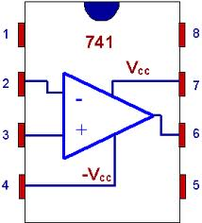
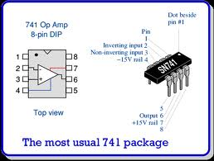
Notch defines 1,8 position or alternatively, a dot defines 1
Operational Amplifiers (Op amps): an Introduction

Slide 2
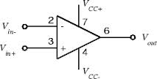
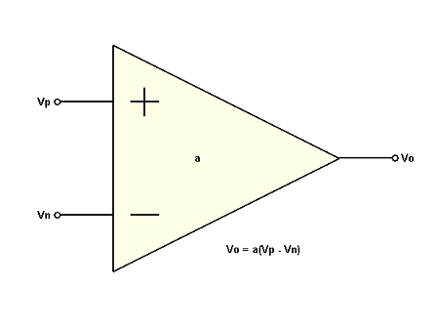
Symbolics for op amp
=+15 V
=-15 V

Slide 3
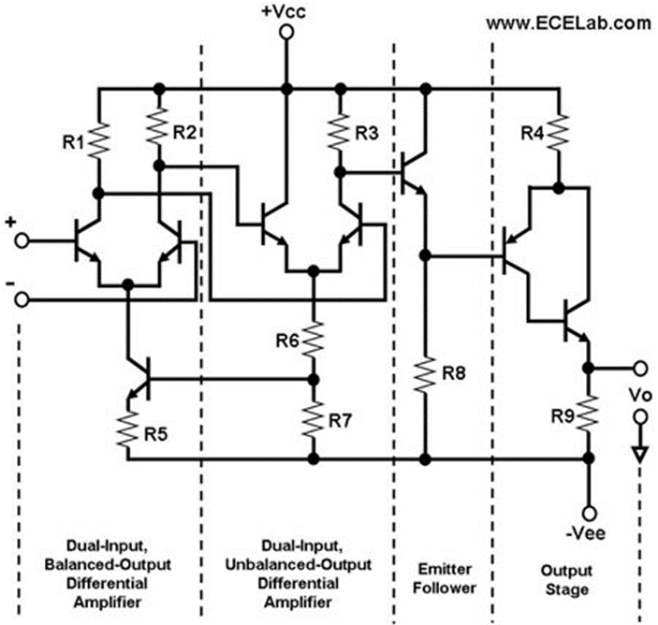
Ugly details of op amps
A parallel set of 8 transistors

Slide 4
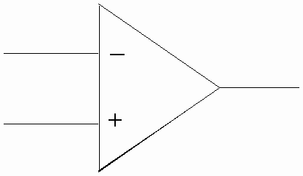
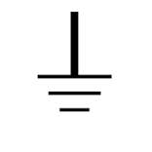
Key characteristics of op amps
R(op amp) ~ ∞ (isolates in from out)
Δv= v₋ - v₊ ~ 0
A= gain ~ 10⁵⁻⁶
A Δv = V_{out} (why it’s called an amplifier)
Inverting v₋
V_{out}
Non inverting v₊
When non-inverting lead is grounded, the `summing point’ (the dot) is called virtual ground

Slide 5
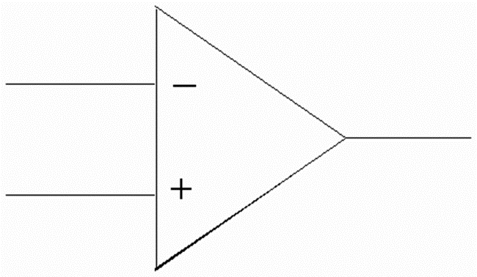
Most basic op amp circuit: the voltage switch
V_{in}
V_{out} = A*(v_{in}-v₊)
Since v₊ is ground
V_{out} = A*V_{in}
Since nothing is connected between summing point and output voltage jack, the op amp cannot neutralize V_{in} and null it. The output is thus just the amplified V_{in}
A=10⁵=> we often get the power supply limit (15 V)

Slide 6
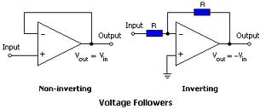
The next `simplest’ op amp circuits: voltage followers

Slide 7
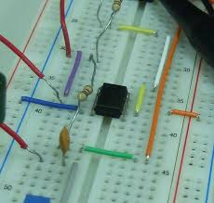
Actual `Bread Boarded’ op amp integrator (differentiator ?)

