Slide 1
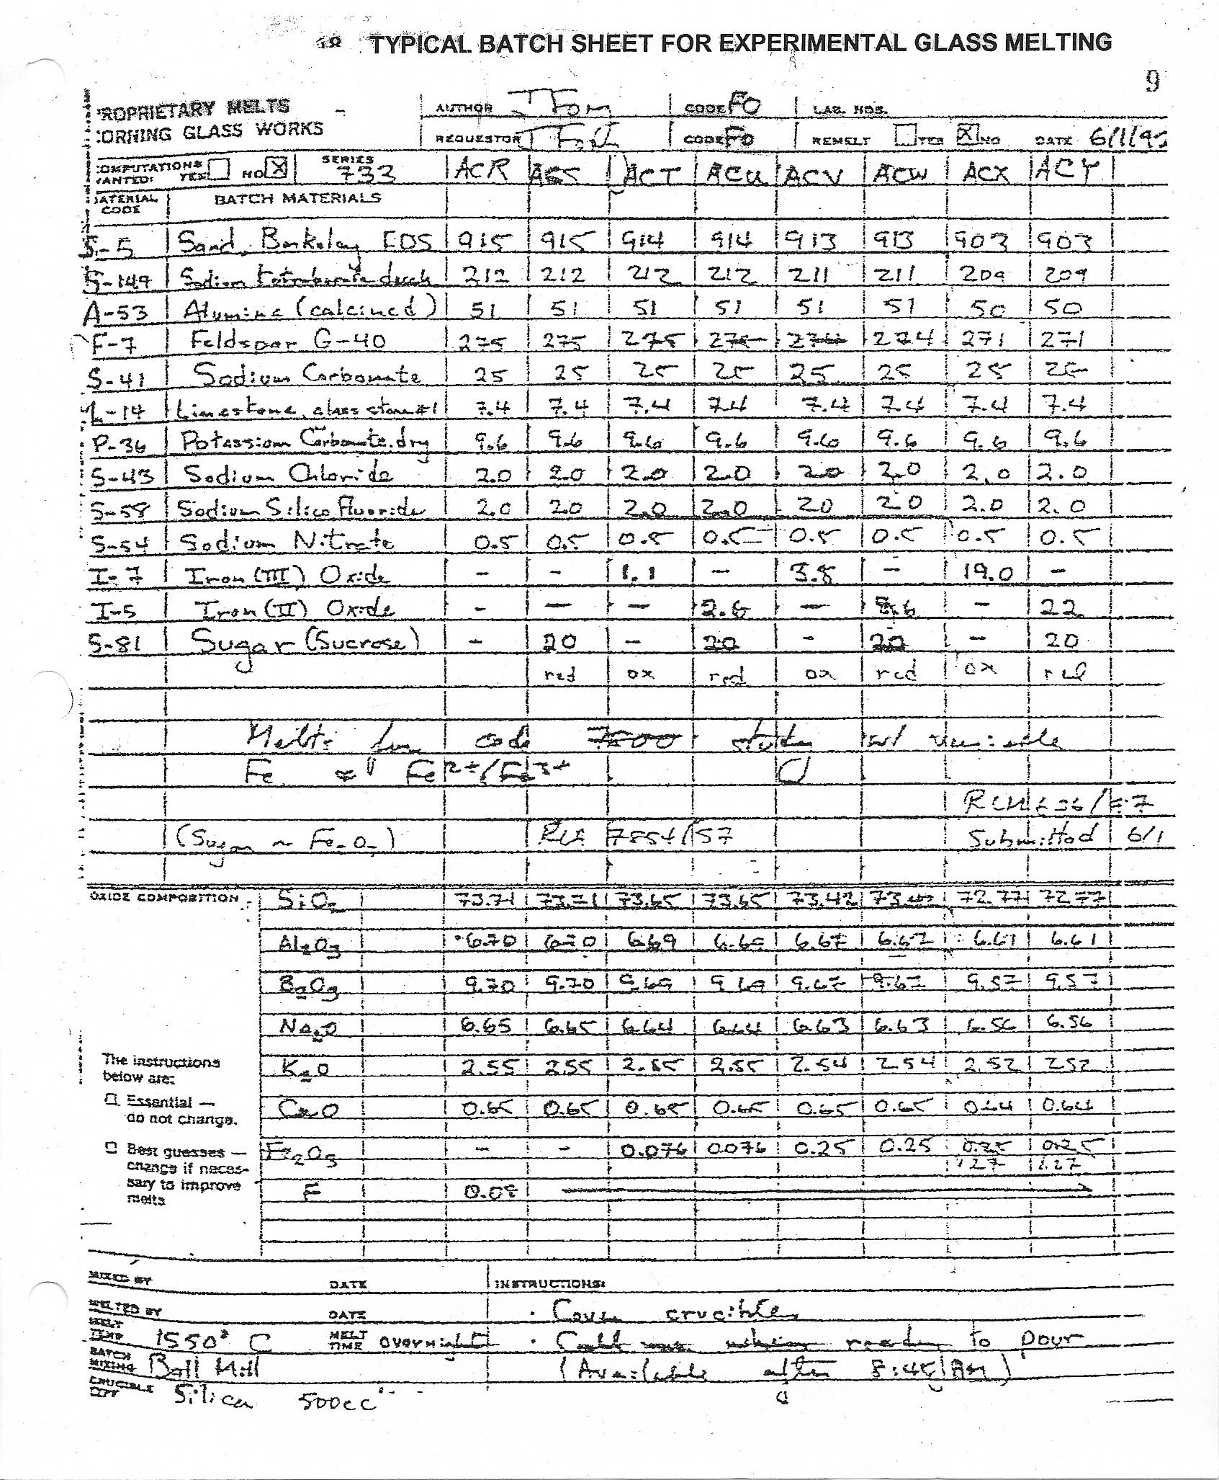
Typical Corning Glass Batch Sheet for Experimental Glass Melt

Slide 2
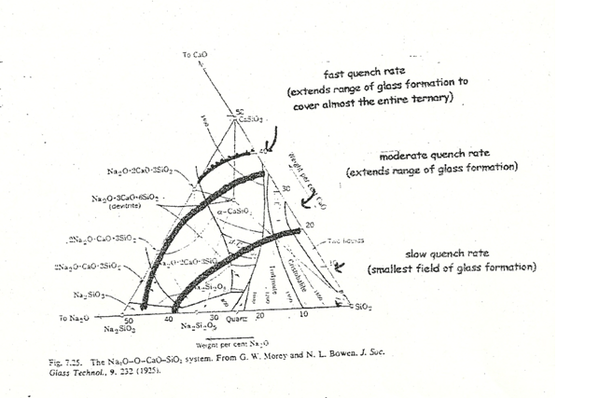
Glass Composition Phase Diagram
Underlying crystalline habits that characterize the various glass formation regions vs quench rate

Slide 3
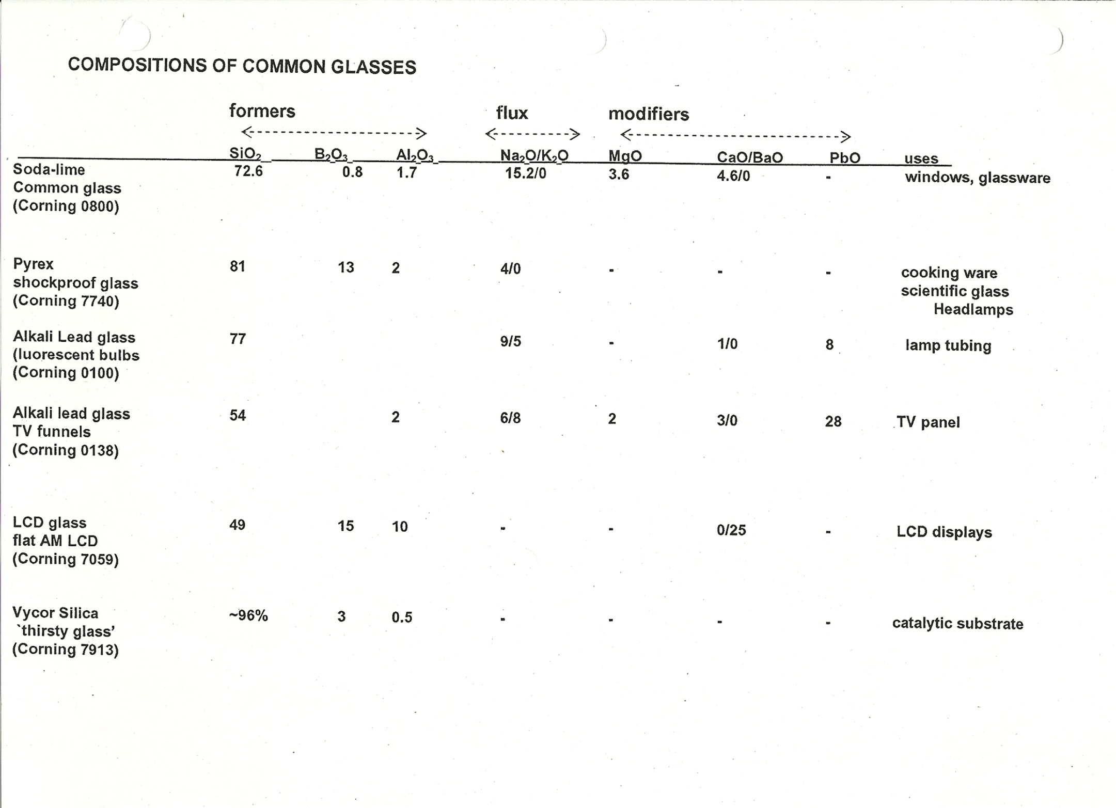

Slide 4
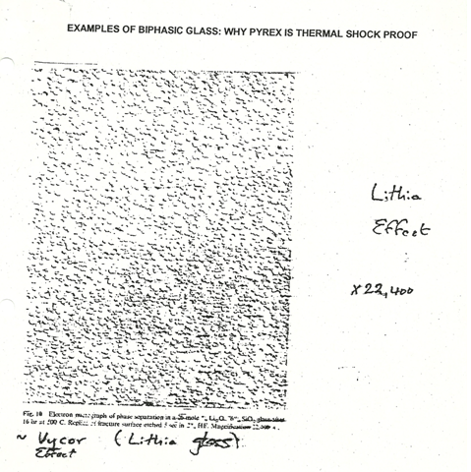
Examples of bi-phasic glass; example 1-Vycor
Effect of soft lithia glass in silica matrix after HF etch
X22,400 (SEM)

Slide 5
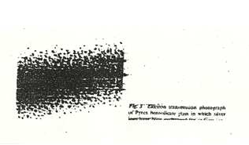
Examples of bi-phasic glass; example 2
Pyrex (>50,000X)
(silver ions have been `interculated’ into structure to reveal biphasic character)
Pyrex is a combination of `softer’ glass (so it flows under flame )and a much harder glass (so it resists chemical and physical change)

Slide 6
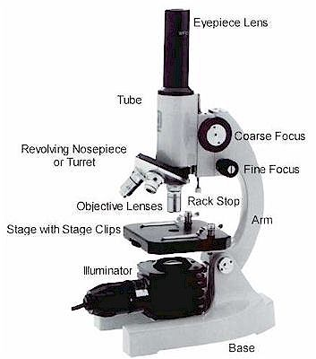
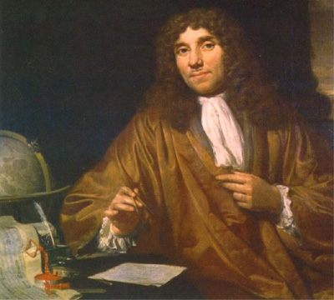
Scanning Electron Microscopy (SEM)
Optical Microscopy
λ(obs) ~ 500 nm ~minimum object size
1000X practical maximum magnification
A. Leeuwenhoek 1632-1723

Slide 7
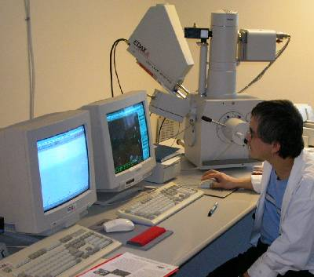
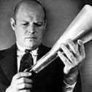
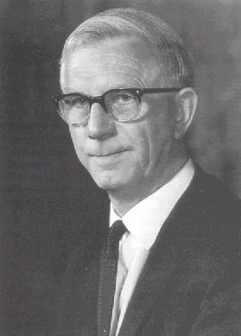
Electron microscopy: a breakthrough microscopy
=h/p (De Broglie equation) ~ 0.02 nm for 3.6 keV beam
Practically=>Can see 0.2-1 nm objects
higher beam energy, lower λ
40-100,000 X magnifications
Manfred v. Ardenne 1907-1997
invents in 1937
Charles Oakley
1904-1996
develops in 1947

Slide 8
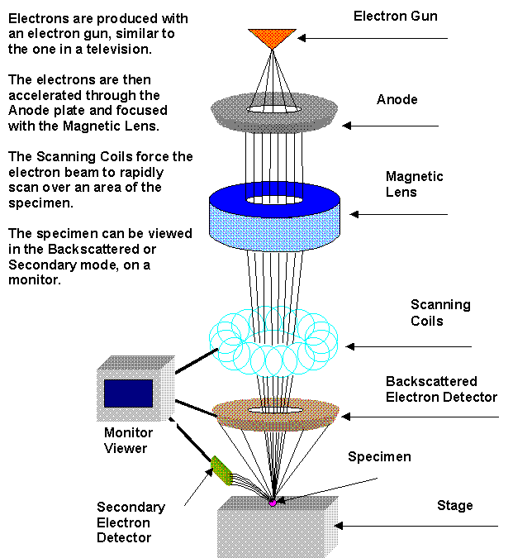
BASICS of SEM technique
1-10 keV
Main imaging methods
Secondary electrons (SE)
Backscattered electrons (BSE)
Main analytical method
XRED = EDX (same)
(X-Ray Energy Dispersion or Energy Dispersive analysis of X-rays
Beam spot typically 0.2 nm)

Slide 9
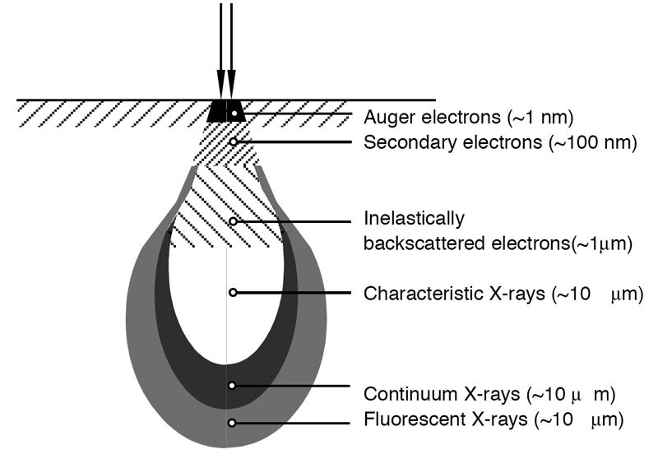
Some Geeky Details Of SEM
Electron beam produces a characteristic tear-drop shaped hole in material, which vomits electrons and x-rays
Inelastic BSE =impacting electrons re-scattered (sensitive to atomic masses producing scattering)
Auger (pronounced OJay)=surface state electrons
SE = electrons re-emitted by absorbing materials (provides great depth of field & primary image)
Characteristic x-rays= energy spacings of elements (used for XRED=EDX)
0.2-2 nm spot
5-100 um

Slide 10
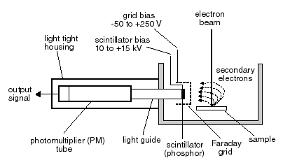
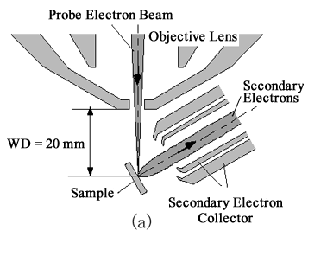
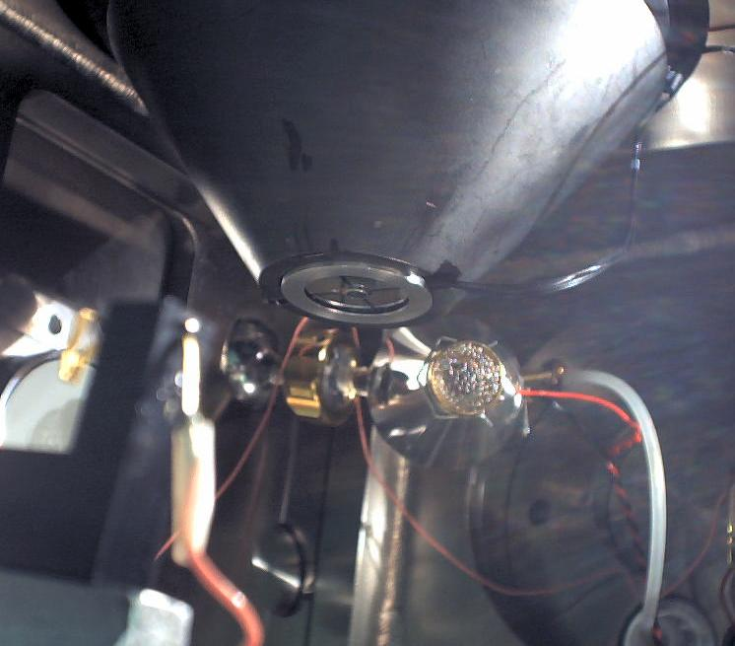
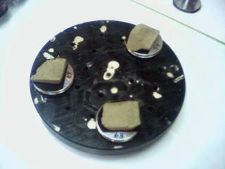
More geeky details of SEM:SE detection

Slide 11
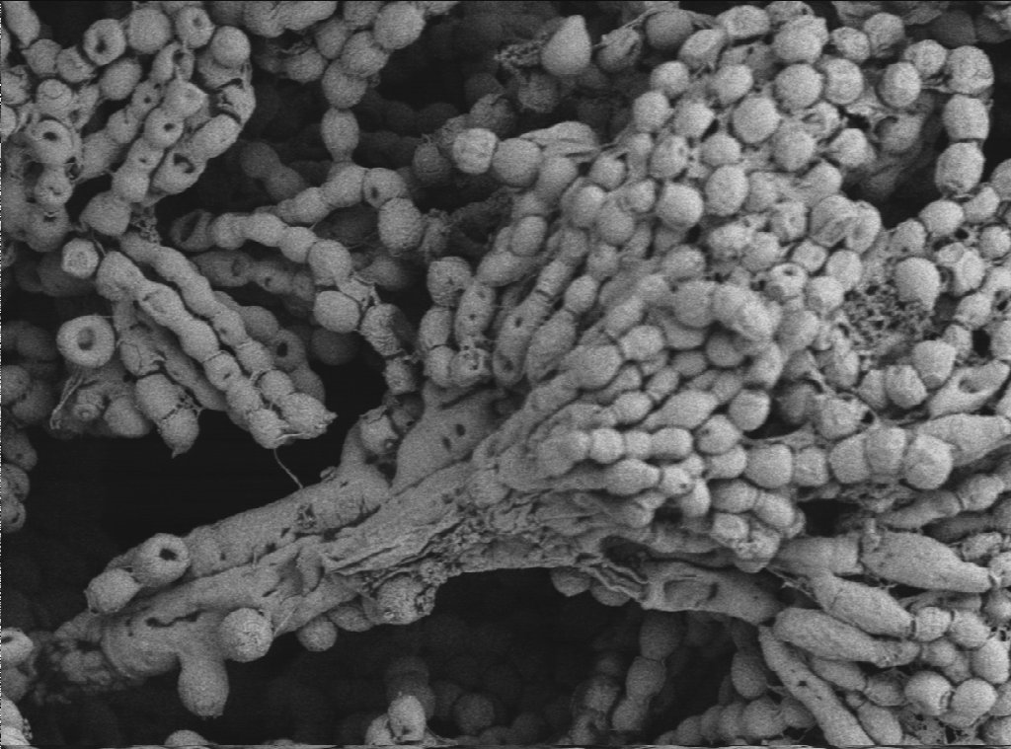
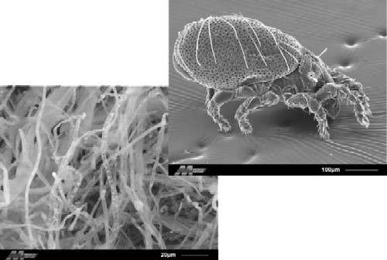
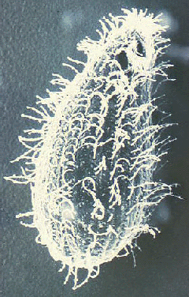
Typical `SE’ images
Cheese at 1500X
Spider mite
Hair on spider mite’s leg
Ballatidium coli (stomach protozoan) at ~5000X

Slide 12
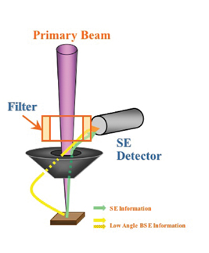
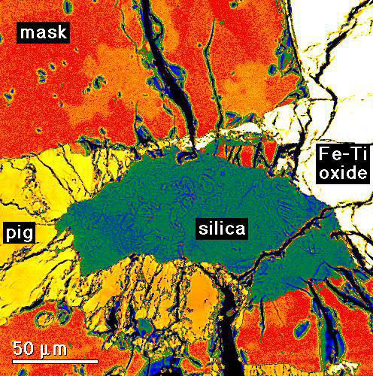
Yet more geeky details: BSE & EDX
BSE=backscattered electrons
BSE provides map of element and compound distributions
(but poor depth of field)
BSE electrons
Magnetic doughnut used to gather BSE and direct into SE (Everhart-Thornley) detector

Slide 13
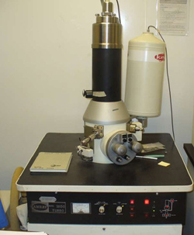
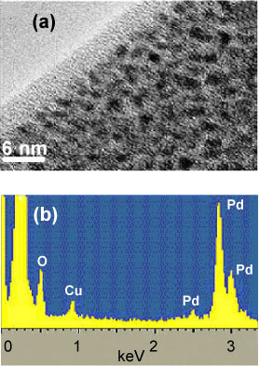
Elemental analysis EDX
Basic SEM
XRED (x-ray energy dispersion unit)…an add-on unit
Sampling Limitation
Sample volume and area depend on beam
Top not like insides ?
SEM and accompanying XRED spectrum of scanned region

Slide 14
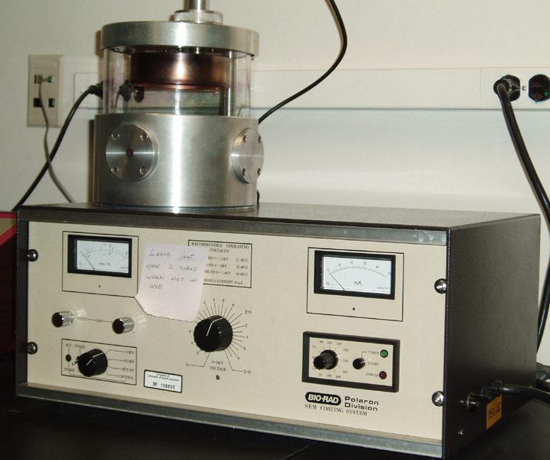
The last few details on SEM
Metals and other conductors can be observed without preparation
Non-conductors (glasses, ceramics, biological and organic samples) need to be coated with a conductive thin layer or the beam will cause local `melt’ down at beam focus and sample will glow
Au or C
Coated sample
Initially uncoated sample
+ -
Filament power
Evacuated chamber
Schematic of an SEM coater

Slide 15
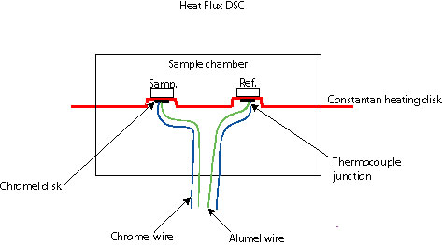
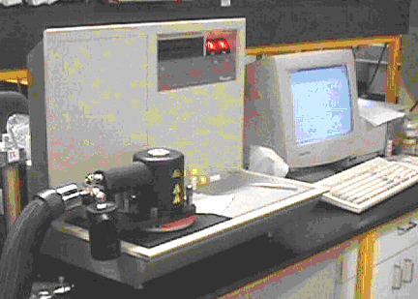
DSC (Differential Scanning Calorimetry)*
DSC if heat difference measured;
DTA (differential temperature analysis if temperature difference measured)
Schematic of basic DSC/DTA
Heated strip
(can go to 1800 C)
Power supply/interface
Thermocouple pair (measures T difference)
measures exo or endothermic (sample-reference) response vs input energy (or temperature) of strip

Slide 16
Glass transition (T_{g}) and crystallization (T_{c}) (=devitrification)
Disordered glass
T_{g} T_{c}
Q(cal)
T→
T_{g}
Glass melt is quenched faster than structure can reorganize into crystallographically ordered arrays=> quenched glass has no thermodynamic definition…glass is not a liquid (which is defined)
Disorder is a function of quench rate
Supercooled liquid is semi-ordered and thermodynamically defined
It takes energy to `reorganize’ chaos into supercooled order=> why T_{g} is endo proces
‘supercooled liquid structure’
T_{c}
Ordered crystal structure

Slide 17
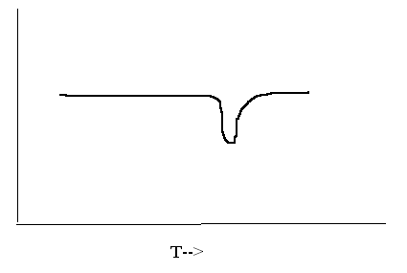
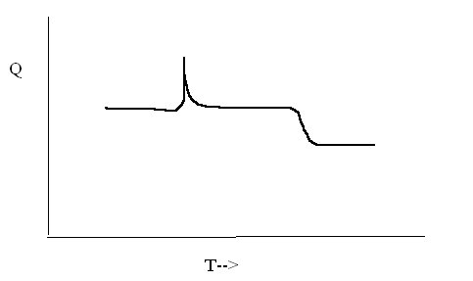
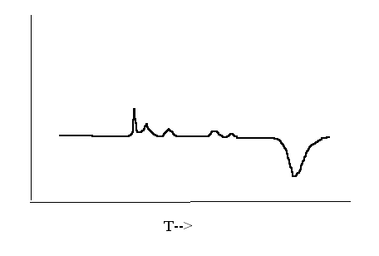
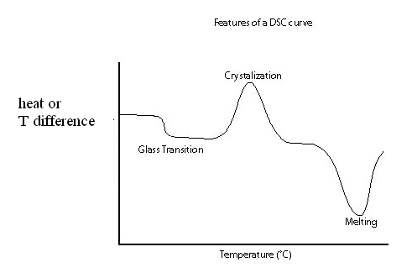
Kinds of thermograms
Crystal-crystal transition followed by melting (tridymite silica->cristobalite silica)
Single phase, melting
(e.g. cubic NaCl)
Melting
Phase change (exo)
mp (endo)
Simple glass thermogram
(e.g. glassy silica->cristobalite)
Release of hydration water (e.g CuSO₄*5H₂O)
melting
Dehydration (exo)

Slide 18
Some useful facts to help sort out DSC curves
1) Typical melting points for selected materials
MATERIAL MELTING POINT, ^{O} C
Silica (glass or crystal) ~1800
Pyrex glass 1250
Soda lime glass 1000-1050
Most inorganic salts 600-900
(NaCl, CaCl₂, KCl)
Plastics <400

Slide 19
More useful facts to help sort out DSC curves
2) Glass transition temperatures (T_{g}) for selected glassy materials
Glass T_{g} ^{O} C
Silica (glass) ~1200
Pyrex glass 550
Soda-lime glass 500- 550
Plastics < 100

Slide 20
And yet more useful facts to sort out DSC curves
1) Waters of hydration make multiple sharp, (weak) exothermic peaks
2) crystal-crystal transitions (T_{cc}) make pretty sharp, (strong) exothermic peaks
3) glass-crystal transitions (T_{gc}) make broad, (strong) exothermic peaks
4) For a glass, T_{g} < T_{gc} < T_{cc}

Slide 21
Possible Materials Producing Exercise 9 DSC (modified)
PVC plastic
KCl (mp 740 ºC)
NaCl (mp 820 ºC)
CuSO₄ *5H₂O
Soda-Lime Glass
Pyrex glass
Silica glass

Slide 22
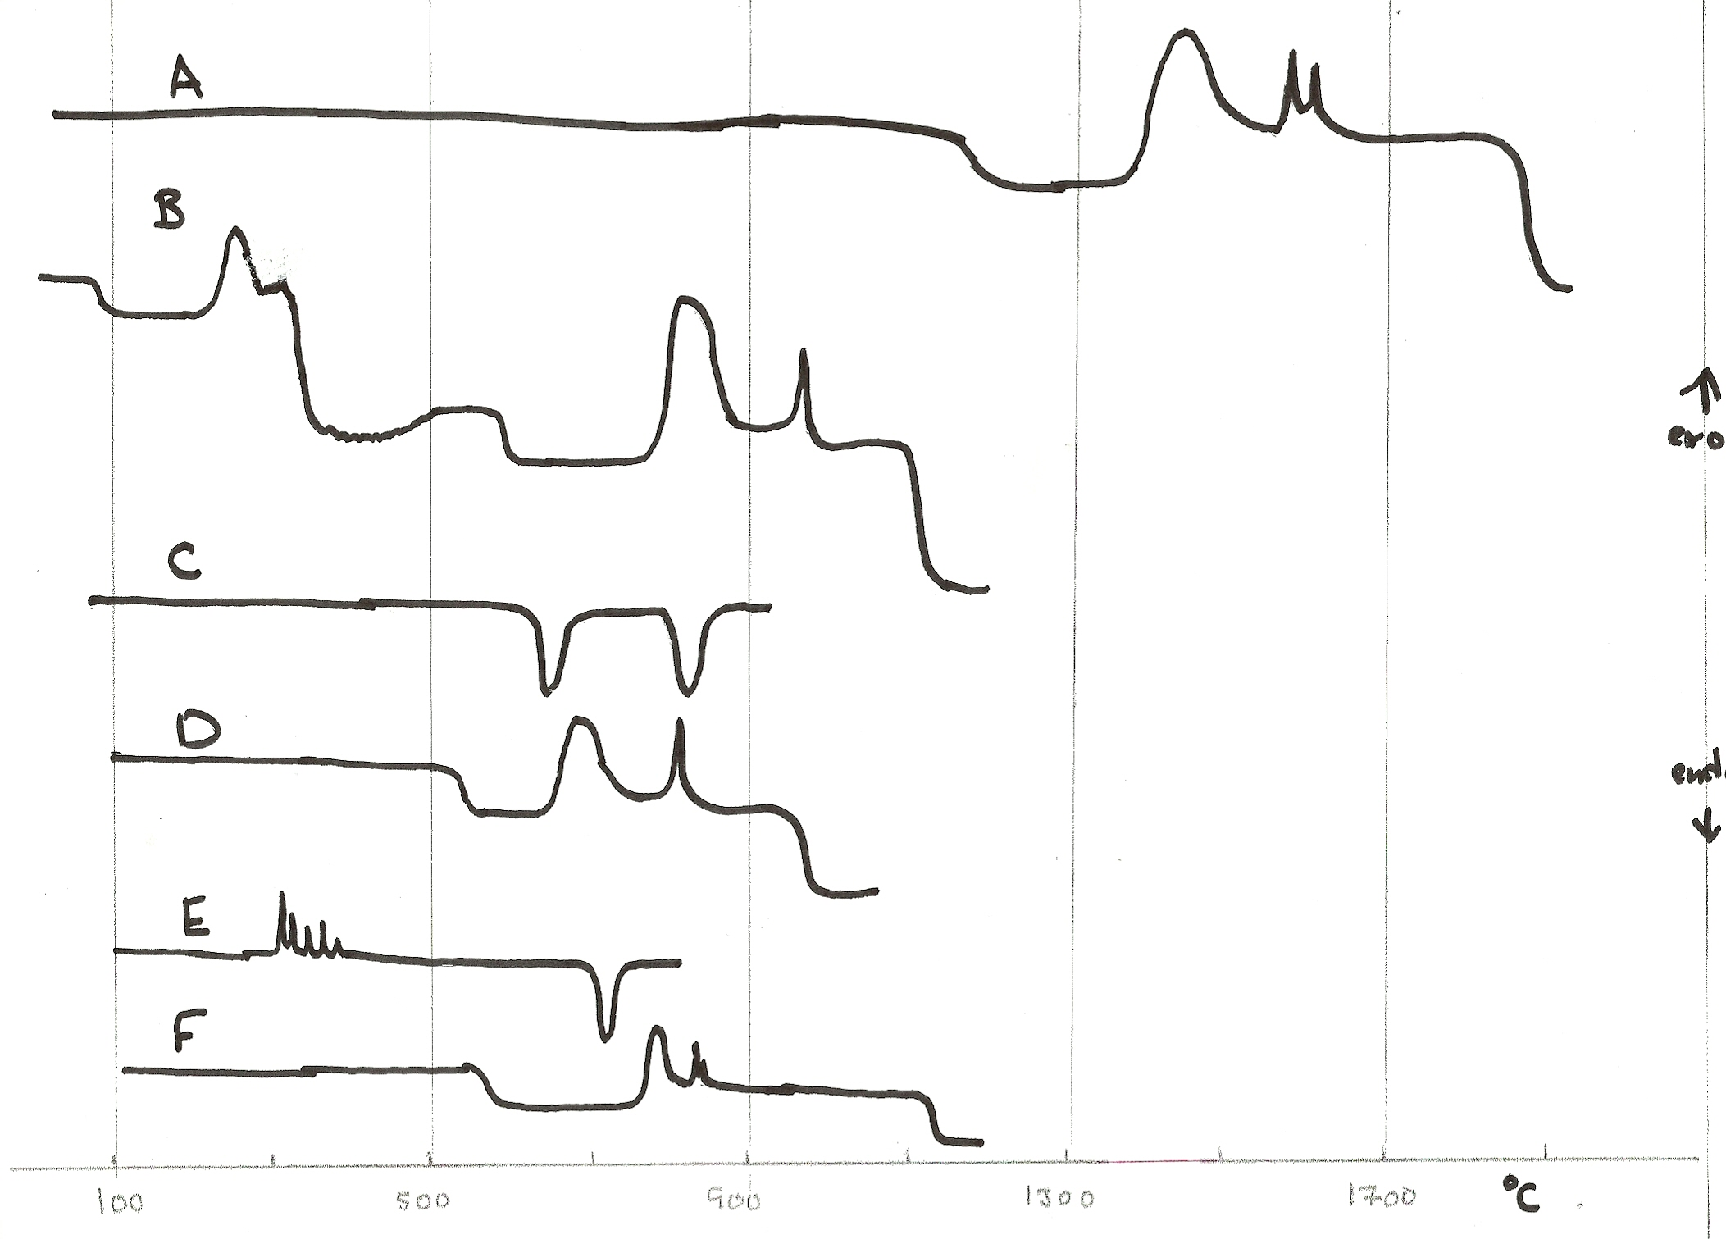
Exercise 9: Interpreting DSC Curves (modified)
Using the list on the previous slide, try to rationalize the composition of the samples measured in thermograms A-F

Slide 23
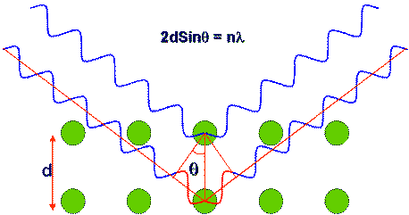
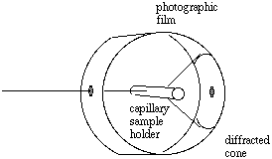
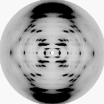
XRD (X-ray Diffraction)
Basic `X-ray powder diffraction’ camera (Debye-Scherrer design)
Bragg’s Law: 2*d*sinθ=λ
X-rays in
Diffracted X-rays
X-rays in
The key point….
Diffraction pattern of DNA
Taken by Rosalind Franklin
Given fixed λ & a measure of the angle θ, you can determine atomic spacing d

Slide 24

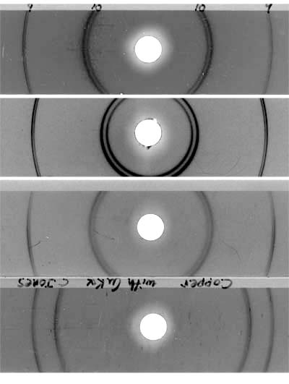
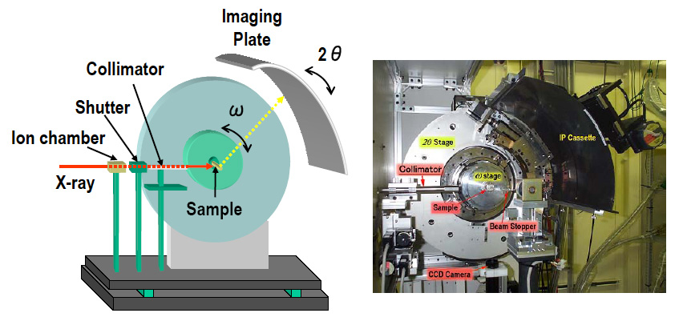
Details of Debye-Scherrer XRD diffraction camera
rings
or
lines

Slide 25
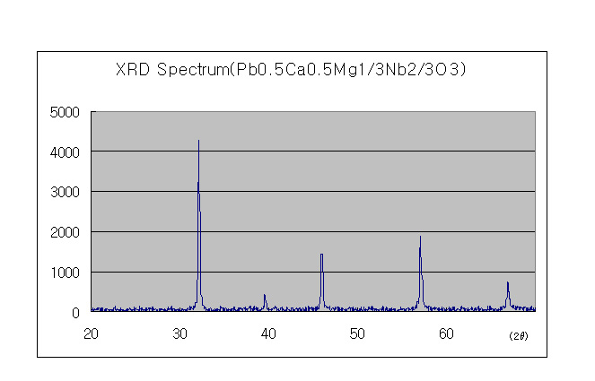
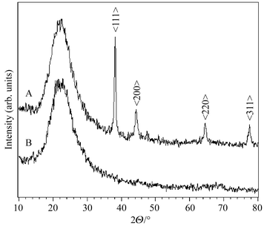
Examples of XRD spectra
Pure crystalline substance
Partially `devitrified’ glass*
Only lines…all crystal
Halo + lines= glass + crystal (devitrified glass)
Glass only (`glass halo’)
Halo only= all glass

