Slide 1
Exercise 13: Scenarios for Simple Solid Mixtures
You are analyst in a dirt poor analytical lab located in Backofbeyond, Nigeria. You are equipped with only compound microscopes, glass slides, test tubes and a reasonable collection of both organic and inorganic reagents. A local official arrives with a Baggie containing ~30 grams of white powder with no hint as to its contents. You are charged with figuring out as much as you can about the sample’s contents.
1) What is a good, common sense first step ?
Place a small bit of the powder on a slide and see if it can be dissolved with a few drops of distilled water/HCl

Slide 2
As it turns out, about half of the powder appears to dissolve but doesn’t fizz, while the rest seems to float on top of the water drop. Now what do you do ?
You probably have both organic and soluble inorganic material together, or, it’s all inorganic, but with an insoluble component. You need to get them apart.
Prepare a larger sample of powder dissolved in water, c.a. 2-3 mL with a small spatula’s worth of powder. Carefully decant or pipet the aqueous layer, leaving the insoluble (behind. Allow the latter to dry in air.

Slide 3
You have separated out the aqueous component with the soluble portion of the sample dissolved, and have dried out the damp, insoluble material which is (unsurprisingly) a white solid. You decide to focus on the latter, first. What’s your next move ?
Ascertain if the white, water insoluble compound(s) are organic or inorganic .
Use simple polar (acetone, methanol) , simple non-polar (pentane, benzene) solvents , and perhaps an intermediate polarity organic solvent (methylene chloride) and test samples of the water insoluble compound crystals to see if they dissolve.

Slide 4
Despite your best efforts, the water-insoluble solid fails to dissolve in any common organic solvent. What can you conclude ?
It’s most likely an water-insoluble inorganic.

Slide 5
Since you have an insoluble, inorganic compound, what might be the next sensible step?
See if it can be dissolved with either acid or base.
Take a small drop of 6M HCl and see if the sample dissolves.
Repeat this using a small drop of 6M NaOH.

Slide 6
The water-insoluble compound remains unaffected by NaOH, but reacts vigorously with HCl. The sample fizzes and generates copious gas which causes a lighted match to quickly extinguish. Eventually, the compound disappears and the solution left is colorless and clear.
Can you make a guess on what the compound might be partially composed of?
Non-oxidizing gas generation (non-oxidized since match is put out) in the presence of an acid by an inorganic material often means the material is a carbonate

Slide 7
Based on your recent experience in lab, what would be a good way to test the carbonate hypothesis ?
Perform a microcrystalline test on the dissolved material formed using 6M HCl by running a Chamot/Mason test with H₂SO₄ , and see if characteristic CaSO₄ dendrites form.
Since CaCO₃ is limestone, a very commonly encountered insoluble material, the simultaneous observation of acid-initiated gas formation (to CO2 if carbonate), and, the observation of Ca would make sense.

Slide 8
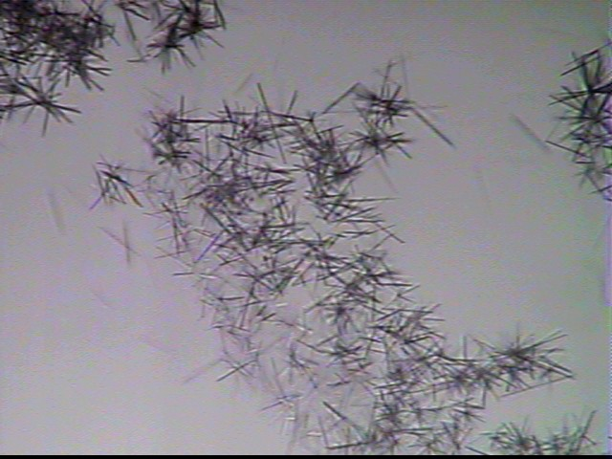

After a few minutes, the following crystal growth pattern appears most noticeably at the edge of the drop wherein both H₂SO₄ and your HCl-dissolved sample are present. What do you conclude?
Looks like Ca²⁺ is present !

Slide 9
The water soluble material still needs to be examined. What might you you do first ?
Dry a few drops of the aqueous sample carefully on a microscope slide using a hot plate. Examine the resulting solid residue under the microscope.

Slide 10
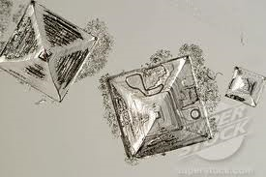
Your photomicrographic exploration reveals the following:
What is a reasonable guess about the identity of the soluble, inorganic component(s) ?
NaCl, or KCl ?

Slide 11
How might you `prove’ that Cl is present?
Run the AgNO₃ test with a drop of the dissolved, water-soluble salt. If a flocculent whte-grey precipitate forms instantly, Cl is indicated
How might you quickly distinguish Na from K salts ?
Dip a clean platinum loop into the solution and then place the loop in a lean blue methane-air Bunsen burner flame. Yellow indicates Na. Lavender indicates K.

