Slide 1
The main bits and pieces of electronics in EVERYTHING
Resistors
Capacitors
Inductors
Diodes and LED
Transistors
Chips = Integrated Circuits (IC) by wiring together all of the above (gates, op amps, timers…)
Passive
elements
Semiconductor devices

Slide 2
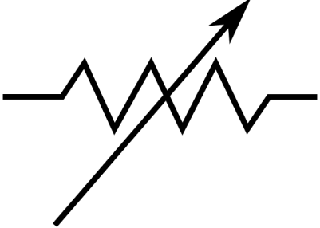

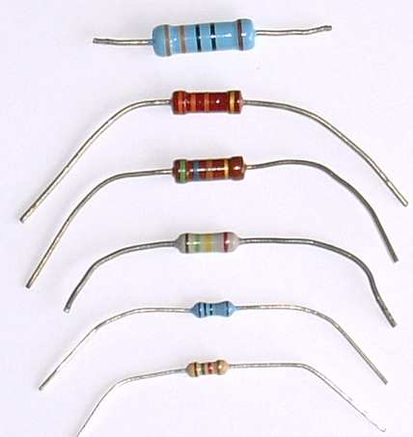
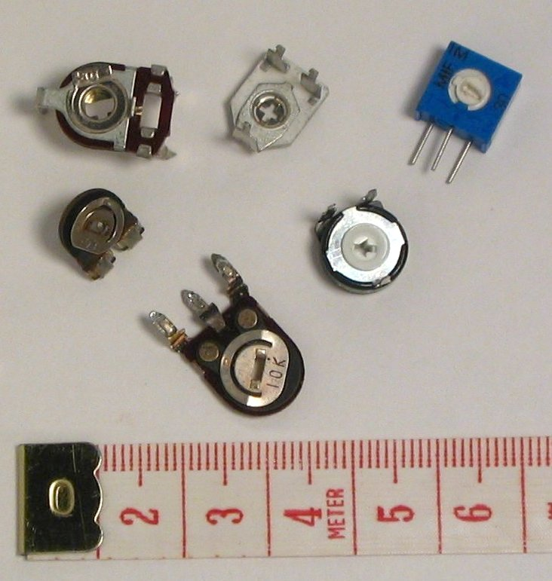
RESISTORS ( R )
Units in Ohms (Ω)
Dial to change R
variable
fixed

Slide 3
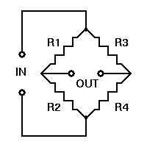
Basic Instrumentation Device Using Resistors: Wheatstone Bridge (1843 !)
R₁ and R₂ are usually fixed
At `null’ on G*:
Often the test R
V
G
R₄ = R₂
R₃ R₁
(usually adjustable)
G= galvanometer
Or…current meter
I
*no current across bridge where G is

Slide 4
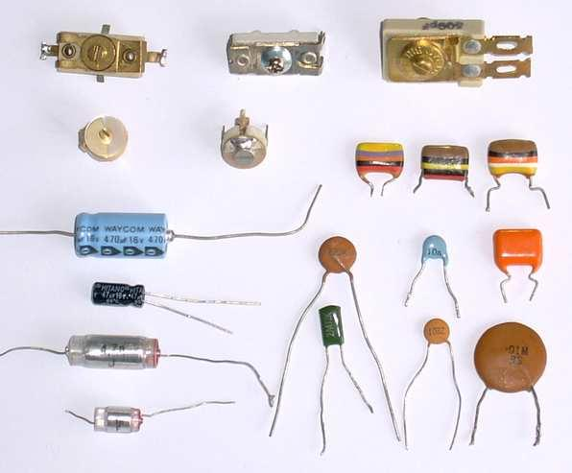
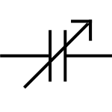
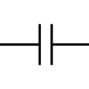
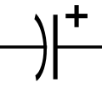
CAPACITORS (C)
Units in Farads (F)
variable
(has dial)
polarized, fixed
(can shaped, higher C attained. Contains electrolytes)
Non-polarized, fixed
(Flattened)

Slide 5

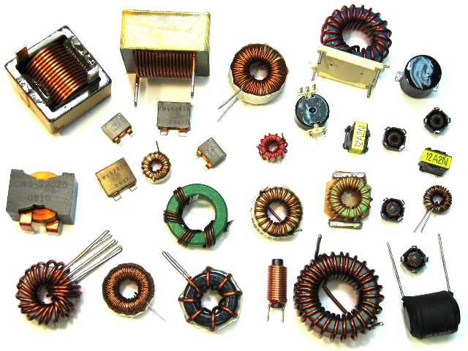
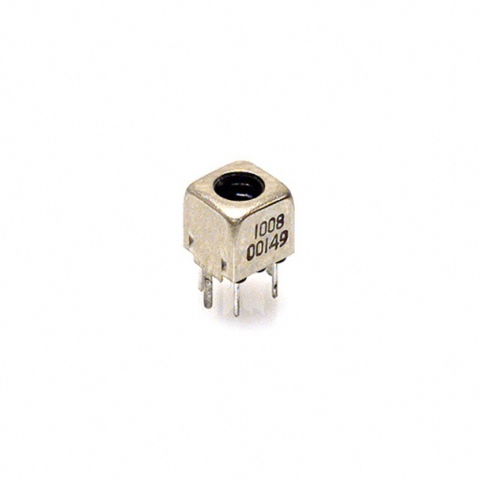
INDUCTORS (L)
Units in Henries (H)
fixed variable
Harder to spot variable ones
Slot for screw driver adjust

Slide 6
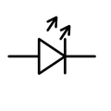
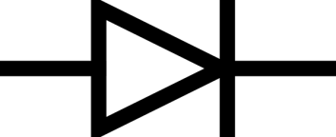
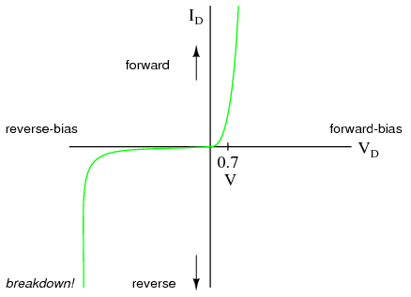
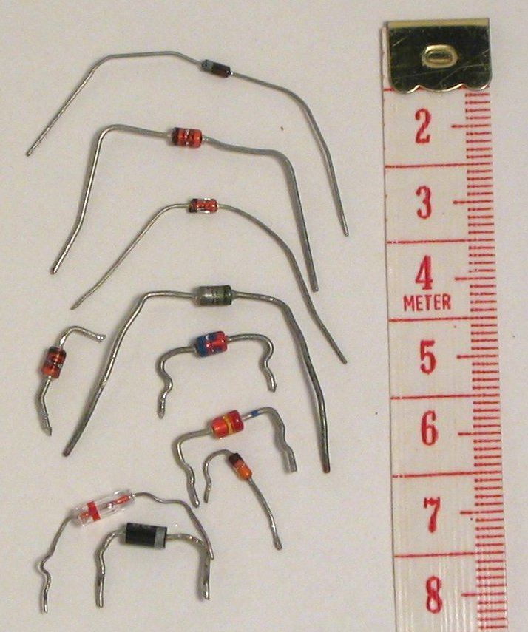
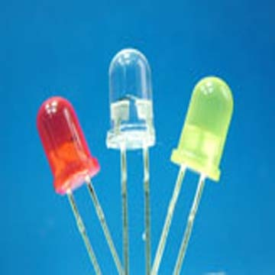
DIODES
(one way current filters)
Rated for PIV and Vf
regular
LED
PIV
=Vf
Light emitting diodes (LED)
regular diodes

Slide 7
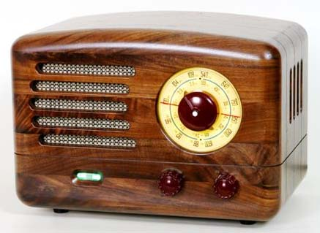
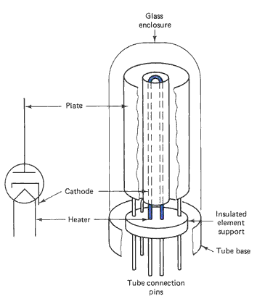
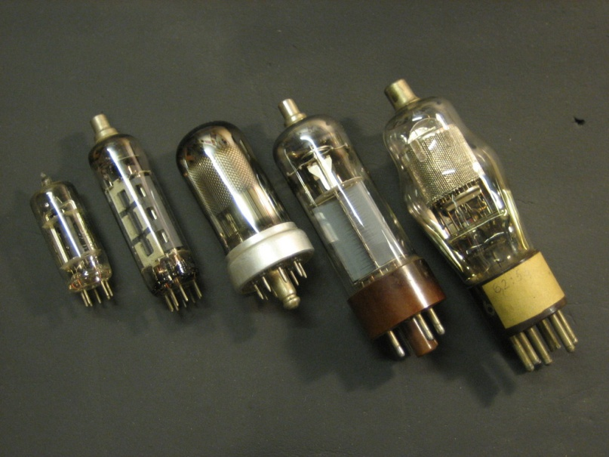
In days of yore…(pre 1960) before solid state transistors became commercially chip and available
grid
Grid current (mA) determines whether current flows cathode→ anode (plate)…essentially an electronic on/off switch

Slide 8
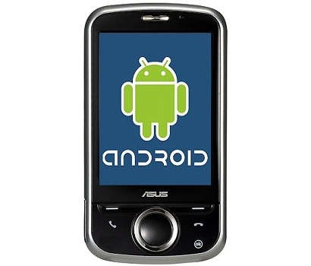
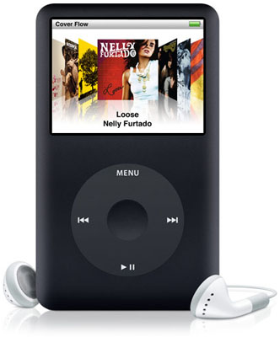
R,C, L….+ `vacuum’ tubes
…the big technological jump occurred in 1950’s as we moved from from passive to active devices

Slide 9
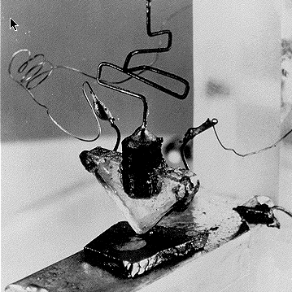
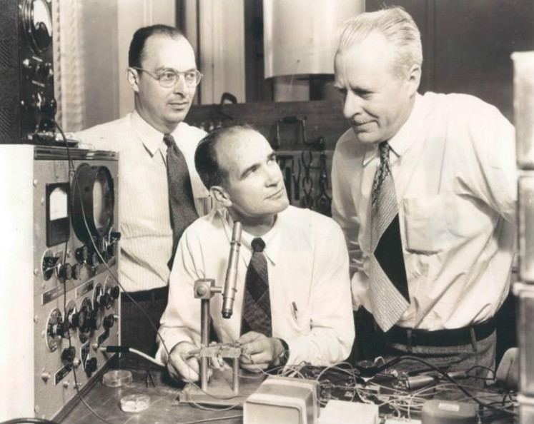
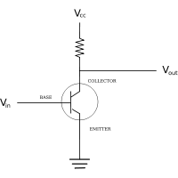
First Transistor
Bardeen Schockley Brattain
Bell Labs 1948
~ a solid state on-off switch
Key advantages
* base control current tiny (pA)
*switching is fast
*solid state allows minaturization

Slide 10
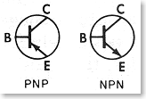
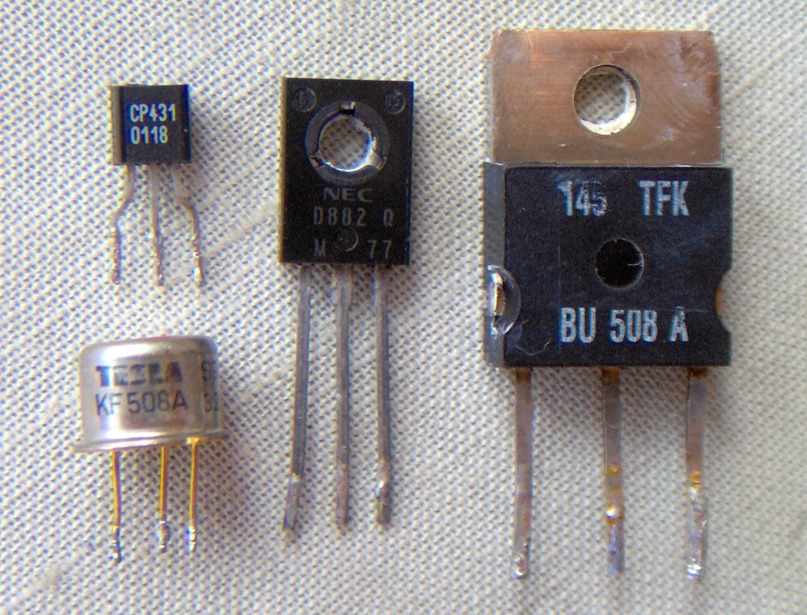
TRANSISTORS
voltage controlled current switch
Almost always characterized by 3 prongs
Small base current controls much larger current from C→E
Emitter Base Collector

Slide 11
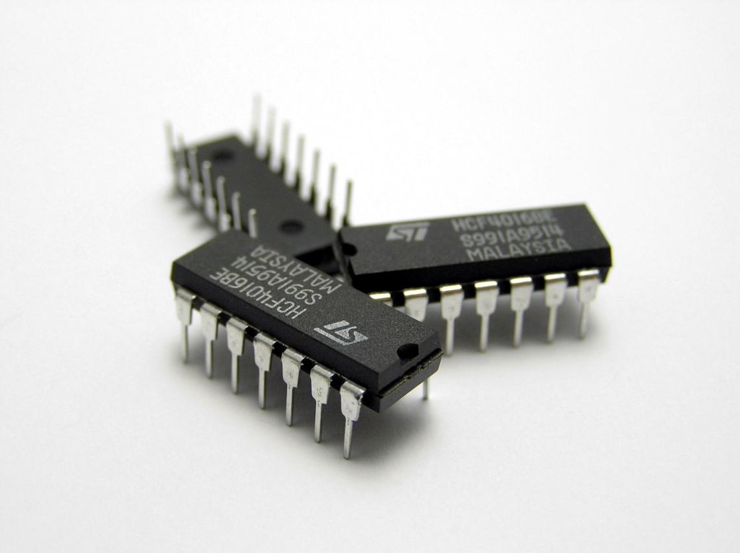
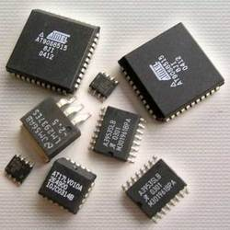
Integrated circuits = IC =microchips = chips
Many transistors + …in module to control something
`old timers’ (aka the Doc) called them `bugs’

Slide 12
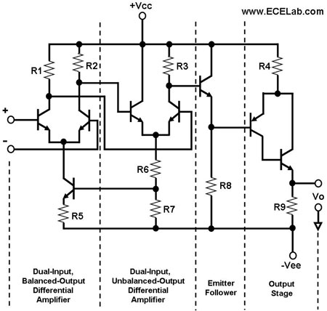
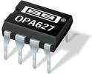

Inside a simple IC: operational amplifier (op amp)
Can use to build/ interface measurement and control systems of nearly everything

Slide 13
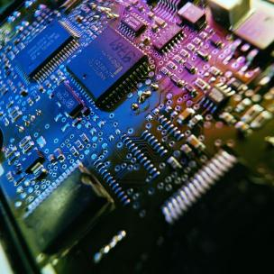
Many IC wired to a printed circuit board to perform complex tasks
How many IC do you count ?
Probably computer “chip”
(zillions of transistors)
Part of Engine control board for Ford F-250

Slide 14
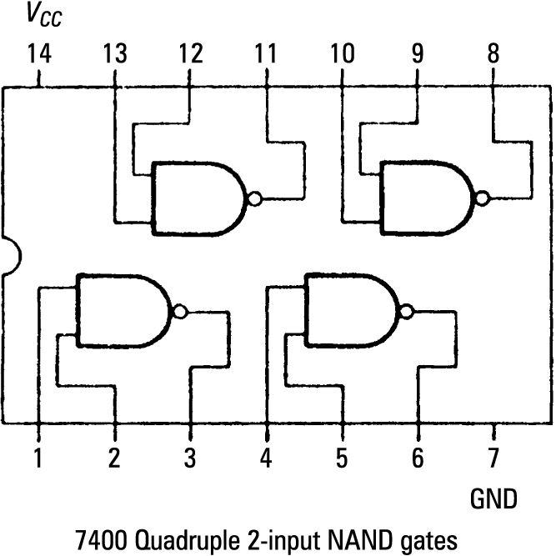
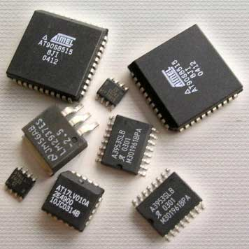
Simple Integrated Circuit Chip…with a few hundred transistors
1970s Texas Instruments figures out how to make many transistors on an `IC’ (Integrated Circuit)…so many decisions can be made

Slide 15
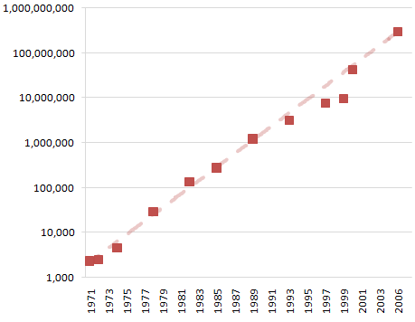
Moore’s* Law Predicts # transistors/chip area rises exponentially in time
Transistor count
* First CEO of Intel
year

Slide 16
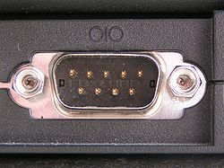
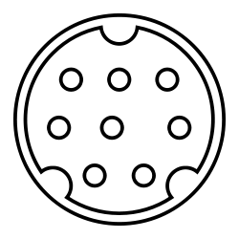
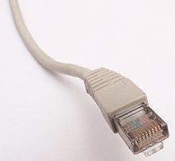
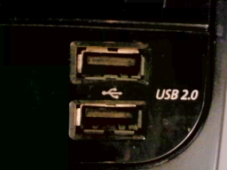
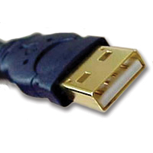
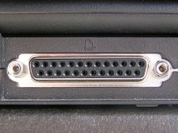
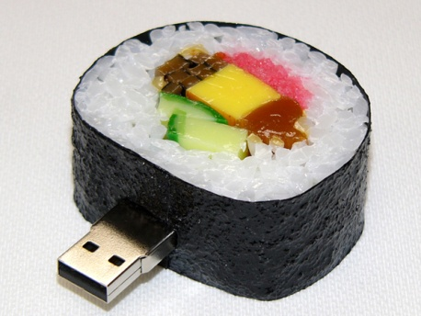
Getting information to and from computer device…thru a `BUS’: some connector types
DE-9 serial port (RS-232)
(printers, projectors…for PC)
RJ 45 `ether
net cable’ (for LAN)
Mini DIN -8 serial port ( for Macs)
USB = Universal Serial Bus
25 pin parallel port
DB 25 (many current printer ports)

Slide 17
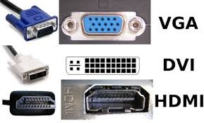
More input/output cabling types
(Video)

Slide 18
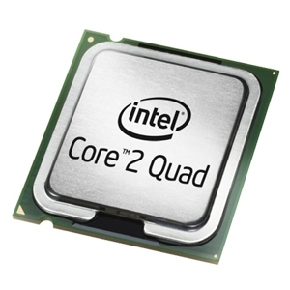
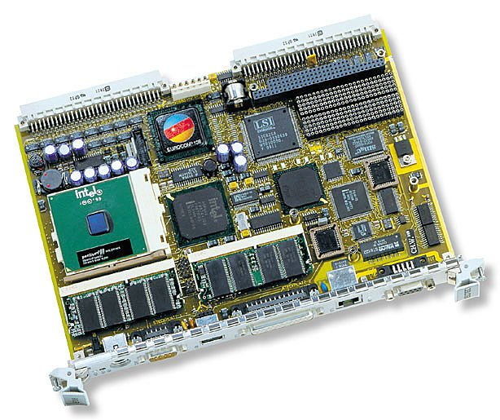
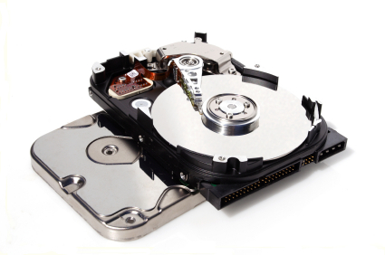
What are these ???
motherboard
cpu
Hard Drive

Slide 19
PPT Electronic parts exercise….

Slide 20
Computer/digital device Language now permeates our lives….
How fluent are you ?
(Geek speak exercise)

