Slide 1
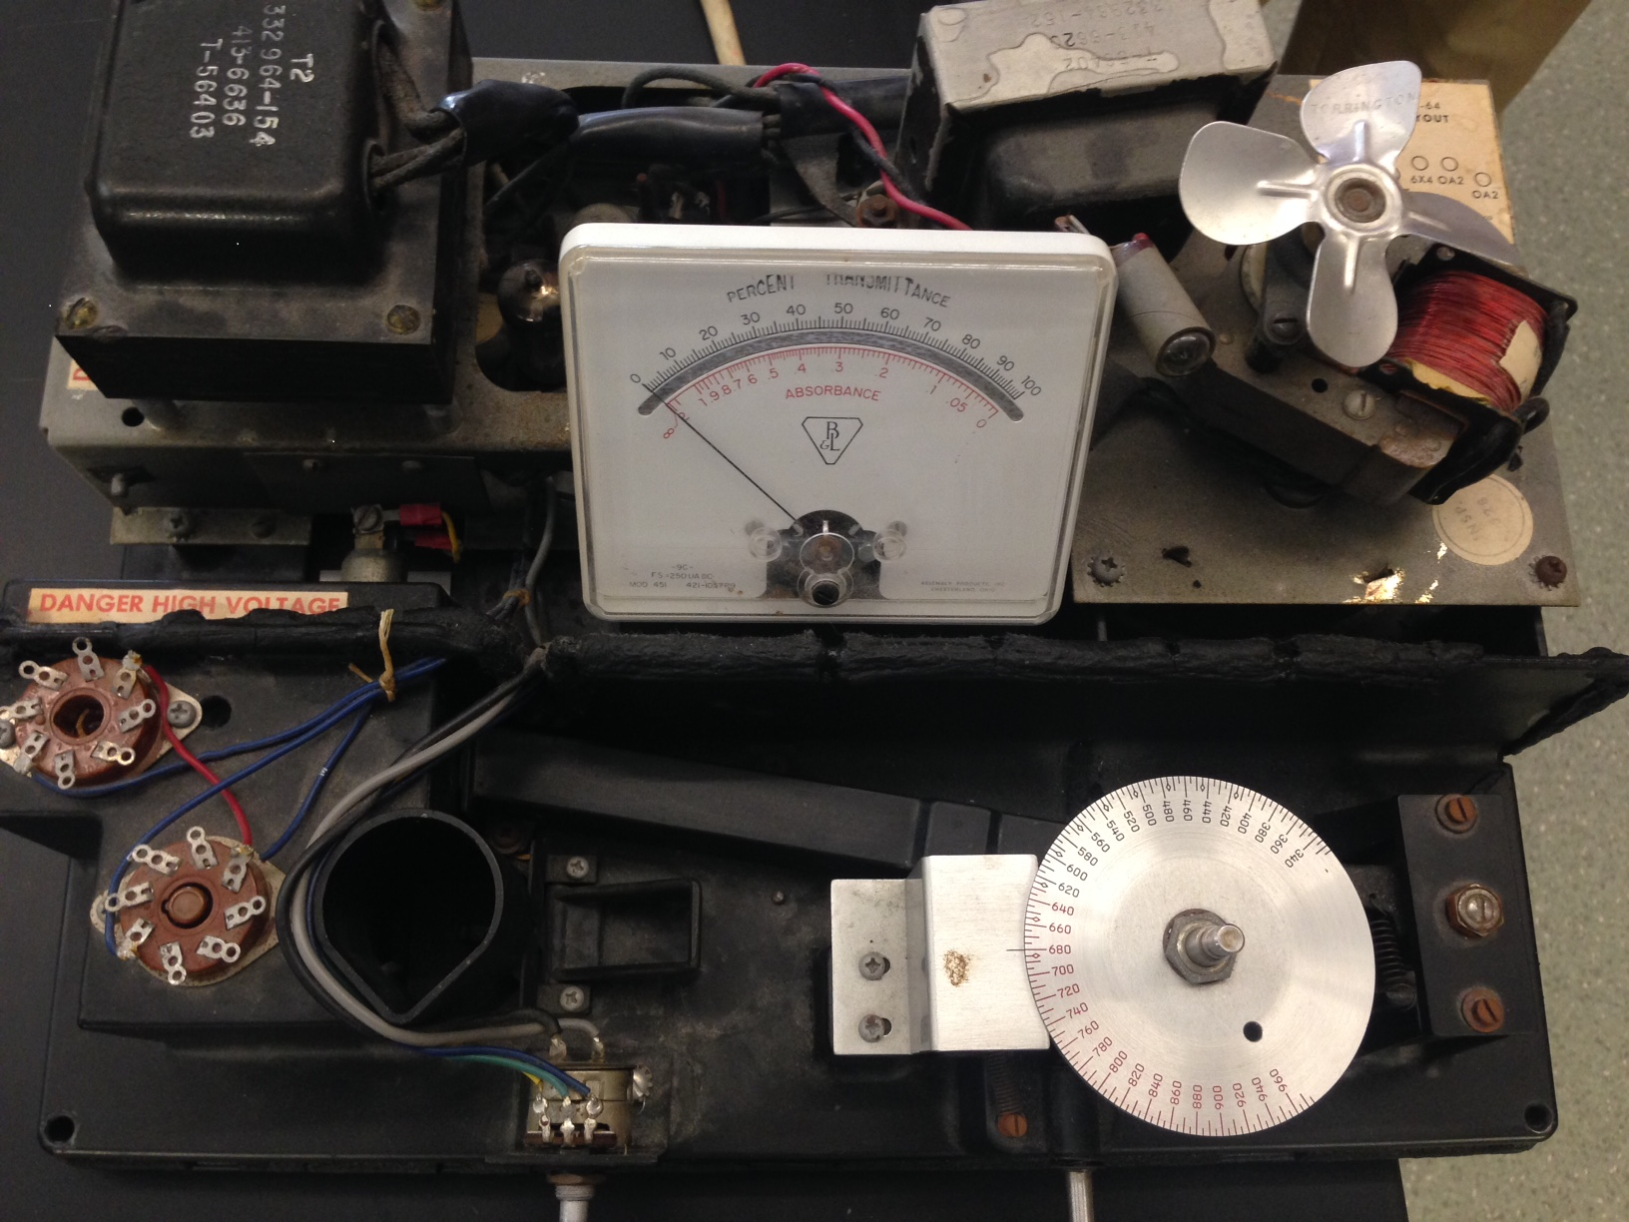
Spec 20

Slide 2
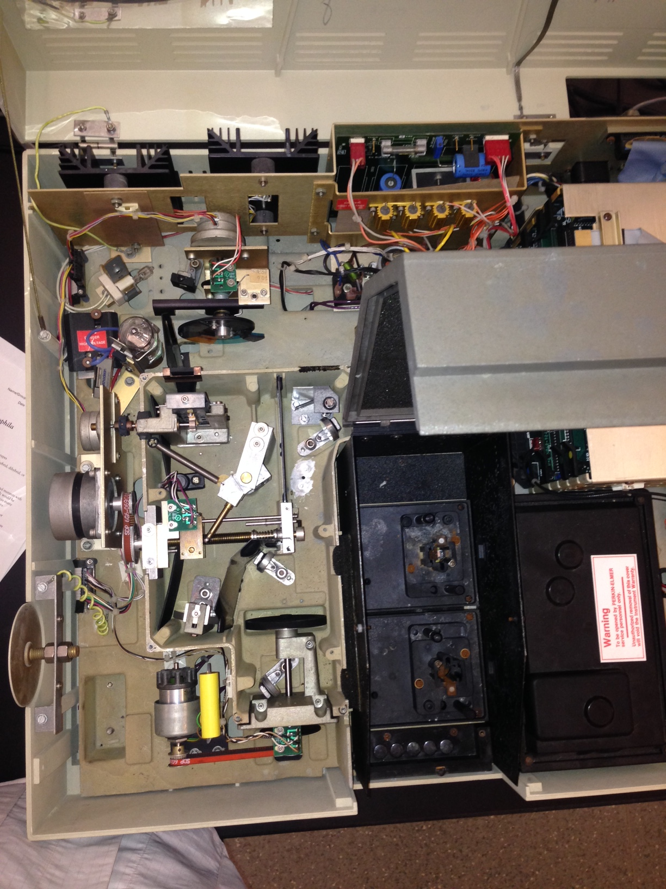
Perkin-Elmer
Lambda 4b

