Slide 1
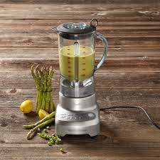
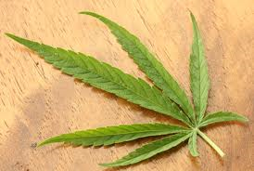
The ORIGINS OF GAS “CHROMATOGRAPHY”
What chemicals are in…..???
??????

Slide 2

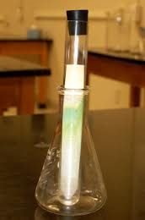
First, easiest approach:
Paper chromatography...separates bands
(but hard to collect sample components)

Slide 3
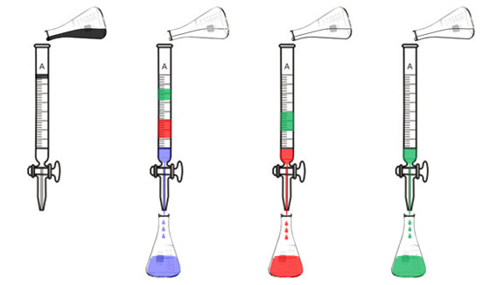
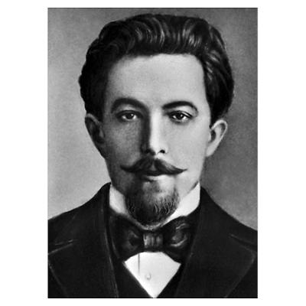
The ORIGINS OF GAS “CHROMATOGRAPHY” : column separations
Plant extract in ether/hexane mix
Here, the ether/hexane mix is the `mobile phase’
“I did this first ! Da! Da !”
Packed column
(originally packed with Confectioners sugar=
`stationary phase’)
Transducer= detector= eyeball
Russian Botanist Mikhail Tswett (1872-1919)

Slide 4
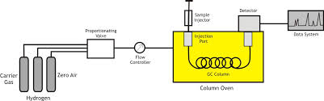
Schematic of Typical Modern Gas“Chromatograph” (GC)
Sample injection
Detector
Proportionating valve
Data system and instrument control
Flow controller
GC column
Column oven
(thermal ramp)
Helium

Slide 5
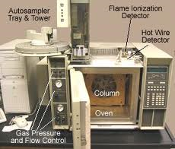
HP 5890A GC with FID detector
We use single port injector, not auto samplers
In HP 6890N GC
(ASC): computer controls all flow and pressure via “Chemstation”

Slide 6
Main Components of a ’GC’
Plumbing to handle gases
Column (heart of GC => separation)
Oven (thermal ramp to aid
separation)
Detectors (to see components once they are separated)

Slide 7
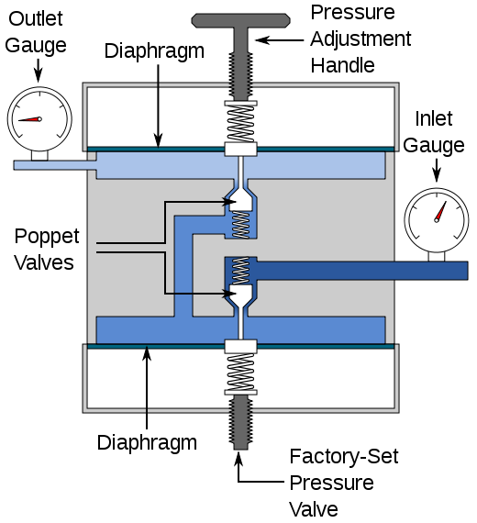
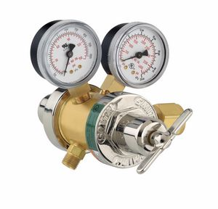
Plumbing:Tank Valves
secondary tank Valve
secondary
primary
weaker spring
Compensating springs
Very strong spring
Primary tank
Valve

Slide 8
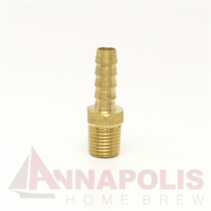
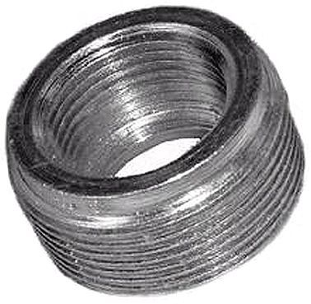
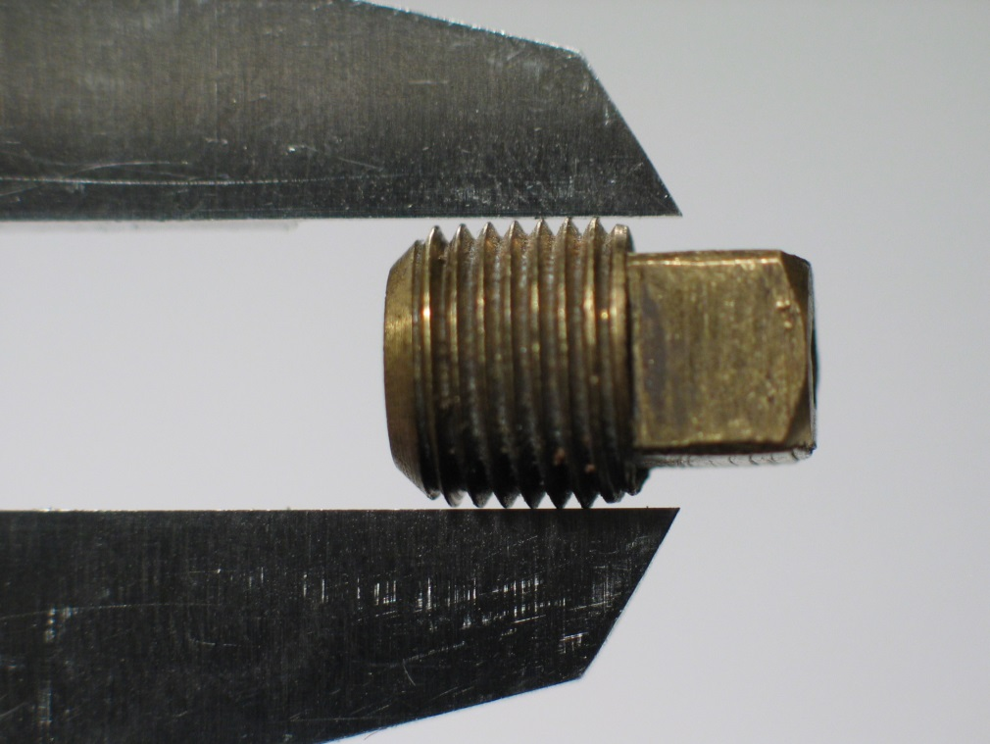
Plumbing: National Pipe Thread (NPT) fittings

Slide 9
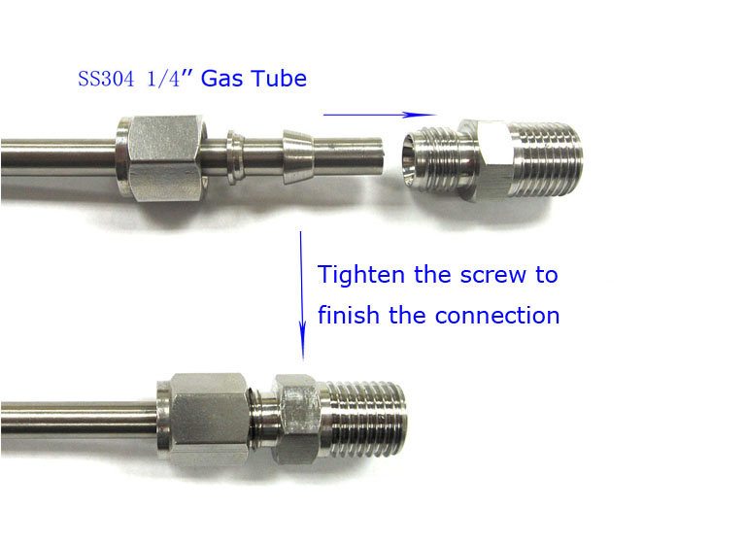
Plumbing:Swagelok fittings
ferrule
Nut
Swagelok-NPT adapter
Back cap
FYI..ASC GC, MS and HPLC plumbing is all 3/16” OD…and use 7/16” nut wrench

Slide 10
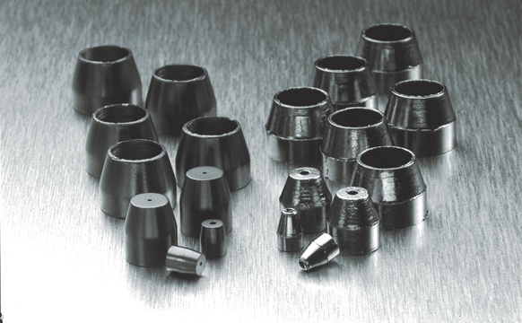
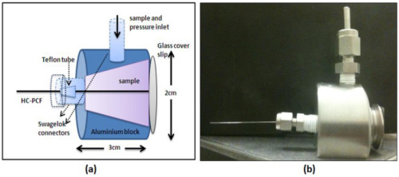
Plumbing: Ferrules
Ferrules for capillary columns are made of carbon (lower crush pressure)

Slide 11
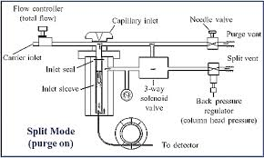
Plumbing: split-splitless inlet system:
Modern way to control sample volume

Slide 12
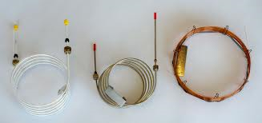
Columns: There are 3 species
Packed, Glass
Packed, metal
Open, capillary (glass)
Packed: typically 0.3-2 m long,
3/16-1/4” OD, stationary phase on support (usually diatomaceous earth
Open, 30-100 m long
0.25 mm ID, stationary phase on inside (0.2-0.3 um)

Slide 13
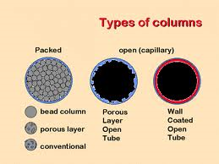
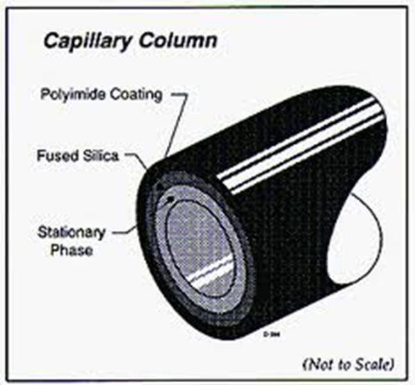
Columns (continued)
`FSWC’ type most common
(Fused Silica Wall Coated
MAOT = Maximum Operating Temperature (Typically < 400 ºC)…
Beyond that and stationary active phase delaminates or cooks off

Slide 14
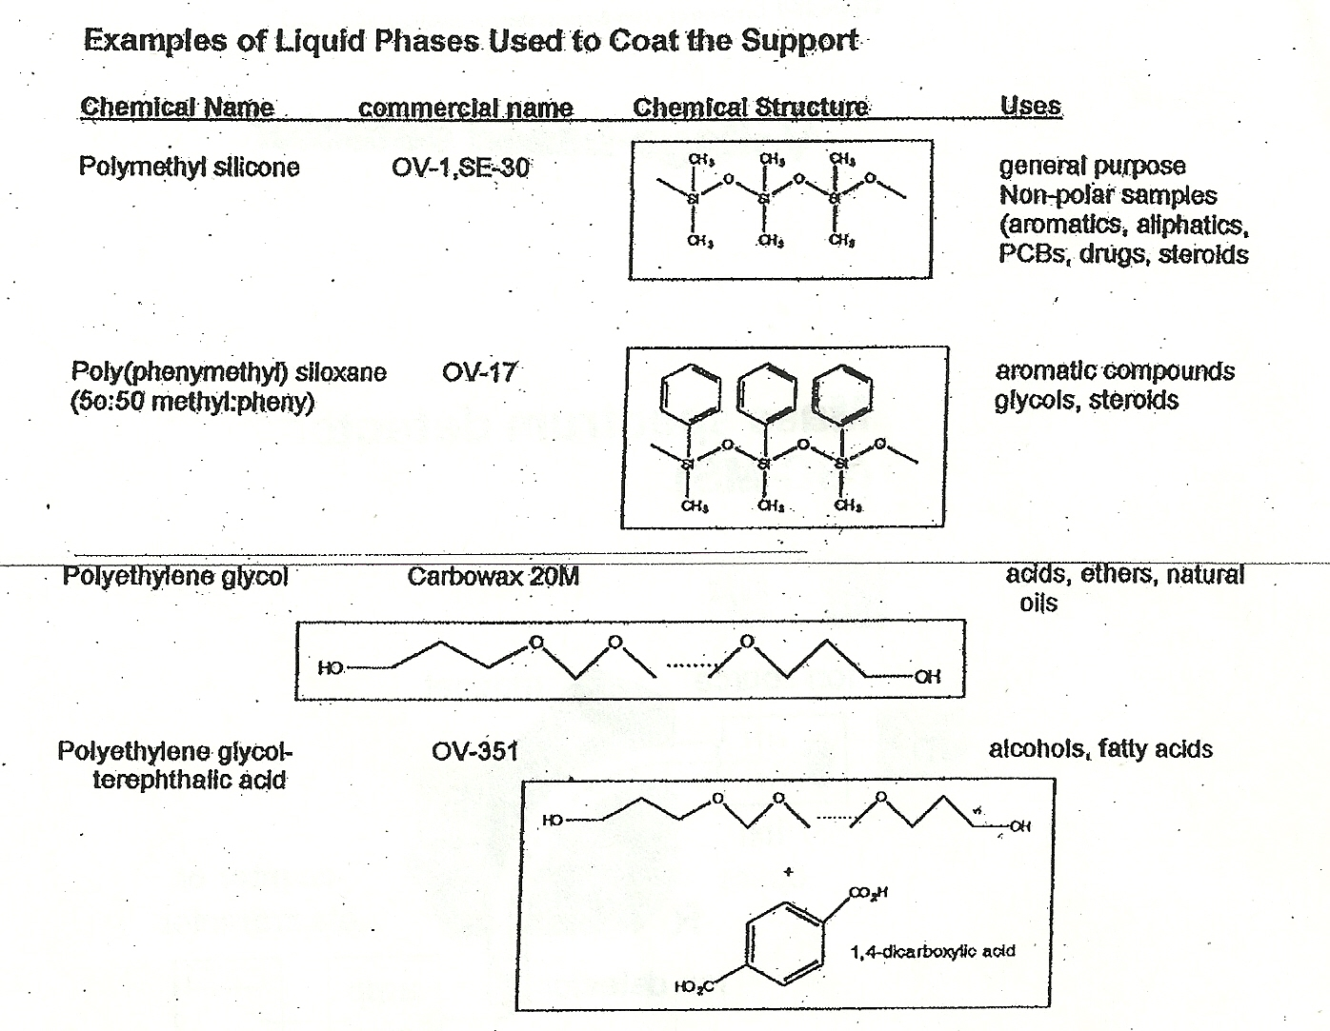
Columns (continued)
`support’ = inner silica wall
The liquid phase is the stationary phase. Physically `painted’ onto the silica (wall coated):Typical thickness are 0.25 μm

Slide 15
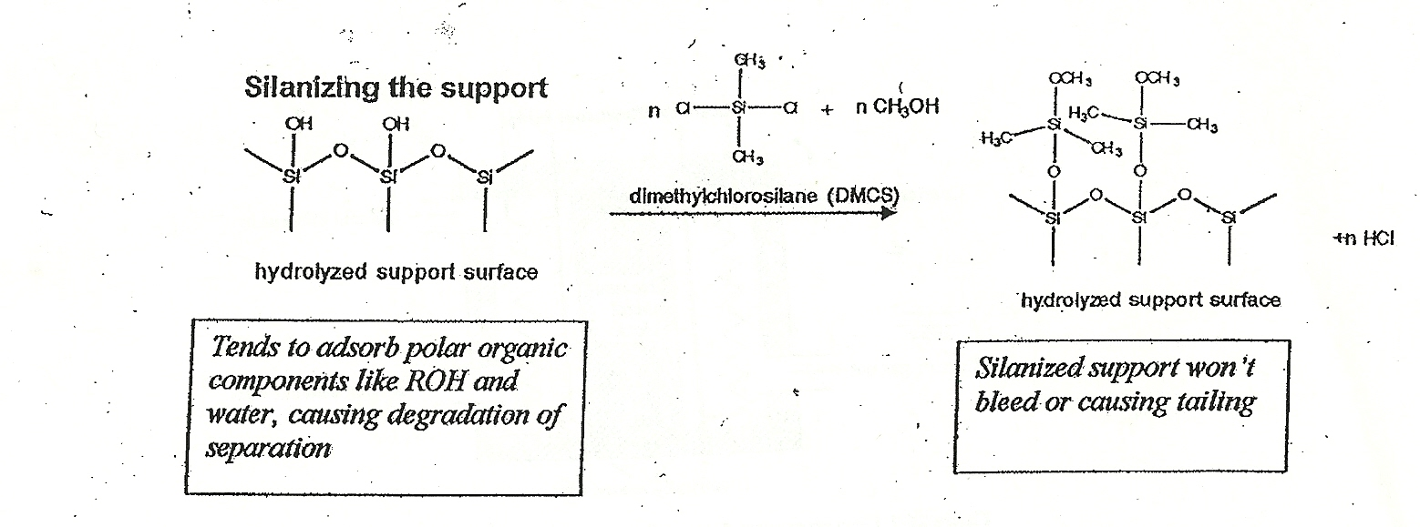
Columns (continued)
Silica wall is often treated with silanizing agent to prevent sample sticking to it (a big problem early on with FSWC columns)
The silanized support is post-coated with the stationary phase and an initial thermal conditioning is applied to new columns to allow stationary phase and silanizing agent to bond/fuse

Slide 16
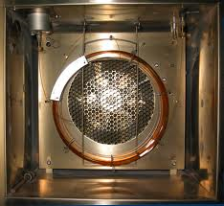
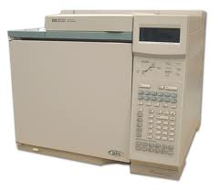
GC Oven…how we make a thermal ramp
HP 6890 GC with single inject port
GC Oven and Fan
What’s behind the white door…

Slide 17
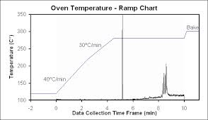
What’s a Thermal Ramp and why do we need it ?
2 min Initial Hold time

Slide 18
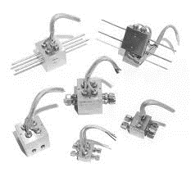
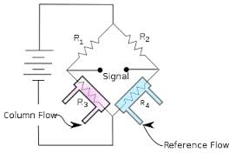
Thermocouple GC Detectors
(passive temperature change)
System is nulled when no sample through column side. The change in Voltage across `Signal’ means Column vs. Ref out of balance

Slide 19
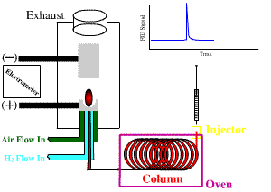
FID=Flame Ionization Detector
Particularly good for…
Alkanes
Alcohols
Ketones, aldehydes
Ethers
Low weight aromatics
Less good for…
Large aromatics
Herbicides
Pesticides
Organic acids

Slide 20
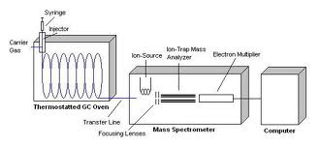
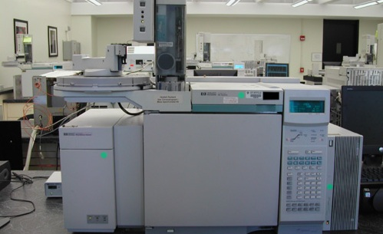
MSD Mass Selective Detector
Detector of choice in drug analysis
(MSD IDs drugs)

Slide 21
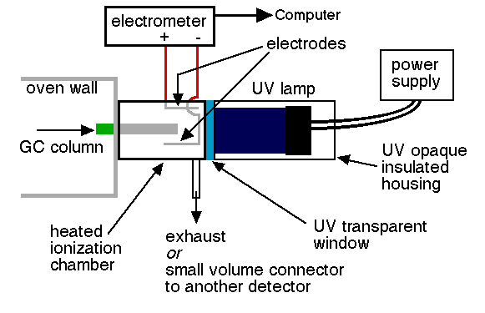
PID=Photoionization Detector
Blind to alcohols, alkanes, ketones (ALIPHATICS)
Good with aromatics
(including many herbicides and pesticides

Slide 22
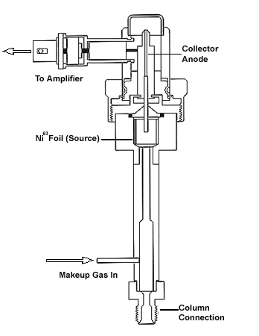
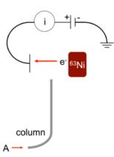
ECD=Electron Capture Detector
⁶³ Ni* → ⁶³Cu + e⁻ (radioactive decay of a beta particle=electron)
e⁻ + X → X- causes change in current from background
Is 10-1000X more sensitive than FID
Particularly good with agricultural chemicals * (but generally useful)
*Herbicides
Pesticides
Drawback: needs US Atomic Energy Commission Government License

