Slide 1
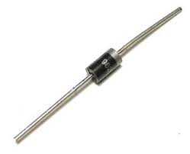
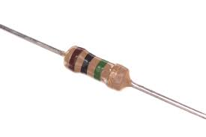
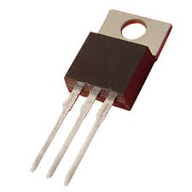
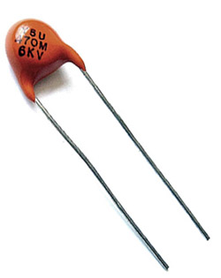
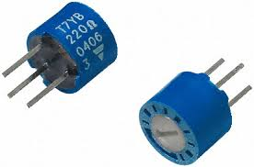
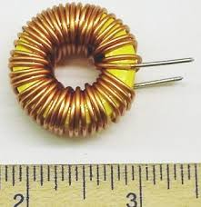
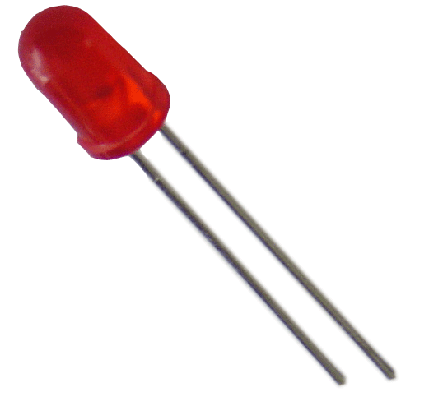
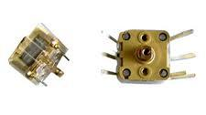
Electronic parts ID exercise
Fixed resistor
diode
transistor
Fixed capacitor
Variable resistor
inductor
LED (light emitting diode
Variable capacitor

Slide 2
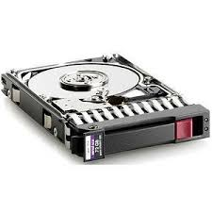
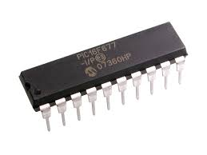
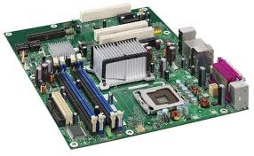
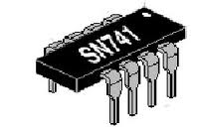
Electronic parts ID exercise (cont.)
`SCSI’ (Small Computer System Interface) hard drive
IC `CHIP’
`op amp’ chip (741 style is very common)
Mother Board

Slide 3
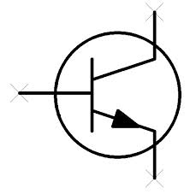
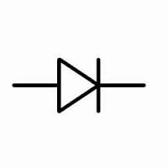





Electronic Symbols ID Exercise
resistor
diode
transistor
Various ground types
Variable capacitor
Variable resistor
inductor

Slide 4
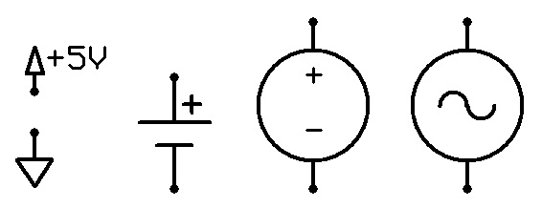

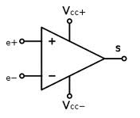
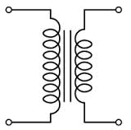
Electronic Symbols ID Exercise (cont.)
LED (light emitting diode)
5 VDC (rectified)
supply
DC
Battery
supply
DC
source
AC
source
`op amp’ (operational amplifier)
Voltage transformer

