Slide 1
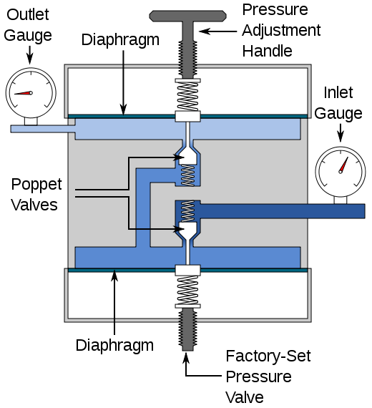
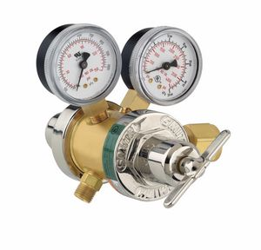
Tank Valves
secondary tank Valve
secondary
primary
weaker spring
Compensating poppet springs
Very strong spring
Primary tank
Valve

Slide 2
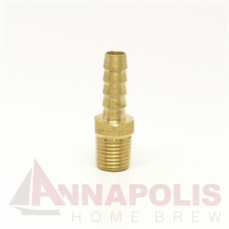
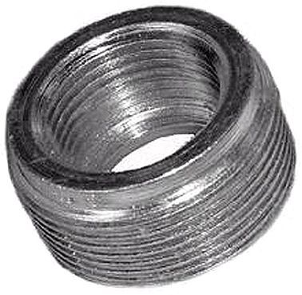
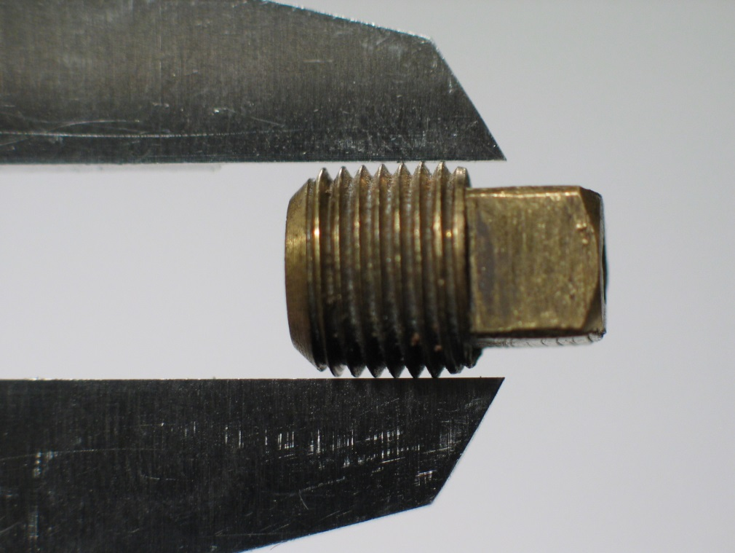
National Pipe Thread (NPT) fittings

Slide 3
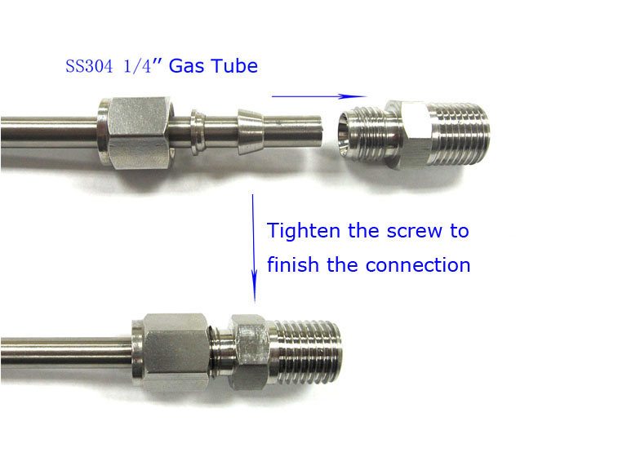
Swagelok fittings
ferrule
Nut
Swagelok-NPT adapter
Back cap
FYI..ASC GC, MS and HPLC plumbing is all 3/16”

Slide 4
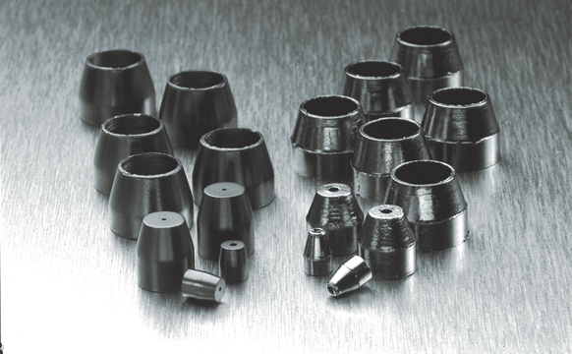
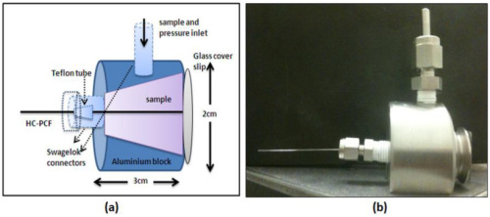
Ferrules for capillary columns are made of carbon (lower crush pressure)

