Slide 1
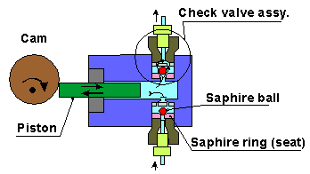
Single piston HPLC pump
Must achieve maximum of 60-120 MPa pressures without leaking or seal failure (600-1200 atm=9000-18,000 psi)
$3000-6000

Slide 2
Push
(upper seal opens and mobile phase pushed into column; bottom seal closes)
Pull,
upper seal closes so that fluid starts to slow down in column; bottom seal opens and re-fills piston with more fluid
PRESSURE IN COLUMN VS TIME

Slide 3
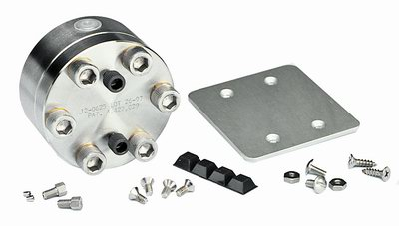
Pulse damper for 1 piston HPLC system
Smooths out sinusoidal pulsing of 1 piston motion
NO DAMPER
PRESSURE IN COLUMN VS TIME
DAMPER

Slide 4
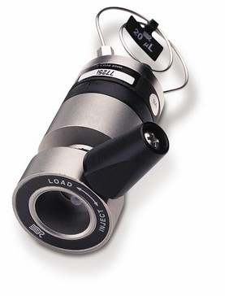
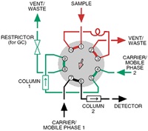
HPLC Injector Port ($750-1750)
Teflon gasket allows arm to turn …can be torn with poor injection technique and create port leaks.
(Why blunt micro syringe is mandatory)

Slide 5
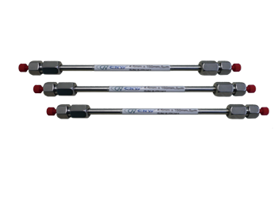
Analytical HPLC columns
Packing size
Porosity
4.6 mm x 250 mm , C-18, 5 u , 300 Ǻ
ID x Length
chain length bonded to silica packing
$500-$2500

Slide 6
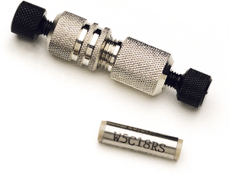
~ $150-250/5 pack = $30-50 each
Guard Column
(2.5 cm ~ 1 inch); usually C-18, 5u, 300 A
Guard column= protective, packed column that filters unwanted components out to protect actual column from degrading.

Slide 7
Some HPLC = High Performance (Pressure) Liquid Chromatography terms
Isocratic= constant composition of mobile phase
Isobaric= constant pressure
Reverse phase column=> polar mobile phase eluting non-polar analyte species (example methanol:water separating toluene/benzene mix in methanol); a reverse phase column has a non-polar stationary phase.
Normal phase column=> non-polar mobile phase eluting polar analyte species (example: octane/cyclohexane separating hexanol/methyl ethyl ketone mix in hexane) ; a normal phase column has a polar stationary phase
Size Exclusion LC- a method to separate based on molecular size (shape)
Ion LC-uses ion exchange columns which `retain’ + or – ions for a time (by swapping stationary phase ions on column); usually aqueous systems

