Slide 1
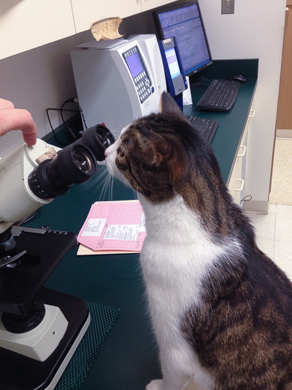
A BRIEF SURVEY OF OPTICAL MICROSCOPY: PRINCIPLES AND LIMITATIONS

Slide 2

But first, a brief detour…

Slide 3
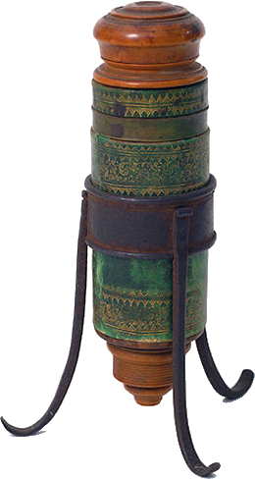
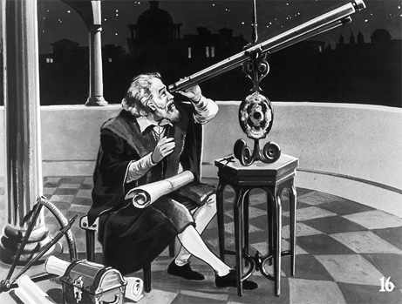
The first microscope circa 1609:
Galileo’s idea ~25X
But images fuzzy and poorly resolved
His telescope worked better (stars emit) so….

Slide 4
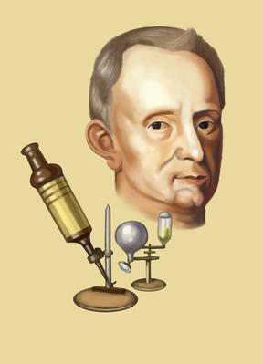
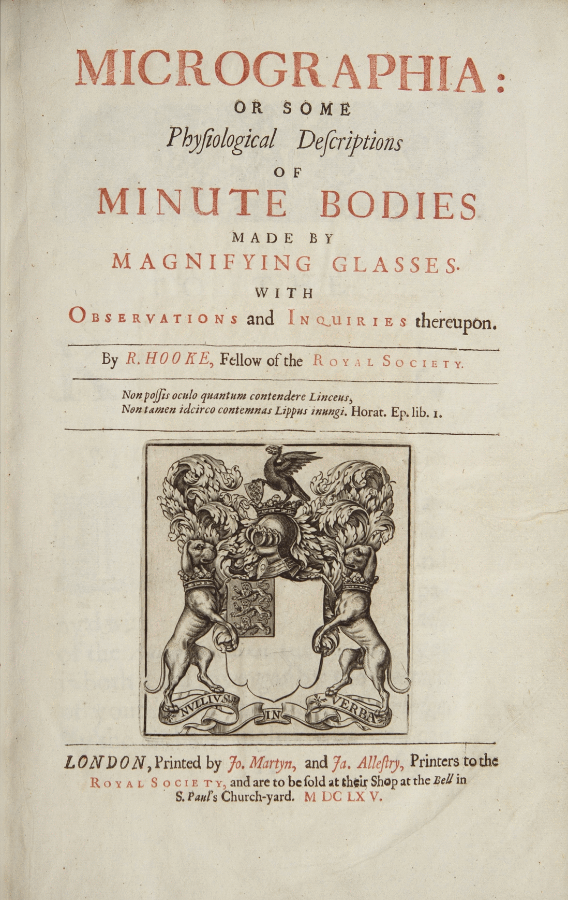
Microscopy popularized by Robert Hooke (1635-1703): (English `polymath’ (one who studies many things)
[optics, biology, mechanics….)
First to see `cells’ *(cork study)

Slide 5
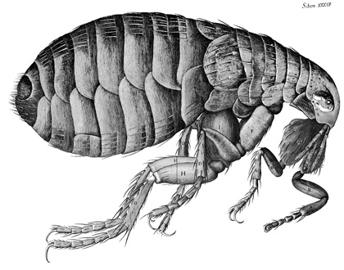
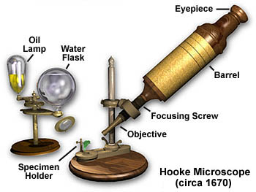
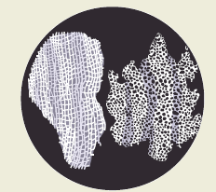
Robert Hooke’s compound microscope
(2 lenses): ~20-25X
Flea
Cork sections

Slide 6
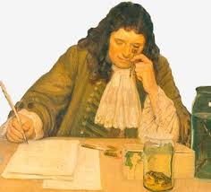
Cell biology and microbiology gets off to a start with Antonie von Leewonhoek 1632-1723 Dutch fabric trader

Slide 7
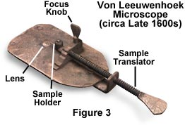
Note: lens is monocular and made by drawing high quality Dutch soda lime into a (near) sphere
(hence bi-convex)=> 70-200X magnifications !!!!!

Slide 8
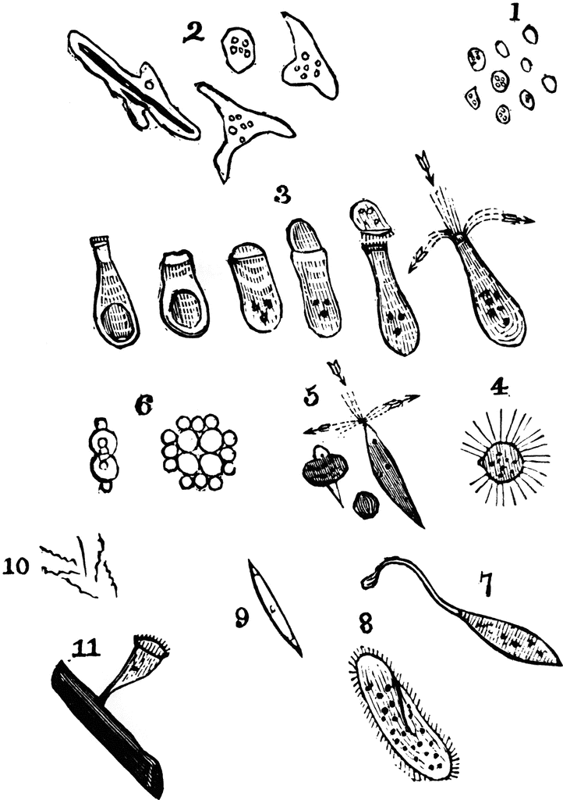
Leewonhoek’s original
‘animalcule’ drawings

Slide 9
Perpendicularly impinging light & refractive index
Light beam
Vacuum or air
light speed in vacuum = c
Plano-plano system
substance
light speed in medium = v < c
light speed in vacuum = c (max)
n= refractive index= c/v

Slide 10
Typical values of n
Material n=refractive index at 25 ºC density (g/cm³)
vacuum 1.0000 0.0000
Air 1.0003 0.0013
distilled water 1.3330 0.9997
window glass 1.510 2.5
lead glass 1.615 2.9
HgS (cinnabar) 2.814 (α axis) 8.17
PbS (galena) 3.91 (α axis ) 7.60

Slide 11
Acutely impinging light and Snell’s Law
Plano-plano system
A
Air or vacuum
n_{a}
Glass, water….
n_{b}
B
Qualitative behavior
Quantitative behavior: Snell’s law
Light bends towards perpendicular in moving from lower to higher refraction medium
(and vice versa)
A
sin A/sin B= n_{b}/ n_{a}

Slide 12
Parallel light through plano convex and double convex lens
Focal line
f
f = focal distance
Plano-Convex lens

Slide 13
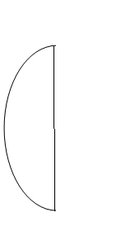
Plano-convex versus double convex lenses
Plano-convex lens
f(double) < f(plano-convex)
Double convex lens

Slide 14
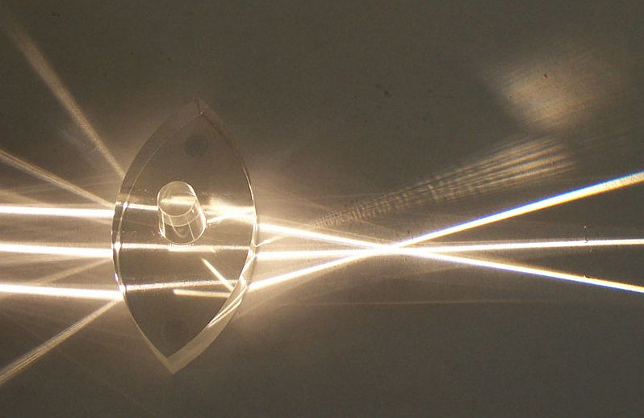
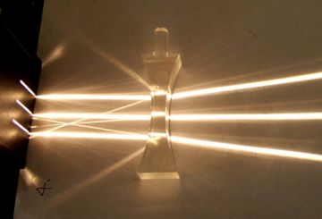
Double convex lens in operation
Double concave lens in operation

Slide 15
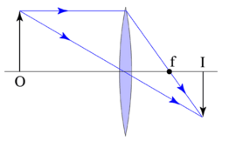
Real object imaging through double convex lens
q
Real image because an actual bundle of light appears here
O=object must lie outside of focal length
M = real image size/object size= q/f
Real images are always inverted vs actual object

Slide 16
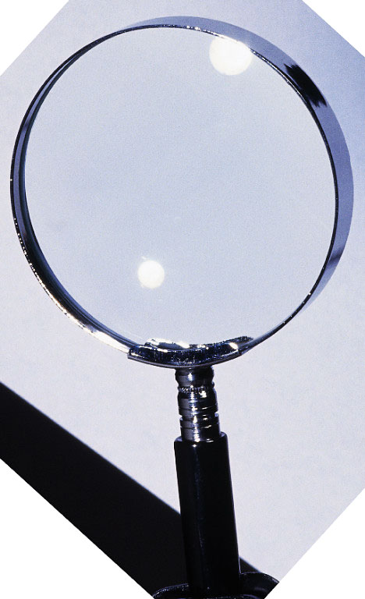
The first image magnifier: the simple hand magnifier glass

Slide 17

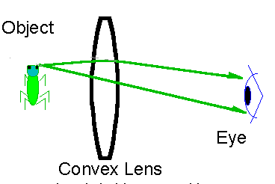

magnifying glasses-the virtual image
Virtual image forms here
10 inches
f
Lens f is << 10 inches so our eyes have trouble focusing…brain `defaults’ to 10 inches and projects real image back in front of lens 10 inches from the real image on your retina
Insect’s real image paints the back of your eye’s retina

Slide 18
Simple and compound magnification
M (simple) = M_{o} = 25(cm)/f(cm) + 1 (magnifier lens)
Insertion of a second `eyepiece’ (simple magnification = M_{e}) to enlarge real image after initial objective magnification leads to compounding of magnification
Virtual image
objective
1st real image
Second real image (on back of eyeball)
M_{total} = M_{o} x M_{e}
M_{e}
M_{o}
eyepiece
object

Slide 19
Why can’t we simply stack many, many lenses on top of each other and magnify without end ???
etc
M * M * M * M.. ???

Slide 20
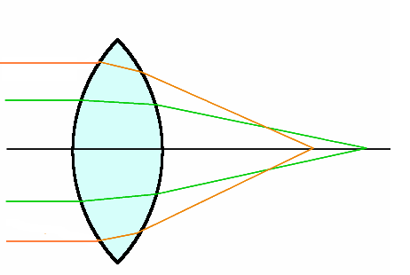

Spherical abberation
Double convex only
focal point different for parallel rays striking different portions of lens
FYI: Before and after
Post –correction to Hubble Space Telescope
Uncorrected for Spherical aberration
Corrected for Spherical aberration
Double convex plano correction

Slide 21

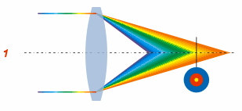
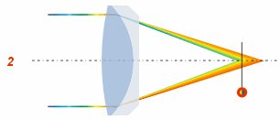

Chromatic abberation
No chromatic correction
2 wavelengths corrected to third
(red & blue corrected to Na-D) = `apo’

Slide 22
Language associated with objectives
Glass quality
E D S
Increasing quality
Field curvature corrected
=> ‘plan’
Two wavelength chromatic correction (Na-D + one other)¹
=`achro’
(Also spherically corrected at Na-D)
Three wavelength correction (Na-D + two others)
`=apo’
(Also spherically corrected at Na-D + one other color )
Objectives…increasing in quality
☺
☹
E-plan
D-plan achromat
S-plan-apochromat
¹ Corrected to same focal pt as Na-D line (589.3 nm)

Slide 23
More language
R= resolution= 0.61 λ(nm) NA
NA= numeric aperture =n sin θ
(measure of light gathering power)

Slide 24
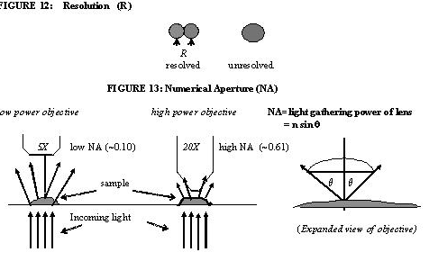
Low NA but area of lens larger=> brighter
High NA but area of lens smaller=>
darker

Slide 25
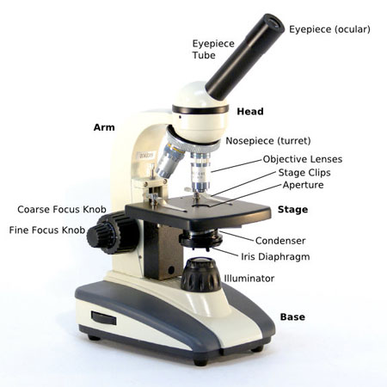
BASIC “BRIGHT FIELD”
OPTICAL MICROSCOPE PARTS
Illuminator adjustment

Slide 26
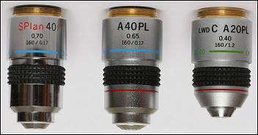
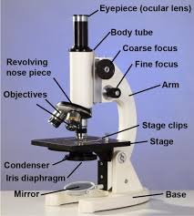
Assumed coverslip
thickness
NA (numeric aperature)
All 3 `plan’ corrected for field curvature
160 mm tube length (eye-piece → objective
Apo
(blue+ red + Na-D)
Apo
(green+ red
+ Na-D)
Achro
(blue+Na-D)
Older school Olympus objective markings

Slide 27
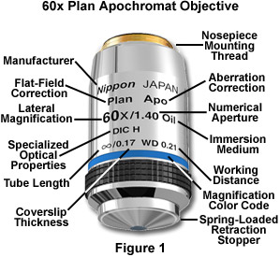
New School objective markings (FYI- the Olympus BH-2 Phase scope objectives are `old school’)

Slide 28
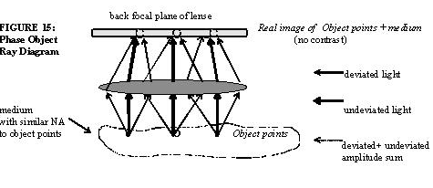
Phase contrast
Bright Field signal = deviated light +
undeviated light

Slide 29
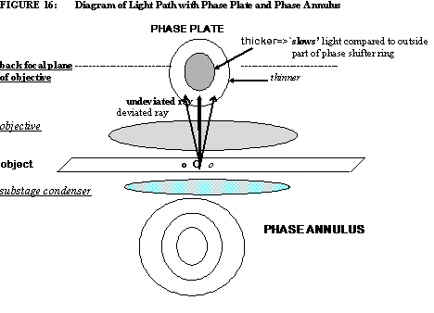
Phase contrast (continued)

Slide 30
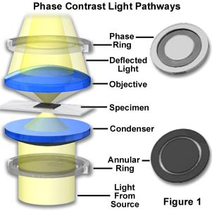
Phase contrast (continued)
Wheel marked 0,10, 20 on stage of ASC’s BH-2 scope is the phase annulus ring. There is a ring for each objective magnification

Slide 31
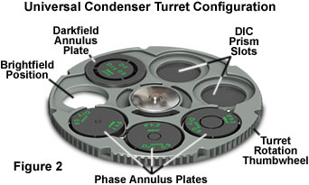
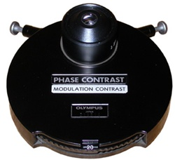
Phase annulus (below stage)
What’s turning under the hood when you turn the dial

Slide 32
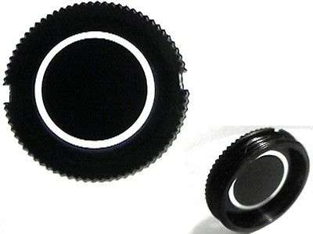
Phase ring (Above the objective inside the microscope armature)

Slide 33
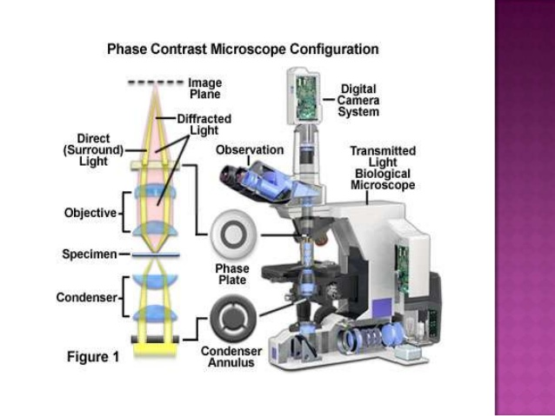

Slide 34
Phase contrast subtracts either the deviated or undeviated light using the phase ring and annulus, thereby `turning down’ the background or object light
Bright Field signal = deviated light + undeviated light
Dark field phase contrast = deviated light
(bright objects, dark background)
Bright field phase contrast = undeviated light
(bright background, dark objects)

Slide 35
ASC’s BH-2 Phase Contrast scope produces destructive interference of undeviated rays to produce `brighter phase’ object images against a darker field.
=> `dark’ field phase object

Slide 36
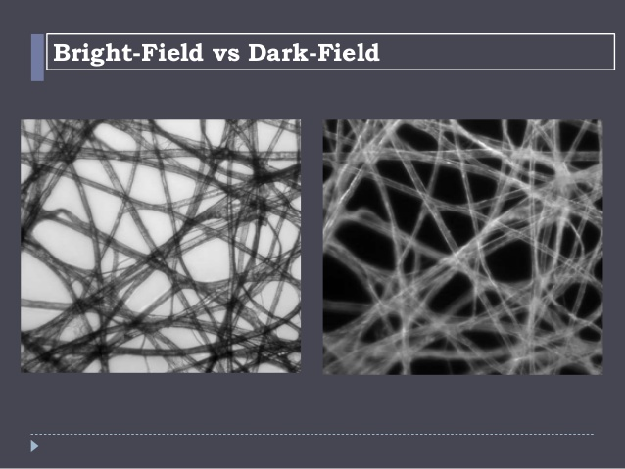

Slide 37
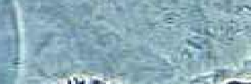
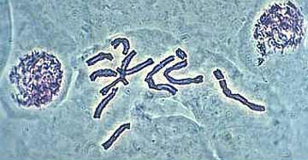
Phase resolved biological objects
No phase correction
With phase plate and annulus (bright field phase contrast)

Slide 38
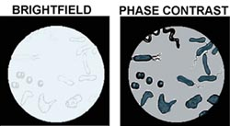
Normal (no phase) bright field phase contrast

Slide 39
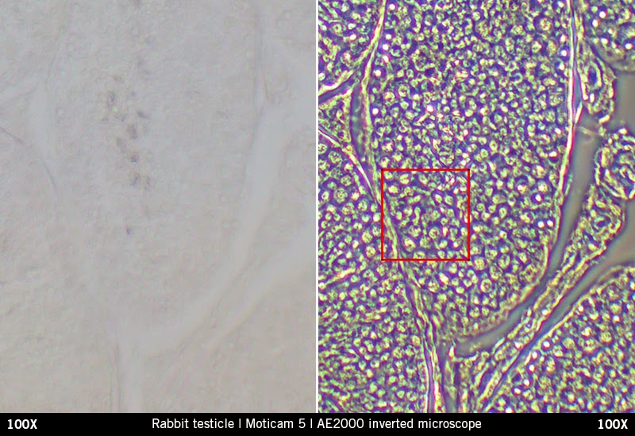
Rabbit testicle
Bright Field Dark Field Phase Contrast

Slide 40

Just for fun….the microscopic image guessing game

Slide 41
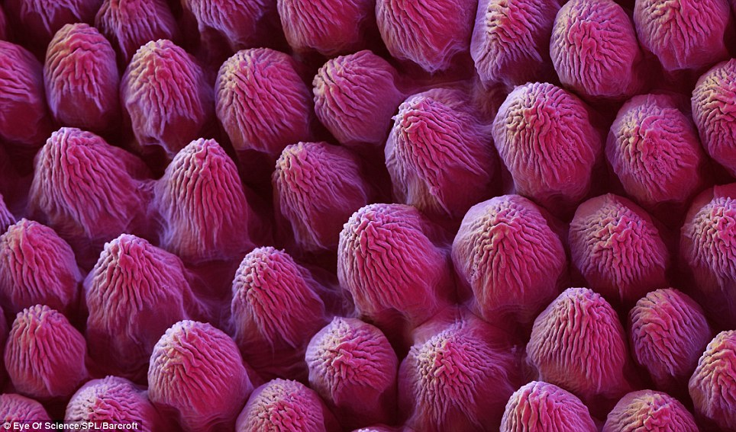

What am I ??
Rose petal 100X

Slide 42
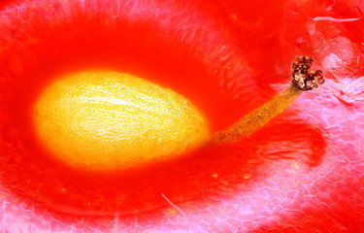
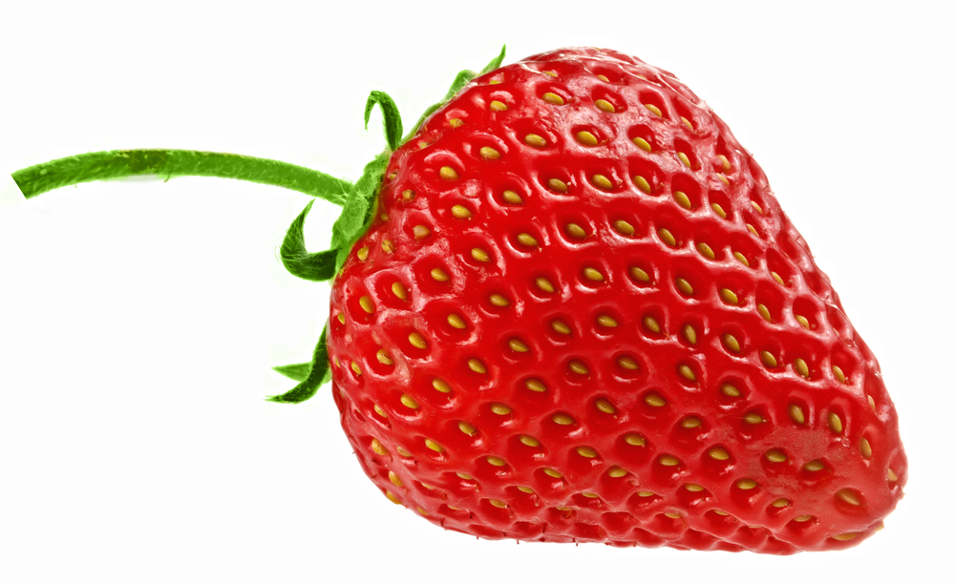
What am I ??
Strawberry seed (20 X??)

Slide 43
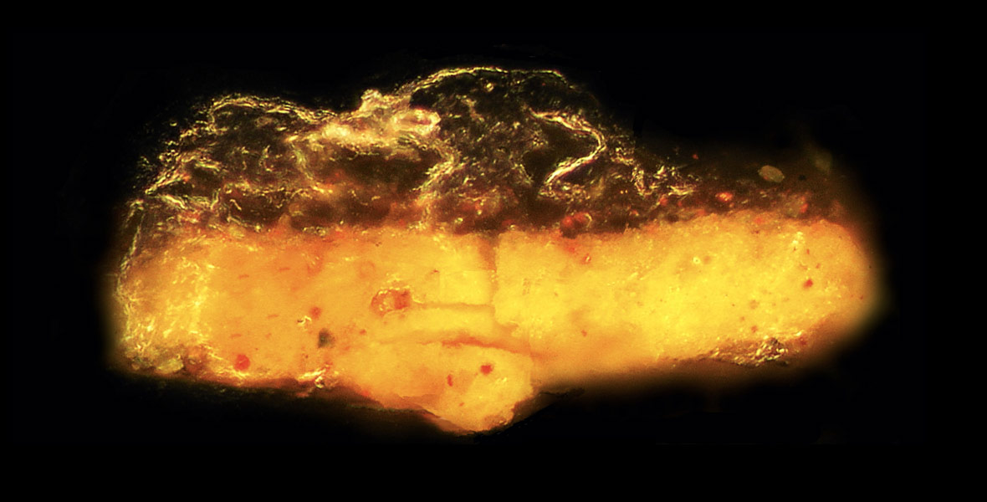
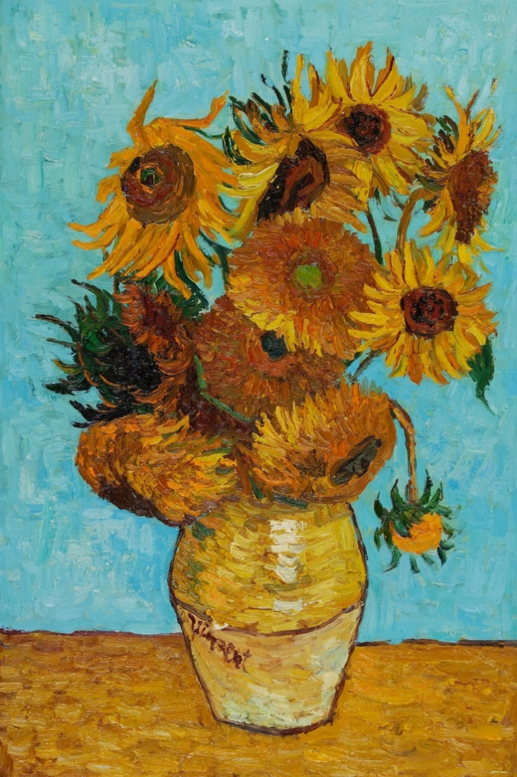
What am I ??
Varnish flake from
Van Gogh painting
Magnification ??

Slide 44
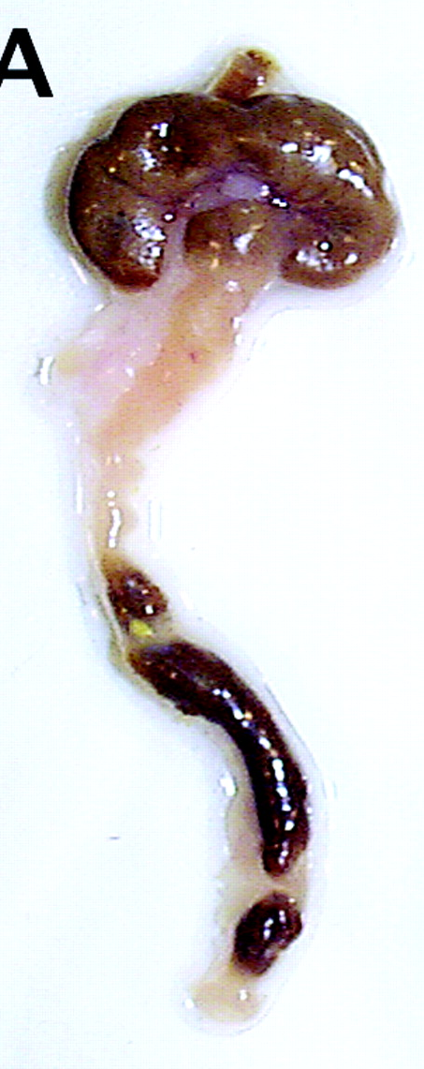
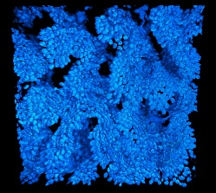
Mouse colon 740X !
What am I ??

Slide 45
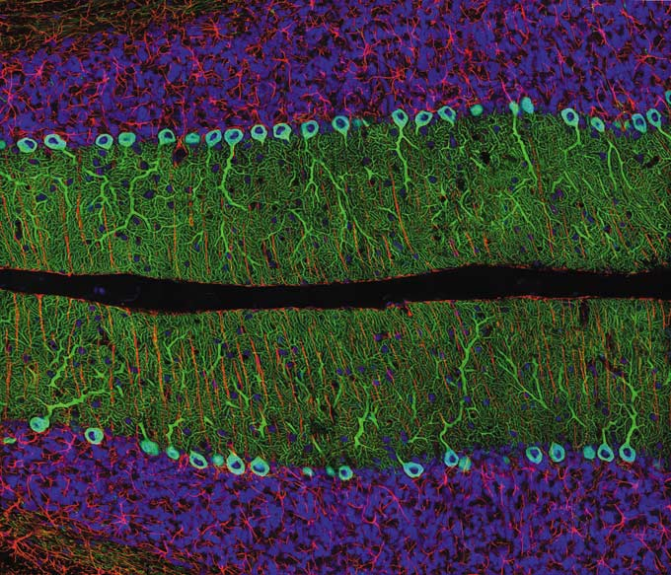
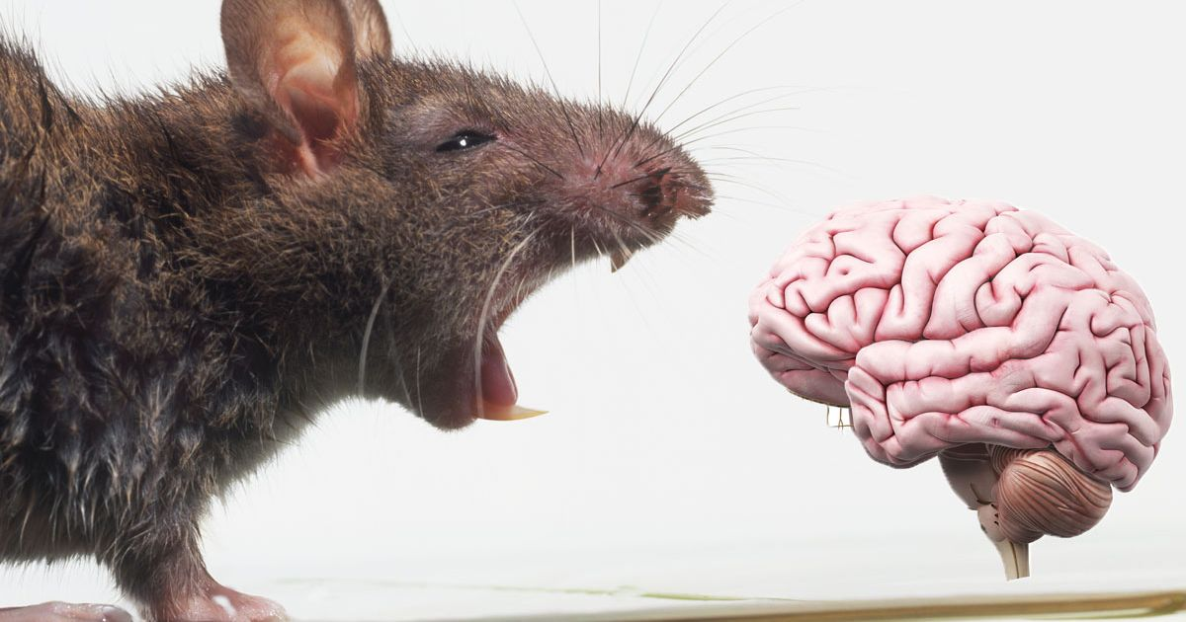
What am I ??
Rat cerebellum 40X

Slide 46
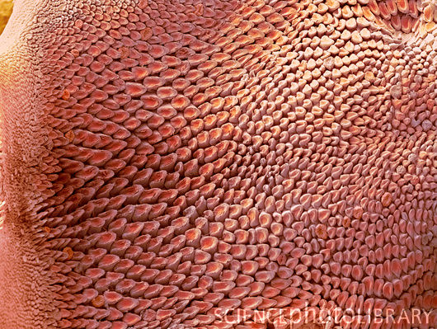
What am I ???? 10X magnification

Slide 47

I give good tongue !

Slide 48

Microscopy Q & A:
Drill and Practice for Mole $

