Slide 1
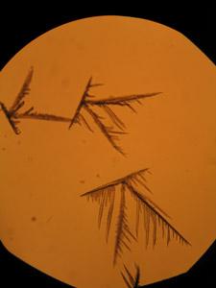
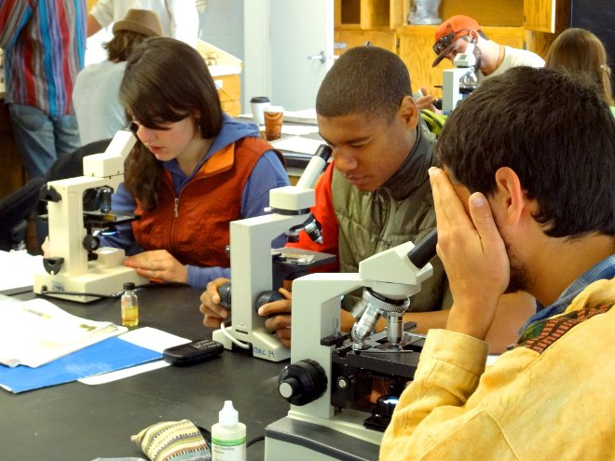
Microcrystalline Tests:
A Simple, Inexpensive Way to Introduce Hands on
Forensic Reasoning to Beginners
AuCl₃:cocaine
Micro-crystals

Slide 2

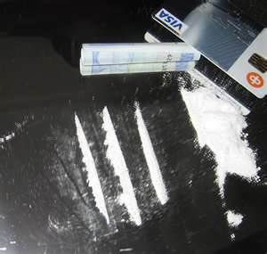
The basic idea is appealingly simple…
+
Specific reagent
Material being tested for identity
Confirmatory microcrystalline habit
(50X)

Slide 3

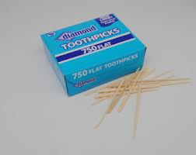
The basic technique is both easy (but requires practice) and cheap…
1.
2.

Slide 4

2.
Wait patiently ….(longer is better!)
Reaction zone
3.

Slide 5
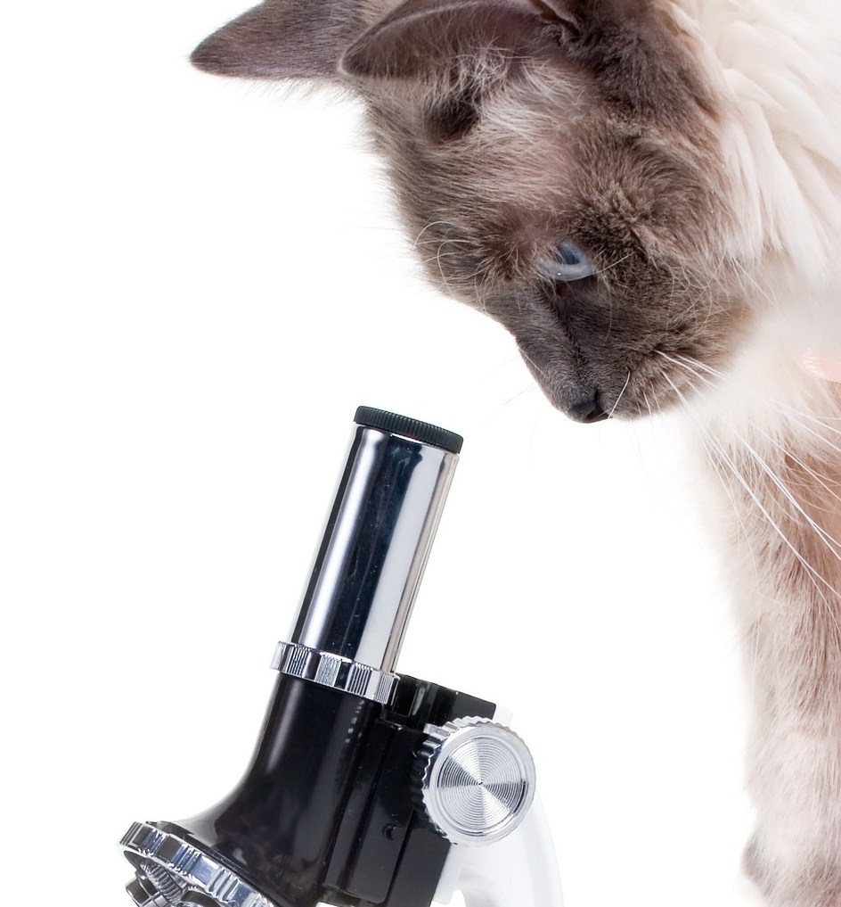
Bingo !
3.
Examine the reaction zone with a microscope
4.
Look for expected,
micro-crystalline habits.

Slide 6
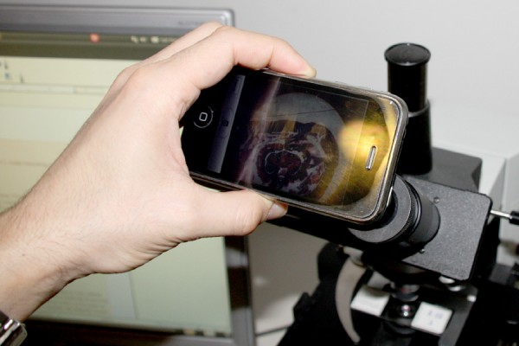
5.
Use a smart phone camera to record/document the microcrystalline habit’s image

Slide 7
What is the pedagogical value of doing this ?
….running and pondering the results of microcrystalline tests as part of a chemical or forensic analysis immerses is the sort critical thinking that lies at the core of all science, which is to make prudent judgments on what is being observed (or not observed) as the result of one’s own application of a technique.

Slide 8

More succinctly:
“The hand is the cutting edge of the mind.”
J. Bronowski from The Ascent of Man

Slide 9
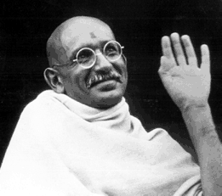
“An ounce of practice is worth more
than tons of preaching.”
For the rest of the hour: attempt to determine/confirm your unknown’s identity using the microcrystalline test-based flow scheme & tests provided.

Slide 11
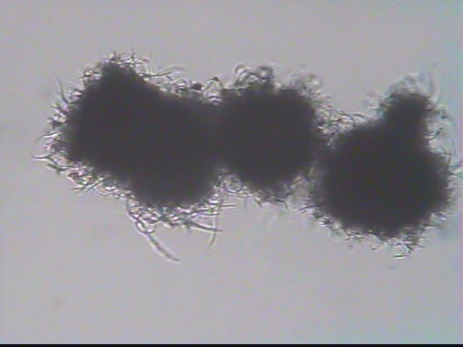
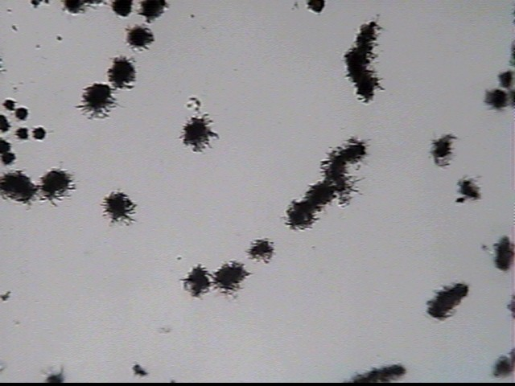
TEST G
MICROCRYSTALLINE TEST FOR CAFFEINE
Place a medium sized drop of 5% HNO₃ on a slide and completely dissolve a few crystals of suspected caffeine in the drop. Place a drop of 0.1M AgNO₃ next to the sample drop and draw the two drops together with a toothpick. Caffeine is indicated if, after a few minutes dense, black fuzzy balls appear at the boundaries of the drops and in the isthmus with habits discernible at 50-100X.
Early stage 100X, bright field

Slide 12
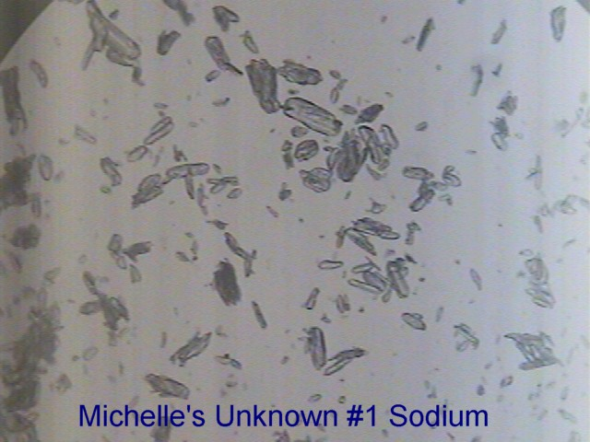
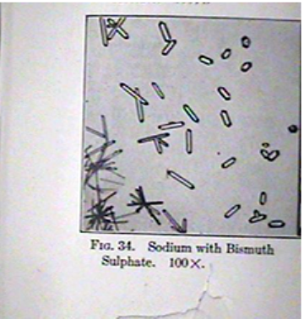
TEST A
MICROCRYSTALLINE TEST FOR Na⁺
Place a medium-sized drop of concentrated H₂SO₄ on a slide and then add to it a drop of distilled water. Carefully add Bi₂(SO₄)₃ solid with stirring and gentle warming until the solution appears ~saturated, as evidenced by faint cloudiness. Add just enough 1M HNO₃ to cause the cloudiness to disappear.
Place 5-6 crystals of the suspected NaCl on a second slide and add just enough concentrated H₂SO₄ so that a thin, damp paste is created after gently warming the sample. (This step converts chloride to sulfate). Add a drop of the Bi₂(SO₄)₃ solution initially prepared to the paste. Warm gently at 50~60º on a hotplate.
NaCl is indicated if slender, narrow hexagonal rods or short prisms with angular ends appear singly or in star-shaped clumps.
student result 50X
Chamot & Mason p. 53, fig. 34

Slide 13
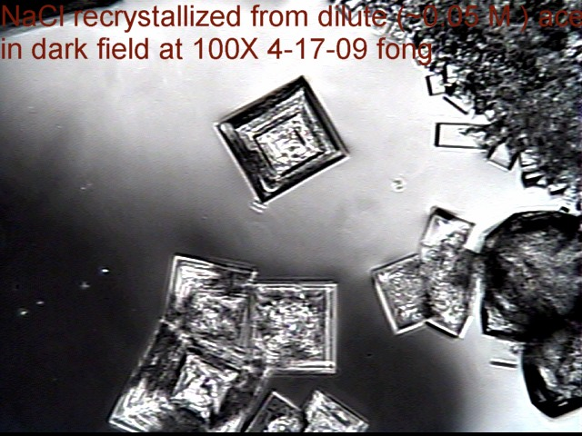
TEST C
MICROCRYSTALLINE TEST FOR NaCl(s)
Put a medium-sized drop of weak (0.05 M) acetic acid on a glass slide and dissolve into it 3-5 small crystals of suspected NaCl using a flat toothpick to deliver and stir the crystals until they dissolve. Solution should be weak to avoid mass crystallization.
Gently dry the solution on a hot plate set to ~ 65-70 ºC until a fine white `rind’ of micro-crystals appear at the outer edge of the drop.
NaCl crystals should appear as strongly birefringent, cubical or rectangular-shaped crystals under dark field phase illumination.
instructor result at 100X (dark field)

Slide 14
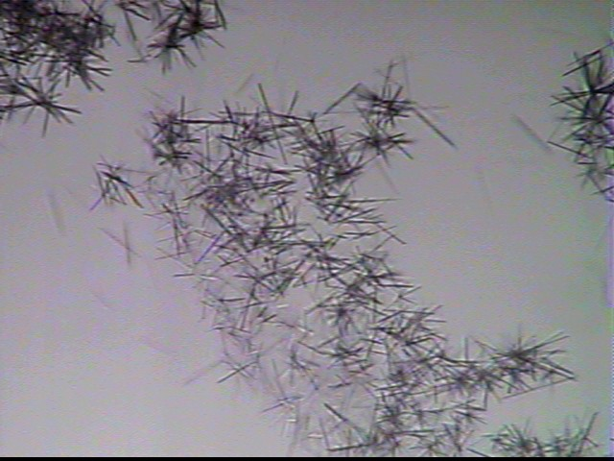
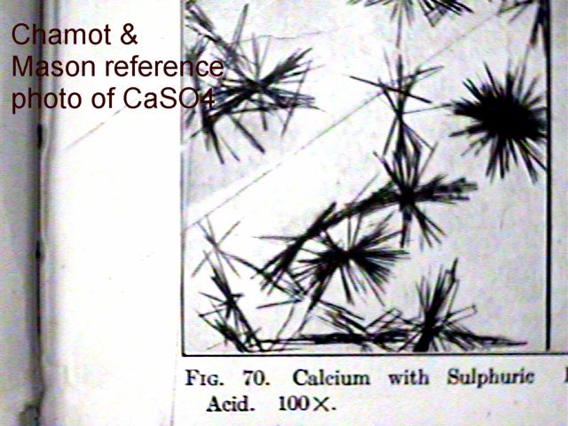
TEST D
MICROCRYSTALLINE TEST FOR Ca²⁺
Place a drop of 6M HCL on a clean slide and add a small crystal of the suspect CaCO₃(s). Place a drop of 6M H₂SO₄ next to the first drop and draw together with a tooth pick. Ca²⁺ is indicated if fine micro- dendritic needles form within a few minutes at drop boundaries and in the isthmus between drops. The microcrystalline habits are discernible at 50- 100X.
instructor result at 50X
Chamot & Mason p. 105, fig. 70

Slide 15
TEST G
MICROCRYSTALLINE TEST FOR CAFFEINE
Place a medium sized drop of 5% HNO₃ on a slide and completely dissolve a few crystals of suspected caffeine in the drop. Place a drop of 0.1M AgNO₃ next to the sample drop and draw the two drops together with a toothpick. Caffeine is indicated if, after a few minutes dense, black fuzzy balls appear at the boundaries of the drops and in the isthmus with habits discernible at 50-100X.
Early stage, 100X, bright field
Late stage, 100X, bright field

Slide 16
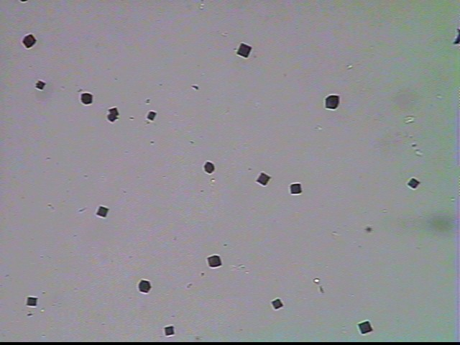
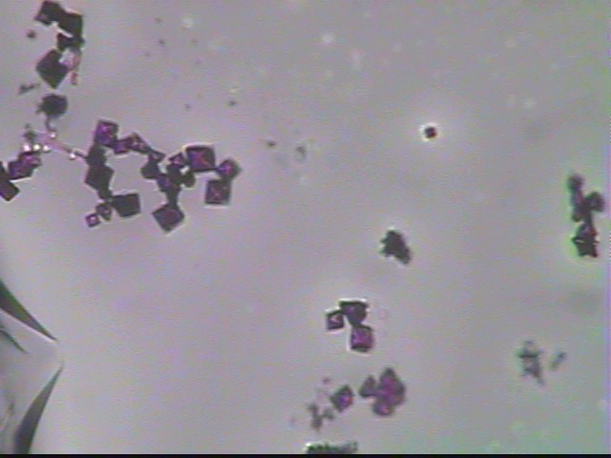
TEST H
MICROCRYSTALLINE TEST FOR CAFFEINE
Place a medium sized drop of 1% NaOH on a slide and completely dissolve a few crystals of suspected caffeine in the drop. Add powdered NaHCO3 until it no longer dissolves. Place a drop of the KI/I₂ solution ((14 g KI & 4.8 g I2/100 mL water) next to the sample drop and draw the two drops together with a toothpick, then place a small crystal of KCl in the mixture. Caffeine is indicated if, after a minute or so: Greenish or dark red solution forms, and small, red
colored cubes appear at 100X.
Early Stage, 100X, bright field
Late Stage, 100X, bright field

