Slide 1
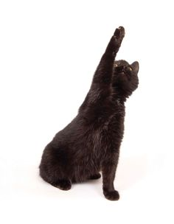
I know, I know all this MS stuff, teacher…pick me, pick me !!!

Slide 2
Mass Spectroscopy (MS) Q & A
There are three basic MS designs. Name them in order from most expensive to least expensive.
Magnetic sector
Quadrupole
Time-of-flight
Which design is resident in the ASC instrumentation lab ?
Quadrupole
For all three of the basic MS designs, what is the most common fragmentation method/source?
Electron Impact (EI)
Name one drawback of EI
Collisions can erase Parent mass
Name a fix to this problem and how it works
Chemical ionization (with methane)…a much softer collision reduces energy and saves parent

Slide 3
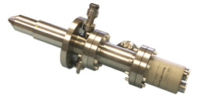
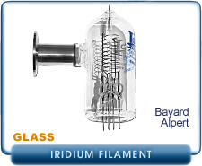
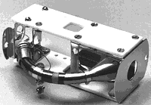
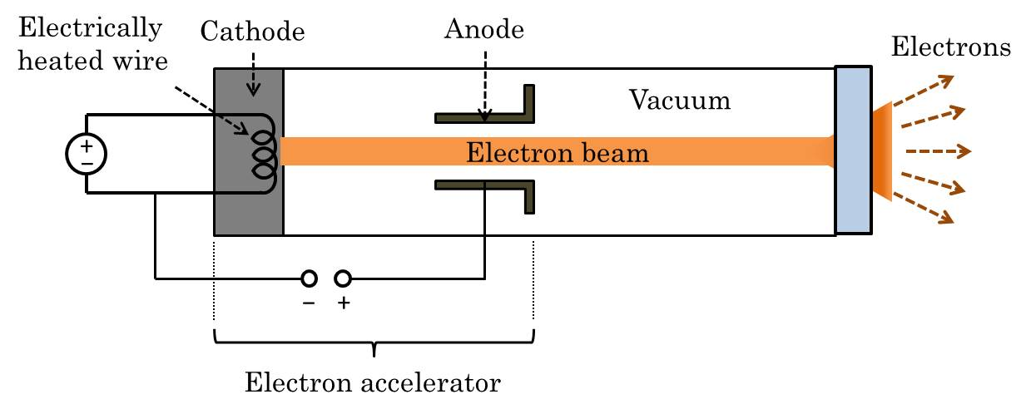
Mass Spectroscopy (MS) Q & A (cont.)
Which is the EI source ?
Use this to explain how the EI source works

Slide 4
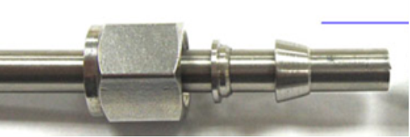
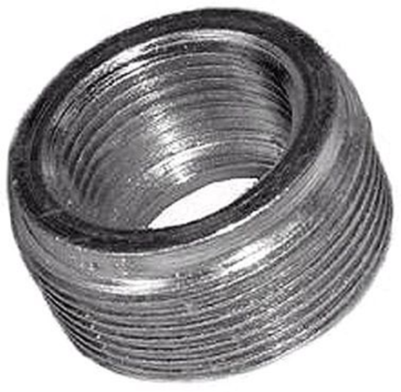
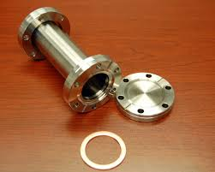
Mass Spectroscopy (MS) Q & A (cont.)
Name these various bits of GC-MS plumbing
Swagelok fitting
NPT fitting
Con-flat fittings
Which is necessary for high vacuum part of MS ?

Slide 5
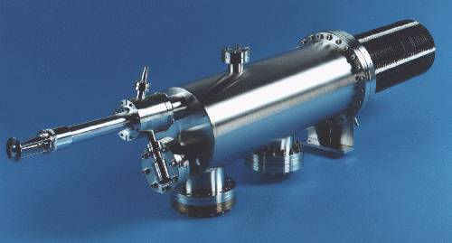
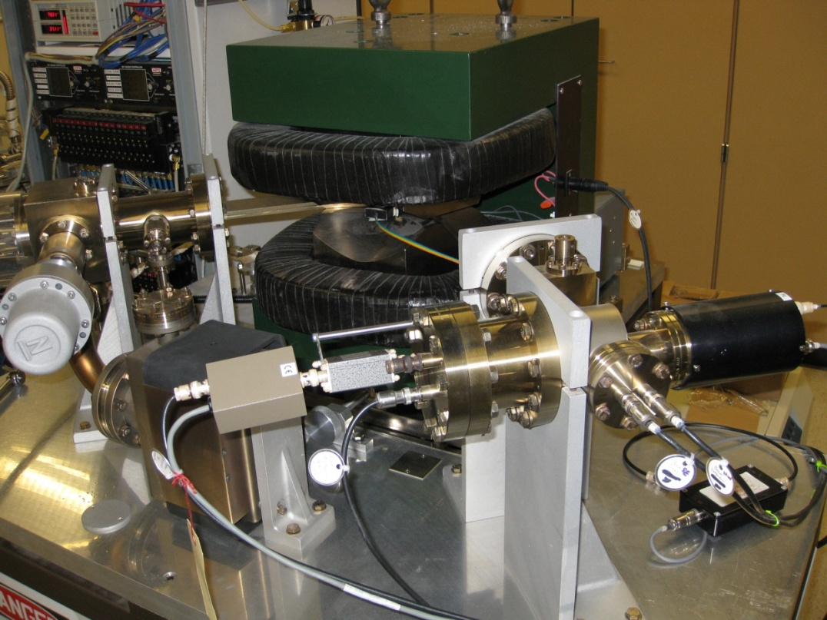
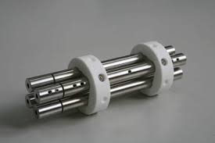
Mass Spectroscopy (MS) Q & A (cont.)
What kind of MS am I ?
Time-of-flight
Magnetic sector
quadrupole

Slide 6
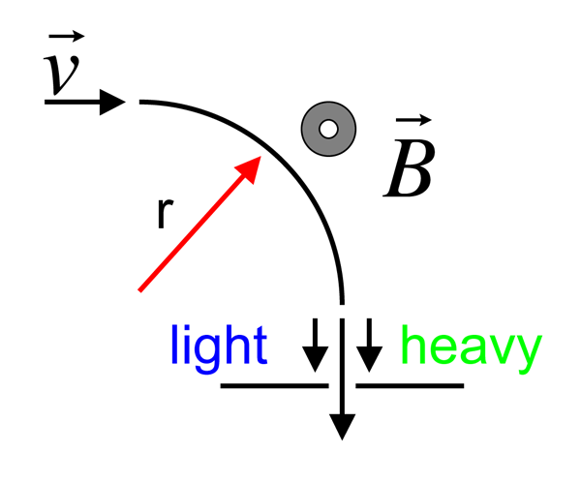
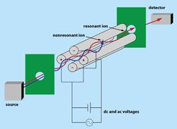
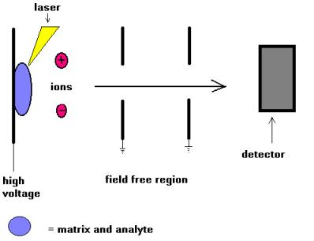
Mass Spectroscopy (MS) Q & A (cont.)
Match the schematic to the MS type
Magnetic sector MS
Quadrupole MS
Briefly explain how each schematic outlines the manner in which mass selection occurs.
TOF (Time-of-Flight) MS

Slide 7
Mass Spectroscopy (MS) Q & A (cont.)
What is the first thing you monitor when starting up any MS ?
Vacuum chamber pressure
Why is achieving a low vacuum chamber pressure critical ?
EI needs clear path to collide with samples. A poor vacuum leads to low signal and can burn out source
What vacuum level is `acceptable’ for our Quad MS?
~(1→5)*10⁻⁵ torr
Two different combinations of pumps are used ASC Quad MS . What are they ?
Mechanical (direct drive) + oil diffusion (ELANOR)
Mechanical (direct drive) + turbomolecular (Bob and Babette)

Slide 8
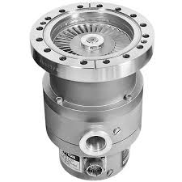
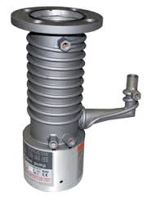
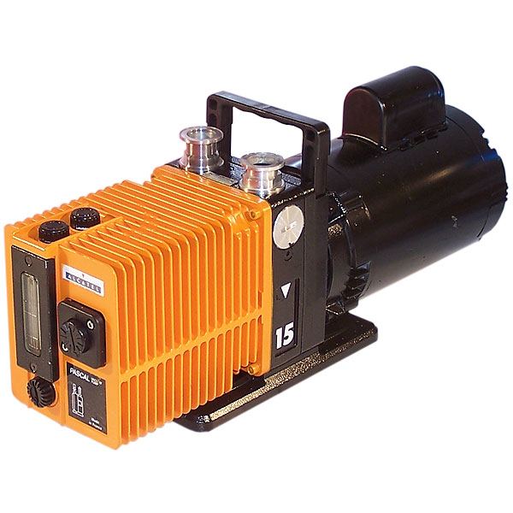
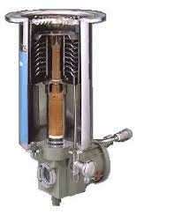
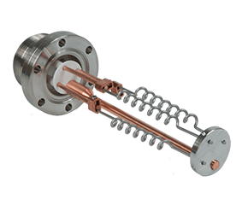
Mass Spectroscopy (MS) Q & A (cont.)
Name the pump…
Turbomolecular pump
Mechanical pump
diffusion pump
Cryo pump
Titanium sublimation (getter) pump

Slide 9
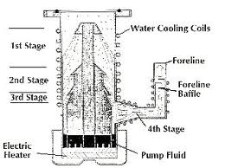
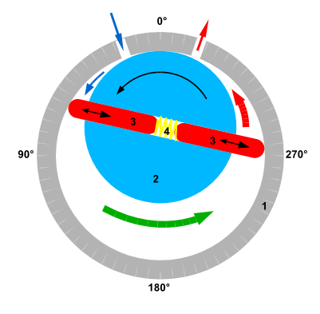
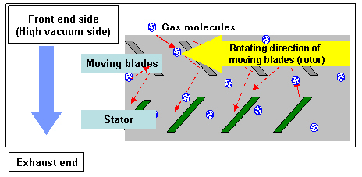
Mass Spectroscopy (MS) Q & A (cont.)
Which pump is associated with these schematics ?
Oil diffusion
mechanical
Turbomolecular

Slide 10
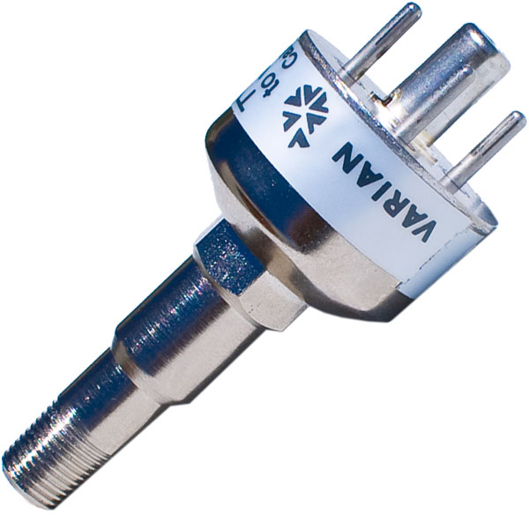
Mass Spectroscopy (MS) Q & A (cont.)
What are our names an what do we measure ?
TC (thermocouple) pressure gauge
Phillips-Granville Vacuum tube pressure gauge
Which measures the pressure at high pressure ?
Which kicks in at very low pressures ?

Slide 11
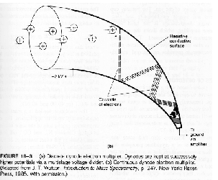
Mass Spectroscopy (MS) Q & A (cont.)
What does this doohickey do in the MS ?
Detects m⁺
What’s its official name ?
Dynode multiplier detector
Use the text’s schematic of the above and explain how it works.

Slide 12
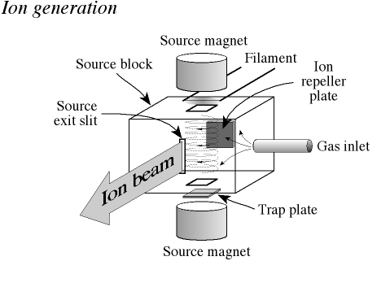
Mass Spectroscopy (MS) Q & A (cont.)
Briefly explain ion generation with this diagram

Slide 13
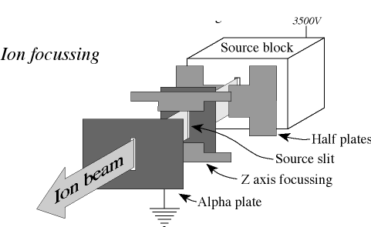
Mass Spectroscopy (MS) Q & A (cont.)
Briefly explain ion acceleration with this diagram

Slide 14
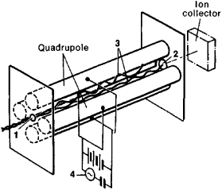
Mass Spectroscopy (MS) Q & A (cont.)
Briefly explain how various M⁺ are `selected’ with this diagram
From accelerator/ion focusing
M₁⁺ , M₂⁺ ,M₃⁺ …

Slide 15

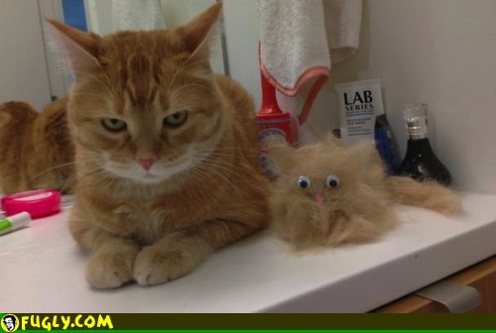
,DOC

