Slide 1

Even with fancy, computer-interfaced 21st century chemical instrumentation…things get ugly fast

Slide 2
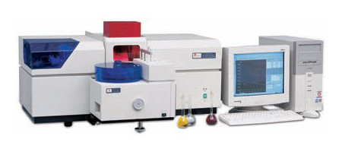
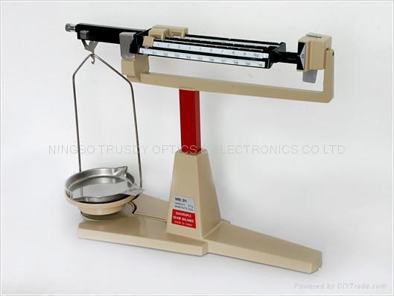
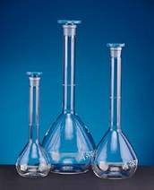
1st Ugly Fact of 21st Century Instrumentation Science:
Calibration of all modern instrumentation rests on 19th century volumetric/analytical methods
..we calibrate this tool
… with these tools

Slide 3
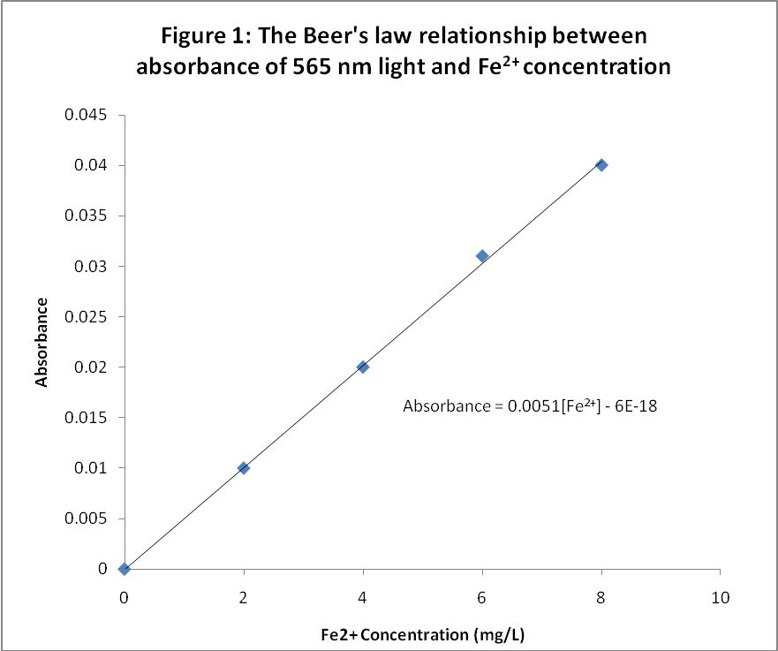
21st century piece
Error determined by std. dev. of repeated measurements
Error ?...a problem…
19th century piece

Slide 4
2nd ugly fact of 21st century instrumentation science: knowing the uncertainty of concentration requires icky math
Example: Primary stock¹ solution concentration C_{o}
What is the expected uncertainty in the concentration C_{o} of 1.000 g NaCl in 50 mL volumetric flask (=0.02 g/mL)?
Mass error Δm= ± 0.001 g
Volume error ΔV ± 0.05 mL
To correctly estimate of uncertainty in C_{o}: ☹
ΔC_{o} = [(∂C/∂m)²(Δm)² + (∂C_{o}/∂V)(ΔV)²)^{1/2}
¹Primary means weighed solute into calibrated volume

Slide 5
Mass error Δm= ± 0.001 g
Volume error ΔV ± 0.05 mL
Mass error piece
Volume error piece
ΔC_{o} = [(∂C/∂m)²(Δm)² + (∂C_{o}/∂V)(ΔV)²)^{1/2}
=[(1/V)²*0.001² + (m/V²)²*0.05²]^{1/2}
=[(1/50)²*0.001² + (1/50²)²*0.05²]^{1/2} =2*10⁻⁵
% C_{o} error = 100* ΔC_{o}/Co = 100*2*10⁻⁵/0.02
=0.1%

Slide 6
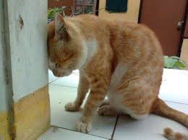
Error contributions to primary C₀ = mass/volume
concentration for 1 g/50 mL stock solution
±∆m(g) ±∆V(mL) V error % m error % total % C error
0.0010 0.05 <1 >99 ± 0.100
0.0001 0.05 10 90 ± 0.011
∴Primary standard error comes mostly from the scale’s error
Technology sucks

Slide 7
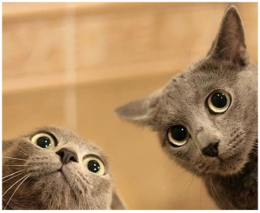
What about error in secondary standards
(diluting primary using pipets to a larger volume ?)
Example:
5 mL of primary 0.02 g/mL stock diluted→ 100 mL=>
0.02000 g/mL ± 0.00002 g/mL
5 mL pipet ± 0.01 mL
100 mL volumetric flask ± 0.08 mL
⇒
After icky math…
secondary standard
0.001000 ±0.000002 g/mL
(~0.2% error)
Distribution of error in secondary standard
Pipet primary C_{o} 100 mL volumetric
71 % 18 % 12%
Volumetric ware is the limit in secondary and later dilutions

Slide 8
Primary C₀ error arises from balance ±Δm
~ ±0.1%
Secondary C_{s} error arises from initial C₀ error and pipet ±ΔV. For a simple dilution error % in C_{s} is typically:
±0.2-0.3%
Further dilutions increase the % error by ±(0.1-0.3%) for each additional dilution step. (Larger pipets better.)

Slide 9
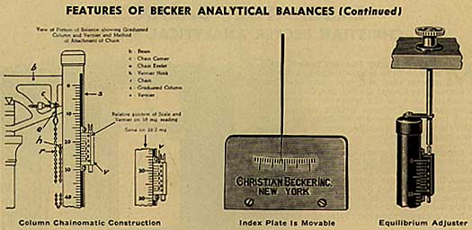
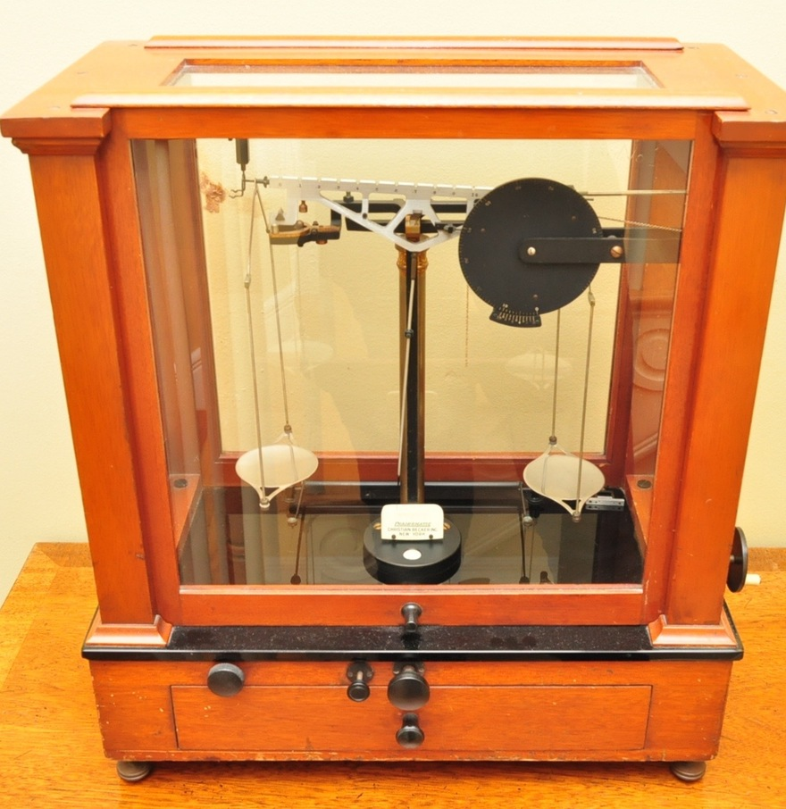
The chief source of solution error …”back in the day…”
Δm ~ ± 0.001 g (10 swings)
A Becker Chainomatic 2-pan swing balance circa 1960
2)Measure over ~10 swings with needle ending at same deflection left and right
1) Fine tune balance with `chain’

Slide 10
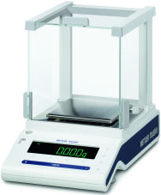
The chief source of solution error …now
Mettler-Toledo AK 160 g
4 place top-loading, taring electronic balance
Δm ~ ± 0.001 g
While 0.0001 g balances are available at ASC, they tend to drift and are unstable unless great care is taken to stabilize the base and exclude drafts

Slide 11
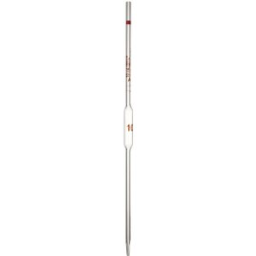
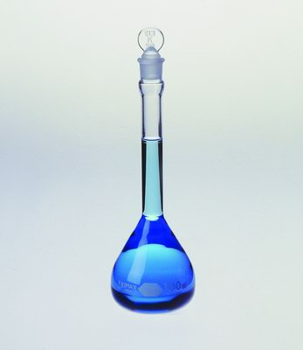
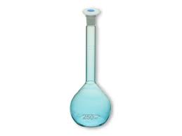
Secondary* solution concentrations, C_{s}
*secondary=> solute delivered as a volume from a primary standard C₀ and diluted
Class A volumetric pipet transfers V(mL) of C₀
Primary C₀
Secondary C_{s}

Slide 12
Class A Pipet Tolerances
Volume, V(mL) | ±ΔV(mL) | % error
0.5 | ± 0.006 | 1.2
1.0 | ± 0.006 | 0.6
2.0 | ± 0.006 | 0.3
3.0 | ± 0.010 | 0.3
4.0 | ± 0.010 | 0.3
5.0 | ± 0.010 | 0.2
10.0 | ± 0.020 | 0.2
15.0 | ± 0.030 | 0.2
20.0 | ± 0.030 | 0.2
25.0 | ± 0.030 | 0.1
50.0 | ± 0.050 | 0.1
100.0 | ± 0.080 | 0.08

Slide 13
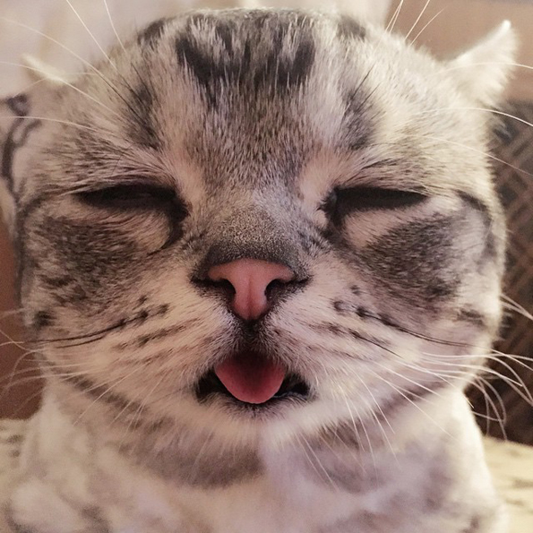
The bottom line, kids….you will still need to be competent with all all those icky 19th century math things…. e.g., calculate in moles, ppm, wt % and do dilutions

