Slide 1
Vibrational memory lane
Vibrational source ???
O-H stretch
Above 3000 cm⁻¹
Medium (m)
Sharp
Can be shoulder on C-C-H band
~ 3500 cm⁻¹ vs br
Characteristics of C=C-H stretch ?
3000 cm⁻¹
Vibrational source for A ?
C-C-H stretch (CH₂)
Vibrational source for B ?
C-C-H stretch (CH₃)
A B

Slide 2
Vibrational memory lane (continued)
Weak multiplets near 2000 cm⁻¹…dead give away for…
Aromatic ring
Speaking of rings…where are the two main ring breathing modes ?
~1500 and 1600 cm⁻¹
1690-1710 cm⁻¹
vs shp
Vibrational source ?
C=O (carbonyl) stretch
Aldehydes (RCHO)
Ketones (RR’CO)
Carboxylic acids (RCOOH)
Name 3 compound
classes that could
exhibit C=O ?

Slide 3
Vibrational memory lane (continued)
~ positions of CH₂ and CH₃ bends ??
~1420 and 1370 cm⁻¹
What two possible conditions are required for a molecule to be IR active ?
1) Permanent dipole 2) induced dipole
The diagnostic region is mostly created by what kind of vibration ?
stretches
The diagnostic region allows you to determine a molecule’s….
Functional groups
The fingerprint region is mostly created by what kind of vibration ?
bends
The fingerprint region allows you determine a molecule’s…
Specific identity
formula for the number of possible vibrations for a non-linear molecule with N atoms
3N-6

Slide 4
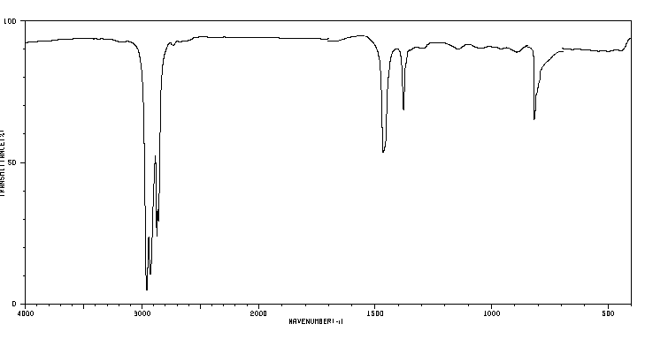
1) What’s my
likely functional
group ?
3000
1370
710
alkane
1470
2)Long or short chain ?
3)Use IR correlation table to assign this band’s motion
Relatively short;
1370 and 1470 are not too different
Methyl group wag

Slide 5
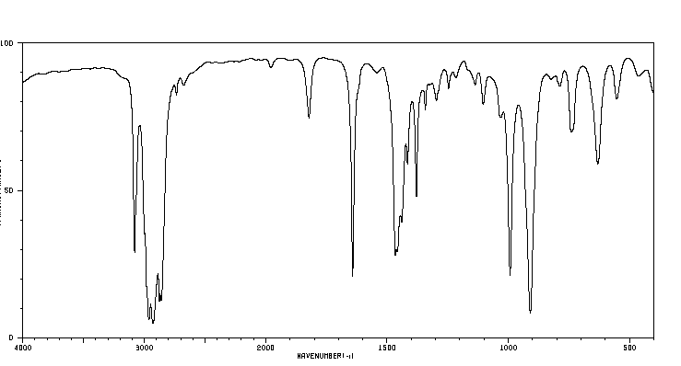
1) What is my main functionality?
aromatic
2) * 4 bands used to
make this assignment
3000
1640
1470
* Ring overtones
*
C=C-H
stretch
*Ring breathing modes
1360
1520
Yes..alkyl group (probably just one)
3) Is ring substituted and if so with what ?

Slide 6
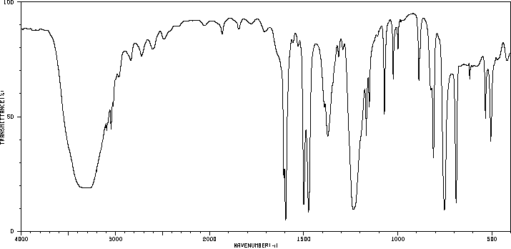
1) Guess my main functionalities
3) Who am I ?
~3400
2) what’s weird here ?
~ 2000-1800
OH
1600
1500
3000
1300
No strong evidence of either CH₂ or CH₃

Slide 7
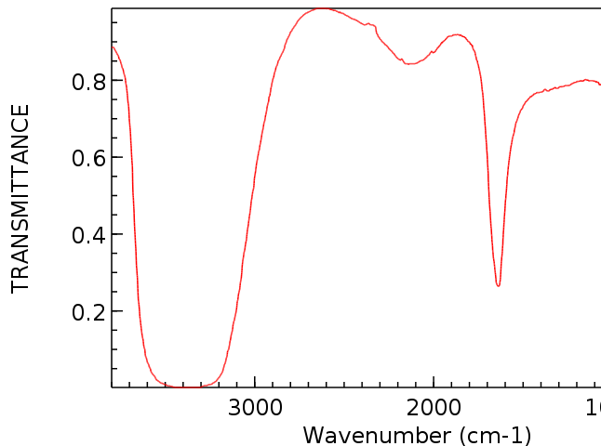
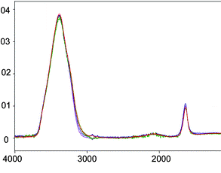
2)`Organic’ ? Why/Why not?
1)What’s different with this IR ?
2)Not..no C-H stretches or bends
3)Guess what the compound is based on what you know
*
*
*
1)Upside down. Plots Absorbance A
not % T: A= 2-log %T
3. H₂O
Strong OH at 3400
3*3-6=3 bands * expected

Slide 8
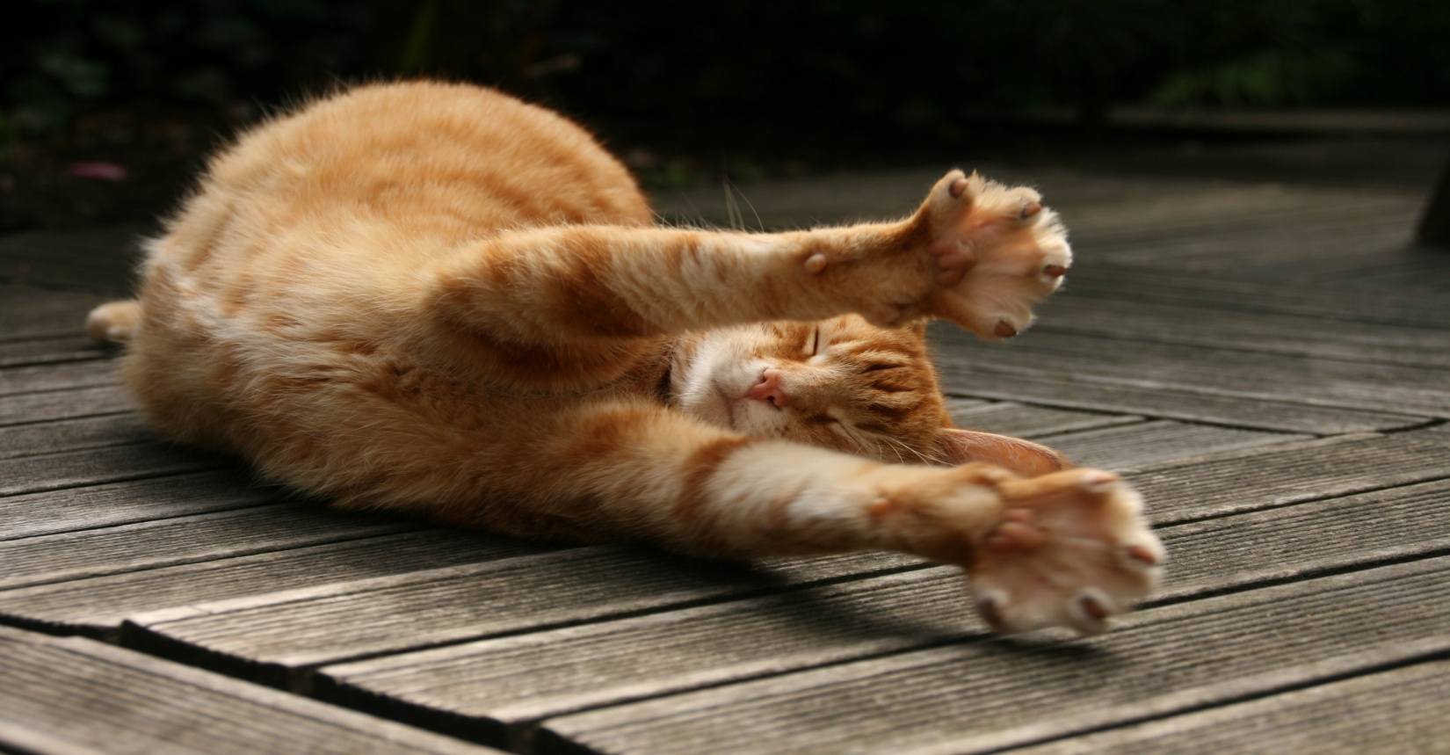
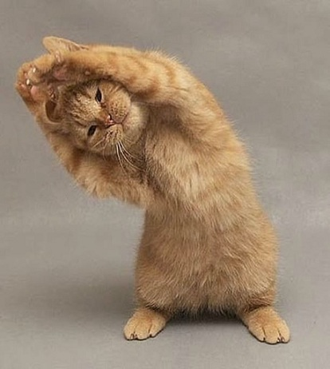
Cat IR
Diagnostic stretching region
Fingerprint bending region

Slide 9

SAY GOODBYE TO IR !

