Slide 1

READY FOR SOME HPLC DRILL AND PRACTICE, KIDS ???

Slide 2
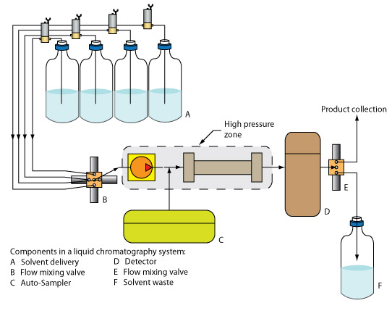
HPLC drill and practice
Where’s the mobile phase ?
Mobile phases
Where’s the injection port ?
Where’s the column ?
Follow the mobile phase &
answer oral questions at each stop
What’s this called ?
Reciprocating HPLC pump
column
What’s this called ?
Quaternary proportionating solenoid valve
(=solenoid flow mixing valve)
Injection port

Slide 3
HPLC drill and practice (cont.)
You can produce SSS in HPLC by:
1)
Varying the solvent mixture composition
2)
Changing the column type
True/False: HPLC can also produce SSS by using a thermal ramp T F
Why is HPLC used mostly for biological samples (sugars, amino acids, fats…) ?
HPLC runs at room temperature and allows recovery of samples
Why are organic compounds detected with UV wavelengths in Alfred’s HPLC?
Organics absorb strongly in UV but not in visible

Slide 4
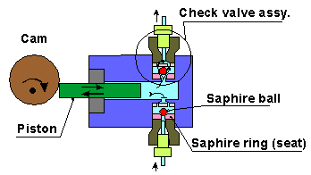
HPLC drill and practice (cont.)
HPLC stands for….
High Performance Liquid Chromatography
What replaces the thermal ramp in HPLC?
Solvent mixing
What moves the mobile phase in HPLC ?
What are these and what are they made of ?
(single piston) Reciprocating pump
Ball check valves Sapphire (Al₂O₃)
Why use sapphire?
Withstands high pressure without cracking

Slide 5
HPLC drill and practice (cont.)
Briefly explain how reciprocating pump works using the diagram below
What does the output pressure vs. time signal look like from this pump ?

Slide 6
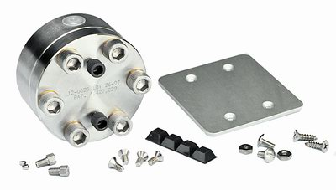
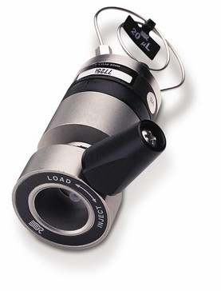
HPLC drill and practice (cont.)
What’s this called and what is it for ?
Pulse damper-it `evens out’ the oscillating pump signal
Turns input Pressure vs time to….
P
Out
In
Gross-sounding effect why ?
Calibrated capillary volume (10-20 μL)
What ‘s my name ?
Pee-in-the pool
effect
HPLC injector port
When I inject samples in `LOAD’ where does the sample go ? (Show me on picture)

Slide 7
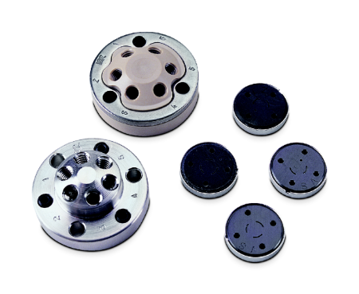
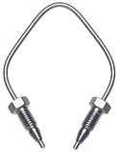
(1) Where are the Teflon Gaskets ?
(2) Where are the mating gaskets leading to column or calibrated loop volumes ?
(1)
(4) What goes in here ?
(2)
(4) Calibrated volume sample loop
(3)
(3) Where are bolt threads/holes used to press gasket system together ?

Slide 8
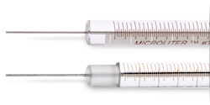
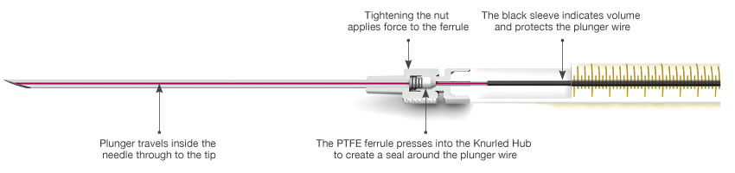
Blunt end
Which syringe type is used in HPLC ?
Why ?
Avoids tearing/scoring Teflon gaskets of injector port

Slide 9
HPLC drill and practice (cont.)
Identify the physical meaning of each dimension/ notation describing the HPLC column listed below
Porosity
Packing size
4.6 mm x 250 mm , C-18, 5 u , 300 Ǻ
ID x Length
chain length bonded to silica packing
A reverse phase column uses what polarity of solvent and separates what polarity of sample ?
Polar mobile solvent / non-polar samples
What does an isocratic HPLC separation mean?
Fixed solvent mixture ratio used during HPLC run
What does an isobaric HPLC separation mean?
Fixed solvent pressure used during HPLC run

Slide 10
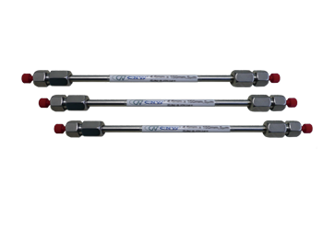
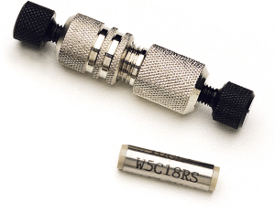
HPLC drill and practice (cont.)
We’re analytical columns …how long are we in inches ??
My special name ?
Guard Column
~10 inches (25 cm)
My special purpose ?
Typical pressures in atmospheres needed to get flow down these packed columns ?
Protects (guards) analytical column from solvent impurities
600-1200 atm

Slide 11
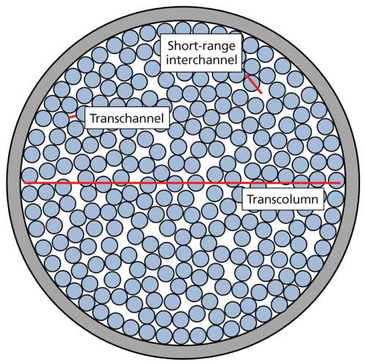
1)What is the packing size (5 μ) referring to here ?
2)What is porosity (500 A=0.05 μ) referring to here ?
2)Average diameter of spacing between support particles
1)Diameter of support

Slide 12
HPLC drill and practice (cont.)
What is the detector in the PE `Nelson’ HPLC at Alfred ?
UV-VIS spectrometer
Is the above detector operated in scanning or fixed wavelength mode ?
Fixed wavelength λ
What is the y axis of the detector measuring ?
Absorbance at fixed λ
Name two other common detectors used in HPLC
Refractive index
Electrochemical
Fluorescence
Conductivity
Mass Spec
(see p. 823 of text)

Slide 13

Yeah baby !
That’s all there is.
(Not.)

