Slide 1

A lightening fast survey of various glass technology bits and pieces

Slide 2
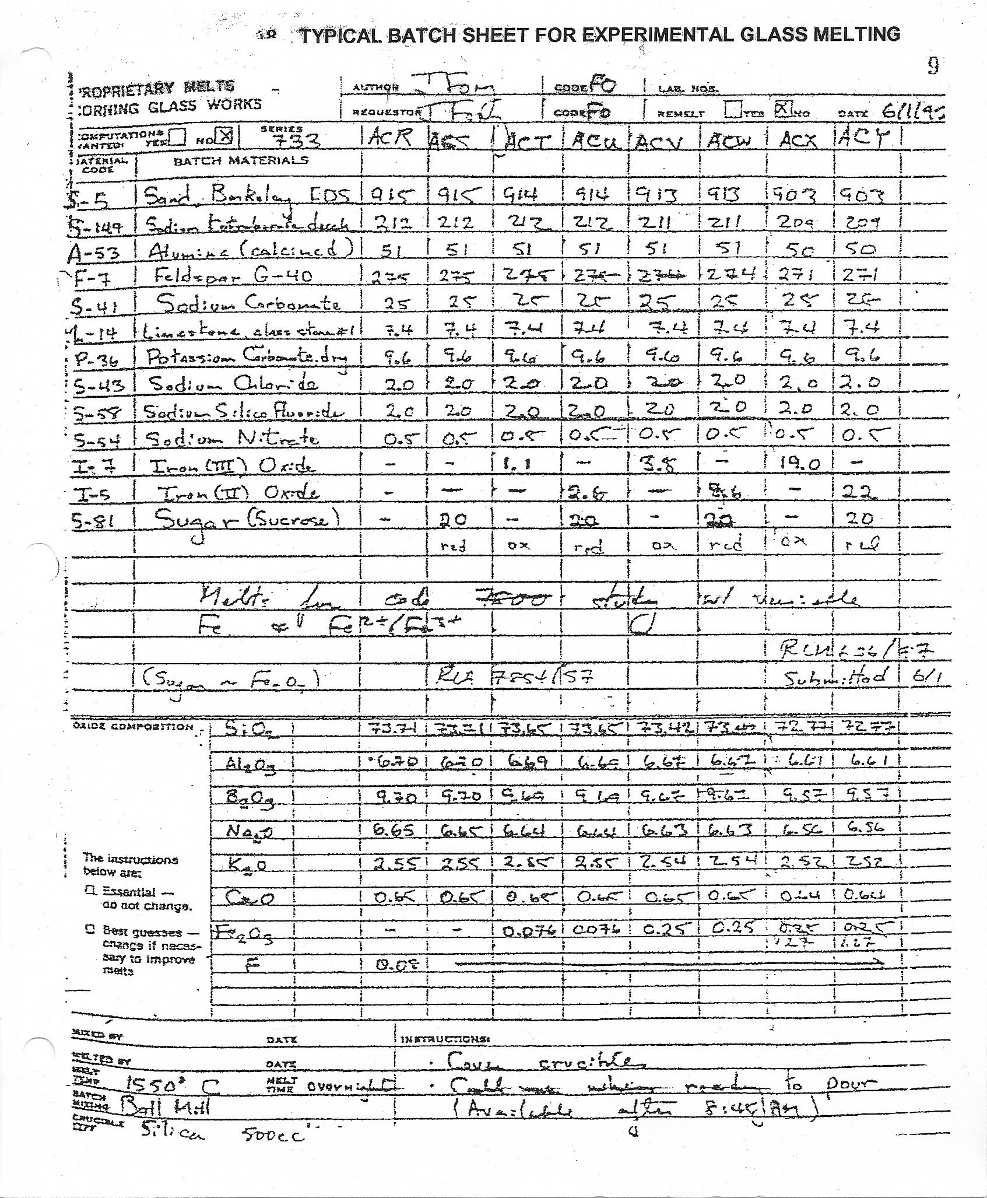
Typical Corning Glass Batch Sheet for Experimental Glass Melt: The heart of the original glass business

Slide 3
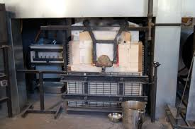
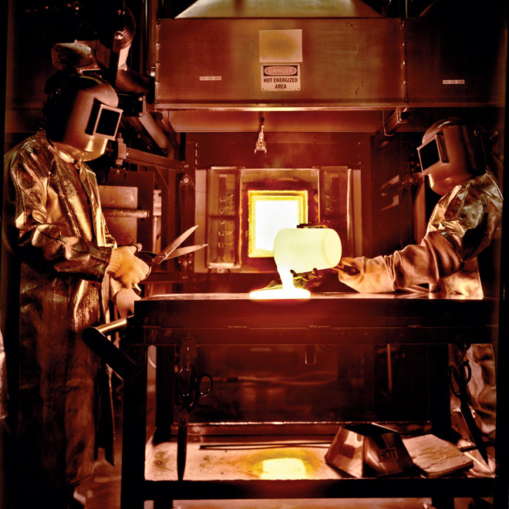
9 (nine) Crucible gas fired melt furnace, Sullivan Park Labs CGW
Melting Technology Technicians quenching a melt

Slide 4
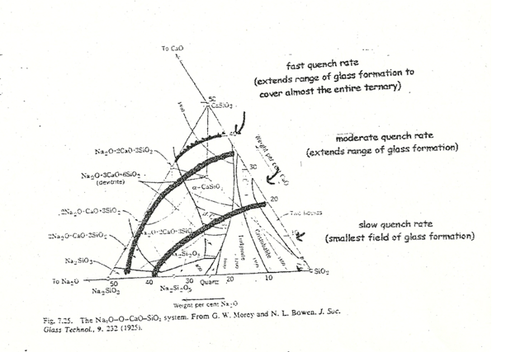
Glass Composition Phase Diagram
Underlying crystalline habits that characterize the various glass formation regions vs. quench rate
fast quench rate
(largest field of glass formed)
modest quench rate
(medium field of glass formed)
Slow quench rate
(smallest field of glass formed)

Slide 5
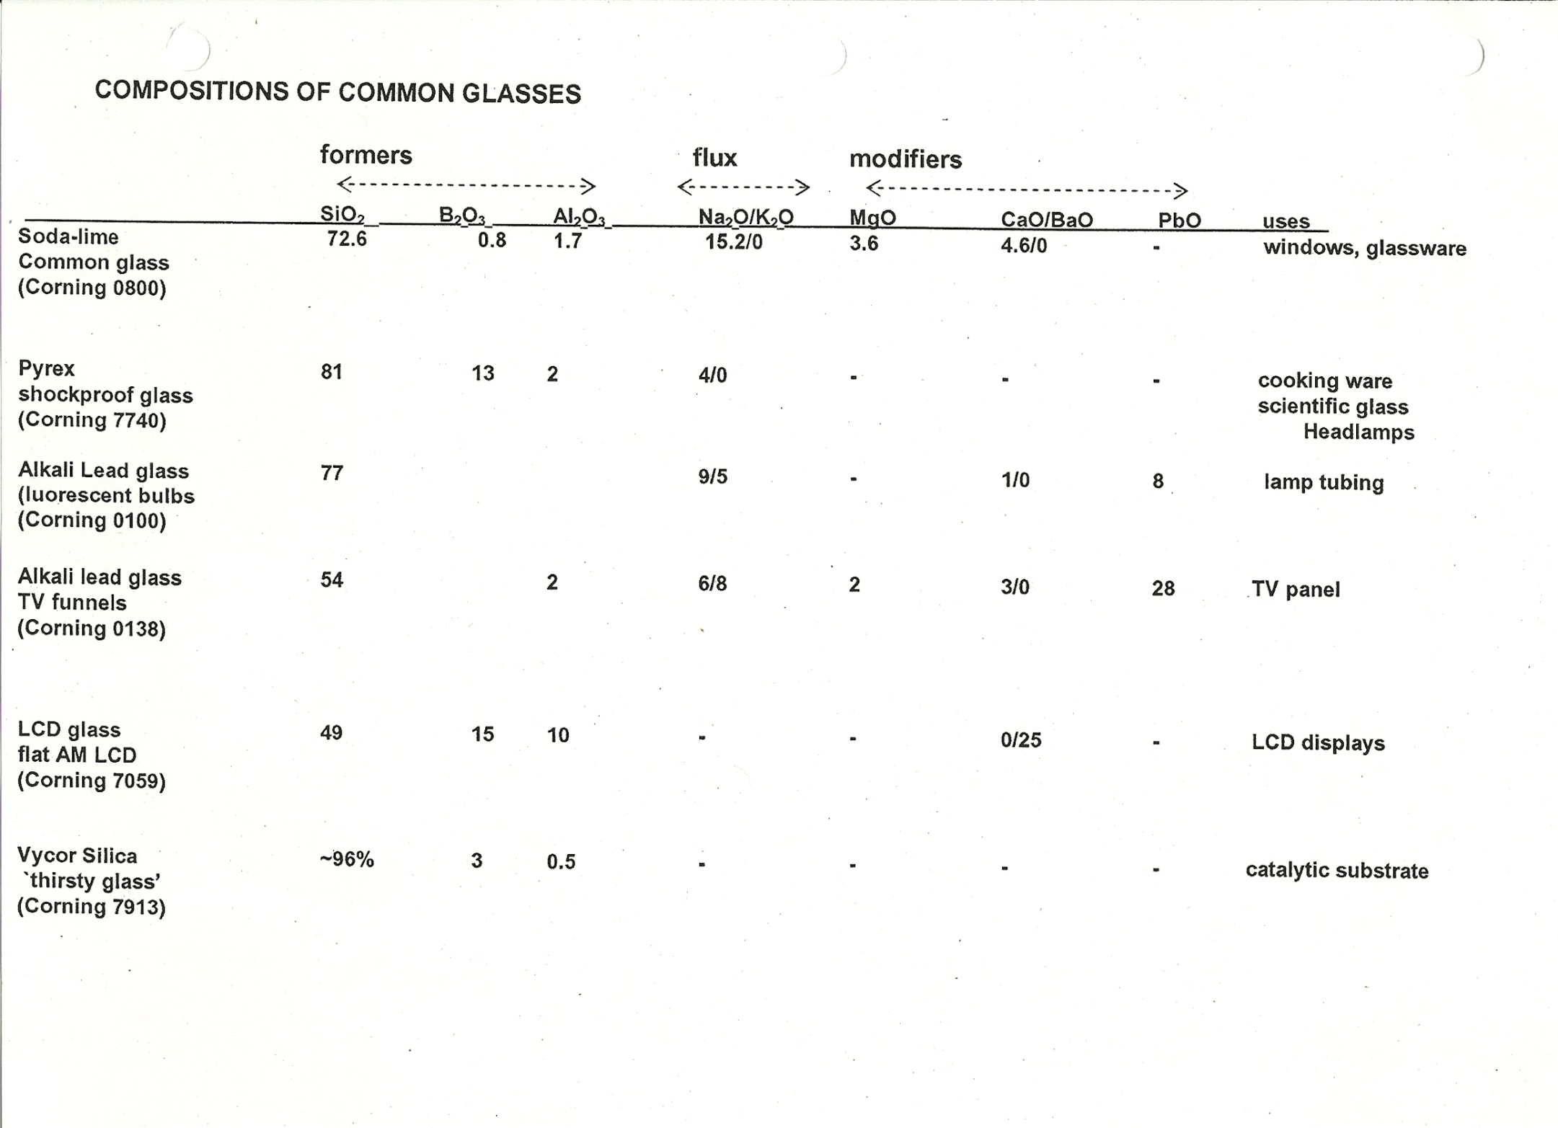
Taken from CGW Survey Manual of CGW product glass (D. Thompson, 1985)

Slide 6
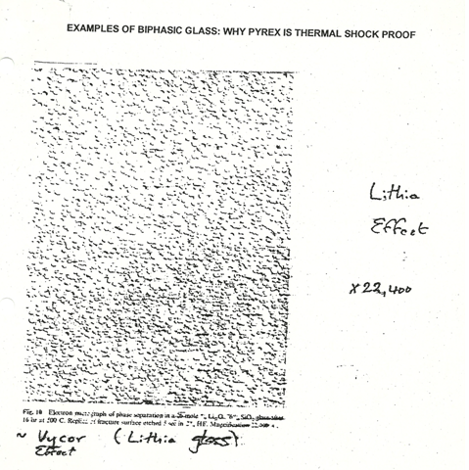
Examples of bi-phasic glass; example 1:Vycor
Effect of soft lithia glass in silica matrix after HF etch
X22,400 (SEM)
Called “Sticky glass”
…can embed/bind chemicals to surface

Slide 7
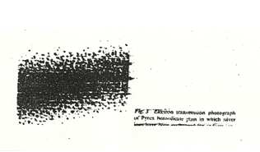
Examples of bi-phasic glass; example 2
Pyrex (>50,000X)
(silver ions have been `intercalated’ into structure
to reveal biphasic character)
Pyrex is a combination of `softer’ glass (so it flows under flame )and a much harder glass (so it resists chemical and physical change)

Slide 8
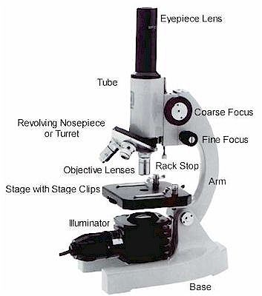
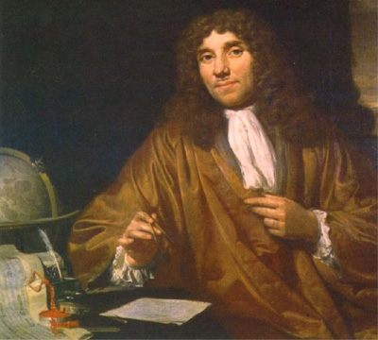
Scanning Electron Microscopy (SEM)
Optical Microscopy
λ(obs) ~ 500 nm ~minimum object size
1000X practical maximum magnification
A. Leeuwenhoek 1632-1723

Slide 9
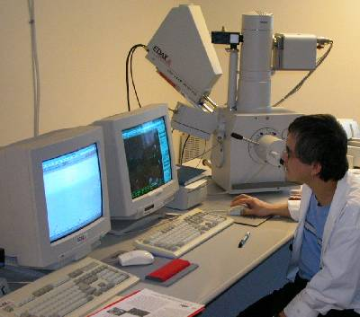
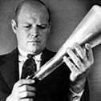
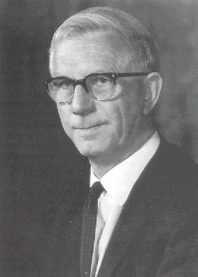
Electron microscopy: a breakthrough microscopy
=h/p (De Broglie equation) ~ 0.002 nm for 300 keV beam (minimum theoretical limit)
Practically=>Can see 0.1-1 nm objects
higher beam energy, lower λ
40-100,000 X magnifications
Manfred v. Ardenne 1907-1997
invents in 1937
Charles Oakley
1904-1996
develops in 1947

Slide 10
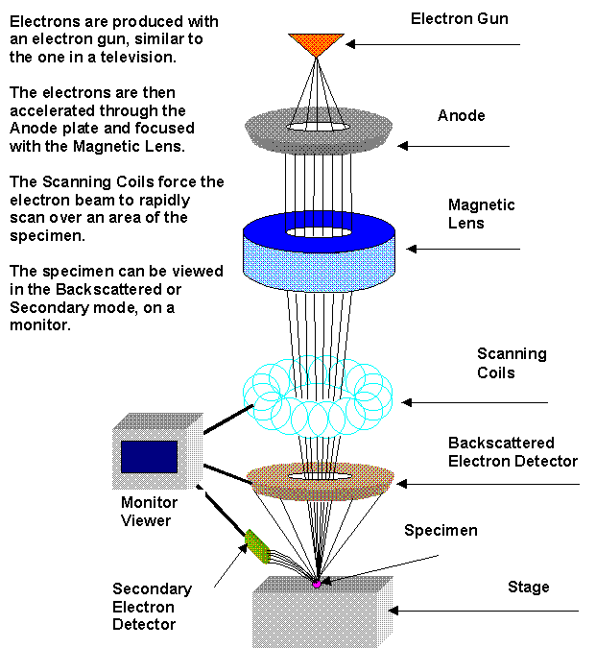
BASICS of SEM technique
1-10 keV
Main imaging methods
Secondary electrons (SE)
Backscattered electrons (BSE)
Main analytical method
XRED = EDX (same)
(X-Ray Energy Dispersion or Energy Dispersive analysis of X-rays
Beam spot typically 0.2 nm)

Slide 11
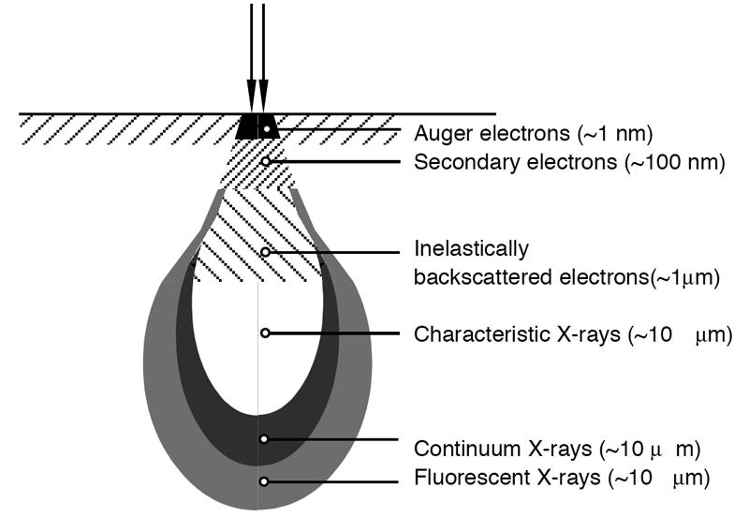
Some Geeky Details Of SEM
Electron beam produces a characteristic tear-drop shaped hole in material, which vomits electrons and x-rays
Auger (pronounced OJay)=surface state electrons
Inelastic BSE =impacting electrons re-scattered (sensitive to atomic masses producing scattering)
SE = electrons re-emitted by absorbing materials (provides great depth of field & primary image)
Characteristic x-rays= energy spacings of elements (used for XRED=EDX)
0.2-2 nm spot
5-100 um

Slide 12
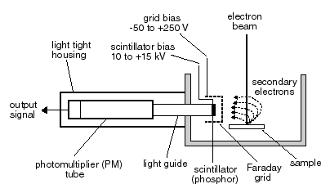
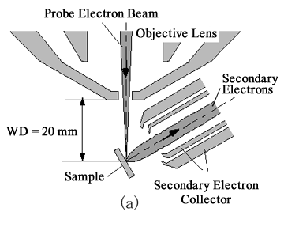
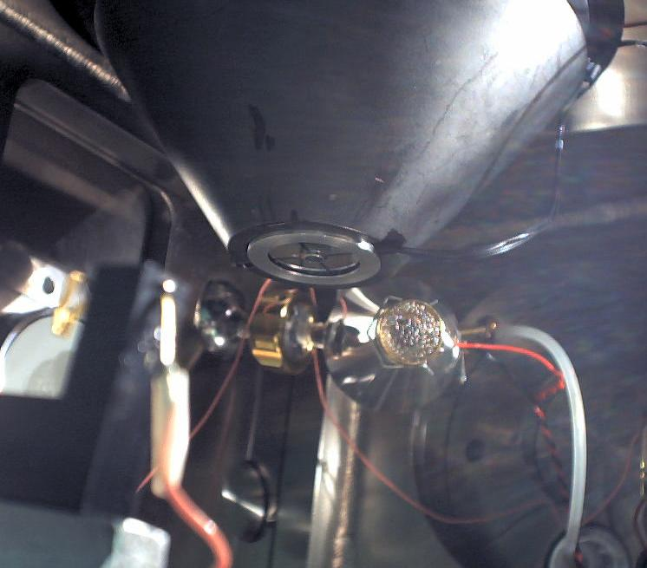
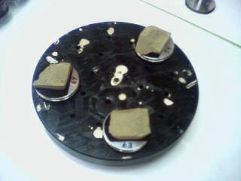
More geeky details of SEM:SE detection

Slide 13
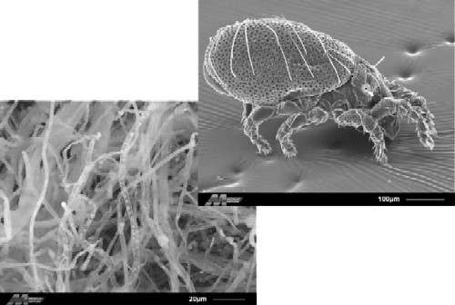
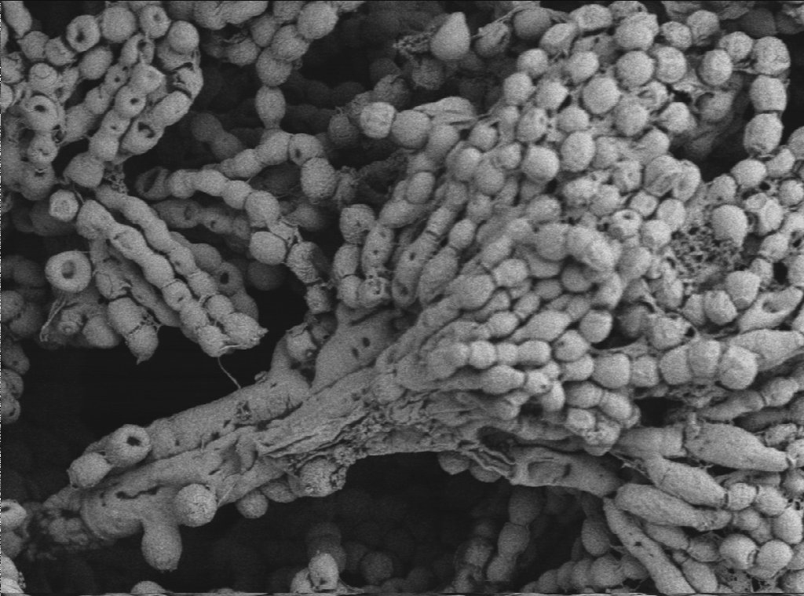
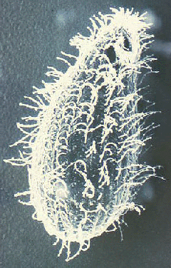
Typical `SE’ images
Cheese at 1500X
Spider mite
Hair on spider mite’s leg
Ballatidium coli (stomach protozoan) at ~5000X

Slide 14
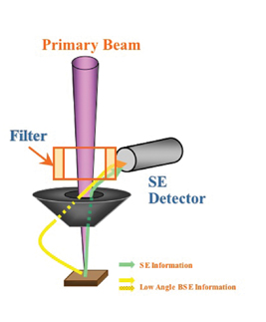
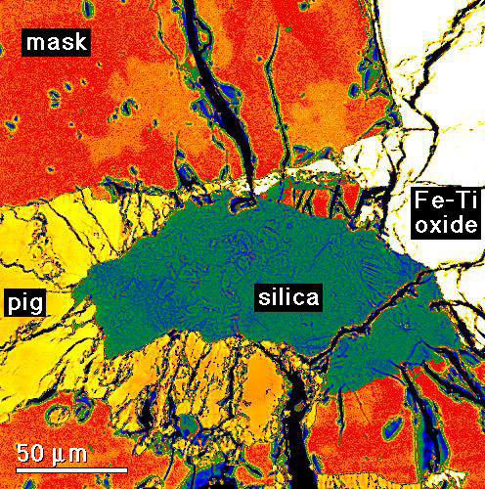
Yet more geeky details: BSE & EDX
BSE=backscattered electrons
BSE provides map of element and compound distributions
(but poor depth of field)
BSE electrons
Magnetic doughnut used to gather BSE and direct into SE (Everhart-Thornley) detector

Slide 15
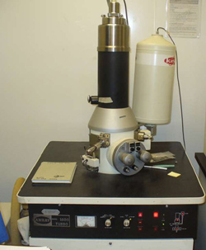
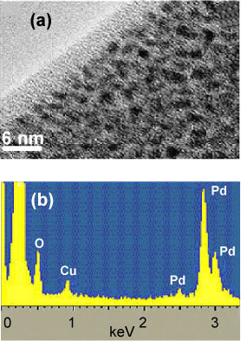
Elemental analysis EDX
Basic SEM
XRED (x-ray energy dispersion unit)…an add-on unit
Sampling Limitation
Sample volume and area depend on beam
Top not like insides ?
SEM and accompanying XRED spectrum of scanned region

Slide 16
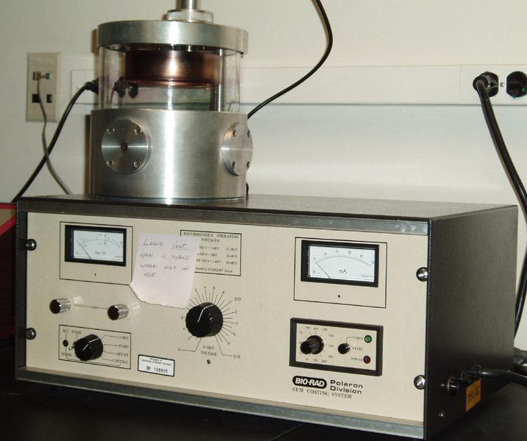
The last few details on SEM
Metals and other conductors can be observed without preparation
Non-conductors (glasses, ceramics, biological and organic samples) need to be coated with a conductive thin layer or the beam will cause local `melt’ down at beam focus and sample will glow
Au or C
Coated sample
Initially uncoated sample
+ -
Filament power
Evacuated chamber
Schematic of an SEM coater

Slide 17
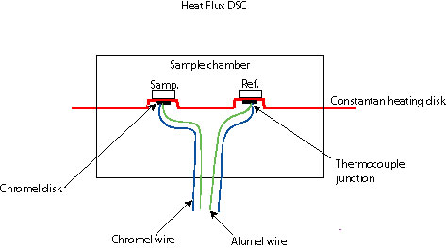
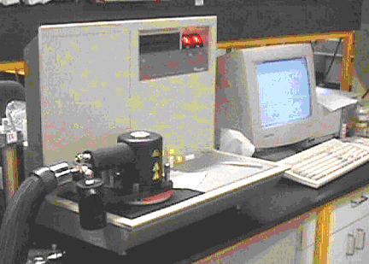
DSC (Differential Scanning Calorimetry)*
DSC if heat difference measured;
DTA (differential temperature analysis if temperature difference measured)
Schematic of basic DSC/DTA
Heated strip
(can go to 1800 C)
Power supply/interface
Thermocouple pair (measures T difference)
measures exo or endothermic (sample-reference) response vs input energy (or temperature) of strip

Slide 18
Glass transition (T_{g}) and crystallization (T_{c}) (=devitrification)
Disordered glass
T_{g} T_{c}
Q(cal)
T→
T_{g}
Glass melt is quenched faster than structure can reorganize into crystallographically ordered arrays=> quenched glass has no thermodynamic definition…glass is not a liquid (which is defined)
Disorder is a function of quench rate
Supercooled liquid is semi-ordered and thermodynamically defined
It takes energy to `reorganize’ chaos into supercooled order=> why T_{g} is endo proces
‘supercooled liquid structure’
T_{c}
Ordered crystal structure

Slide 19
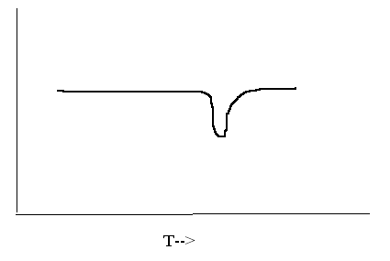
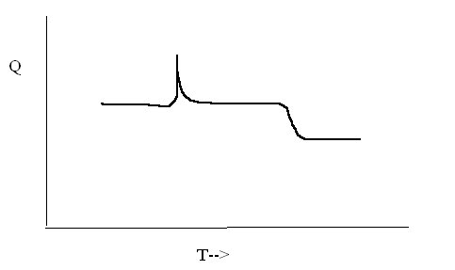
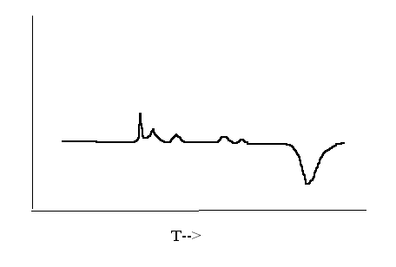
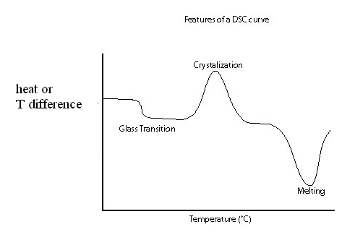
Kinds of thermograms
Crystal-crystal transition followed by melting (tridymite silica->cristobalite silica)
Single phase, melting
(e.g. cubic NaCl)
Melting
Phase change (exo)
mp (endo)
Simple glass thermogram
(e.g. glassy silica->cristobalite)
Release of hydration water (e.g CuSO₄*5H₂O)
melting
Dehydration (exo)

Slide 20
Some useful facts to help sort out DSC curves
1) Typical melting points for selected materials
MATERIAL MELTING POINT, ^{O} C
Silica (glass or crystal) ~1800
Pyrex glass 1250
Soda lime glass 1000-1050
Most inorganic salts 600-900
(NaCl, CaCl₂, KCl)
Plastics <400

Slide 21
More useful facts to help sort out DSC curves
2) Glass transition temperatures (T_{g}) for selected glassy materials
Glass T_{g} ^{O} C
Silica (glass) ~1200
Pyrex glass 550
Soda-lime glass (crap) 500- 550
Plastics < 100

Slide 22
And yet more useful facts to sort out DSC curves
1) Waters of hydration make multiple sharp, (weak) exothermic peaks
2) crystal-crystal transitions (T_{cc}) make pretty sharp, (strong) exothermic peaks
3) glass-crystal transitions (T_{gc}) make broad, (strong) exothermic peaks
4) For a glass, T_{g} < T_{gc} < T_{cc}

Slide 23
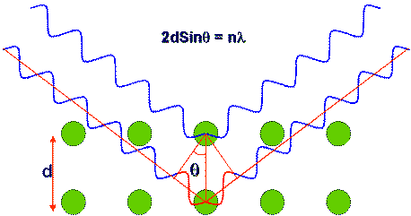
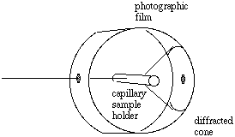
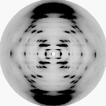
XRD (X-ray Diffraction)
Basic `X-ray powder diffraction’ camera (Debye-Scherrer design)
Bragg’s Law: 2*d*sinθ=λ
X-rays in
Diffracted X-rays
X-rays in
The key point….
Diffraction pattern of DNA
Taken by Rosalind Franklin
Given fixed λ & a measure of the angle θ, you can determine atomic spacing d

Slide 24
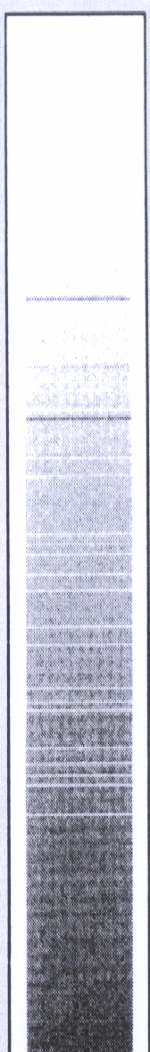
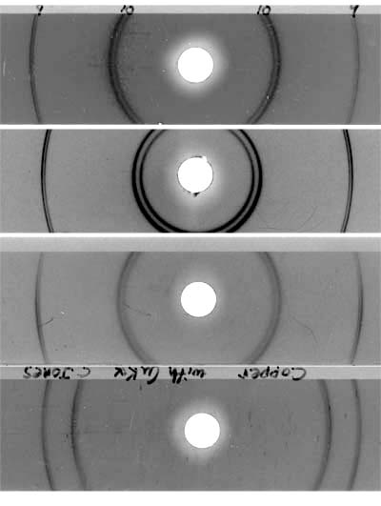
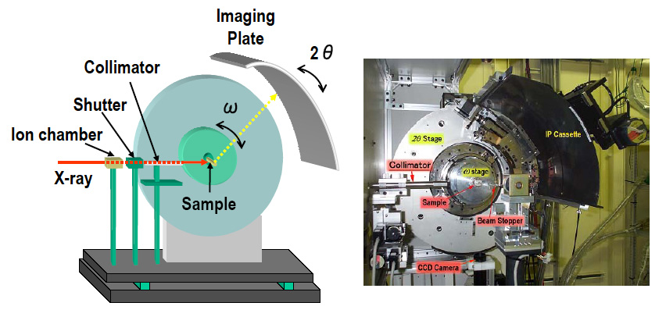
Details of Debye-Scherrer XRD diffraction camera
rings
or
lines

Slide 25
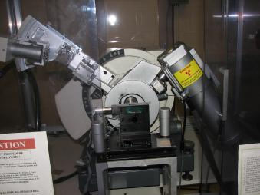
Typical powder x-ray diffractometer instrument
Powdered sample mounted (and turned) in here
X-ray source
(Cu-Kα 1.54 A=0.15 nm)
Detector camera in here

Slide 26
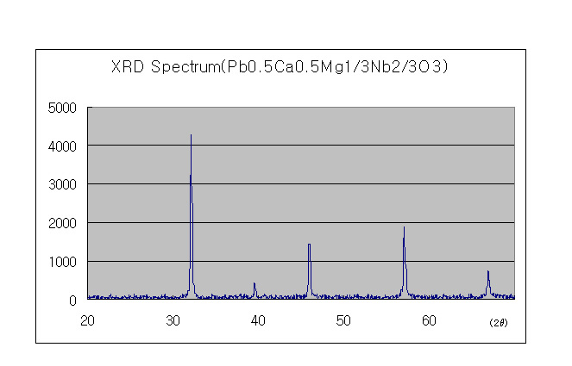
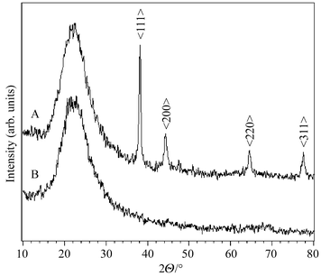
Examples of XRD spectra
Pure crystalline substance
Partially `devitrified’ glass*
Only lines…all crystal
Halo + lines= glass + crystal (devitrified glass)
Glass only (`glass halo’)
Halo only= all glass

Slide 27

We is done with the glass sh*t
(almost…)

