Slide 1

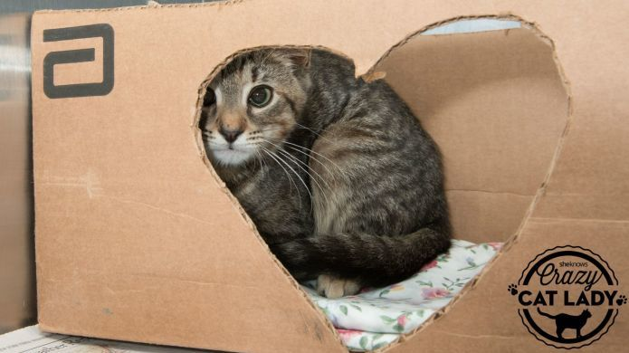
No hiding from this, kids…

Slide 2
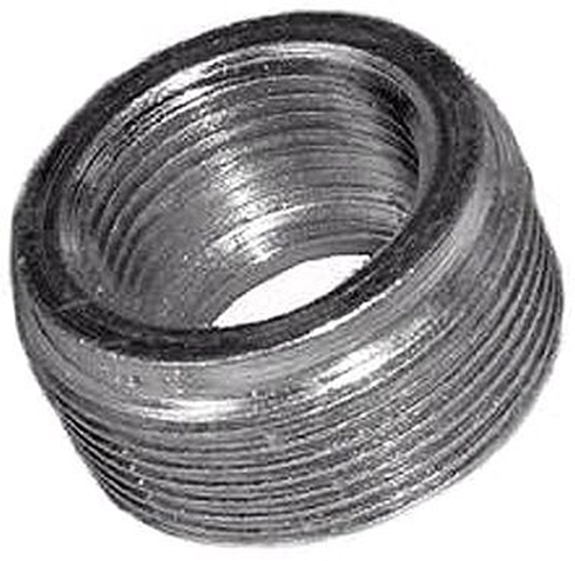
GC Jeopardy….
What is the mobile phase in GC (at least in the USA) ?
He gas
What kind of `fitment’ is immediately connected to the carrier gas tank? (an acronym is ok)
NPT (National Pipe Thread)
What kind of plumbing fitment is typically used to connect a GC ?
Swagelok fittings
ID the plumbing types here
Swagelok
NPT

Slide 3
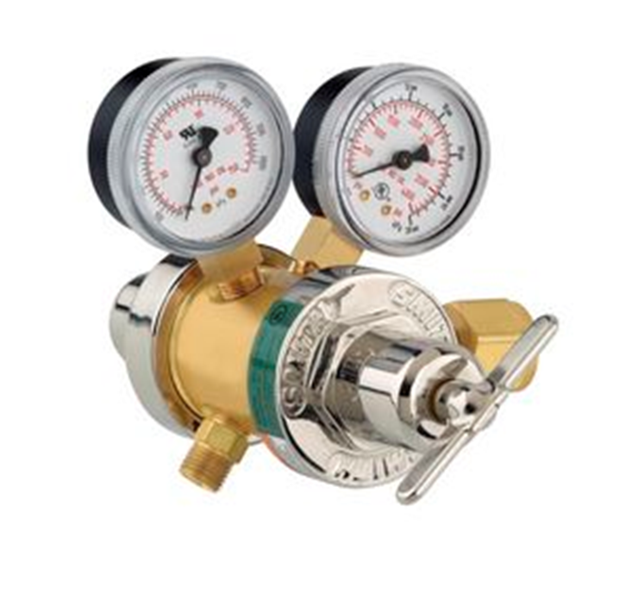
GC Jeopardy…(continued):
To tank
Which end of the two stage valve is connected to the tank ?
Which end of the two stage valve is connected to the GC instrument ?
Which gauge is the secondary gauge ?
Typical pressure on secondary gauge ? (in psi)
To GC
25-60 psi

Slide 4
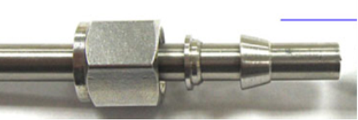
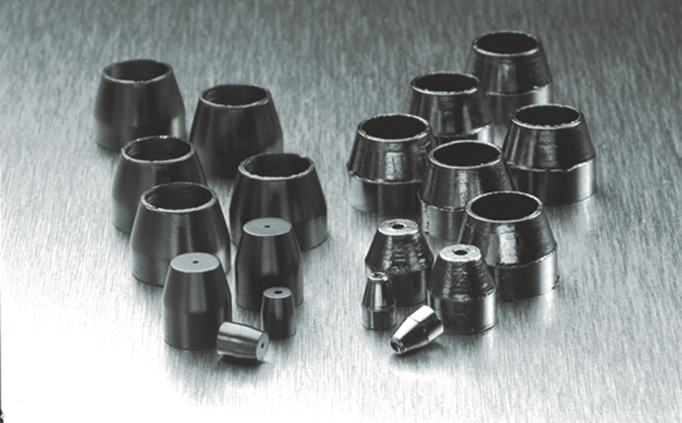
GC Jeopardy…(continued):
ID the pieces of the Swagelok
nut
ferrule
back cap
What are we called, what are we (typically) made of
(carbon) ferrules
What is our purpose ?
Making gas tight connection to capillary glass columns

Slide 5

GC Jeopardy…(continued):
What am I called and what do I do ?
What replaces me in a modern GC ?
Mass flow controller
Term used to define the ratio of sample discarded to sample placed into column.
Split ratio
Where in the instrument is the split ratio usually adjusted ?
Bubble-ometer (soap bubble flow meter)- used to measure carrier gas flow rate (with stopwatch)
Just after inlet

Slide 6
GC Jeopardy…(continued):
Typical dimensions of packed column ?
Column type ?
Column type ?
1/8 - 1/4” dia; 1-3 m long
(30-60 mm dia)
Typical support in packed column ?
diatomaceous earth or silica powder
Typical dimensions of capillary column ?
0.2-0.3 mm dia; 10-30 m long
Capillary (Open)
Typical support in open column ?
Packed
glass

Slide 7
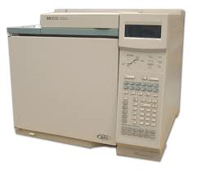
GC Jeopardy…(continued):
GC oven
What’s behind this door ?
Why do we need a thermal ramp ?
Improves separation and shape of chromatogram (SSS)
What is this curve called and who makes it ?
140 ºC
Thermal ramp made by GC oven
40 ºC

Slide 8
GC Jeopardy…(continued):
A thermal ramp helps produce SSS. What do these letters stand for?
SSS (Sharp, Separated, Symmetric chromatographic peaks)
Mobile
He gas is the __________________________ phase
Where is the stationary phase in a packed column ?
Coated on the support
Where is the stationary phase in a capillary column ?
Coated on the inside wall of the capillary.
Which phase is most critical to produce SSS ?
Stationary

Slide 9
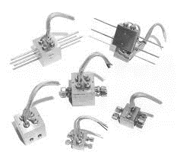
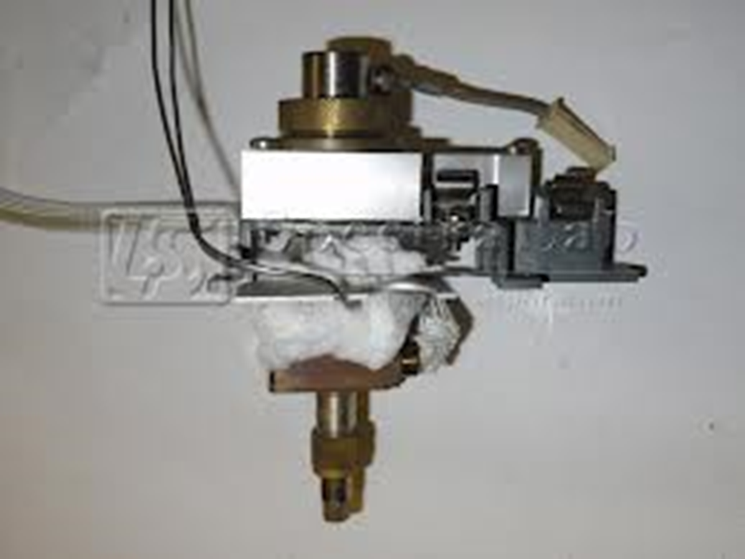
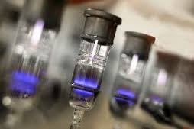
GC Jeopardy…(continued): Name that detector
TCD (Thermocouple Detector)
FID (Flame Ionization Detector)
PID (Photoionization Detector)

Slide 10
GC Jeopardy…(continued): Explain that detector
TCD measures…
FID measures…
PID measures…
Sample vs. reference TC resistance ∝ T across Wheatstone bridge
Ion current created by burning sample with H₂ + O₂ flame
Ion current created by ionizing sample with UV light

Slide 11
GC Jeopardy…(continued):
Which GC detector requires a license from the Atomic Energy Commission?
Electron capture detector (ECD)
Which GC detector is able to measure any and all sample types ?
Thermocouple detector (TCD)
Name two detectors particularly capable of analyzing for herbicides and pesticides
ECD and MS (also PID if aromatic)
What’s burned in an FID ?
H₂ + O₂
What signal is recorded as the chromatogram in an FID?
Current across flame (containing ions of sample)

Slide 12
In- lab Q and A about the kids….

Slide 13
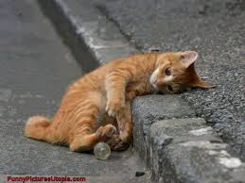
GC equipment is exhausting

