Slide 1
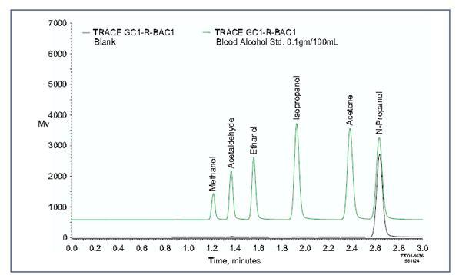
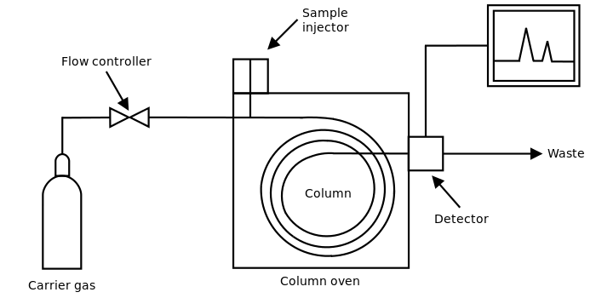
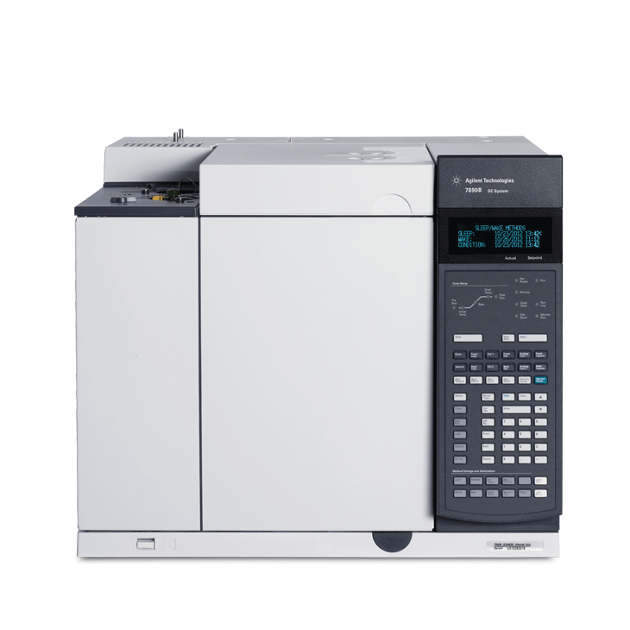
Gas Chromatography (GC)

Slide 2
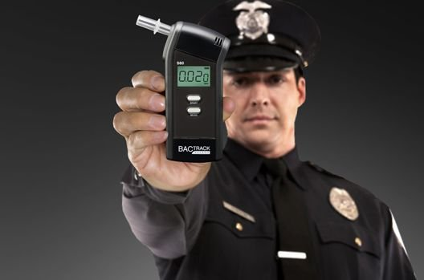

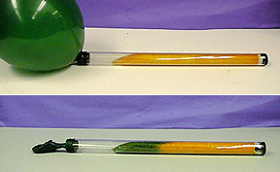
Alcohol
Breathalyzer
GC `apps’
in the real
world
Honestly, officer, I ain’t drunknk
Replaces old school
`balloon test’ for alcohol

Slide 3
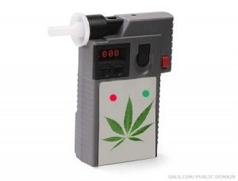
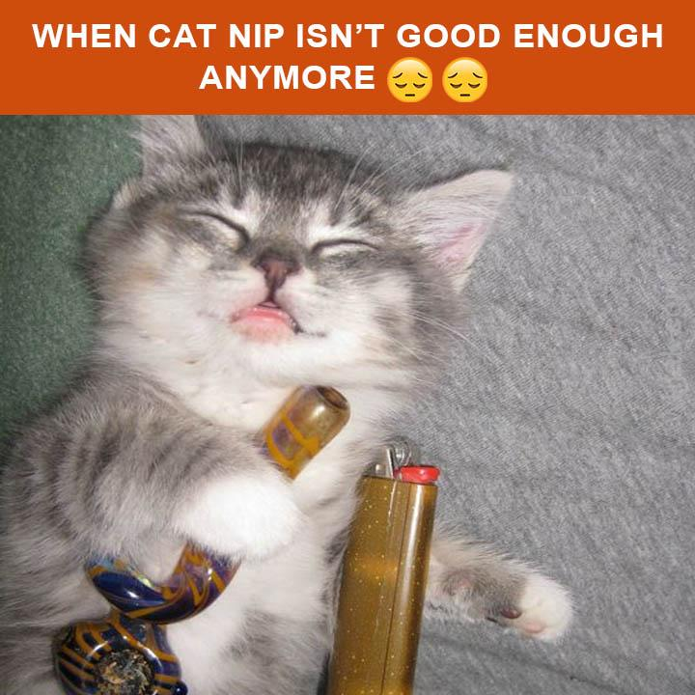
…what is this portable GC detector looking for ???
Portable Cannabis (THC) GC detector

Slide 4
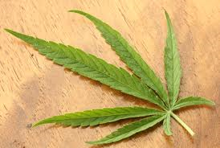
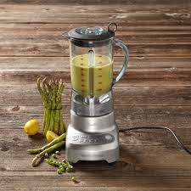
The ORIGINS OF GAS “CHROMATOGRAPHY”
What chemicals are in…..???
??????

Slide 5

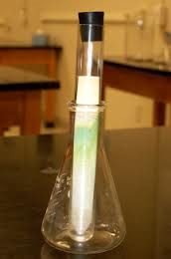
First, easiest approach:
Paper chromatography...separates bands
(but hard to collect sample components)
Chroma= color

Slide 6
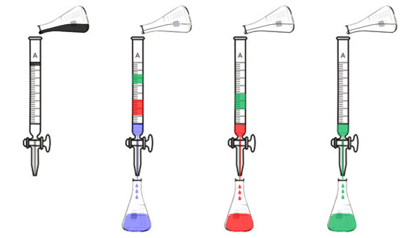
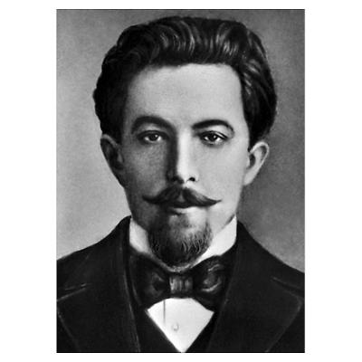
The ORIGINS OF GAS “CHROMATOGRAPHY”: packed column separations
Plant extract in ether/hexane mix
Here, the ether/hexane mix is the `mobile phase’
“I did this first ! Da! Da !”
Packed column
(originally packed with Confectioners sugar=
`stationary phase’)
Transducer= eyeball
Russian Botanist Mikhail Tswett (1872-1919)

Slide 7
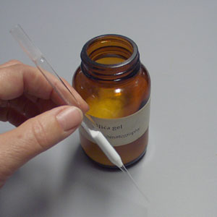
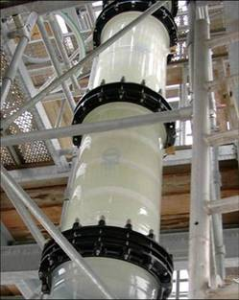
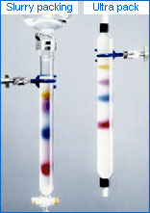
Packed glass columns can come in all kinds of sizes

Slide 8
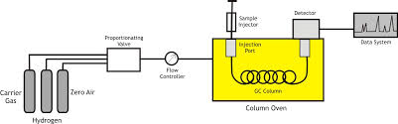
Schematic of Typical Modern Gas“Chromatograph” (GC)
Split flow : discard most (typical split 20:1→ 100:1)
Measure output at selected transducer vs. background He
Sample injection
Detector
Step down P from 1600→50 psi
Level flow to fixed rate
Proportionating valve
Data system and instrument control
Flow controller
GC column
Column oven
(thermal ramp)
Primary Helium
T
t(min)

Slide 9
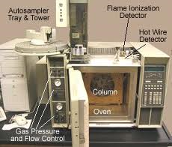
HP 5890A GC with FID detector
We use single port injector, not auto samplers
In HP 6890N GC
(ASC): computer controls all flow and pressure via “Chemstation”

Slide 10
Main Components of a ’GC’
Plumbing to handle gases
Column (heart of GC => separation)
Oven (makes thermal ramp to produce SSS =Sharp, Symmetric, Separated peaks)
Detectors (to see components once they are separated)

Slide 11
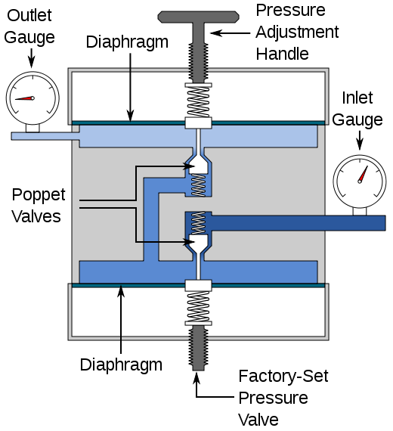
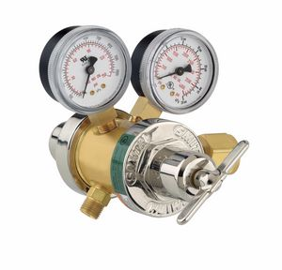
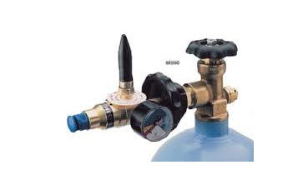
Plumbing
Controlling the carrier flow part 1:
Tank Valves
secondary tank Valve
secondary
primary
weaker spring
Compensating springs
Very strong spring
Primary tank
Valve controls here

Slide 12

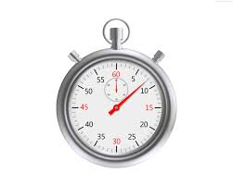
Controlling the carrier flow part 2
old school: flow meters
10 mL
mark
A soap bubble flow meter (bubble-ometer)
Compute flow:
10 mL/8 seconds= 1.25 mL/s
=75 mL/min
Soap solution in here
He flow from test port of GC

Slide 13
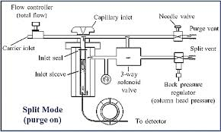
Controlling the flow part 2: split-splitless inlet system- Modern way to control sample volume
and carrier flow
Most of He flow diverted to reduce flow into capillary

Slide 14
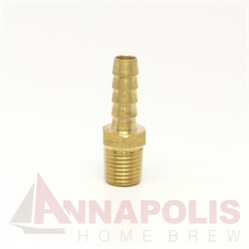
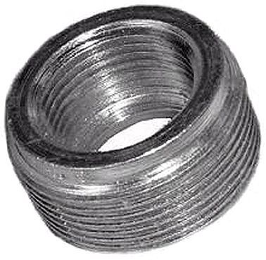
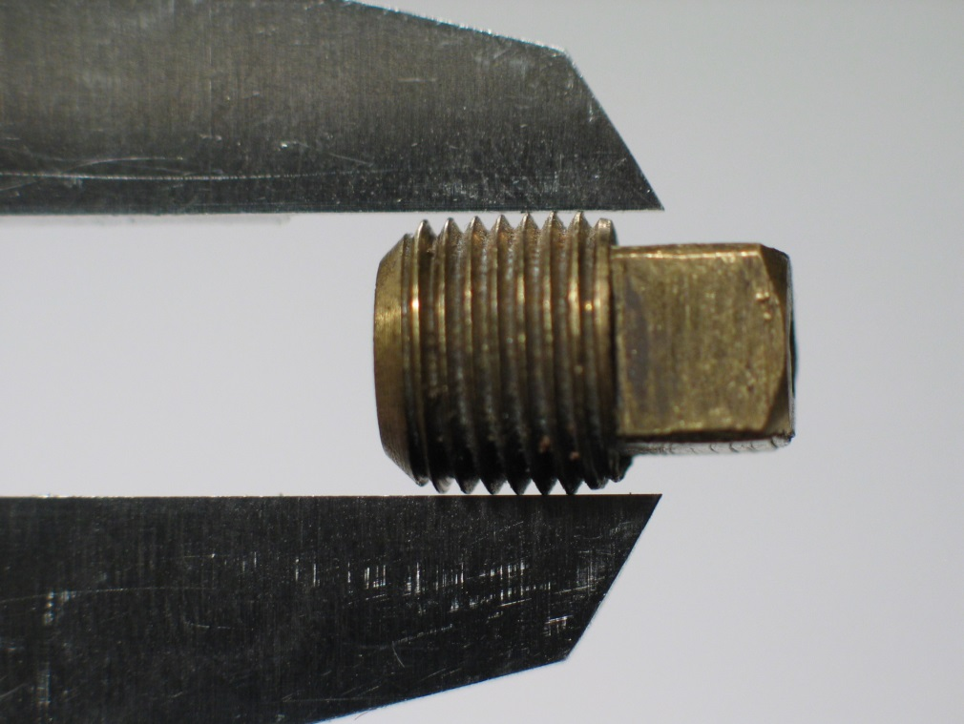
Plumbing part 3: Hooking things up
National Pipe Thread (NPT) fittings… tank fitments

Slide 15
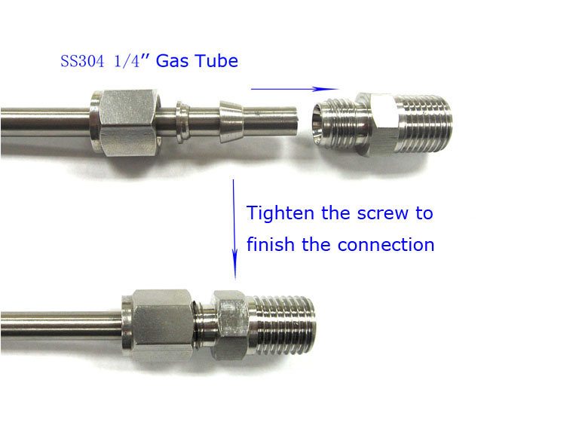
Plumbing part 3 –hookups :Swagelok fittings
ferrule
Nut
Swagelok-NPT adapter
Back cap
FYI..ASC GC, MS and HPLC plumbing is all 3/16” OD…and use 7/16” nut wrench

Slide 16
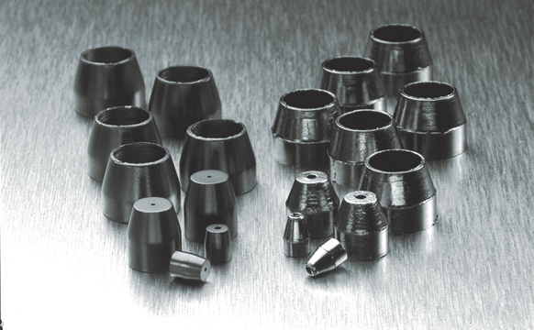
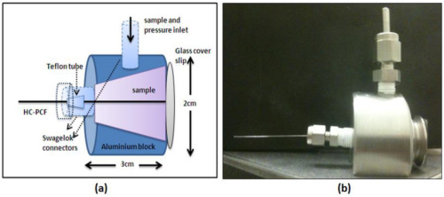
Plumbing part 3-hookups : Ferrules
Ferrules for capillary columns are made of carbon (lower crush pressure)

Slide 17
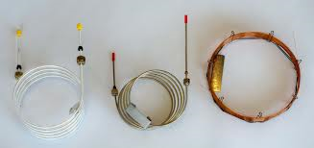
Columns-heart of a GC: There are 3 species
Packed, Glass
Packed, metal
Open, capillary (glass)
Packed: typically 0.3-2 m long,
3/16-1/4” OD, stationary phase on support (usually diatomaceous earth
Open, 30-100 m long
0.25 mm ID, stationary phase on inside (0.2-0.3 um)

Slide 18
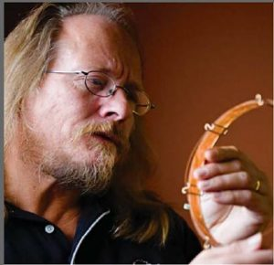
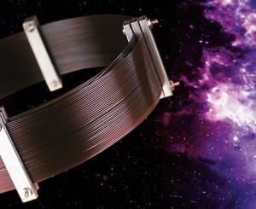
Jaap de Zeeuw, a Dutch chromatographer with Restak (commercial column manufacturer), holds the Guinness Record for longest capillary column in the world (1.3 km)

Slide 19
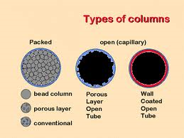
Columns (continued)
Most common
`FSWC’ type most common
(Fused Silica Wall Coated
Important acronym: MAOT = Maximum Operating Temperature (Typically < 400 ºC)…
Beyond that, the stationary active phase delaminates or cooks off . (You see this in MS…as siloxanes)

Slide 20
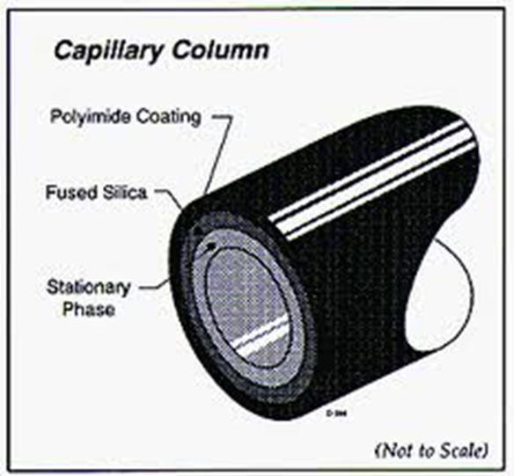
Column dimensions
and MAOT written on
column tag or box
(Most stored on computer so that flow and pressures can be computed)
(outside)
(inside)
0.25 mm
0.35-0.37 mm
0.00025 mm

Slide 21
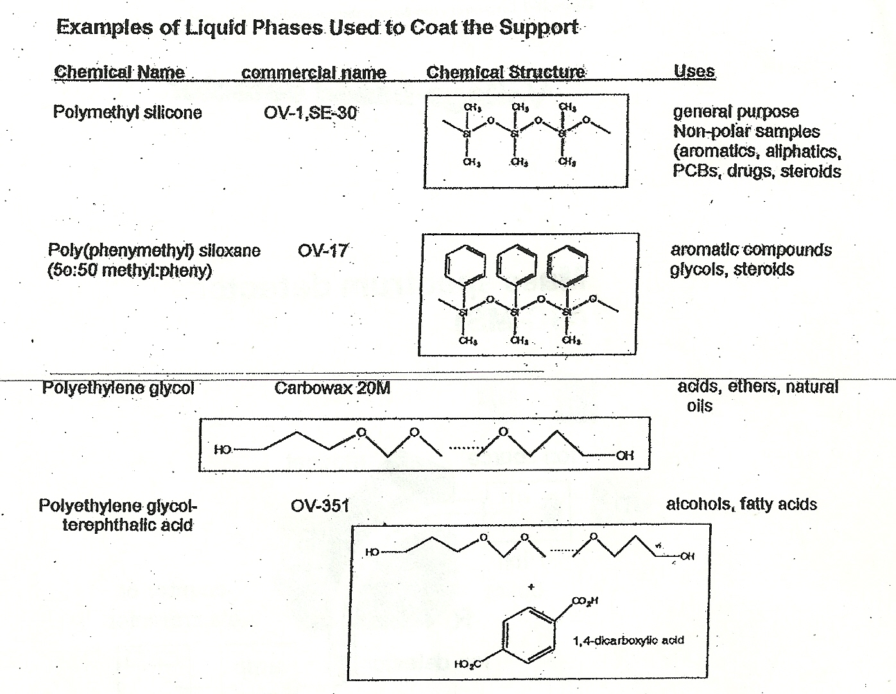
Columns (continued)
`support’ = inner silica wall
The liquid phase is the stationary phase. Physically `painted’ onto the silica (wall coated):Typical thickness are 0.25 μm

Slide 22
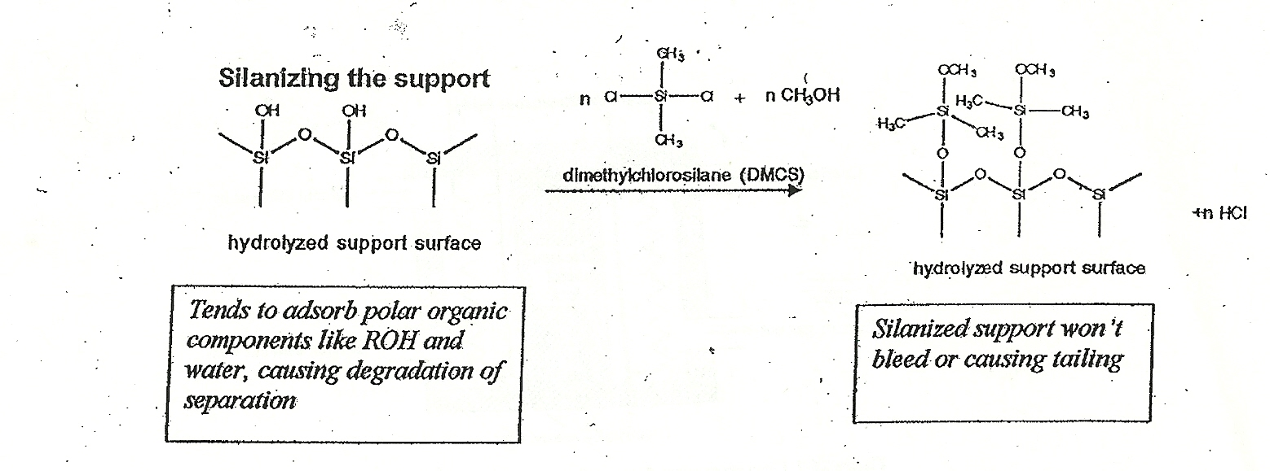
Columns (continued)
Silica wall is often treated with silanizing agent to prevent sample sticking to it (a big problem early on with FSWC columns)
The silanized support is post-coated with the stationary phase and an initial thermal conditioning is applied to new columns to allow stationary phase and silanizing agent to bond/fuse

Slide 23
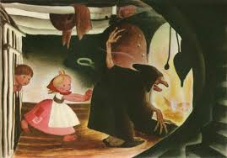
The GC Oven
The GC oven is used to create thermal ramps

Slide 24
What’s a Thermal Ramp and why do we need it ?
I(pA)
Sample mix injected at fixed temperature T=70 ºC (isothermal)
Injected here
time
I(pA)
Sample mix injected with thermal ramp applied (40 ºC→ 140 ºC over 10 min =>
ramp=10 ºC/min)
10’
time
140 ºC
40 ºC

Slide 25
Thermal ramps help us achieve SSS
GC peaks are:
Sharp
Symmetric
Separated

Slide 26
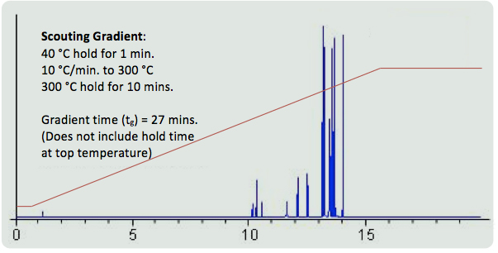
A typical `real life’ thermal ramp and resultant chromatogram
Held to bake/purge column
Held at low T initially to stabilize column and lets lighter species get a head start

Slide 27
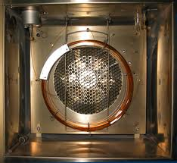
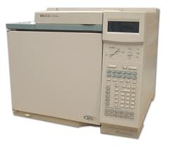
GC Oven…what it really looks like
HP 6890 GC with single inject port
What’s behind the white door…
A large thermally stable volume
GC Oven and Fan

Slide 28

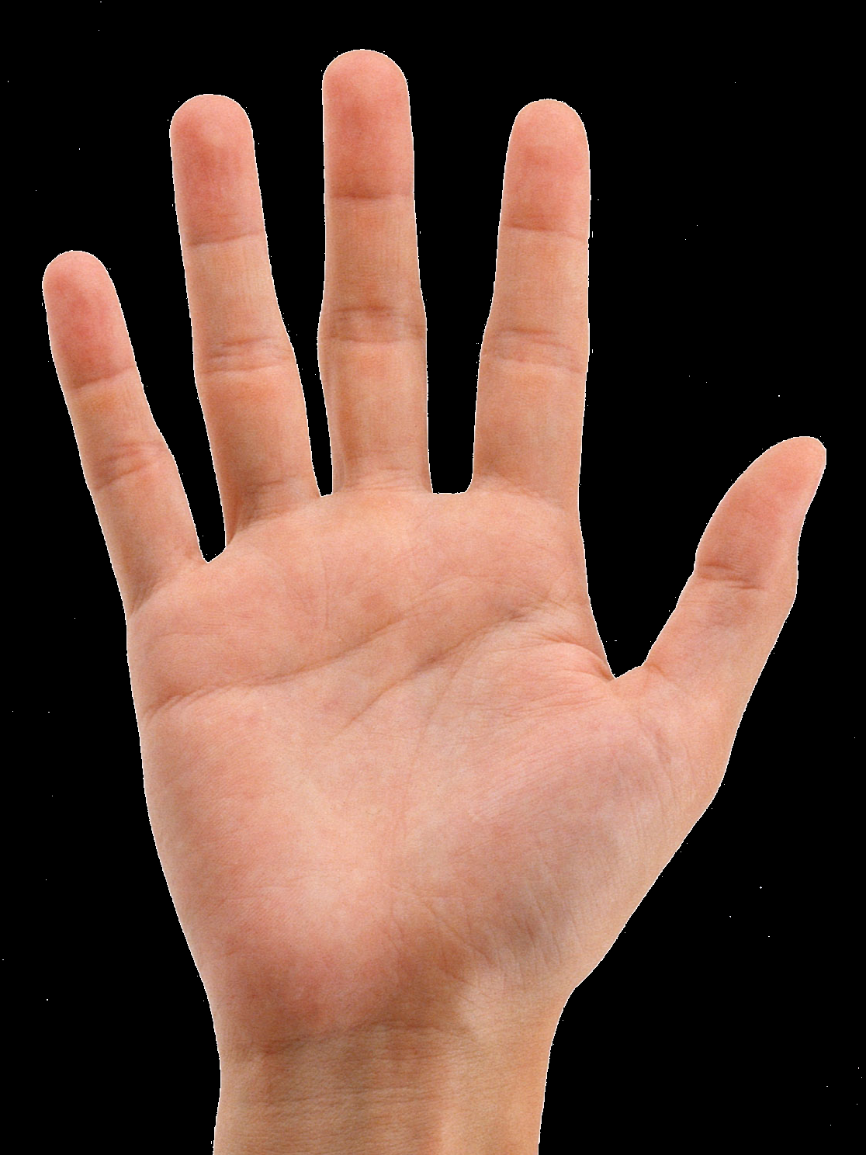
If no oven needed, GC can be very portable

Slide 29
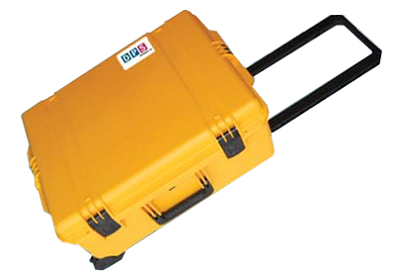
With oven…not so portable

Slide 30
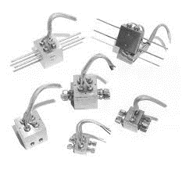
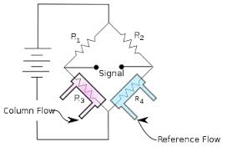
Thermocouple GC Detectors
(passive temperature change)
The trusty Wheatstone bridge makes another appearance
System is nulled when no sample through column side. The change in Voltage across `Signal’ means Column vs. Ref out of balance

Slide 31
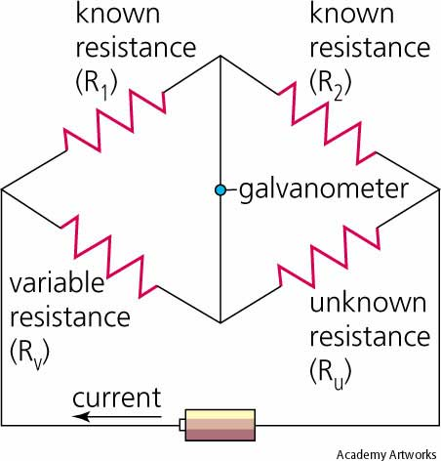
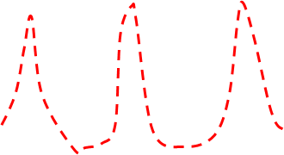
Brief aside on the Wheatstone Bridge
The details on how it works:
1) Variable R_{u} created by sample changing R_{u} . Syststem is initially `nulled’ by using R_{v}
A
0 ?
I(mA)
R_{v}
B
(R_{u})
0
R_{v} (or time , t)
2) Current (or voltage) is plotted vs.time as resistance at R_{u} changes . This produces a signal dependent on R_{u}. As R_{u} changes in => spectrum or chromatogram

Slide 32
Wheatstone bridge details(continued)
Using Kirchoff’s laws for voltage and current sums at nodes…
Can solve for numerical value of R_{u} using the recipe
(where R_{v} is at null point):
R_{u} = R_{v}*R₂
R₁
I=0
R_{v}
(R_{u})

Slide 33
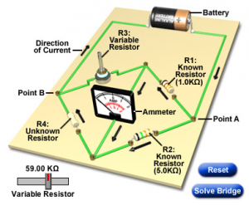
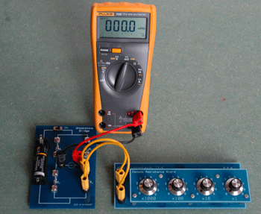
Wheatstone bridge details (cont.)
What a basic Wheatstone bridge set-up really looks like

Slide 34
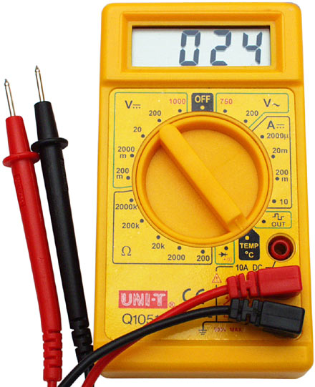
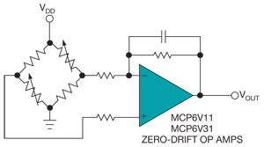
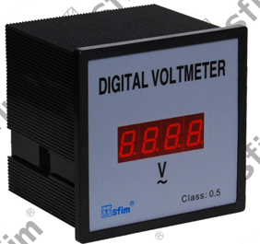


Wheatstone bridge details (cont.)
The `bridge’ is everywhere in modern equipment
All digital voltmeters & voltage displays (DVM)
Dynamic Base line (null) correction with op amp
micro pressure sensor : heart monitor
Mechanical strain gauge

Slide 35

Wheatstone bridge details (cont.)
185 years old and still awesome ,you
snotnosed, young whippersnappers !
Wheatstone bridge is courtesy of Sir Charles Wheatstone…1833 !!
Even if something is ancient, it doesn’t mean it isn’t awesome. The Wheatstone bridge is still one of the best ways to null a circuit.

Slide 36

FID=Flame Ionization Detector
(what we use in ASC lab)
Particularly good for…
Alkanes
Alcohols
Ketones, aldehydes
Ethers
Low weight aromatics
Less good for…
Large aromatics
Herbicides
Pesticides
Organic acids

Slide 37

Basic Design of an FID
(DC current in pA)

Slide 38

A real FID
collector
current out here
Air + H₂ in here
Igniter (?)
Sample with carrier gas in here

Slide 39


MSD Mass Selective Detector
(also part of ASC detectors)
Detector of choice in drug analysis
(MSD IDs drugs)
GC
MSD

Slide 40

PID=Photoionization Detector
(ASC got-no use for now)
Blind to alcohols, alkanes, ketones (ALIPHATICS)
Good with aromatics
(including many herbicides and pesticides

Slide 41
Sketch of typical PID chromatogram
100 ppm toluene in ethanol
I, pA
ethanol
time

Slide 42

PID quartz envelope in the flesh…

Slide 43


ECD=Electron Capture Detector (ASC used to have..no $)
⁶³ Ni* → ⁶³Cu + e⁻ (radioactive decay of a beta particle=electron)
e⁻ + X → X- causes change in current from background
Is 10-1000X more sensitive than FID
Particularly good with agricultural chemicals * (but generally useful)
*Herbicides
Pesticides
Drawback: needs US Atomic Energy Commission Government License => $$$$

Slide 44
Common GC detectors summarized
Detector
What it detects best
FID (Flame Ionization Detector) alkanes, alkenes, alcohols, ketones, aldehydes
TCD (Thermocouple Detector) any compound with vapor pressure
PID (Photoionization Detector) aromatics
MSD(Mass Selective Detector) any compound with
  vapor pressure
ECD(Electron Capture Detector) pesticides, herbicides

Slide 45

What do cats and chromatography scientists have in common ?
Separation anxiety, of course !

