Slide 1

https://www.youtube.com/watch?v=d6lYeTWdYLw

Slide 2
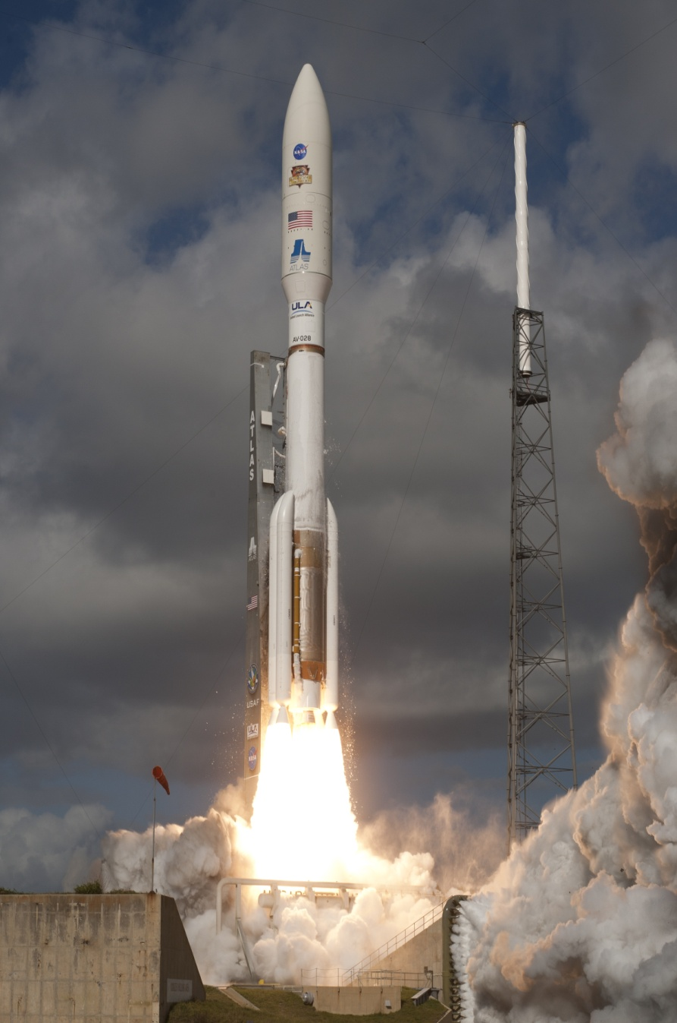
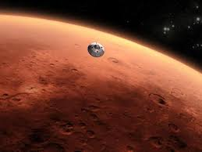
NASA-JPL Curiosity Mission to Mars
August 6, 2012
November 26, 2011

Slide 3
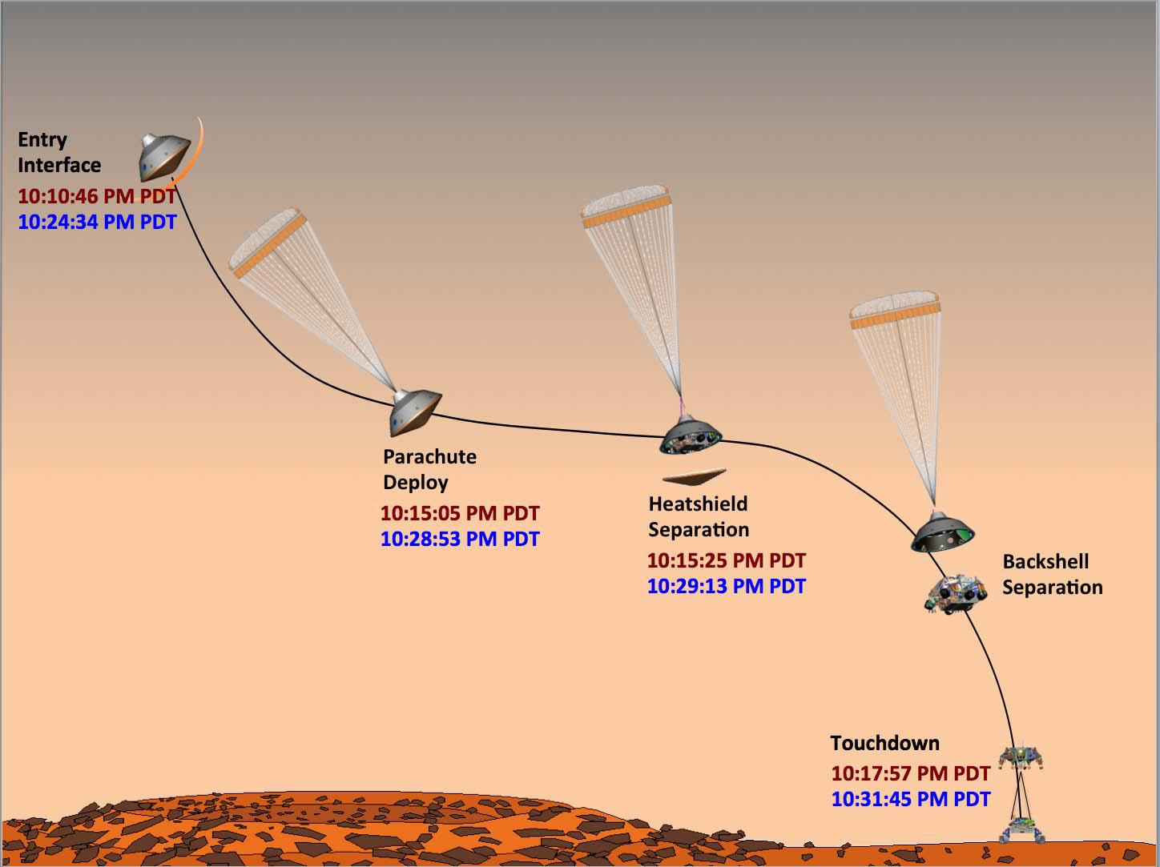

The Final Piece of the Curiosity Mission
~40 million miles to Mars
360 million mile trip
$2.5 billion… crown jewel of NASA space efforts

Slide 4
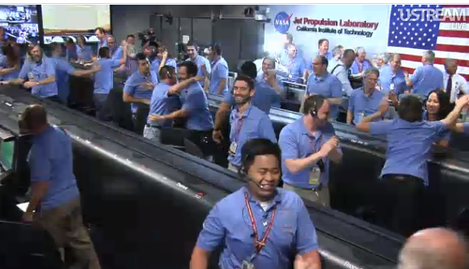
Curiosity Mission Control just after Curiosity sends back `Touchdown’ signal
10:17 PM PDT 6 August 2012 check landing window!

Slide 5
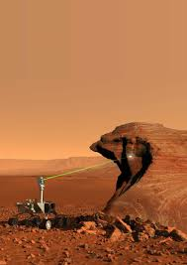

The chief mission of Curiosity:
Explore the chemical make-up of Mars
(and look for life !)
Artist’s view of Curiosity in action

Slide 6
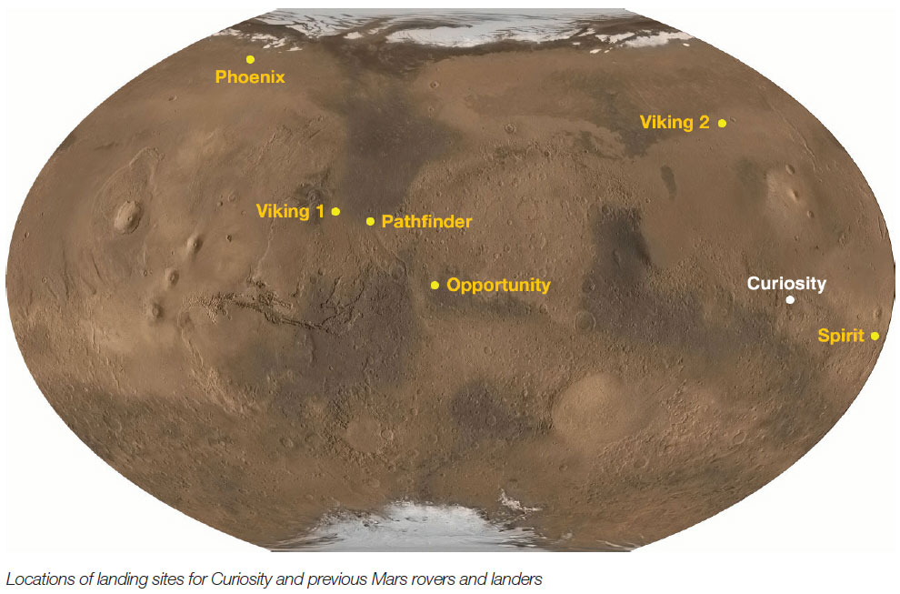
5/25/08-10/10/08
350 kg
9/3/76-4/11/80
572 kg (lander only)
7/20/76-11/11/82
572 kg lander only
7/4/97-9/27/97
10.5 kg
8/6/12- ??
899 kg
1/25/04- ??
180 kg
1/4/04-5/24/11
180 kg
A brief history of American space travel to Mars

Slide 7
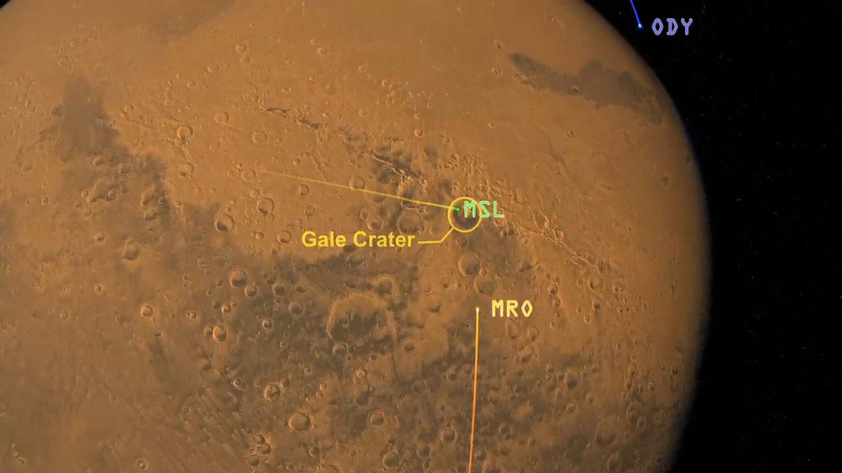
http://mars.jpl.nasa.gov/msl/multimedia/interactives/learncuriosity/index-2.html
Old Odyssey orbiter (2001 Mars Surveyor mission)
Mars Science Lab (Curiosity )
Mars Reconnaissance Orbiter
(from 2005 launch)

Slide 8
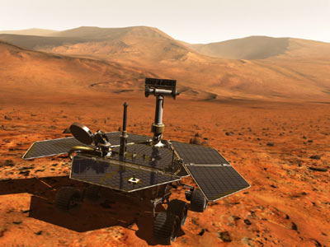
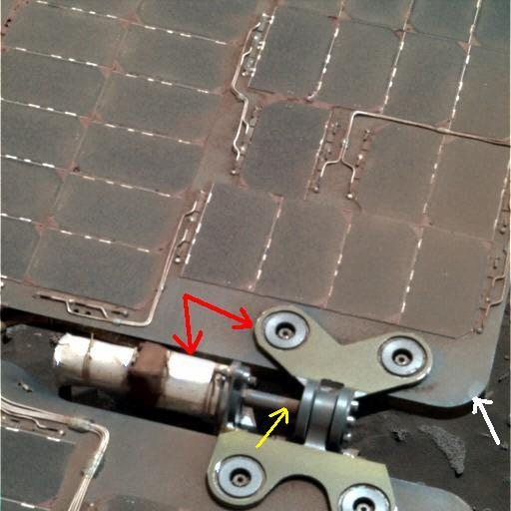
Martian dust coats panels and reduces light flux
Mars dust etching fittings
Spirit and Opportunity powered via ~ commercial solar panels

Slide 9
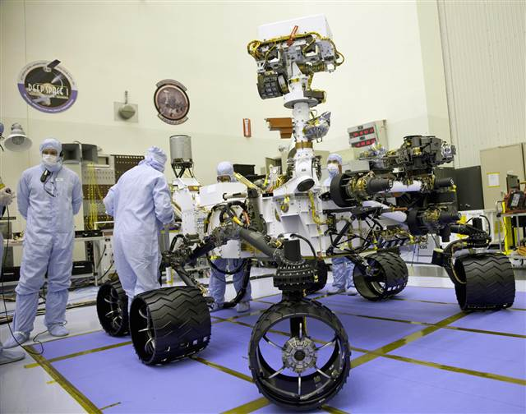
Curiosity `in the shop’:
(899 kg ~ 1980 lbs ~ Size of a Mini-Cooper )
What’s missing from Curiosity that were omni-present in Spirit and Opportunity ?

Slide 10
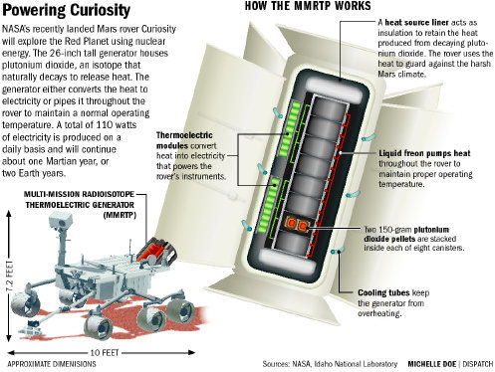
Factoid: The entire Rover runs on 100 Watts

Slide 11

MMRTP shows up in The Martian

Slide 12
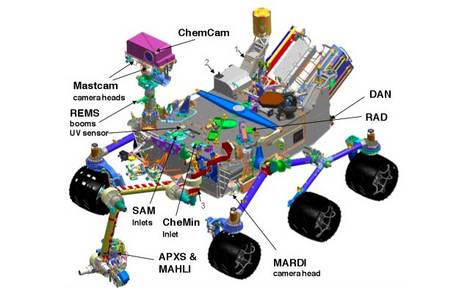
Chemistry and Camera
(~ laser + optics piece)
NASA’s $2.5 billion Chemical Instrumentation
Lab on Mars
ChemCam spectrometers here
Sample
Analysis of Mars
(instruments)
Chemical and Mineralogy Instrument
Alpha Particle X-Ray Spectrometer and Mars Hand Lens Imager

Slide 13
Chemistry and Camera
(~ laser + optics piece)
NASA’s $2.5 billion Chemical Instrumentation
Lab on Mars
ChemCam spectrometers here

Slide 14
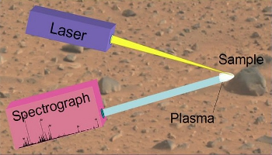
Simplified Schematic of ChemCam Idea

Slide 15
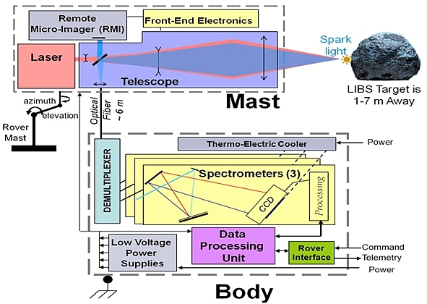
Schematic of ChemCam (laser is fired 50-75X in 5 nS bursts to get temperature to ~2100-2300 C)

Slide 16
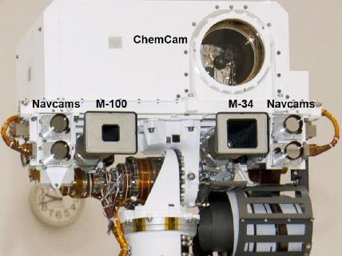
ChemCam in the flesh…as mounted on Curiosity’s Mast

Slide 17
Geek-Speak about ChemCam
The fiber carries the light to three dispersive spectrometers which record the spectra over a range of 240 - 850 nm at resolutions from 0.09 to 0.30 nm in 6144 channels. The spectra consist of lines of elements present in the samples. Typical rock and soil analyses yield detectable quantities of Na, Mg, Al, Si, Ca, K, Ti, Mn, Fe, H, C, O, Li, Sr, and Ba. Other elements often seen in soils and rocks on Earth include S, N, P, Be, Ni, Zr, Zn, Cu, Rb, and Cs. It is anticipated that 50-75 laser pulses will be required achieve the desired 10% accuracy for major elements at 7 m distance.
http://msl-scicorner.jpl.nasa.gov/Instruments/ChemCam/
Samples can be vaporized to 2100-2300 ºC
www.gizmag.com/curiosity-shield/23588/‎
1) What kind of light is being observed by ChemCam ?
2) Are ChemCam spectrometers absorption or emission devices ?
3) Given the hint about the channels and resolutions, what spectroscopic method you’ve learned about would seem to be applied here ?

Slide 18
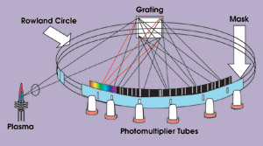
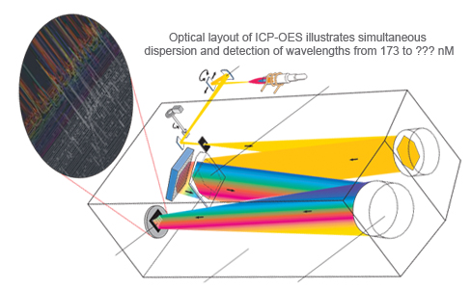
A blast from the past…from previous Chem 6614 Lecture on ICP
‘Old school’ Arrangement (Rowland circle with many PMT on circle to measure individual λ…big footprint)
What does the ChemCam laser replace in my `old school’ figure here?
`New School’
Charge-coupled 2D detection (CCD)

Slide 19
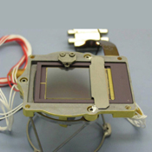
The main `2D transducer’
Collecting dispersive Spectrometer signals for ChemCam
What might be the identity of this “doohickey” ?
CCD like in new ICP

Slide 20
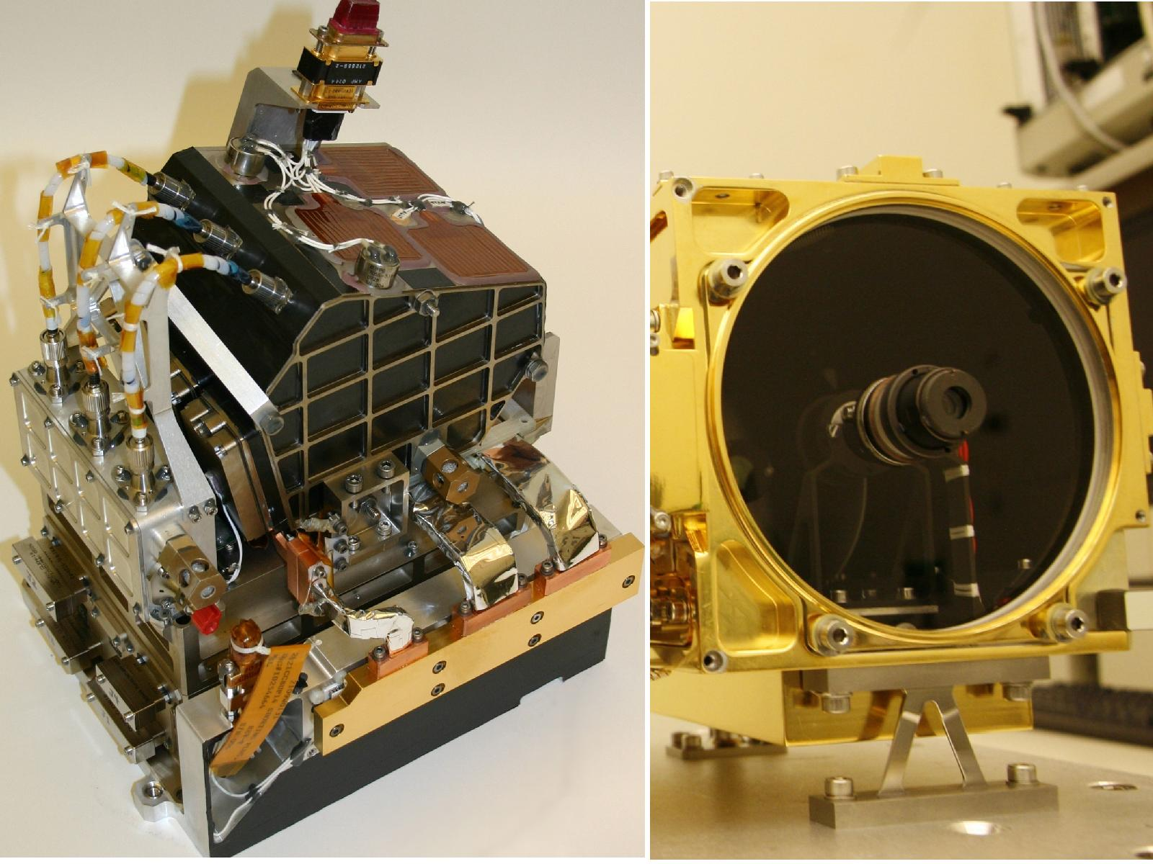
Business end of 1067 nm IR laser
Fiber feeds to 3 spectrometers
3 Dispersive spectrometers receiving
light from vaporized samples
Locate the optical feeds to the dispersive spectrometers

Slide 21
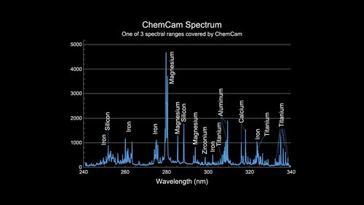
What spectral character from ChemCam tells us this is a gas phase spectrum ?

Slide 22
NASA’s $2.5 billion Chemical Instrumentation
Lab for Mars
Sample
Analysis of Mars
(instruments)

Slide 23
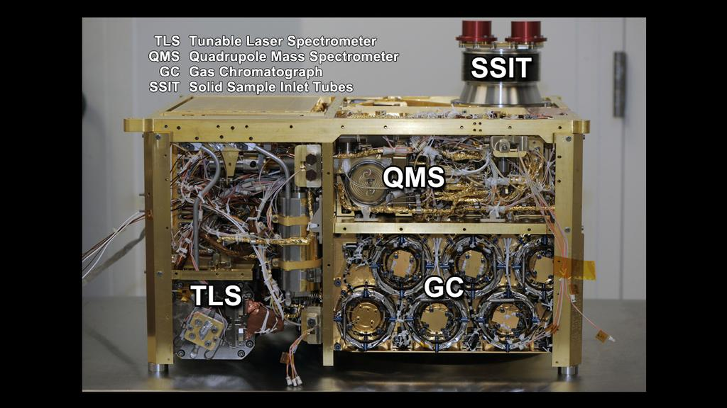
SAM up close & in person
Can you figure out what some of the acronyms mean ??
Solid Sample Inlet Tubes
Quadrupole Mass Spectrometer
Gas Chromatograph
Tunable Laser Spectroscopy
Note: the TLS is essentially an `IR’ designed to detect H₂O, CH₄ , CO₂ and measure C and O isotope

Slide 24
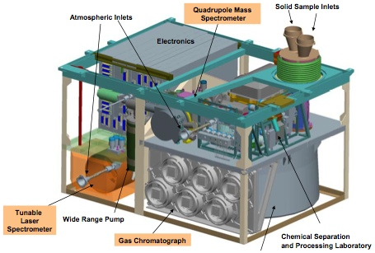
Schematic of SAM
Both CheMin and SAM eat here
The SAM is the two systems directly sucking up samples of Mars
http://msl-scicorner.jpl.nasa.gov/Instruments/SAM/

Slide 25
Material inlets in perspective

Slide 26
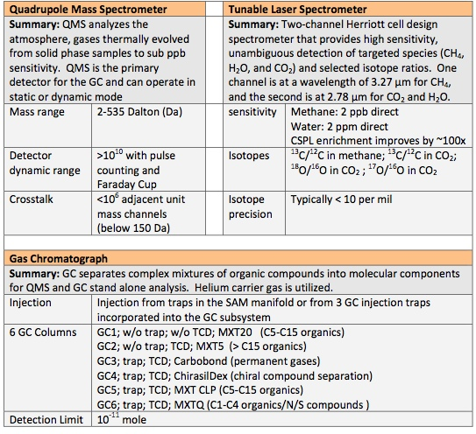
NASA Specs on SAM
http://msl-scicorner.jpl.nasa.gov/Instruments/SAM/
1) What are SAM’s GC detectors ?
2) How many GC columns are on Mars ?
3) What is SAM’s carrier gas?
3) How do we know from Specs alone, that SAM is looking for life on Mars?

Slide 27
NASA’s $2.5 billion Chemical Instrumentation
Lab for Mars
Chemical and Mineralogy Instrument

Slide 28
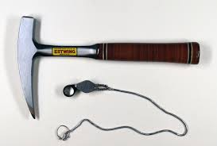
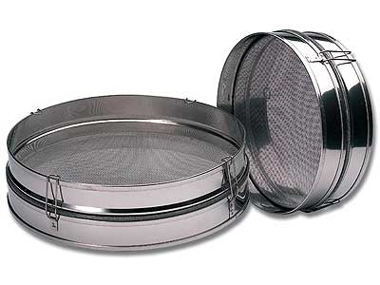
ChemMin (Chemistry and Mineralogy System)
and `old school’ geology/geochemistry
Traditional tools of the field geologist

Slide 29
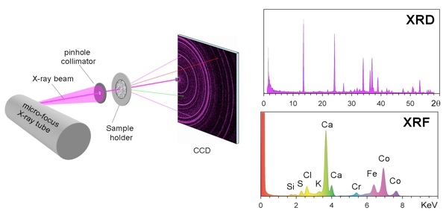
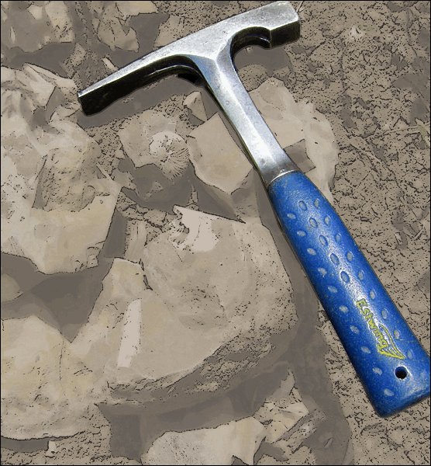
Schematic of CheMin’s analytical instrument package and output : x-rays are the `hammer’
Co-Kα
Source: http://msl-scicorner.jpl.nasa.gov/Instruments/CheMin/

Slide 30
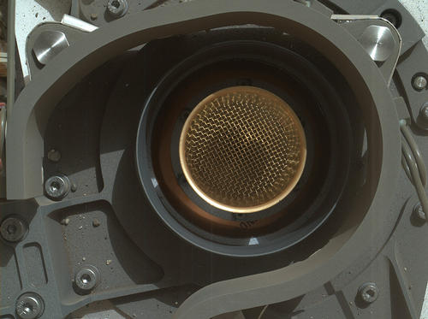
A simple metal filter sieves powder samples for analysis by CheMin
Say 'Ahh' on Mars
This image from NASA's Curiosity rover shows the open inlet where powdered rock and soil samples will be funneled down for analysis. The Mars Hand Lens Imager (MAHLI) was about 8 inches (20 centimeters) away from the mouth of the Chemistry and Mineralogy (CheMin) instrument when it took the picture.
http://mars.jpl.nasa.gov/msl/mission/instruments/spectrometers/chemin/

Slide 31
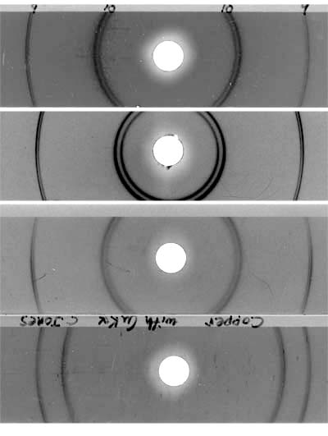
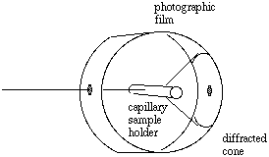
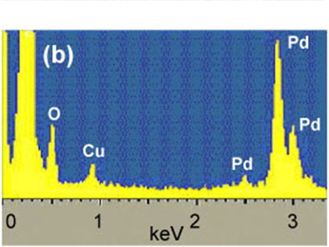
X-ray beam Cu-Kα
XRED (x-ray energy dispersion unit)=> crystal structure or powder
XRED (XRF) spectrum of solid
Powder XRF=> chemical composition of powder
FYI: From a recent Chem 6614 Lecture….

Slide 32
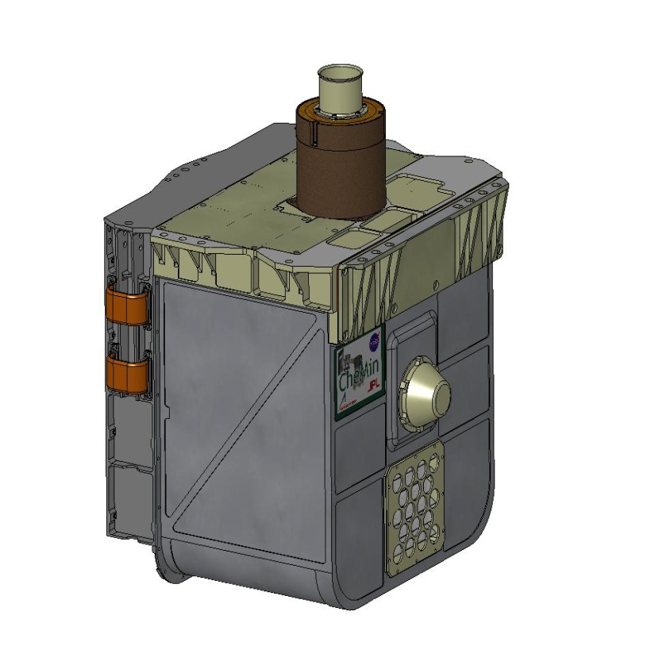
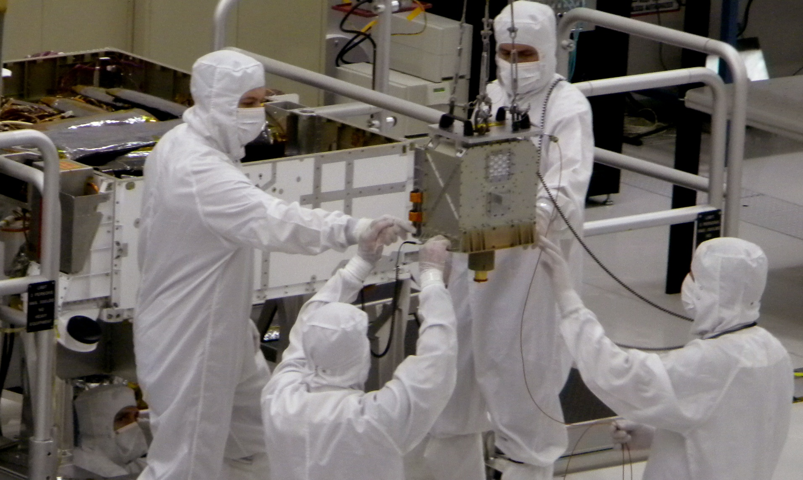
CheMin up close and in person
Sieve mouth up here
Sketch of CheMin
Can you see where the Mars dust is delivered into CheMin in sketch?
..and on actual device ?

Slide 33
NASA’s $2.5 billion Chemical Instrumentation
Lab for Mars
Alpha Particle X-Ray Spectrometer

Slide 34

Alpha Particle X-Ray Spectrometer: a bigger hammer
APXS alpha source energy
ChemMin ‘s x-ray source energy

Slide 35
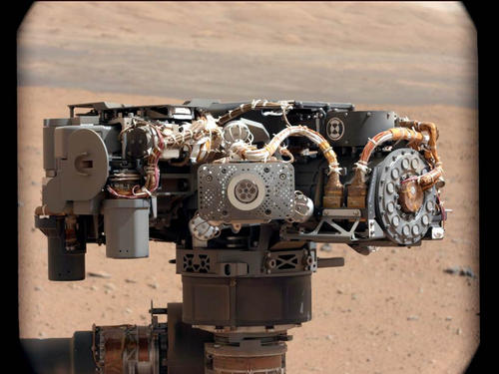
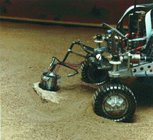
Alpha Particle X-ray Spectrometer
(APXS) in the flesh
Translation:
Robot arm sticks this thing (almost) into the dirt, ray-guns it and sends the vomited X-ray data back to Curiosity
The instrument consists of a main electronics unit in the rover’s body and a sensor head mounted on the robotic arm. Measurements are taken by deploying the sensor head towards a desired sample, placing the sensor head in contact or hovering typically less than 2 cm away, and measuring the emitted X-ray spectrum for 15 minutes to 3 hours without the need of further interaction by the rover.
http://msl-scicorner.jpl.nasa.gov/Instruments/APXS/

Slide 36
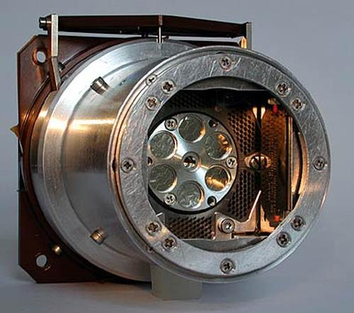
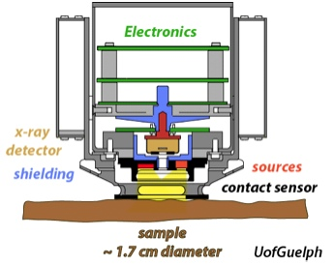
Schematic of AXPS
Detector head for AXPS up close
α Alpha particle source = accelerated He⁺
α + `dirt’ → dirt + dirt element x-rays
What famous experiment featured alpha particles ?

Slide 37
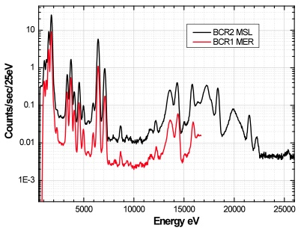
Comparison of Mars Mission AXPS for different Sources
(peaks specific to particular elements; heights are related to abundance)
http://msl-scicorner.jpl.nasa.gov/Instruments/APXS/

Slide 38
NASA’s $2.5 billion Chemical Instrumentation
Lab for Mars
Mars Hand Lens Imager

Slide 39
What MAHLI reproduces on Mars

Slide 40
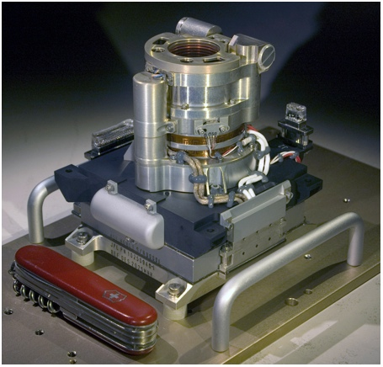
“Second only to the rock hammer, the hand lens is an essential tool of human geologists. Usually carried on a string around the person's neck, the hand lens helps a geologist in the field identify the minerals in a rock. The robotic geologist, Mars Science Laboratory, carries its own equivalent of the geologist's hand lens, the Mars Hand Lens Imager (MAHLI).”
http://msl-scicorner.jpl.nasa.gov/Instruments/MAHLI/
MAHLI is essentially a camera with wide sapphire window (1.5” dia.) and some magnification which has been `hardened’ to withstand Martian weather.
(<0.05 atm, -153 to +20 C)
Why use sapphire ? Why not glass ?

Slide 41
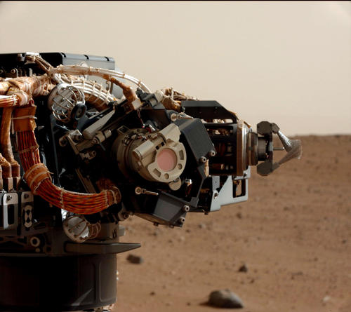
MAHLI at home on Curiosity’s robot arm

Slide 42
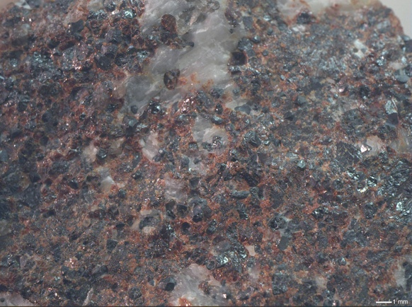
Zinc Ore Sample Picture by MAHLI (terrestrial)

Slide 43
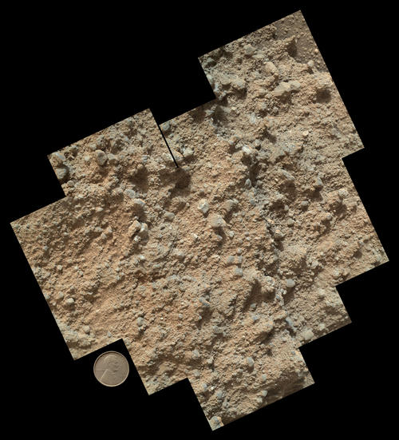

Composite of 9 separate shots of Mars dirt taken by MAHLI
Single frame dimension
What does the red color imply about the composition of Mars dirt ?
Factoid: Mars dust is ~ 50% iron ore, which is why it’s called the Red Planet.

Slide 44
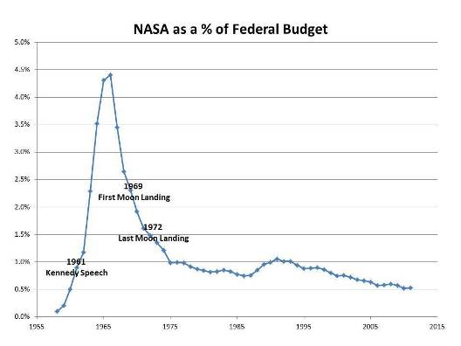
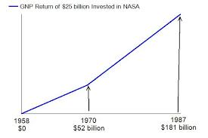
Currently, the US depends on the Russians to get to the International Space Station.
We have no modern primary launch systems that can lift major payloads (though NASA has one in the works…)

Slide 45
Why we need NASA and its programs
I don't think the human race will survive the next thousand years, unless we spread into space. There are too many accidents that can befall life on a single planet. But I'm an optimist. We will reach out to the stars.
STEPHEN HAWKING, The Daily Telegraph, Oct. 16, 2001
It’s human nature to stretch, to go, to see, to understand. Exploration is not a choice, really; it’s an imperative.
— Michael Collins, flew on Gemini 10 and Apollo 11.
To strive, to seek, to find, and not to yield.
From Tennyson’s poem: “Ulysses”

Slide 46
And why Instrumentation is critical to us…some final thoughts
Accurate and minute measurement seems to the non-scientific imagination, a less lofty and dignified work than looking for something new. But nearly all the grandest discoveries of science have been but the rewards of accurate measurement and patient long-continued labour in the minute sifting of numerical results.
— Baron William Thomson Kelvin
An experiment is a question which science poses to Nature, and a measurement is the recording of Nature's answer.
— Max Planck

Slide 47

“Clever theories come and go.
A careful measurement endures.”
R.L Kuczkowski-Doc’s thesis advisor
“If I want a theoretician’s opinion,
I’ll give it to him.”
Your violently empiric instructor

Slide 48

Live long and prosper

