Slide 1
The main bits and pieces of electronics in EVERYTHING
Resistors
Capacitors
Inductors
Diodes and LED
Transistors
Chips = Integrated Circuits (IC) by wiring together all of the above (gates, op amps, timers…)
Passive
elements
Semiconductor device=active elements

Slide 2
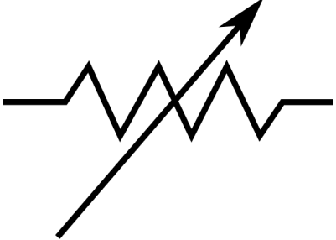

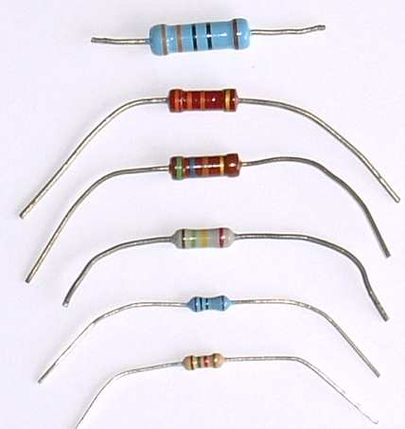
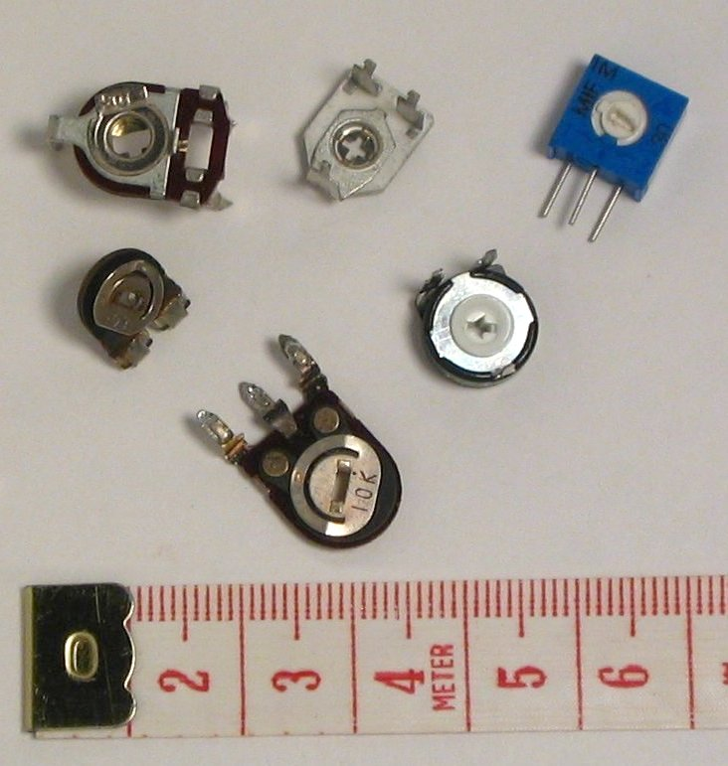
RESISTORS ( R )
Units in Ohms (Ω)
Dial to change R
variable
fixed

Slide 3
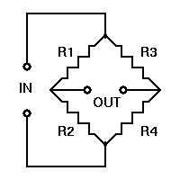
Basic Instrumentation Device Using Resistors: Wheatstone Bridge (Pierpont 1843 !)
R₁ and R₂ are usually fixed
At `null’ on G*:
Often the test R
V
G
R₄ = R₂
R₃ R₁
(usually adjustable)
G= galvanometer
Or…current meter
I
*no current across bridge where G is

Slide 4
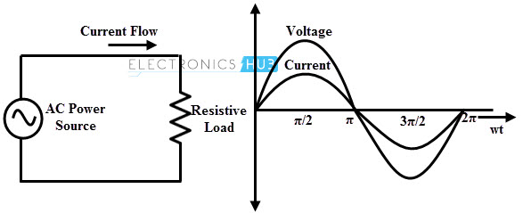
Time-varying signals across R
I=
V=AC voltage
Current (I) through a resistor stays `in phase’ with applied voltage (V)

Slide 5
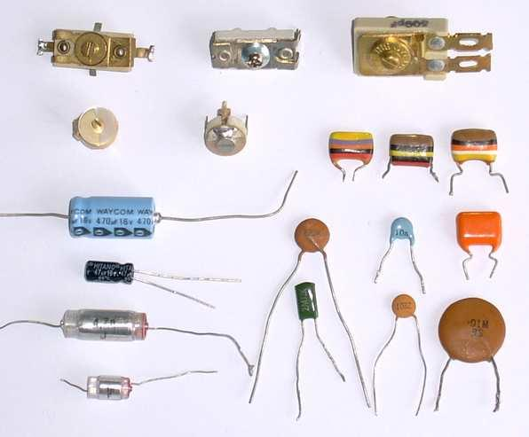
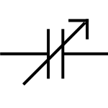
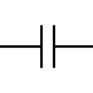
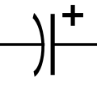
CAPACITORS (C)
Units in Farads (Coulombs/Volt)
variable
(has dial)
polarized, fixed
(can shaped, higher C attained. Contains electrolytes)
Non-polarized, fixed
(Flattened)

Slide 6
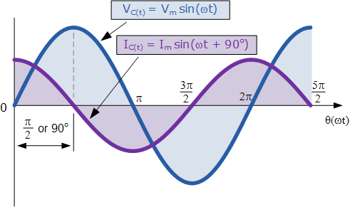
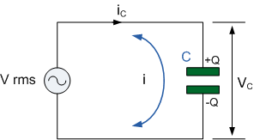
Time-varying signals across C
Current (I) through a capacitor ‘leads’ applied voltage (V) (out of phase by +90⁰)

Slide 7
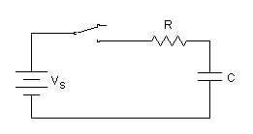
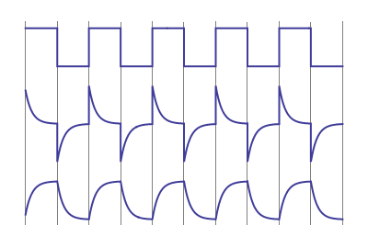
RC response to square wave (DC on/off) input
I=I_{o}*e^{-t/RC}
I=I_{o}*e^{-t/τ} τ=RC time constant
V_{s}
I_{R}
V_{C}

Slide 8
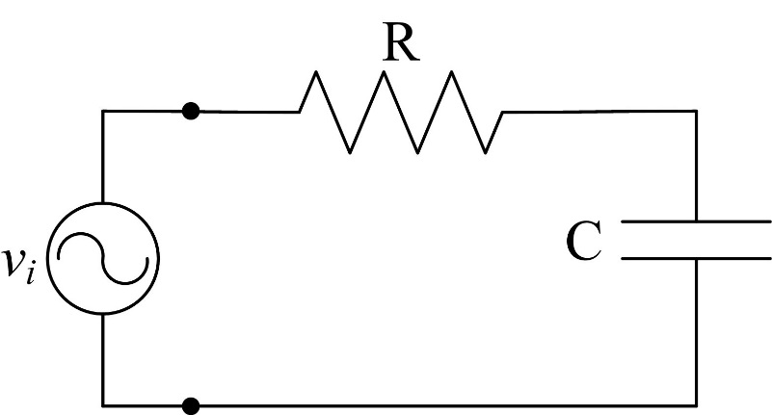
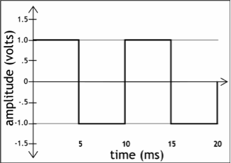
Series RC can be used as a `high pass’ frequency current filter
I_{m}
Suppose τ=RC ~ 5*10⁻⁴ seconds
Input time~ 5 *10⁻⁶/pulse
t/τ = 5*10⁻⁶/5*10⁻⁴= 100
I/I_{o}=e^{-t/τ}
=e^{-0.01}~ 1
Output currernt
∴If RC >> input signal f, then output current looks just like input voltage wave

Slide 9
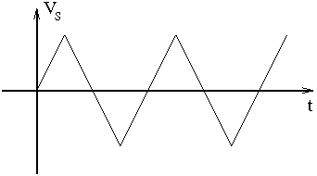
Series RC can be used as a to convert square volt input to triangle output waves
Suppose τ=RC ~ 5*10⁻⁴ seconds
Input time~ 5 *10⁻⁶/pulse
V
t/τ = 5*10⁻⁶/5*10⁻⁴= 0.01
V= V_{o} (1-e^{-t/τ})~ t/τ for small t/τ
Output Voltage
∴If RC >> input signal f, then output voltage looks just like triangle

Slide 10

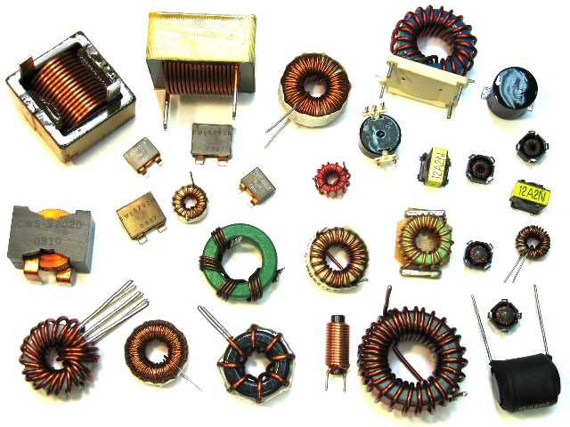
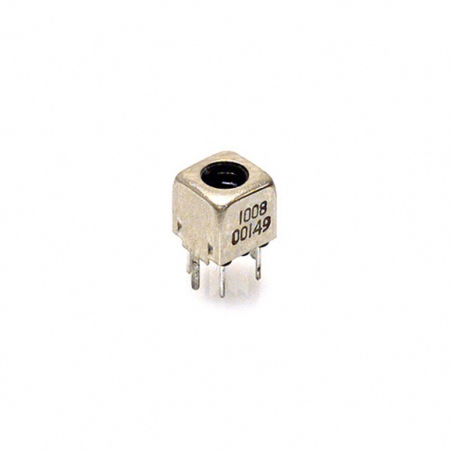
INDUCTORS (L)
Units in Henries (H)
fixed variable
Harder to spot variable ones
Slot for screw driver adjust

Slide 11
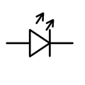
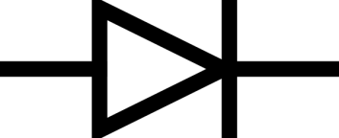
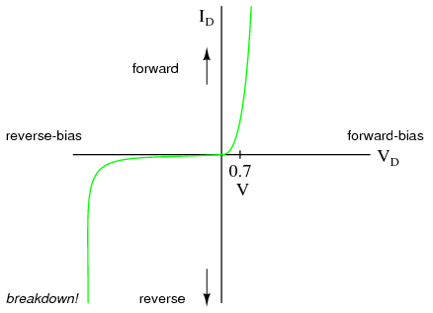
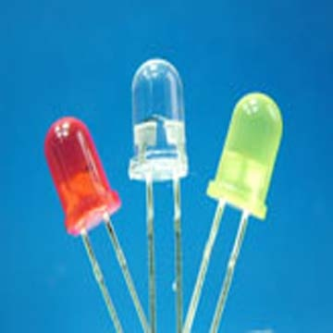
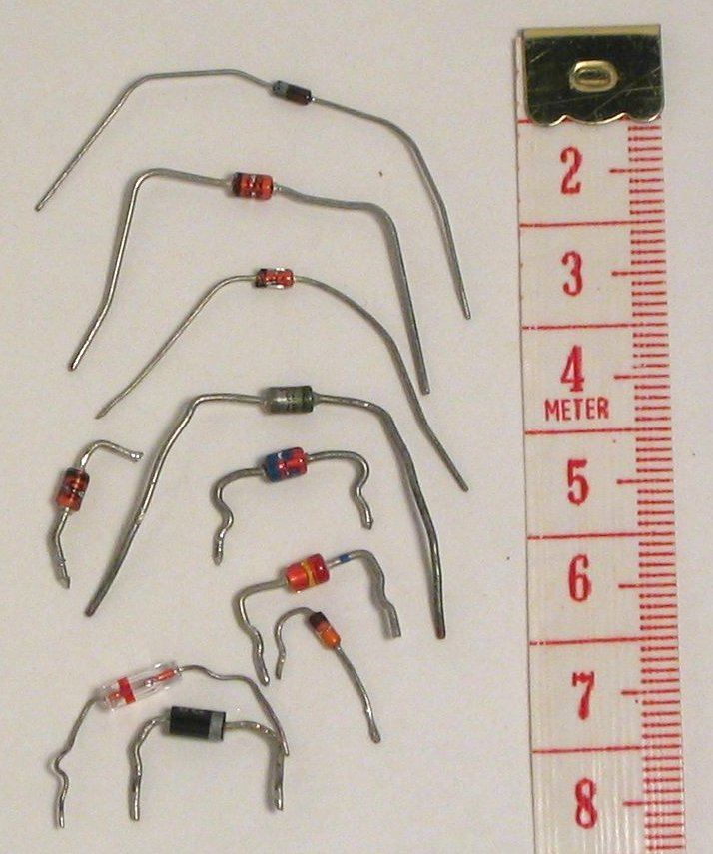
DIODES
(one way current filters)
Rated for PIV and Vf
regular
LED
PIV
=Vf
Light emitting diodes (LED)
regular diodes

Slide 12
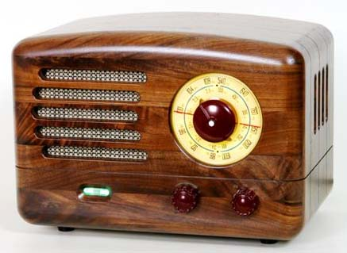
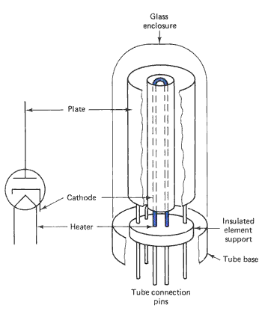
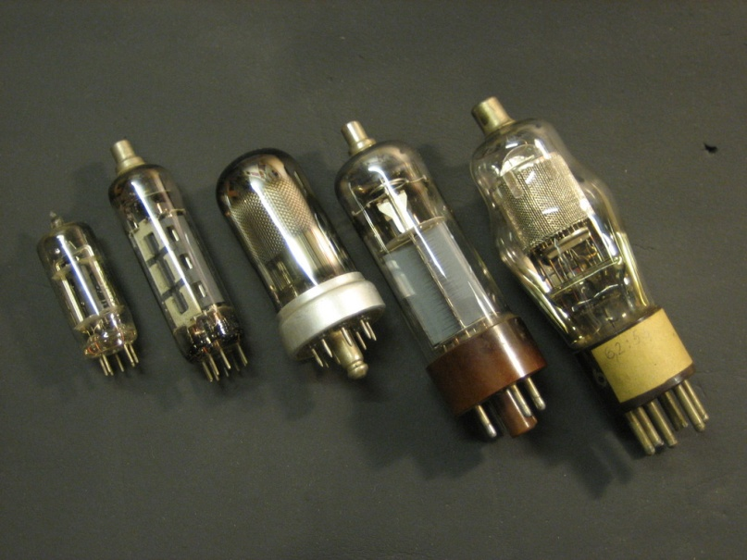
In days of yore…(pre 1960) before solid state transistors became commercially chip and available
grid
Grid current (mA) determines whether current flows cathode→ anode (plate)…essentially an electronic on/off switch

Slide 13
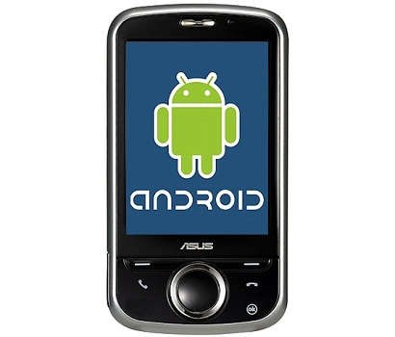
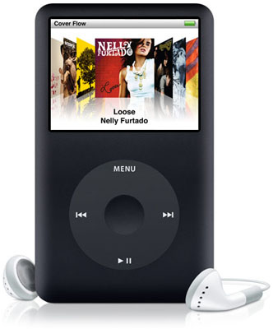
R,C, L….+ `vacuum’ tubes
…the big technological jump occurred in 1950’s as we moved from from passive to active devices

Slide 14
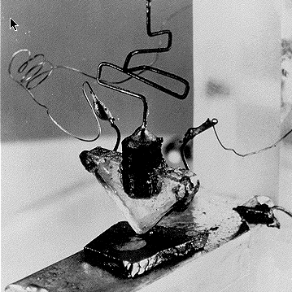
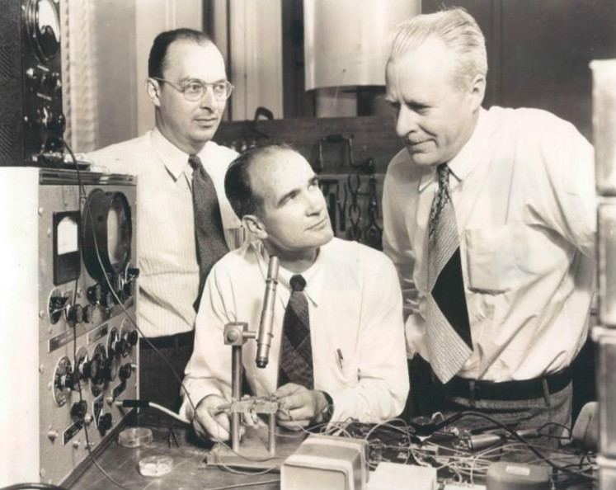
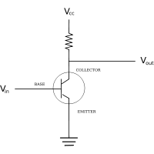
First Transistor
Bardeen Schockley Brattain
Bell Labs 1948
~ a solid state on-off switch
Key advantages
* base control current tiny (pA)
*switching is fast
*solid state allows minaturization

Slide 15
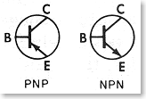
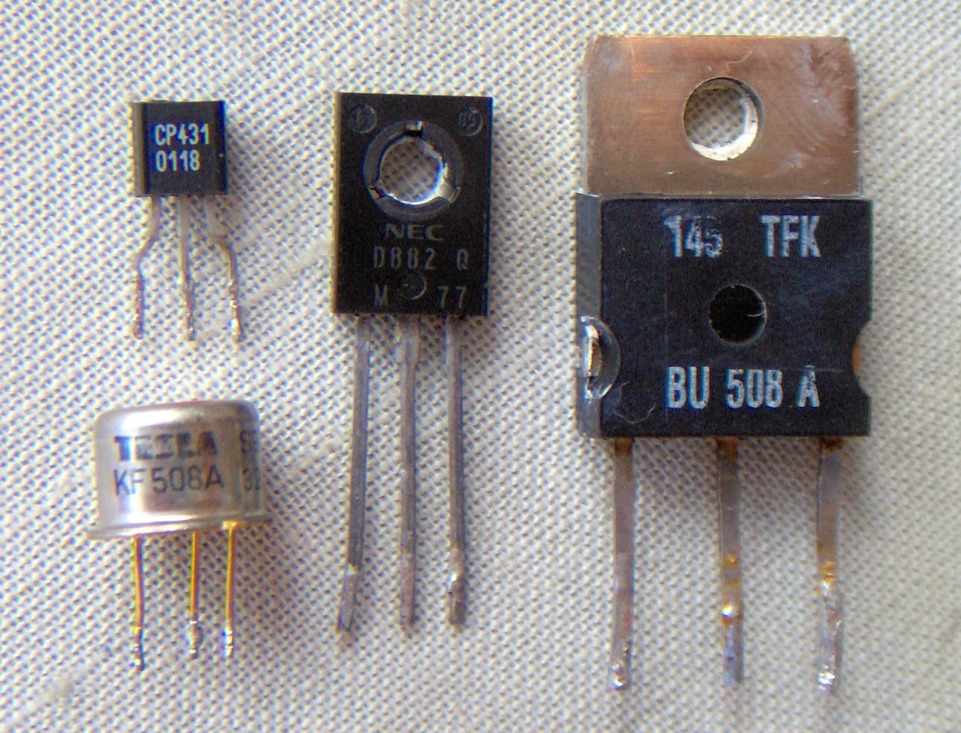
TRANSISTORS
voltage controlled current switch
Almost always characterized by 3 prongs
Small base current controls much larger current from C→E
Emitter Base Collector

Slide 16
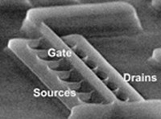
~5000X SEM of microchip transistor

Slide 17
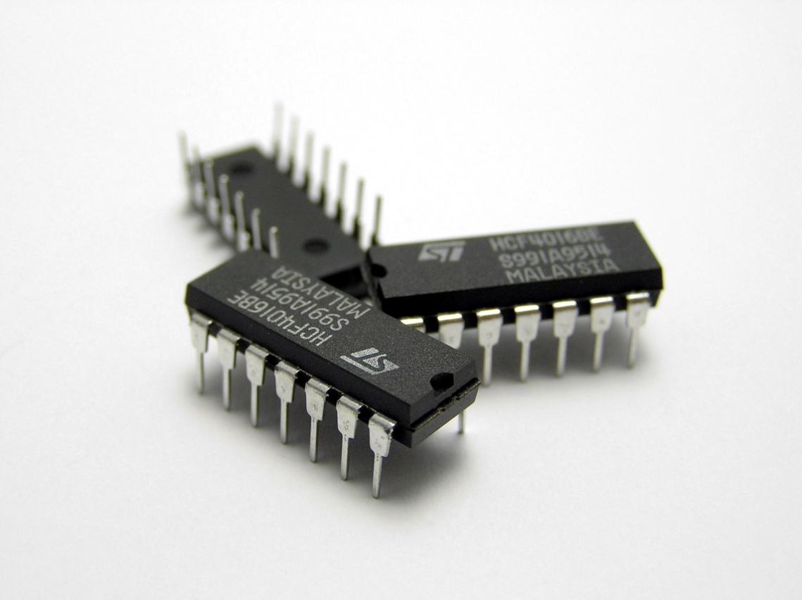
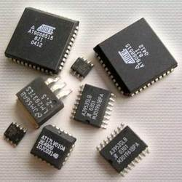
Integrated circuits = IC =microchips = chips
Many transistors + …in module to control something
`old timers’ (aka the Doc) called them `bugs’

Slide 18
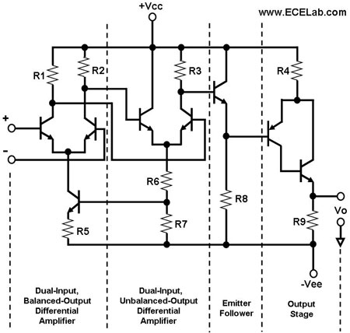
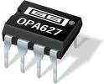

Inside a simple IC: operational amplifier (op amp)
Can use to build/ interface measurement and control systems of nearly everything

Slide 19
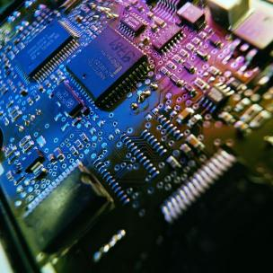
Many IC wired to a printed circuit board to perform complex tasks
How many IC do you count ?
Probably computer “chip”
(zillions of transistors)
Part of Engine control board for Ford F-250

Slide 20
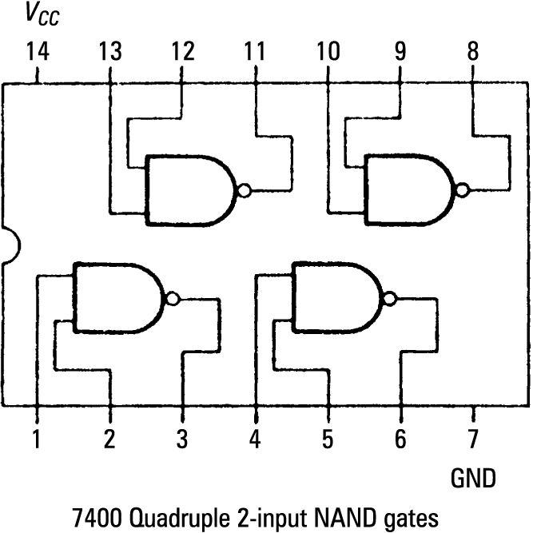
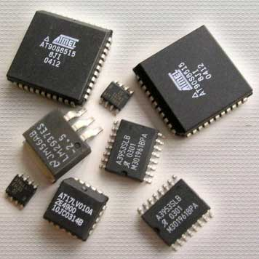
Simple Integrated Circuit Chip…with a few hundred transistors
1970s Texas Instruments figures out how to make many transistors on an `IC’ (Integrated Circuit)…so many decisions can be made

Slide 21
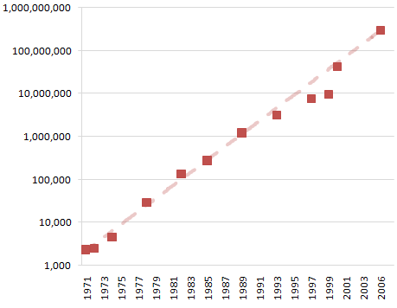
Moore’s* Law Predicts # transistors/chip area rises exponentially in time
Transistor count
* First CEO of Intel
year

Slide 22
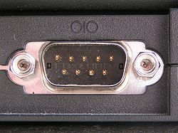
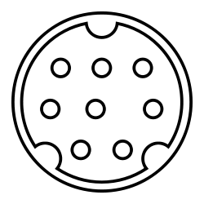
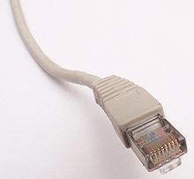
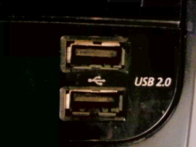
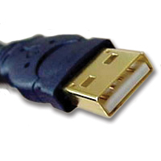
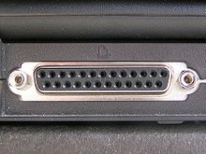
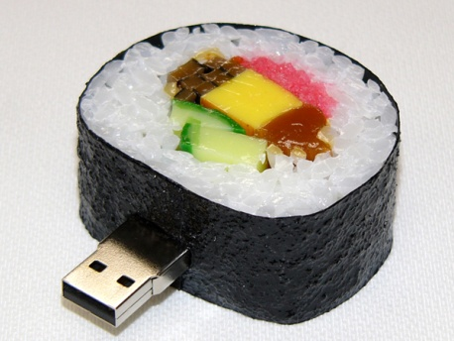
Getting information to and from computer device…thru a `BUS’: some connector types
DE-9 serial port (RS-232)
(printers, projectors…for PC)
RJ 45 `ether
net cable’ (for LAN)
Mini DIN -8 serial port ( for Macs)
USB = Universal Serial Bus
25 pin parallel port
DB 25 (many current printer ports)

Slide 23
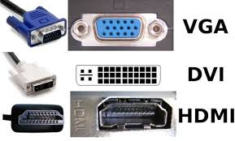
More input/output cabling types
(Video)

Slide 24



What are these ???
motherboard
cpu
Hard Drive

Slide 25
PPT Electronic parts exercise….

Slide 26
Computer/digital device Language now permeates our lives….
How fluent are you ?
(Geek speak exercise)

