Slide 1
Drill and Practice for Optical Microscopy
Equation for refractive index, n= ?
c_{vac}/v_{matter}
Can n ever be less than 1 (why or why not ?)
No. v_{matter} < c_{vac}
air
Which way does the light beam bend as it passes from air to glass ?
glass
Which way does the light beam bend as it passes from glass back to air ?

Slide 2
Drill and Practice for Optical Microscopy (cont.)
Trace the pathway the light takes from top of arrow and parallel to the optical axis and across the lens to the back focal plane.
f
Trace the pathway the beam from the top of the arrow takes in passing through the front focal point across the lens and to the back focal plane
What does the image look like on the back focal plane ?
Official name of the back focal plane image?
Real image

Slide 3

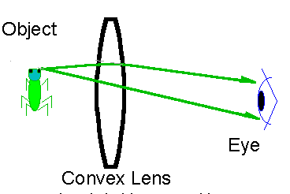

Drill and Practice for Optical Microscopy (cont.)
How far away (d) does the eye think it sees the real image registered here on the retina ?
Apparent image plane for eye at default distance d
10 inches
d= ???
Official name of the `image’ your brain thinks is at 10 inches from the eye ??
Virtual image

Slide 4
Drill and Practice for Optical Microscopy (cont.)
Name for mechanical adjustment `iris’ that controls total light coming from microscope source
Field diaphram
Focuses and directs light just after the field diaphram
Substage condenser
Ring beneath the stage and beneath condenser that is part of phase contrast system
Condenser (or substage) annulus
Ring above objective that is also part of the phase contrast system
Phase annulus or ring or plate

Slide 5
Drill and Practice for Optical Microscopy (cont.)
What general. physical defect of optical lenses precludes indefinitely stacking double convex lenses to produce (in principle) infinite magnification ?
Lens aberrations
Spherical aberration
Aberration type illustrated below
Field curvature aberration
Aberration type illustrated above
chromatic aberration
object
Aberration type illustrated above
Real image

Slide 6
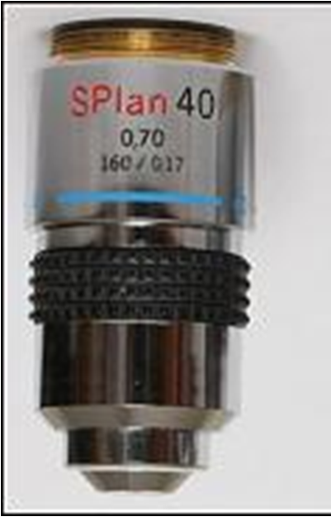
Drill and Practice for Optical Microscopy (cont.)
What is the magnification for the objective below ?
40X
What does the `S’ mean on the objective below ?
Glass quality (best=S) E<D<S
What does Plan mean about the objective ?
Field curvature effect is corrected for
What does 0.70 refer to ?
NA (numerical aperture )
What does 160 refer to ?
Olympus
Barrel length of objective (in mm)
What does 0.17 stand for ?
Suggested coverslip thickness (mm)

Slide 7
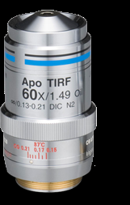
Drill and Practice for Optical Microscopy (cont.)
How many wavelengths is this lens chromatically corrected for ?
Apo => 3 (sodium D at 589.3 nm and two others)
How many wavelengths is it spherically corrected for ?
Apo => 2, (sodium D and one other)
Nikon
What does 1.49 Oil mean ?
NA (Numerical Aperture) in oil
What does WD 0.13-0.21 mean ?
Working distance (mm) from lens to object allowed

Slide 8
Drill and Practice for Optical Microscopy (cont.)
What kind of microscopy gives rise to the image below ?
Phase contrast microscopy
Is this dark field or bright field phase contrast ?
bright field (also called positive phase contrast)
What produces the resolved `dark’ image spots, the deviated or undeviate light from the object ?
Undeviated light. The undeviated light destructively interferes because of phase plate and substage phase annulus.
When is phase contrast particularly useful ?
When medium and object refractive indexes are nearly the same
Official name for objects with same index as medium ?
Phase objects

Slide 9
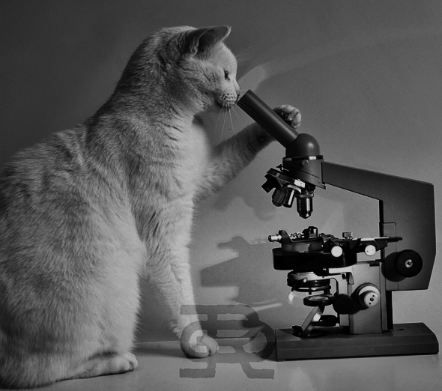
My cat is just going through a phase….

