Slide 1

Ready to answer some questions, maggots ?

Slide 2
Match these terms and acronyms with the short descriptors listed below:
DSC_____ modifier_____ SEM____ flux ____
XRD ____ T_{g} _____
anneal temperature___ poise____
d
g
h
f
e
b
c
a
a) units of viscosity
b) glass transition temperature
c) works out stress
d)measures T_{g}
e) diffraction lines & crystal structure
f) breaks up former bonds
g)re-connects islands
h) 40,000X-100,000X magnifications

Slide 3
Glass Technology and Measurement drill and practice
In classical glass theory, a glass is composed of three components. In order from most to least in %, what are they ?
Former
  flux
modifier
Given the above component types, which type is SiO₂ (sand) ?
Former
What role does flux play in glass making ?
Breaks up extended former network so the glass will
form isolated ‘islands’ and melt at lower temperatures
Na₂O (soda) K₂O (alkali oxides)
Give an example of a flux material.

Slide 4
Glass Technology and Measurement drill and practice
What role does the modifier play in glass making ?
They re-join some of the isolated islands created by the flux and stiffen/strengthen the glass
Give an example of a material that serves as a flux
CaO (lime), MgO, BaO (alkaline earth oxides)
Does it make sense that the most common (and oldest) commercial glass is called `soda lime’ glass ? Explain.
Yes. Flux =15% w/w Na₂O (soda)
Modifier= 10% w/w CaO (lime)
Former= 75% w/w sand

Slide 5
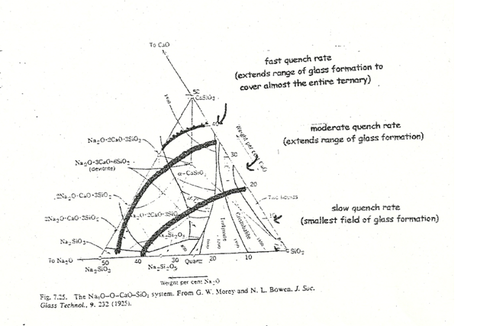
Glass Technology and Measurement drill and practice (cont.)
Glass is non-thermodynamic, non-crystallographic and non-____________________
stoichiometric
In the ternary phase diagram below, the increasing glass-forming regions defined by the dark curves is created by…
Increasing the rate of quenching the glass melt

Slide 6
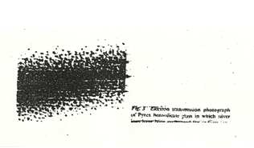
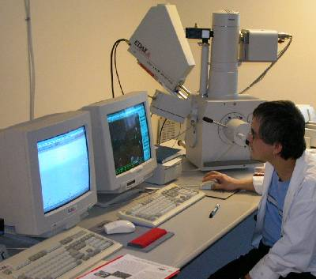
Glass Technology and Measurement drill and practice (cont.)
This 50,000X micrograph of Pyrex reveals what key structural feature of the glass ?
Pyrex is biphasic (hard silica islands filled in with softer soda-silica-borate-CaO regions)
Name and acronym for the instrument shown
Scanning Electron Microscope (SEM)
SEM’s Typical magnification range ?
1000-40,000X

Slide 7
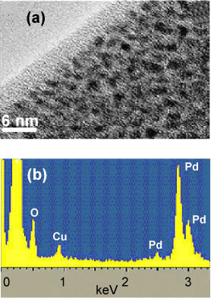
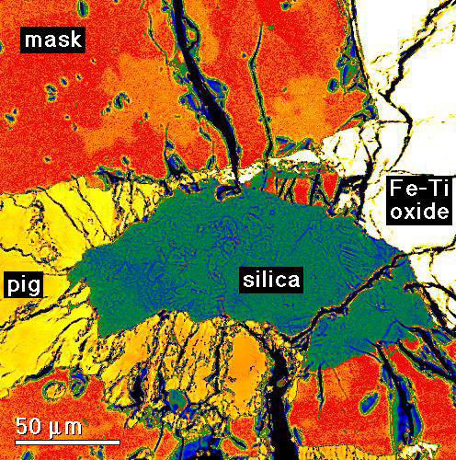
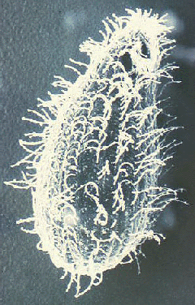
Glass Technology and Measurement drill and practice (cont.)
Back-scattered electrons (BSE)
Secondary electron emission (SE)
Name the SEM technique leading to each of these images
X-ray energy dispersion (XRED)

Slide 8
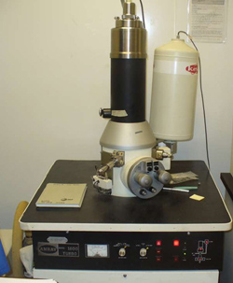
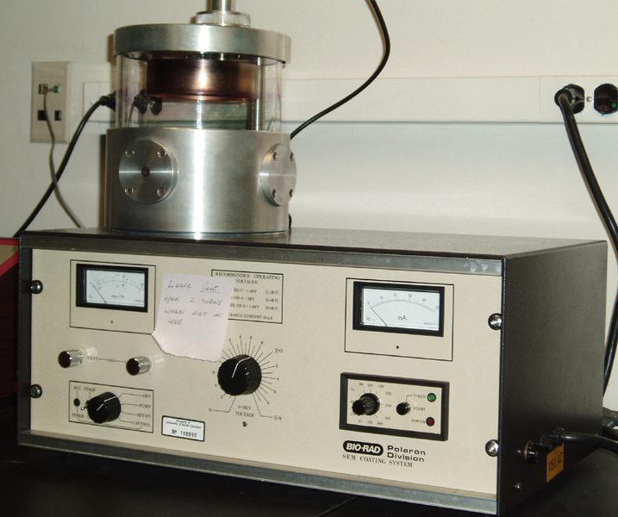
Glass Technology and Measurement drill and practice (cont.)
Where is the SEM piece in the instrument below ?
What’s this piece do ?
XRED unit (analyzes elemental composition at SEM focus pt)
Vacuum coater to spray conductive Au or C onto non-conducting SEM samples
What’s this for ?

Slide 9
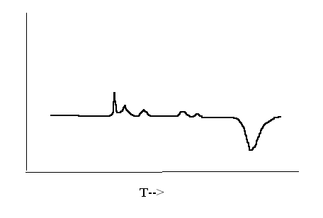
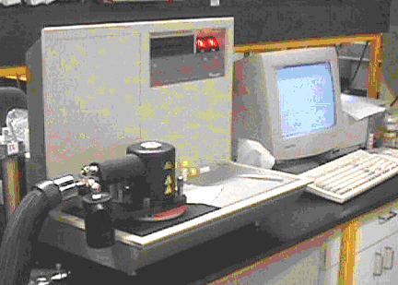
Glass Technology and Measurement drill and practice (cont.)
What technique made the curve below ?
Differential Scanning Calorimeter
ΔQ
melting
Dehydration (exo)
Where does the DSC sample go in the DSC instrument shown to the right ?
T_{g} stands for…
Glass transition T
T_{gc} stands for…
Glass→ crystal transition T
T_{m} stands for…
Melting point

Slide 10
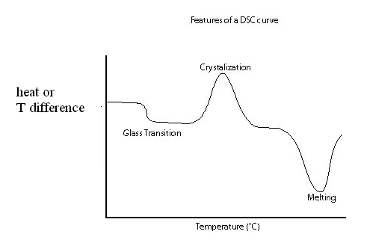
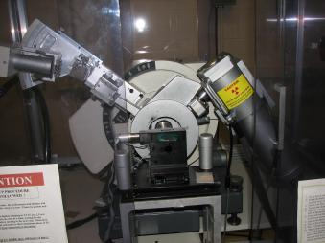
Glass Technology and Measurement drill and practice (cont.)
Find T_{g}, T_{gc} and T_{m} on the DSC curve below
T_{m}
T_{g}
T_{gc}
What’s this instrument called ?
camera
source
X-ray-diffractometer (XRD)
Point to where source, camera and sample are likely to be here
Sample here

Slide 11
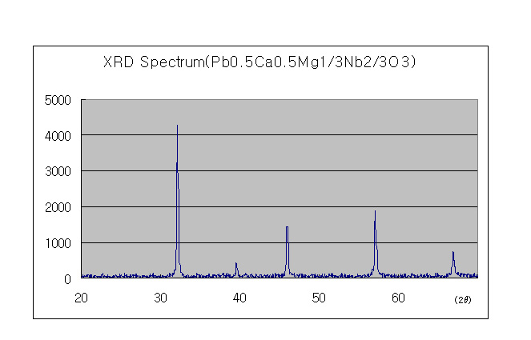
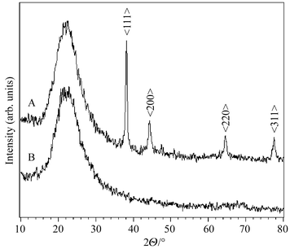
Glass Technology and Measurement drill and practice (cont.)
Phase of sample ?
crystalline
Which XRD scan is created by a pure glass ?

Slide 12
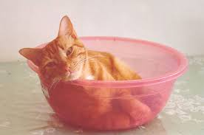
If life is a bowl of cherries,
why am I always in the pits ???

