Slide 1
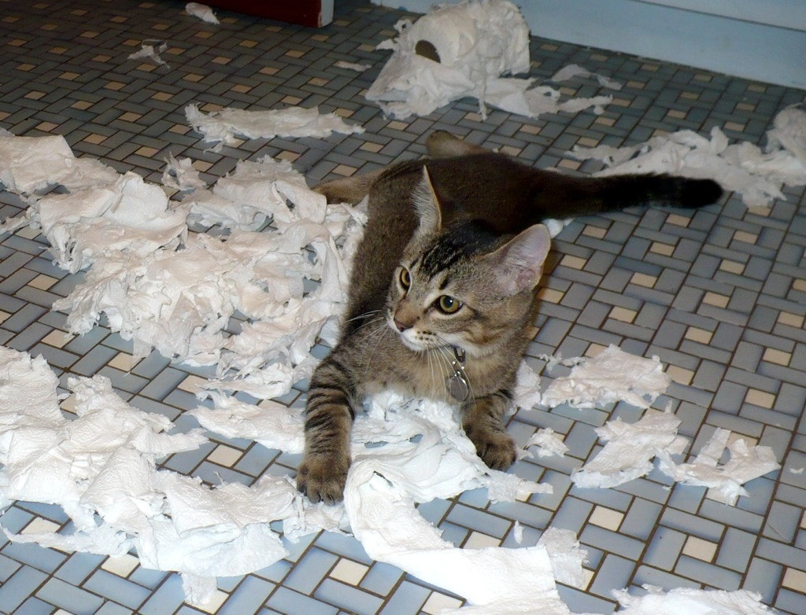
UV-VIS Bits & Pieces drill and practice

Slide 2
Text website exercise:
single beam double beam and multichannel instruments
http://www.cengage.com/chemistry/book_content/0495012017_skoog/student_website/as_ie1.html
Use internet explorer to open

Slide 3
What gas is excited in the UV source of
Both the Lambda 4B and Lambda 25/35 ?
D₂ (deuterium)
What is the hyphenated name of the optical path design of the Lambda 4B UV-VIS ?
Czerny-Turner
What kind of monochromator is in the Lambda 4B instrument ?
Echellette
What produces the visible spectrum in both the Lambda 4B and Lambda 25/35 instruments ?
Tungsten-Halogen bulb
Extends the life of the tungsten
(W(g) +I₂→ WI₂ (g)→ W(s) + I₂ (g)
What does the halogen do in the above source ?

Slide 4
What is the key difference between
the Spec 20 and either of our PE Lambda
UV-VIS instruments ?
Spec 20 is single beam
Lambdas are double beam
What component generates the double beam in the Lambda 4B ?
Optical chopper
What is the chief difference between the Lambda 25/35 and Lambda 4B ?
Lambda 25/35 has no chopper
What component allows the Lambda 25/35 to work without a chopper ?
Focusing, concave, holographic monochromator

Slide 5
Name two advantages of the holographic grating
1)Focusing (better throughput)
2) Less dispersion (scattering)
3) Less spherical aberration
What kind of detector is in the Lambda 4B ?
PMT (photomultiplier tube)
What kind of detector is in the Lambda 25/35 and how many are there in each instrument ?
2 Photodiode detectors (reference and sample)
The above detector is operated in `reverse’ bias for two reasons. What are they ?
Linear response to light flux
Lower capacitance=> faster response
What role does the `color wheel’ play in our double beam instruments ?
Removes unwanted light diffraction orders

Slide 6
If you need to increase the resolution of your uv-vis scan What two things can you change to achieve it ?
Slower scan rate
Smaller slits
What determines the 180 nm cutoff for our Lambda 4b and 25/35 instruments ?
Quartz cell absorption
The Spec 20 has one advantage over our Lambda 4B and 25/35 instruments.
What is it ?
Higher light intensity=> larger net signal
(single vs double beam)
Which measure is linear with concentration, %T or A ?
A (Absorbance)

Slide 7
What kind of transition occurs in our uv-visible instruments ?
electronic
Over what wavelength region does this occur in our instruments ?
180-1100 nm
Why are solution phase absorptions broad and continuous ?
Solvent interactions with absorbing species
What kind of species produces discrete and narrow uv-vis absorptions ?
Gas phase atoms and molecules

Slide 8
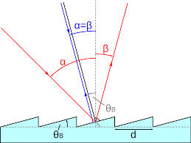
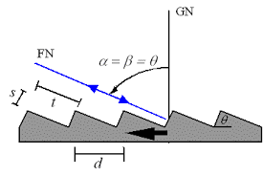
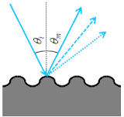
Drill and practice with UV-VIS technique (cont.)
echellette
echelle
Correctly name the two designs of monochromators above
Name of monochromator design shown to left
Holographic (curved) grating

Slide 9
Drill and practice with UV-VIS technique (cont.)
Provide two advantages provided by the holographic (curved) grating design
No chopper…simplifies optical path
Simultaneous sample and reference measurement
Lower spherical aberration
The chopper rotation frequency is ….:
Tuned to, to improve resolution
Used as the phase locking frequency that helps filter noise
Improves light intensity if increased
the Quadrature signal use to increase the PMT output

Slide 10
Drill and practice with UV-VIS technique (cont.)
List all the ways you can think of to improve the resolution of a specific UV-VIS instrument
Slower scan
Smaller slit widths
Maximize analysis order (n) [this is usually not available on regular instruments
Which is not a difference between the Lambda 4B and Lambda 25 instrument ?
Lambda 4b | Lambda 25
Chopper | No chopper
Echellette grating | Holgraphic grating
D₂ and tungsten-I₂ source | Photo-emissive source
One (1) PMT transducer | 2 photodiode transducers
Mirrors + focusing lens optics | Mirrors + beam split optics
Same source as Lambda 4b

Slide 11
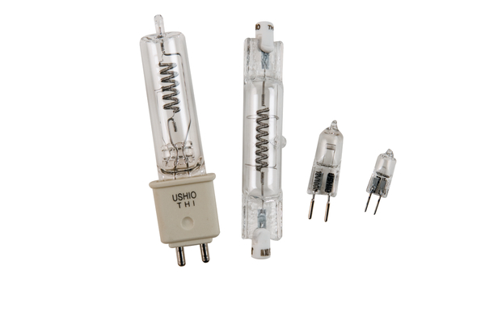
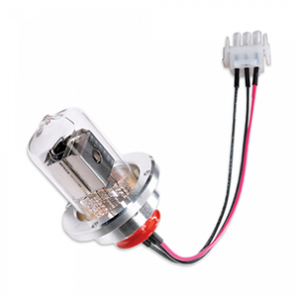
1)ID the names of the two sources shown
Drill and practice with UV-VIS technique (cont.)
2)Which is for vis and which is for UV ?
Tungsten-Halogen
Deuterium lamp
VIS
UV
Improves life span of W filament
What is the purpose of the halogen (I₂) ?
What is the transducer in the Lambda 4B ?
Photomultiplier tube (PMT)
What is the transducer in the Lambda 25 ?
Photodiode

Slide 12
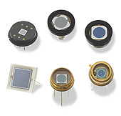
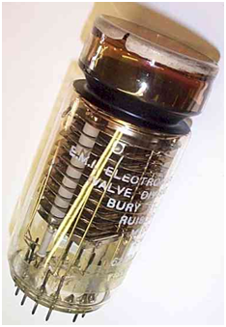
Which is the PMT and which is the photodiode ?
Drill and practice with UV-VIS technique (cont.)
PMT
Photodiode
What metal provides the low workfunction allowing a PMT to operate ?
Cs (cesium)
Name of the PMT part that amplifies the original Photocathode current
Dynode pairs

Slide 13
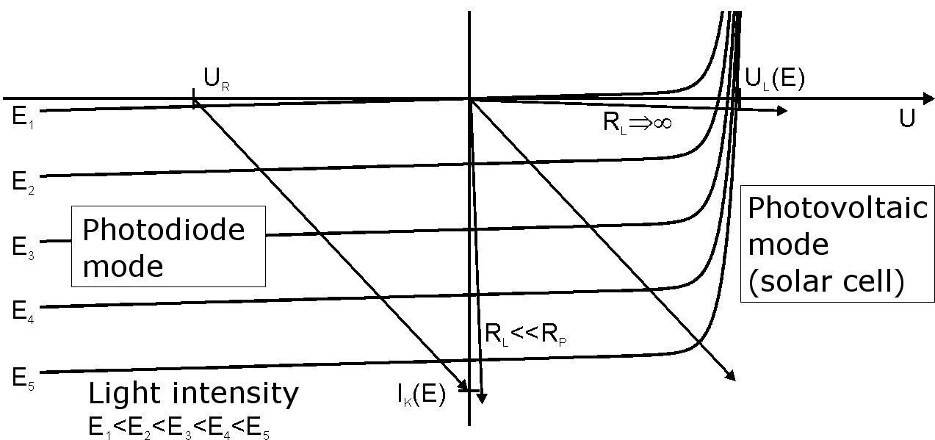
Drill and practice with UV-VIS technique (cont.)
In what part of the I-V curve is the Photodiode operated in UV-VIS
Reverse biasing
What is the technical name for this practice ?
Provide two reasons this is done in the Lambda 25 UV-VIS instrument ?
Lower capacitance=> faster response
Current linear with photon flux

Slide 14
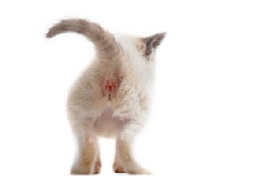
THE END

