Slide 1
What is the transducer in a standard AAS ?
PMT=photomultiplier tube
What is the reference path in a double beam flame AAS ?
The same optical path as sample but not including flame
What is the light source of an AAS ?
HCL = Hollow Cathode Lamp
What is the sample `cell’ for a flame AAS ?
flame

Slide 2
What is the `Achilles heel’ of the AAS method ?
Slotted burner/nebulizer
Name some problems with the above.
Discards >90% of sample
Chemical clogging (sulfates, carbonates, phosphates)
Hard to reproduce identical atomization patterns
What are the two monochromator designs common to AAS ?
Ebert (single beam)
Czerny-Turner (double beam)

Slide 3
What kind of light does an HCL produce ????
Discrete atomic lines
Which is not a broadening source:
a)Doppler b) pressure c) chemical d)uncertainty e) all broaden
What two alternative additives can be added to samples to free metals of carbonates and other precipitate-forming compounds ?
Releasing agents (lanthanum nitrate)
Chelates (EDTA)

Slide 4
The HGA method is more sensitive than flame AAS but less:___________________
Reproducible
Inductively Coupled Plasma
ICP stands for: _____________________
Plasma torch
The source of an ICP is the: ________________
The coupling of the rf/microwave field to a coil creates Ar+ which collide to heat the gas via ________heating
Ohmic
(collisional)
The usual sampling fluorescence from the torch is : (U pick)
radial
axial
circular
circadian

Slide 5
The hottest temperature of the torch is:
~10-12,000 K
The temperature sampling of atoms is done is typically: _________________
6300-6500 C
Old school transducer arrangement for ICP
Rowland circle
“New” school transducer arrangement for ICP
2D array Charge Coupled Device (CCD)
What combo of grating and prism is required for ICP ?
Echelle grating and dispersing prism (need to make 2D spread of wavelengths)

Slide 6
Name two disadvantages of AAS ?
Only does 1 element at a time
Chemical interferences
How does ICP allow you to simultaneously analyze many elements at once ??
Source plasma causes all sample elements to fluoresce and the 2D optics of ICP allows their simultaneous recording
Which method(s) still require a nebulizer ?
AAS
Electrothermal
ICP

Slide 7
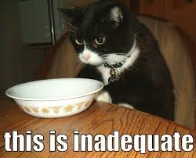

Slide 8
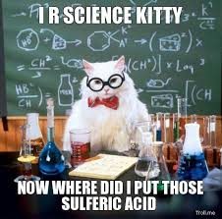
Time for some…..

Slide 9
WHAT TO READ IN SKOOG ON IR
IR effect and phenomena pp 389-391 (16A-1)
Vibrational Modes pp 395 (16A-4)
Instrumentation:
Dispersive (old school) pp 401-403 (16B-2)
FT (single beam (modern) pp 397-401 (16B-1)
FT theory pp 186-192 (7I-1→7I-3)
Bits and pieces 16C-1,2
a)Sources 406-408
b)Transducers 408-409
c)Cells and samples 412-416 17A-1
d) ATR 427-428

Slide 10

???

