Slide 1
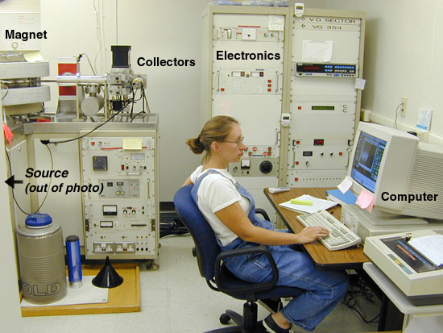
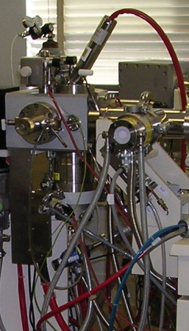
Tour of the Modern Magnetic Sector Instrument
student
Sector MS-University of Wisconsin Department of Chemistry
Inlet plumbing + source (North Carolina State instrument)

Slide 2
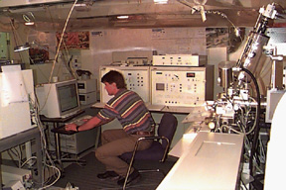
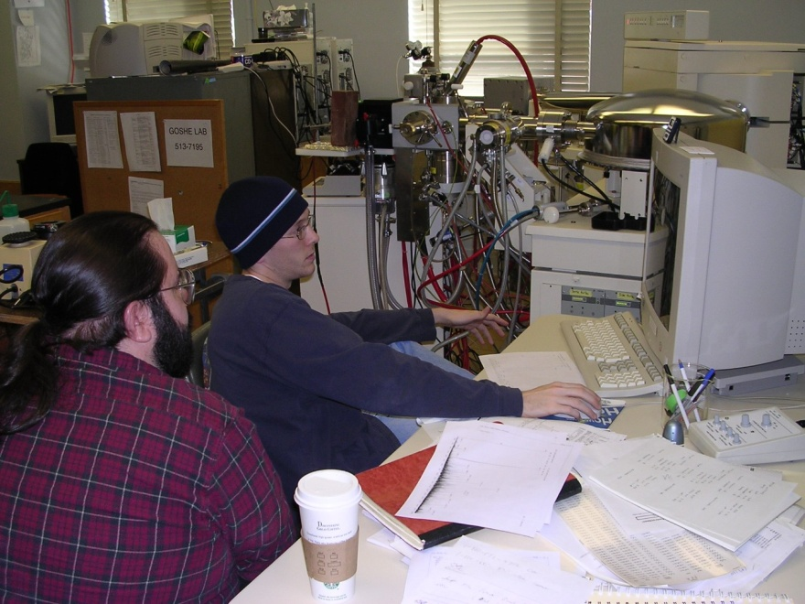
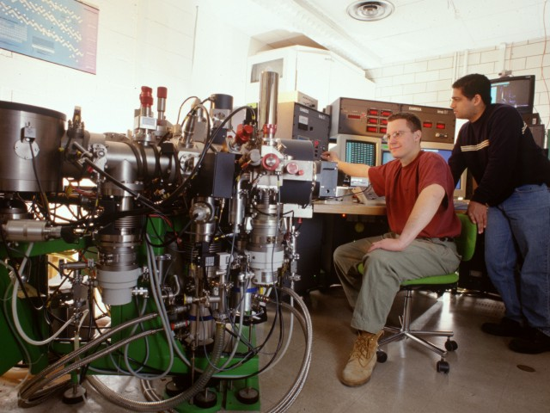
Typical modern ms labs-au’ natural
U of Wisconsin
NC State
Average ms scientist after a few years
MS…an extremely hardware-bound and often draining sport
Johns Hopkins

Slide 3
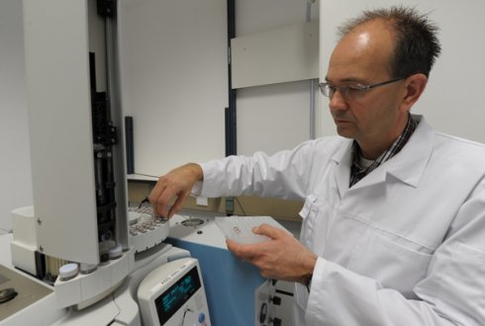
Average Mass Spectroscopist after a few years….

Slide 4
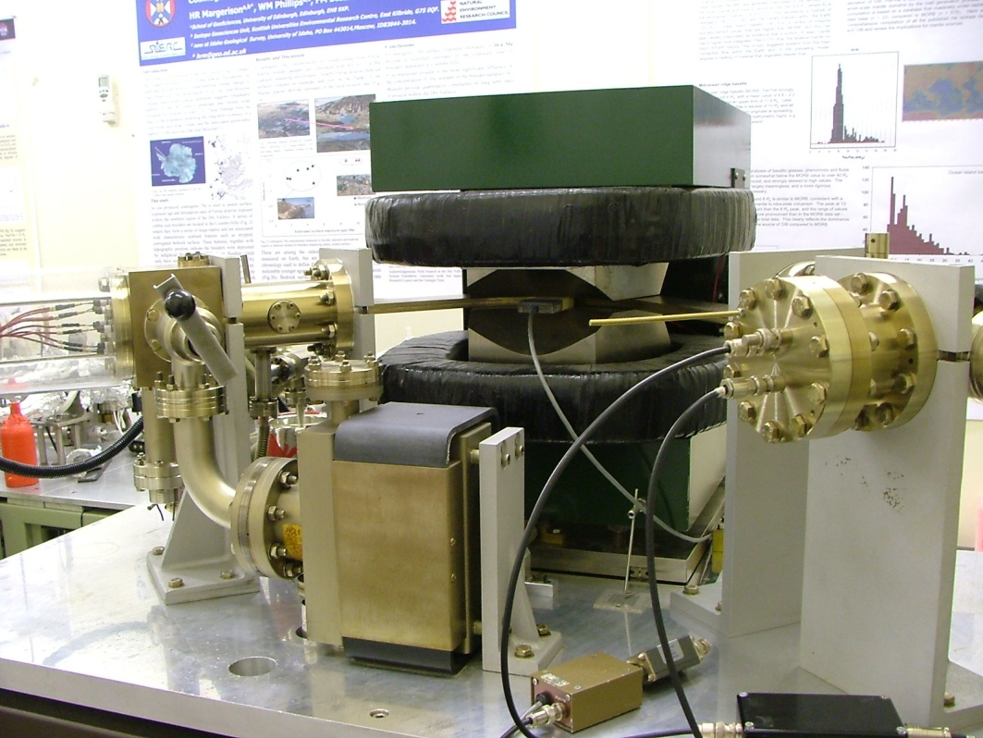
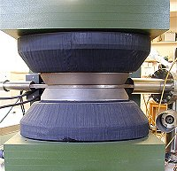
Tour of common major ms components: magnets and “Conflat” UHV* Stainless steel plumbing
Typical plumbing geography
Close-up of magnet
*UHV=Ultra High Vacuum

Slide 5
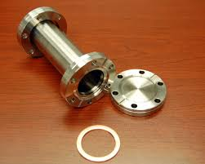
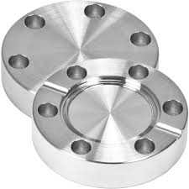
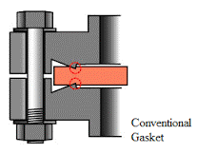
Conflat flange design

Slide 6
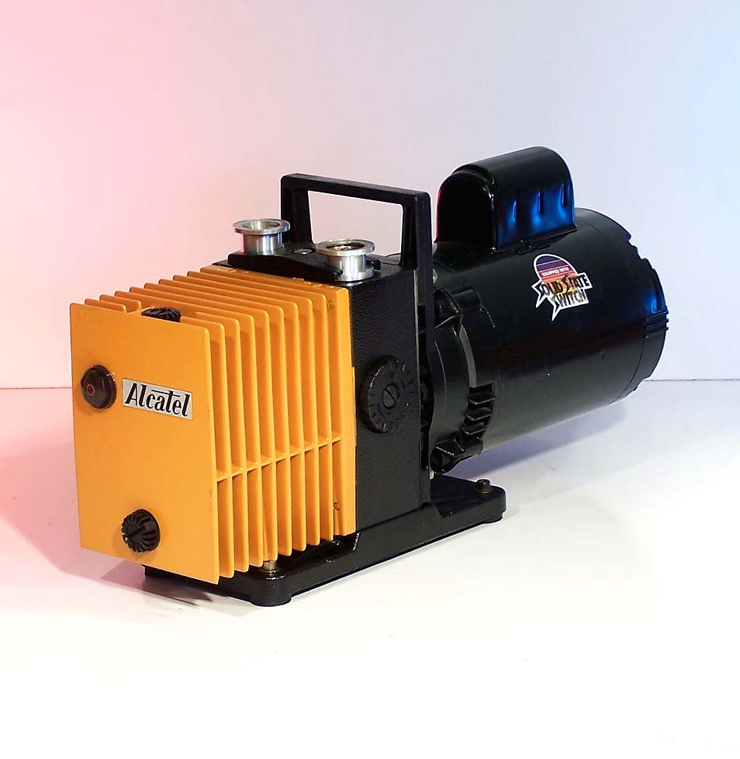
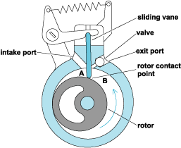
Tour of major ms components: vacuum pumps
Roughing (mechanical) pump
Gas out here
Oil in here
Schematic of rough pump rotor assembly
Note on units:
1 mm Hg =1000 μ
1 mtorr= 1 μ
10⁻⁶ atm =0.76 mtorr ~ 1mtorr =1 μ
Rough pump moves pressure from
1 atm-→ 0.00001 atm ~ 10 μ

Slide 7
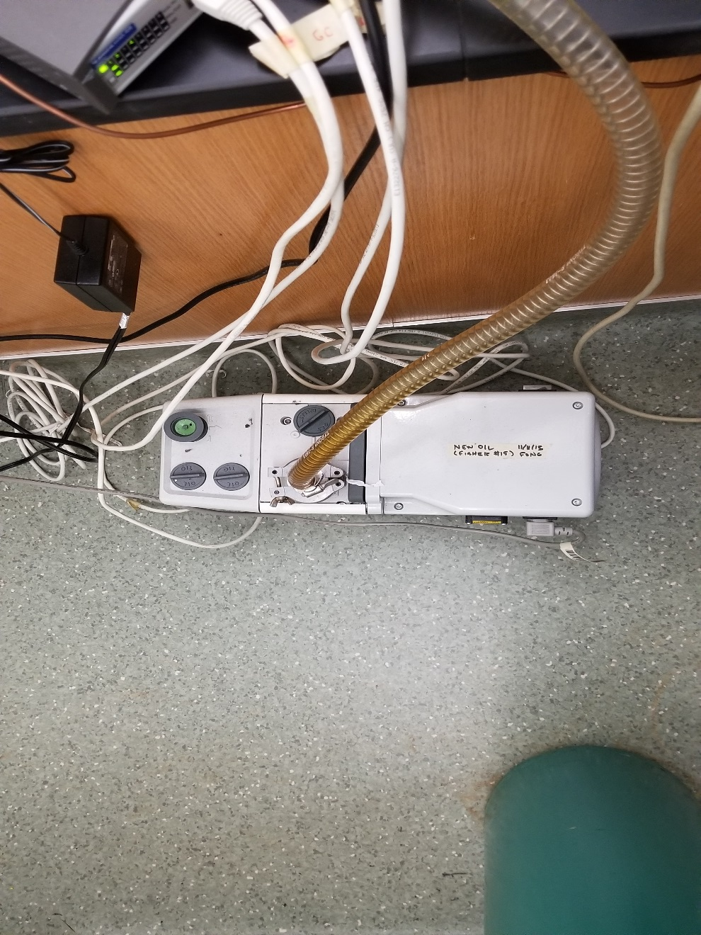
ASC MECHANICAL PUMP FOR BOB
to turbopump

Slide 8
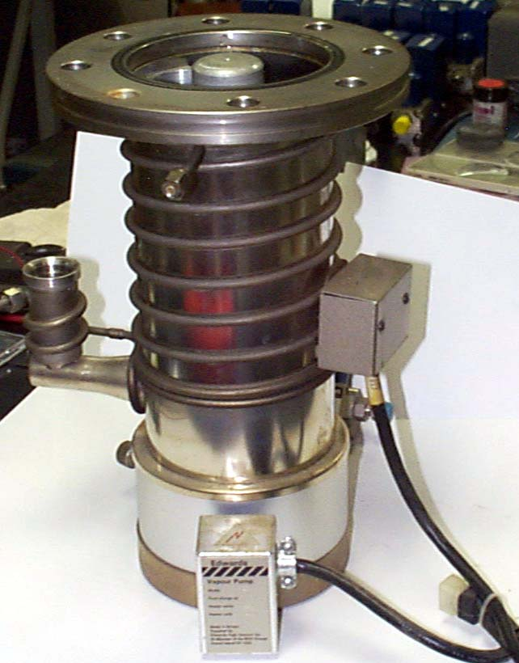
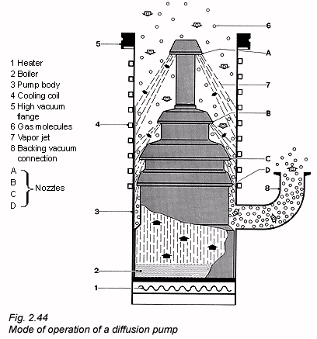
MS components continued: diffusion pumps
From ms manifold
Out to rough pump
1000 μ → 0.001 μ
Specially made` diffusion’ pump oil (a stable silicone, e.g. Dow-Corning 701) is heated, misted and rained down through nozzles to entrain gas from ms manifold

Slide 9
ASC OIL DIFFUSION PUMP ON ELANOR
TO MECHANICAL PUMP

Slide 10
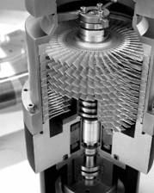
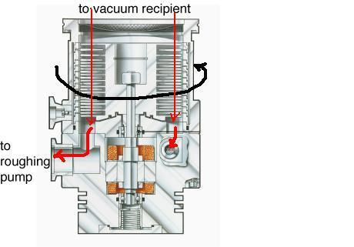
MS components continued: alternative to diffusion ..turbomolecular pumps
From ms manifold
Louvered vanes scoop up gas and guide them out to rough pump
Shaft turns at 10⁴ /s
Nearly supersonic
Cutaway of turbo pump
Turbo pumps are now the dominant choice…not greasy and no outgassing problems…but $$$

Slide 11
ASC TURBOMOLECULAR PUMP AND PHILLIPS GAUGE ON BOB

Slide 12
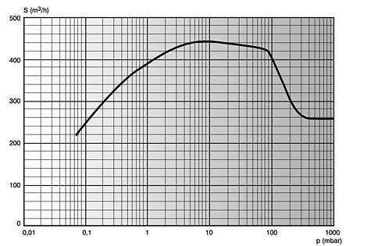
MS components continued: turbomolecular Pumping speed vs pressure
Oil diffusion begins to lose it here
Turbos rated down to10⁻⁶ μ
1 μ
1000 μ
Start of UHV (ultra high vacuum range: 10⁻⁸ atm)

Slide 13
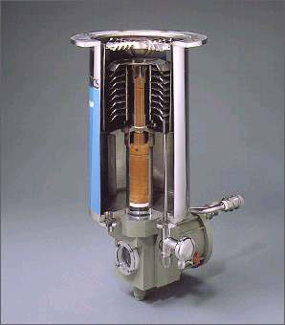
MS components continued: other pump types
Cryopump
Fill cooling loop with refrigerant (liq. N₂)
and freeze out condensable gases on outside of loops
To rough pump (takes out air)
Achieves ~ 0.01-0.001 μ

Slide 14

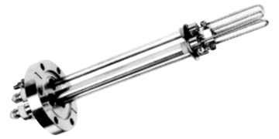
MS components continued: other pump types (continued)
Titanium sublimation pump
(also called a getter pump) …two basic parts:
3) Achieves 0.001 u ?
2)Reactive residual gases not pumped away by rough pump are reacted on baffle surface
B) Getter surface
A) Ti sublimation source
1) Ti is sputtered from three hair pin loops of Ti

Slide 15
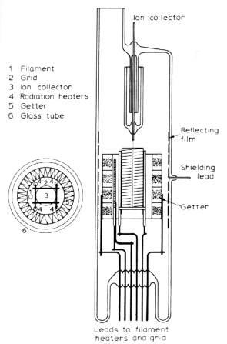
MS components continued: other pump types (continued)
Ion pumps
4) 10⁻¹⁰ → 10⁻¹² atm
(0.01 -0.0001 μ)
Ion trap collector
(+)
1)Best choice for UHV work:
3)or collected at anode trap
2)Ions formed from impact of electrons which are gettered

Slide 16
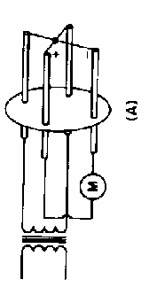
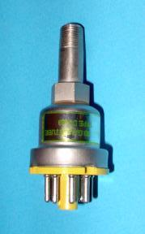
MS components continued: vacuum gauges
Thermocouple gauge
Good from 1 atm-10 μ
Thermocouple junction measures variation of temperature created by residual gases and converts to volts measured at (M)
Produces constant T at reference side
Poor chemist’ universal P gauge… $ 50 (without electronic amplifier)

Slide 17
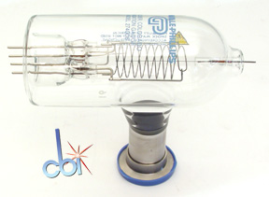
MS components continued: vacuum gauges
Phillips-Granville high vacuum gauge
cathode
Conductance measured here
1)Works by sending a current across space between anode wire and cathode loop
anode
…and at fixed (high) voltage measuring conductance
Measures down 10⁻⁶ u
(also called simply: ion gauge …$1000/tube)

Slide 18
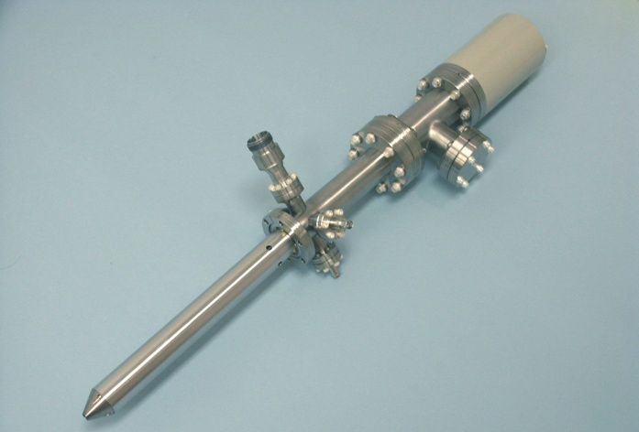
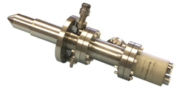
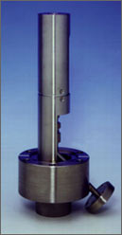
MS components continued:
Electron impact (EI) source
Various designs from HP, Thermoelectron and Perkin-Elmer

Slide 19
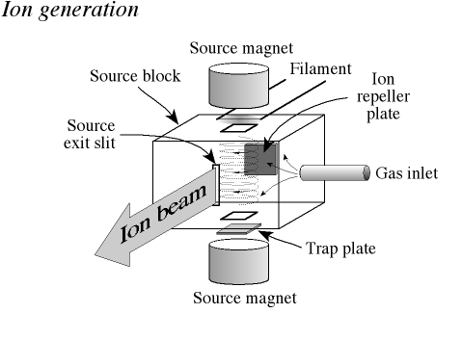
MS components continued:
Electron impact (EI) source (cont.)
SOURCE BLOCK
Magnets used to focus beam and inject into ion accelerator*
…otherwise ions will wander like sheep

Slide 20
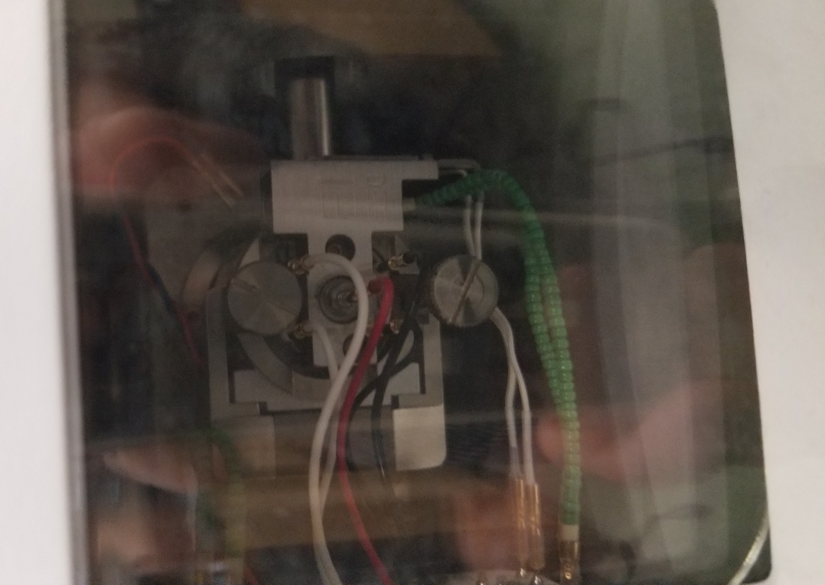
ASC SOURCE AND REPELLER FOR ELANOR
Filament off

Slide 21
ASC SOURCE AND REPELLER FOR ELANOR
Filament on

Slide 22
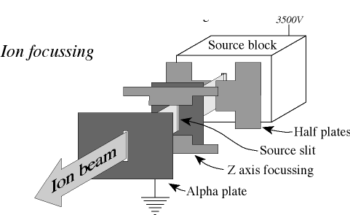
MS components continued:
Electron impact (EI) source (cont.)
This piece caled the ION or MASS ACCELERATOR or `ION OPTICS’
Ions created and focused out of source block slit are accelerated through a series of +/- plates
Addendum:
`accelerator’ to produce fixed velocities….tied to net voltage V across +/- plates

Slide 23
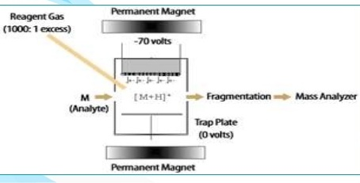
Alternative to EI: Chemical Ionization (CI):
A `soft’ alternative to EI
CI attributes
High pressure of `reagent’ gas (CH₄ common)*
Low accelerating voltages
From GC
M +CH₄⁺
CH₄⁺ replaces electrons
But many other small molecules are also used: NH₃, CH₃CN (acetonitrile), C₂H₆…

Slide 24
The low energy and `softness’ of CH₄⁺ means much less fragmentation of target molecules
EI
Fragmentation pattern
e⁻ accelerated
at 1400 V
Target molecule
C₆H₅⁺ C₆ H₄⁺ C₅ H₄⁺ C₅H₃⁺ C₄H₄⁺ C₄H₃ C₃H₃ C₃H₂…
C₆H₆
CI
CH₄⁺ accelerated
at 70 V
Target molecule
CH₄⁺
C₆H₆
C₆H₆⁺ or C₆H₇⁺
Only P⁺ or PH⁺

Slide 25
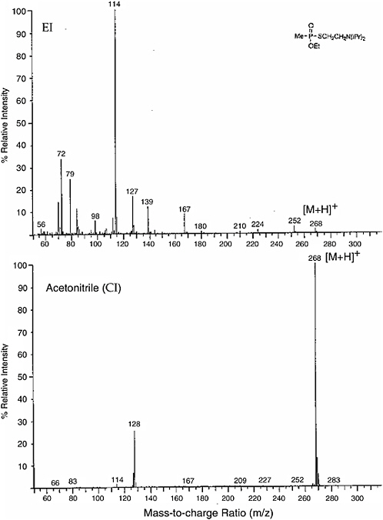
EI vs CI spectrum of a complex compound
Target molecule
MW 267

Slide 26
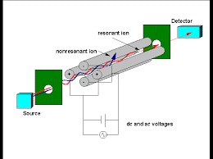
The quadrupole mass selector (ASC)

Slide 27
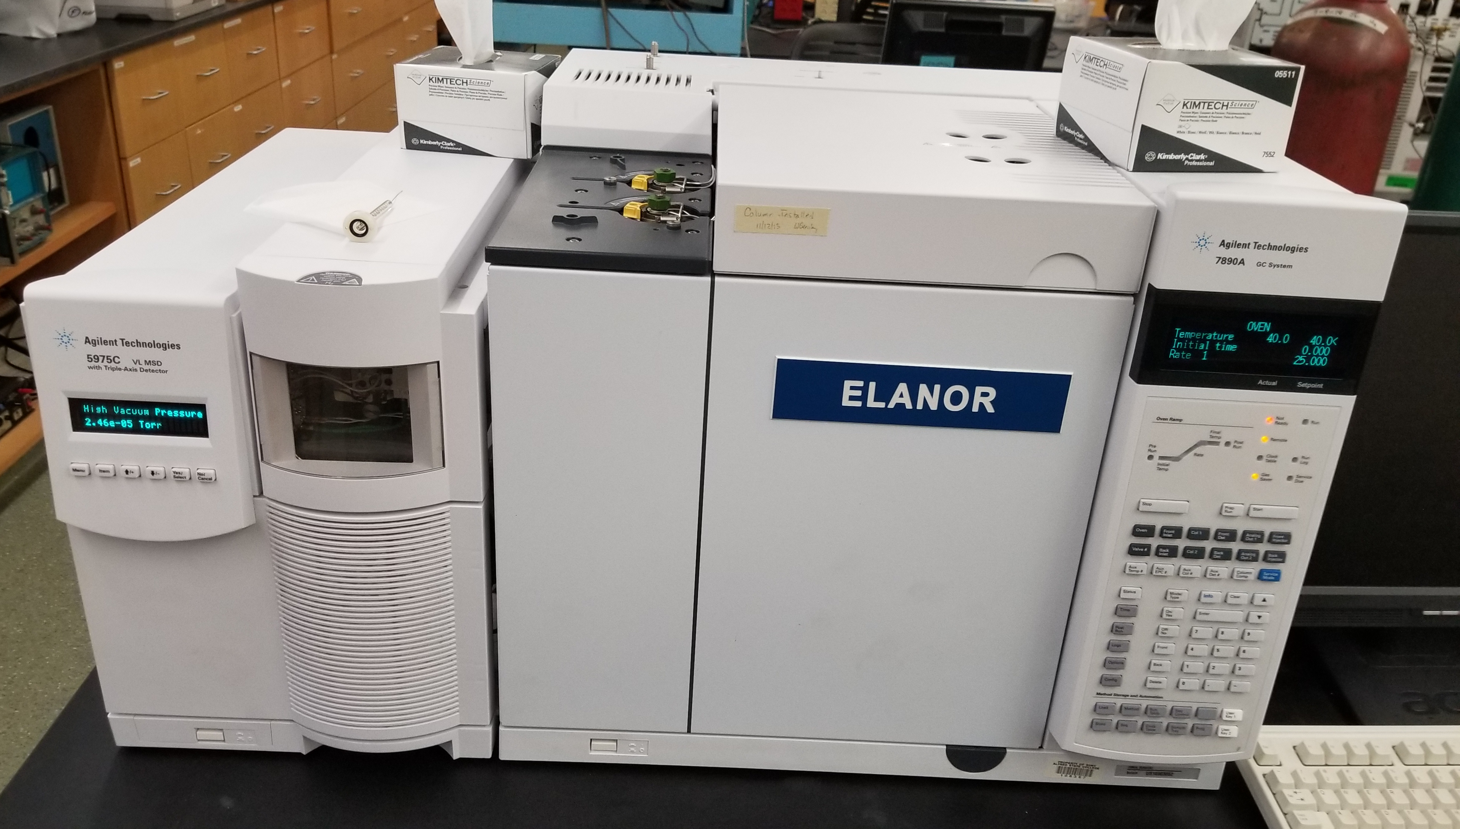
ONE of ASC’s GC-MS (ELANOR)
Filament and repeller (on)
GC
MS
Transfer (AUX) line in here

Slide 28
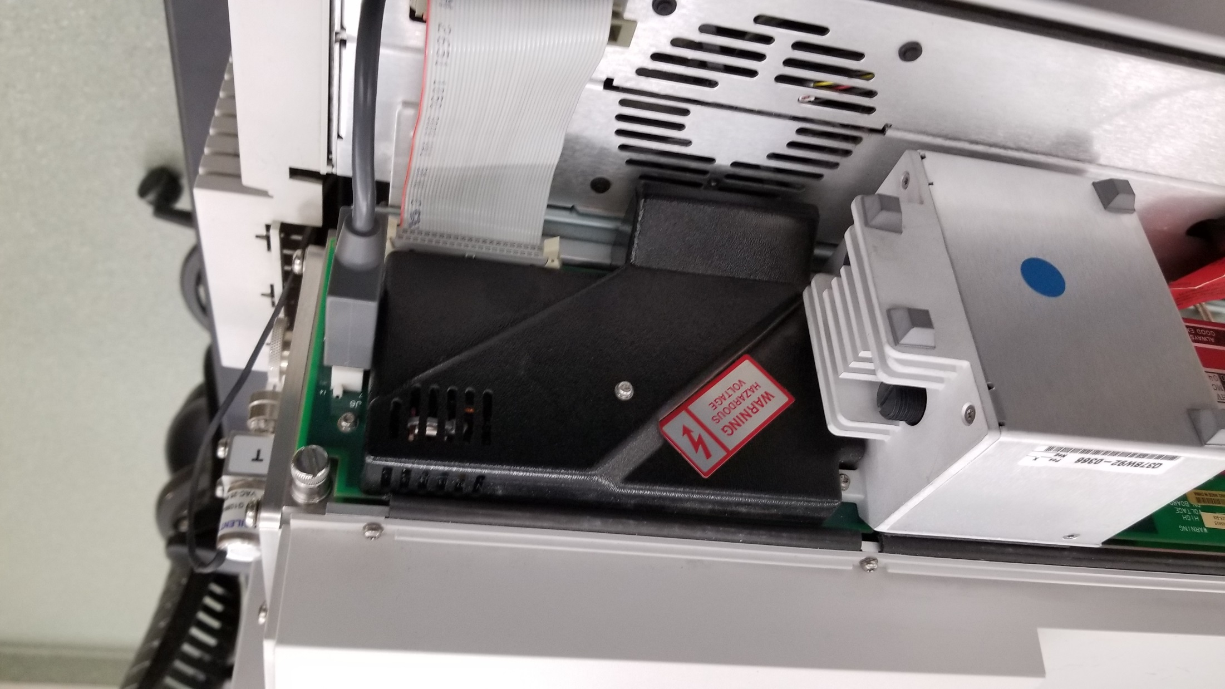
Side view of ASC MS (Babette): All you can see `under the hood without breaking vacuum

Slide 29
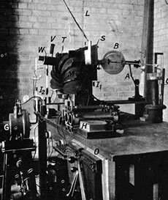
The MS Body parts game
Where is the `detector ?
Where is the vacuum pump?
Where is ion source?
First ion source
… a stick shape
1st detector:
Kodak 35 mm film records spectrum
Mechanical pump

Slide 30
Find the source game
White ceramic back cap is a hint

Slide 31
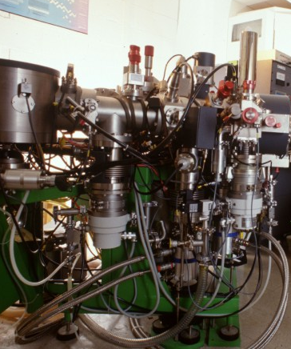
MS parts game (cont.)
ion acceleration (optics)
1)Find pumps
magnet
2) Find magnet
or
(probably) source (or TC gauge ?)
4) Find ion source
Diffusion pumps
3) Find ion optics (accelerator)

Slide 32
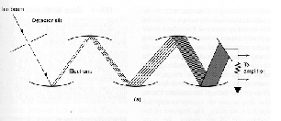
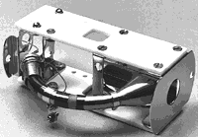
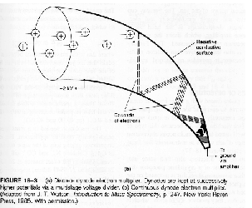
MS components continued: dynode detector design
Original electron dynode multiplier design: emissive plates at angles
Compact version of dynode multiplier
Gain factor is 10^{6 –}10¹²

Slide 33
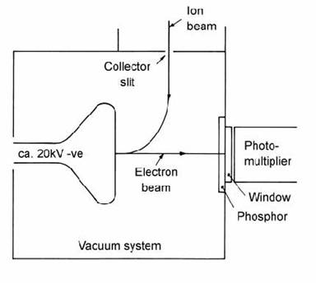
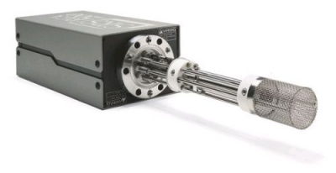
A few more MS bits & pieces: other designs and approaches
Alternative to dynode detector FARADAY CUP
Can also be voltage amplifier (op amp)
Detector pod
Faraday cage
(keeps all charges inside)

Slide 34
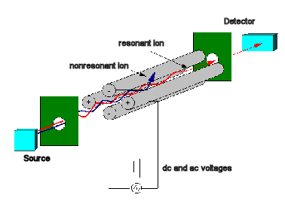
A few more MS bits & pieces (continued)
Alternative to magnetic sector: quadrupole design
Pros
Smaller
Cheaper
Stable
Rugged
Cons
Tuning is tricky
Usually poorer resolution (R)
Alfred MS is quadrupole
See text for description of control issues

Slide 35
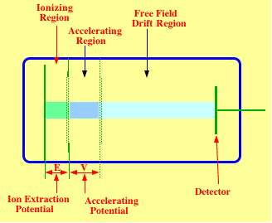
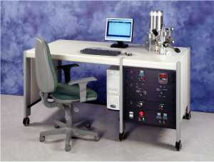
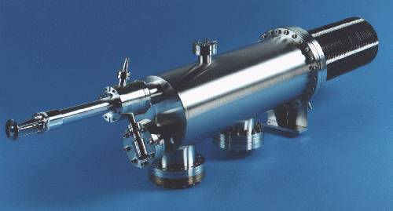
A few more MS bits & pieces (continued)
Pros (vs quadrupole)
Even smaller than quadrupole (no magnets at all !)
Even cheaper alternative:
Time-of-Flight (TOF)
~ 1 foot¹
Con (vs quadrupole)
Resolution only 1 amu (lousy)
¹ even smaller than original Aston MS

Slide 36
Summary of bits and pieces
Pump types
Gauge types
*Mechanical 1 atm -10 μ
*Thermocouple 1 atm-10 μ
Cryopumps 10-0.01 μ
Pirani gauge 100-0.1 μ
Diffusion 1000-0.001 μ
Phillips ion gauge 10 u ---0.00001 μ
*Turbomolecular 10-0.0001 μ
Ti sublimation 10 -0.01 μ
Most common source
Ion pump 1-0.00001 μ
*EI = Electron Impact
*Red colored components in Alfred instruments
Most common detector
*Dynode multiplier (Rheodyne)

Slide 37
Example of Computing R= MS Resolution
Determine minimum spacing where two peaks are still distinguishable :
count
27.95 amu
28.05 amu
ΔM=28.05-7.95=0.10
28.00 = M_{av}
(half-way between two peaks)
Mass (amu)
R= M_{av}
ΔM
=28
0.1
=280 Higher is better

Slide 38
MS Designs compared
Resolution = R= M/ΔM
Example
for M=32 amu ΔM=0.1 amu=>
R= 32 = 320
0.1
Design feature
Magnetic sector
Max 20,000
300-500 k$
Need whole room
research
Quadrupole
Max 2000
75-100 k$
1-2 bench tops
Forensics, analytical chem, environment, education
TOF
Max <500
20-30 k$
½ bench top
Industry, limited species , field
R
$
Size
use

Slide 39
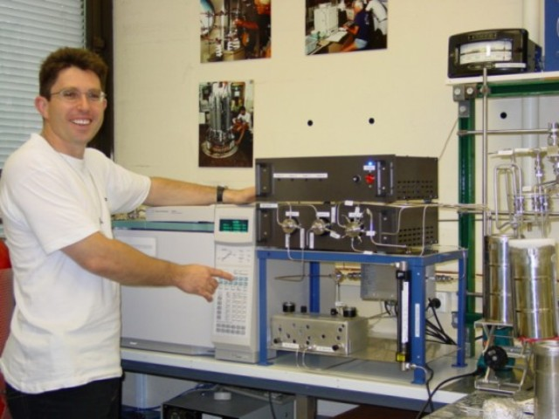
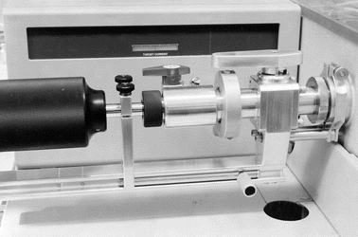
A few more MS bits & pieces (continued)
Traditional MS inlet designs
Indirect gas inlet
Direct probe

Slide 40
GC-MS inlet system
EI
Sample injection here
*
GC oven
*
Sample M
MS chamber
Quad head
(w/ion optics)
He
Transfer line (heated)
Capillary column
Quad rods
To detector
M+ (*)

Slide 41
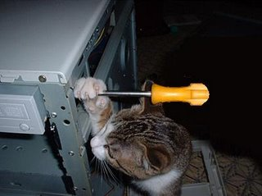
To call a service person to fix a mass spec costs ~$2000-$7000/day (depending on parts)
So…You break it, you fix it, maggots !

