Slide 1

We’re doing MS next !!

Slide 2
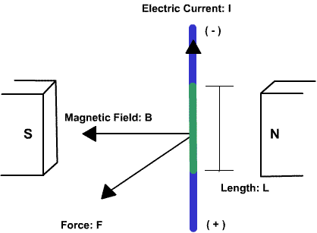
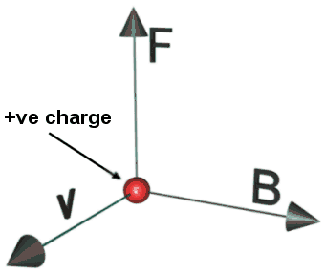
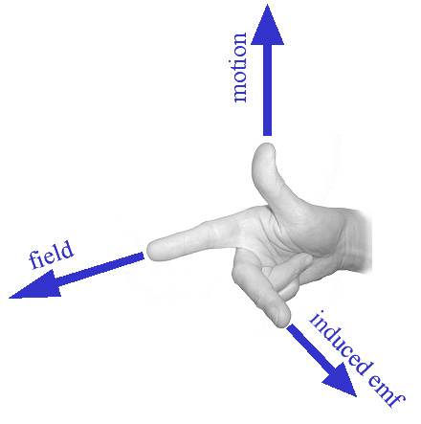
Introduction to Mass Spectroscopy (MS)
Key physics effect
Effect of charge flow direction on magnitude of Lorentz force, F
`Lorentz’ Force (F) Effect
(an example of the Right Hand rule for e⁻)*
current
For + species common in mass spec use left hand rule to decide direction of Lorentz force
N
S
F

Slide 3
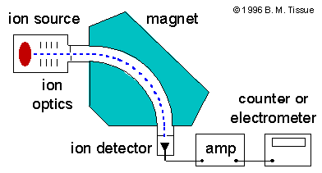

Magnetic sector MS design
Variable effect on R (radius of turn)
B up
v up
q up
m up
q
v
R down
m
R up
B
R down
R up
R
R ~ mv
qB
Vary v with ion optics for fixed R, H and rearrange…
R
RB ~ m
v q

Slide 4
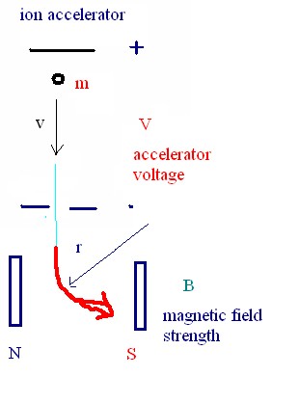
A tiny bit of physics-measuring m/q (mass/charge ratio) in magnetic sector instruments
1)Basic Electrical theory
MS schematic
q= count of charge= 1,2,3…
e=charge in coulombs on an electron (1.6E-19)
V= energy/coulomb= voltage
E_{m} = V(energy) * q*e (coulombs)
(coulomb)
2)Basic mechanical theory
m = particle mass
v= particle velocity
E_{m} = ½ mv²
3) Basic Magnetic effect
r = radius of turn in magnetic field
B= magnitude of the magnetic field
r = m v = radius of turn
qeB

Slide 5
Putting it all together…
3) r = m v = radius of turn
qeB
2) E_{m} = ½ mv²
+
E_{m} = ½ m (qeBr)²
m²
+
1) E_{m} = V(energy) * q*e
E_{m} = ½ m (qeBr)² ⁼ V(energy) * q*e
m²
m = 2V
q B²r²
Reorganize to get m
q

Slide 6
Using what we’ve derived to scan a magnetic sector MS
From Physics:
m = 2V
q B²r²
From Experimental conditions:
1) B constant
2) Set detector to record only at fixed r
m = constant *V
q
∴Vary accelerator voltage V to scan range of m/q

Slide 7
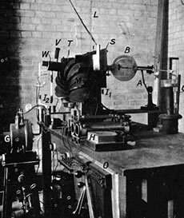
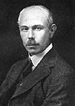
Magnetic Sector design (continued)
Francis William Aston
Cambridge University UK
Nobel Prize in Chemistry 1922
The first sector mass spectrometer (Aston 1919)

Slide 8

First recorded ms spectra: Ne and Cl₂
(Aston magnetic sector system)
²⁰Ne ²²Ne
Ne isotopes*
Exposed film strips
* 10 protons + 10 or 12 neutrons
Cl isotopes**
m/q increasing →
³⁵Cl
³⁷Cl
17 protons + 18 or 20 neutrons
Why are there so many peaks for Ne and Cl which have only 2 isotopes ????
Aston’s vacuum system was crude….air, water, CO₂ and other contaminants are being detected

Slide 9
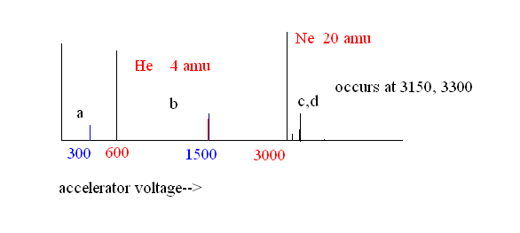
`old school’ MS of He
Voltage scan of magnetic sector MS of He
1a)What are the mass of peaks at a,b,c &d (300, 1500, 3150 & 3300 volts ?
4*300=2 amu
600
20*1500=10 amu
3000
20*3150/3000 =21 amu
20*3300/3000= 22 amu
1b) What are the likely sources of these peaks?
₄He²⁺
₂₀Ne²⁺
₂₁Ne⁺
₂₂Ne⁺

Slide 10
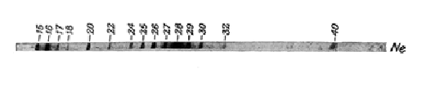
`old school’ MS of Ne
Voltage scan of magnetic sector MS for Ne
Based on the crudeness of Aston’s vacuum, what are likely sources of masses at 16,17,18, 28 & 32 in Aston’ s first MS of `Ne’ ?
16 17 18 28 32
Your
assignment?
O₂⁺
O⁺
OH⁺
H₂O⁺
N₂⁺

Slide 11
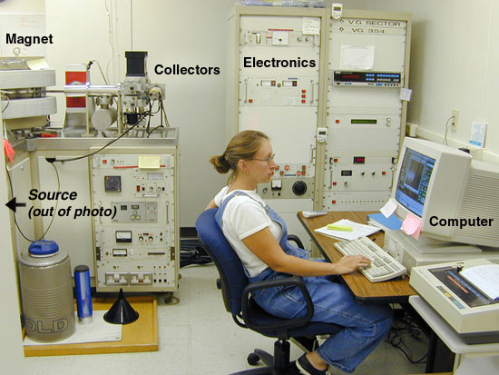
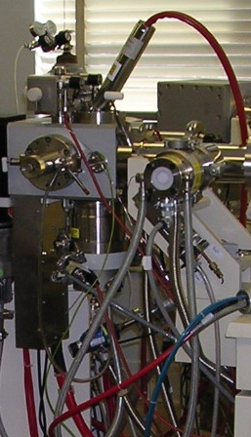
Modern Magnetic Sector Instrument
student
Inlet plumbing + source (North Carolina State instrument)
Sector MS-University of Wisconsin Department of Chemistry

Slide 12
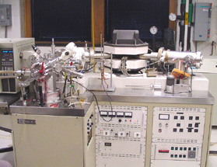
Holistic view:
Magnetic Sector Instrument: University of Michigan Ann Arbor Chemistry Department

Slide 13
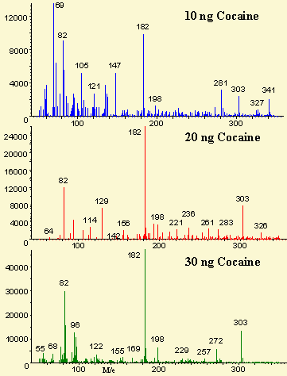
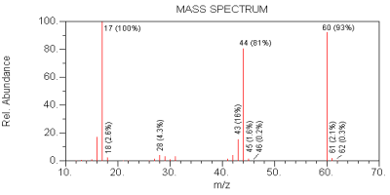
Typical Modern MS spectra
Essence of pee (urea)
cocaine
Detector current
(count)
Mass/charge ratio (m/e)=(m/z)

Slide 14
