Slide 1
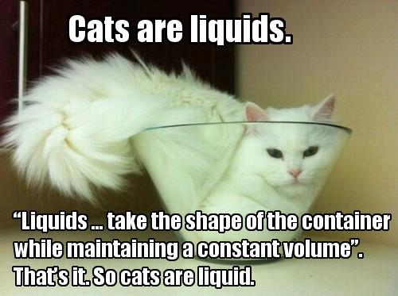
Introduction to High Performance Liquid Chromatography (HPLC)

Slide 2
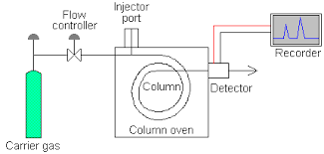
Flow scheme for GC reprised

Slide 3
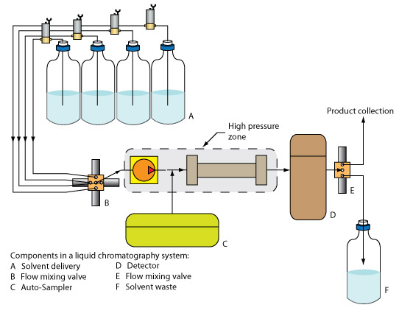
Flow scheme for High Performance Liquid Chromatograph
4) Sample mix is separated on short ~10” packed column
1) Solvents selected by quaternary
Mixing valve (A)
5) Separated components detected at detector
Packed column
Detector (D)
HPLC pump
Quaternary flow mixing solenoid valve (B)
HPLC injector port (sample in here too)
6) Exiting mixture is discarded here
2) High pressure HPLC pump sucks selected solvents into and through injector port (C)
3) Sample mix is injected into port and combined with solvents

Slide 4
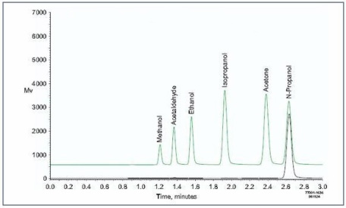
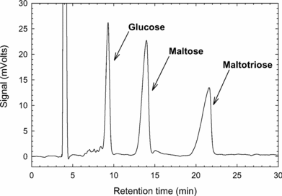
GC chromatogram
HPLC
chromatogram

Slide 5
GC vs. HPLC
Thermal ramp
Gas mobile phase (He)
3. Flow produced by gas pressure
4. Flow is often split
Separated species often lost during detection
Chemical apps common
10-20 m capillary columns (long)
Solvent mixing/25 ºC
Liquid mobile phase (solvents)
Flow produced by pump
4. Flow is not split
Separated species can often be recovered
Biological apps common
0.25 m packed columns (short)

Slide 6
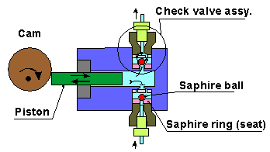
Single piston HPLC pump
Must achieve maximum of 60-120 MPa pressures without leaking or seal failure (600-1200 atm=9000-18,000 psi)
$3000-6000

Slide 7
Animation of HPLC reciprocating pump with commentary
https://www.youtube.com/watch?v=dUcSqRIDCK8

Slide 8
Push (upper seal opens and mobile phase pushed into column; bottom seal closes)
Pull, upper seal closes so that fluid starts to slow down in column; bottom seal opens and re-fills piston with more fluid
PRESSURE IN COLUMN VS TIME

Slide 9
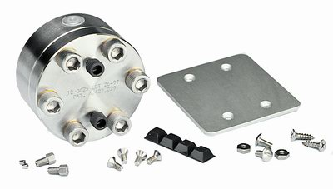
Pulse damper for 1 piston HPLC system
Utilizing the ‘pee in the pool’ effect
Smooths out sinusoidal pulsing of 1 piston motion
NO DAMPER
PRESSURE IN COLUMN VS TIME
DAMPER

Slide 10
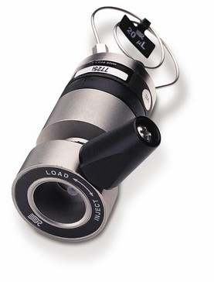
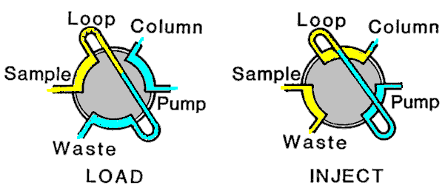
HPLC Injector Port ($750-1750)
Calibrated sample loop: where sample goes when loaded
Teflon gasket allows arm to turn without pressure loss. It can be torn with poor injection technique and create port leaks.
(Why blunt micro syringe is mandatory)

Slide 11
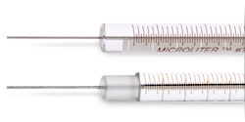
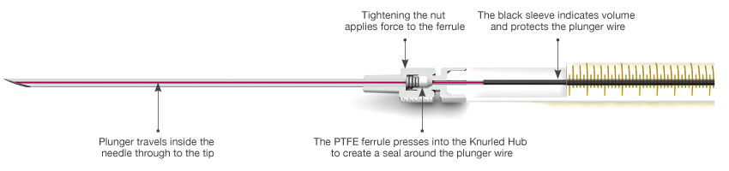
HPLC YES –blunt end ☺
HPLC NO –beveled end ☹

Slide 12
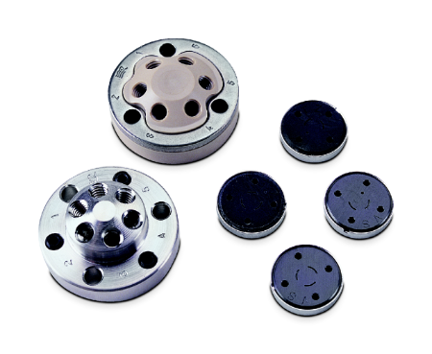
Details of injector port assembly
Teflon gaskets
Threads to fixed volume loop and column
Metal mating gaskets (holes lead to ‘Load ‘ or ‘Inject’ positions)
Bolt holes for bolts to press gasket system together

Slide 13
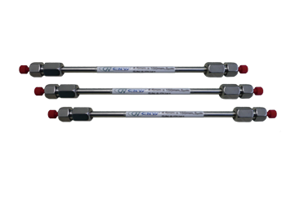
Analytical HPLC columns
magnify
Porosity
4.6 mm x 250 mm , C-18, 5 u , 300 Ǻ
ID x Length
Packing size
chain length bonded to silica packing (stationary phase)
$500-$2500

Slide 14
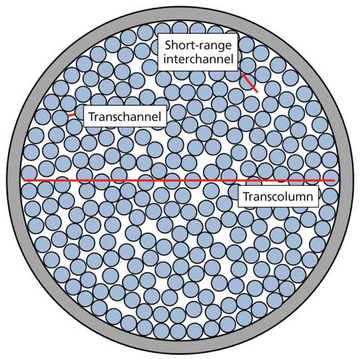
Packing diameter (5 μ)
Porosity
500 A = 0.05 μ
Cross-section of typical analytical HPLC column

Slide 15
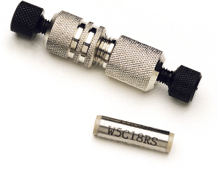
Cheapskate alternative to analytical column
~ $150-250/5 pack = $30-50 each
Guard Column
(2.5 cm ~ 1 inch); usually C-18, 5u, 300 A
Guard column= protective, packed column that filters unwanted components out to protect actual column from degrading.

Slide 16

HPLC Detectors ... A laundry list (see also table 28-1 p. 753)
UV-VIS fixed wavelength (ASC)
Fluorescence fixed wavelength
Refractive index
Electrochemical
Detector sits here
Mass spectroscopy
IR

Slide 17
Some HPLC = High Performance (Pressure) Liquid Chromatography terms
Isocratic= constant composition of mobile phase
Isobaric= constant pressure
Reverse phase column=> polar mobile phase eluting non-polar analyte species (example methanol:water separating toluene/benzene mix in methanol); a reverse phase column has a non-polar stationary phase.
Normal phase column=> non-polar mobile phase eluting polar analyte species (example: octane/cyclohexane separating hexanol/methyl ethyl ketone mix in hexane) ; a normal phase column has a polar stationary phase
Size Exclusion LC- a method to separate based on molecular size (shape)
Ion LC-uses ion exchange columns which `retain’ + or – ions for a time (by swapping stationary phase ions on column); usually aqueous systems

Slide 18
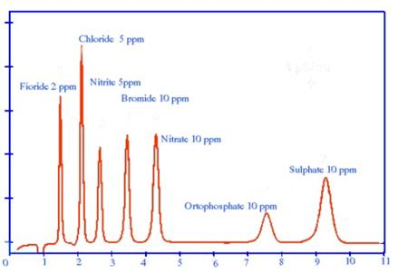
Example of anionic ion chromatogram (=> positive charged resin column)

Slide 19
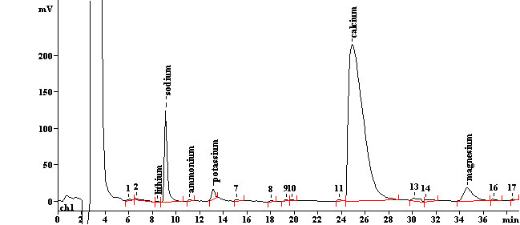
Example of cationic ion chromatogram (=> negatively charged resin column)

Slide 20
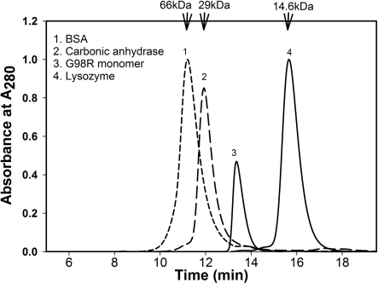
Example of a Size Exclusion Chromatogram (note: 1kDa =1000 amu)

Slide 21

I need more reciprocating pump pressure to get out of here !

