Slide 1
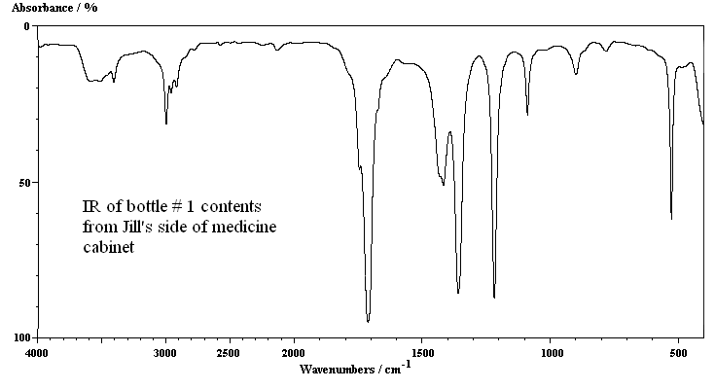
IR of contents in bottle#1 (2.6. chapters 6 & 7)

Slide 2
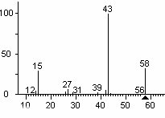
MS of contents in bottle #1( 2.6 chapters 6 & 7)

Slide 3
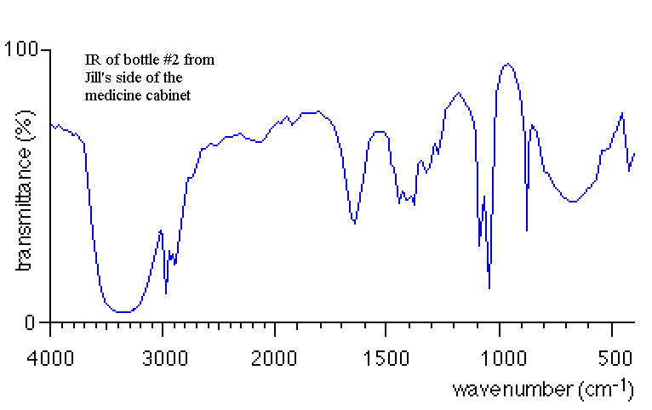
IR of contents in bottle#2 (2.6 chapters 6 & 7)

Slide 4
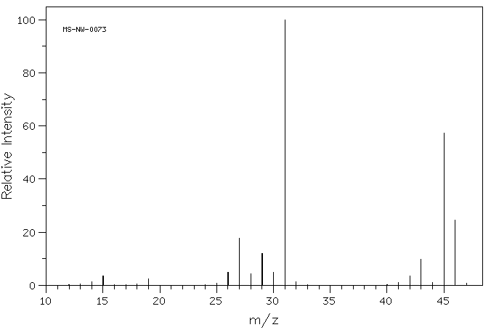
MS of contents in bottle#2 (2.6 chapters 6 & 7)

Slide 5
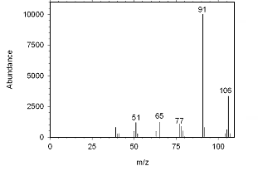
MS of trace impurity (S) in bottles 1 & 2
(2.7 chapters 8 & 9)

Slide 6
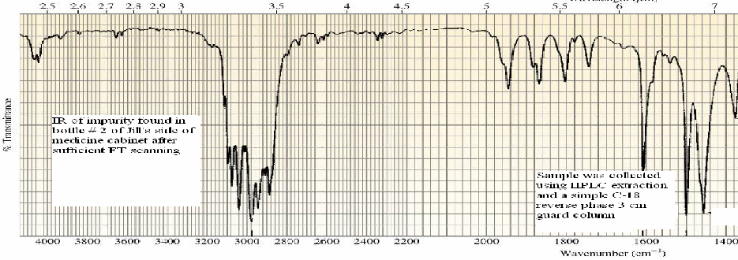
IR of trace impurity (S) in bottles 1 & 2
(2.7 chapters 8 & 9)
IR of impurity found in bottle #2 of Jill’s side of the medicine cabinet after 100 FT scans
Sample was collected by LC extraction off a C-18 reverse phase 3 cm guard column

