Slide 1
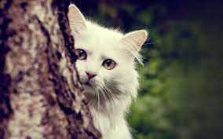
Some brief Drill and Practice with units, moles/wts and dilutions
You can run….but you cannot hide from this

Slide 2
How many grams of Li₂SO₄ (molecular weight=109.9 g/mol) are needed to make 0.5 L of a 0.1 M solution of Li⁺ ?)
(issue 1 - solution prep)
5.495 g
0.05 g
10.99 g
2.7475 g

Slide 3
10 ppm w/v is the same as…. (issue 2: unit→ unit’)
1 mg/L
10 mg/L
10 mg/100 mL
1 mg/L

Slide 4
How many moles of Cu are in 10 mL of a 1% w/v solution of Cu(NO₃)₂ (MW=187.6 g/mol) issue 2- absolute mass→mol
0.1 mol
0.187 mol
5.33*10⁻⁴ mol
0.01 mol

Slide 5
How many grams of Ca (atomic mass = 40.08 g/mol are in 30 mL of a 0.6 mM solution of aqueous CaCl₂ ?
Issue 2-absolute mol→ mass
7.21*10⁻⁴ g
0.018 g
4.5*10⁻⁷ g
1.44*10⁻³ g

Slide 6
A 5 mL volume of an initial stock solution of 0.3 M HCl (molecular mass= 36.46 g/mol) is diluted to 100 mL to make a secondary stock solution. The secondary stock solution is then further diluted by diluting 2 mL of it to a final volume of 250 mL. How many grams of HCl/L are in the final solution?
(issue 3- dilution path)
4.38 mg
0.12 mg
3.3 μg
17.3 mg

Slide 7
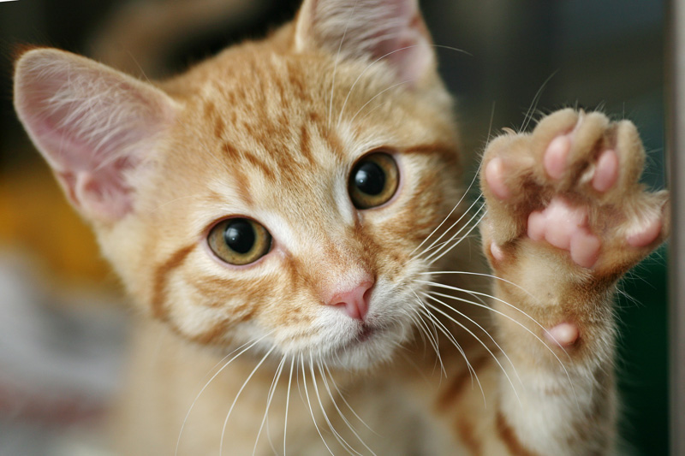
Bye Bye moles and shit for now !

