Slide 1
Perpendicularly impinging light & refractive index
Light beam
Vacuum or air
light speed in vacuum = c
Plano-plano system
substance
light speed in medium = v < c
light speed in vacuum = c (max)
n= refractive index= c/v

Slide 2
Typical values of n
Material n=refractive index at 25 ºC density (g/cm³)
vacuum 1.0000 0.0000
Air 1.0003 0.0013
distilled water 1.3330 0.9997
window glass 1.510 2.5
lead glass 1.615 2.9
HgS (cinnabar) 2.814 (α axis) 8.17
PbS (galena) 3.91 (α axis ) 7.60

Slide 3
Acutely impinging light and Snell’s Law
Plano-plano system
A
Air or vacuum
n_{a}
Glass, water….
n_{b}
B
Qualitative behavior
Quantitative behavior: Snell’s law
Light bends towards perpendicular in moving from lower to higher refraction medium
(and vice versa)
A
sin A/sin B= n_{b}/ n_{a}

Slide 4
Parallel light through plano convex and double convex lens
Focal line
f
f = focal distance
Plano-Convex lens

Slide 5
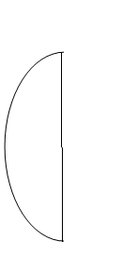
Plano-convex versus double convex lenses
Plano-convex lens
f(double) < f(plano-convex)
Double convex lens

Slide 6
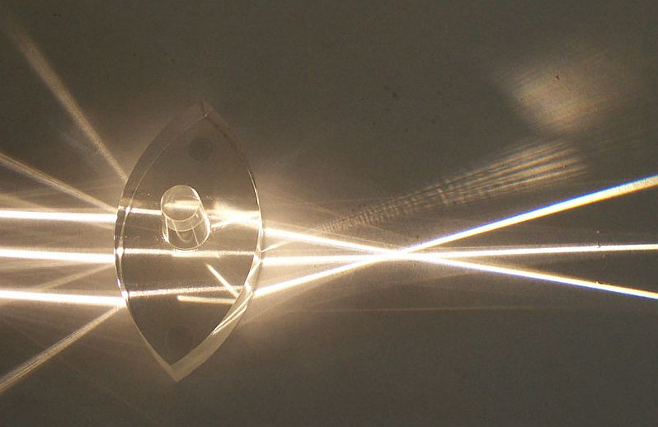
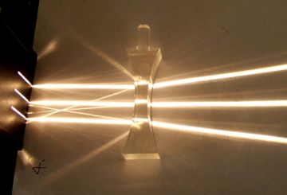
Double convex lens in operation
Double concave lens in operation

Slide 7
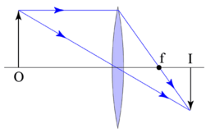
Real object imaging through double convex lens
q
O=object must lie outside of focal length
Real image because an actual bundle of light appears here
M = real image size/object size= q/f
Real images are always inverted vs actual object

Slide 8
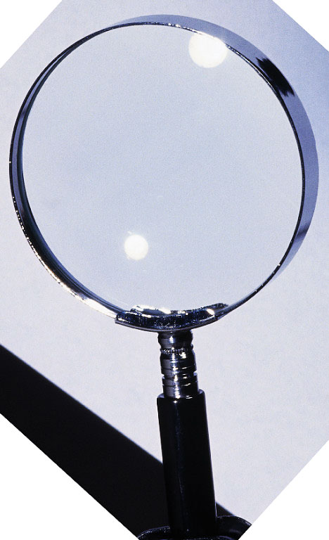
The first image magnifier: the simple hand magnifier glass

Slide 9

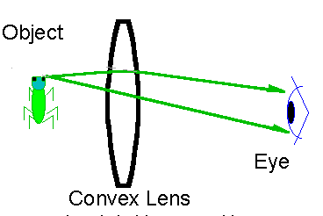

magnifying glasses-the virtual image
Virtual image forms here
10 inches
f
Lens f is << 10 inches so our eyes have trouble focusing…brain `defaults’ to 10 inches and projects real image back in front of lens 10 inches from the real image on your retina
Insect’s real image paints the back of your eye’s retina

Slide 10
Simple and compound magnification
M (simple) = M_{o} = 25/f + 1 the lensmakers formula
Insertion of a second `eyepiece’ (simple magnification = M_{e}) to enlarge real image after initial objective magnification leads to compounding of magnification
Virtual image
objective
eyepiece
Second real image (on back of eyeball)
M_{total} = M_{o} x M_{e}
1st real image
M_{e}
object
M_{o}

Slide 11
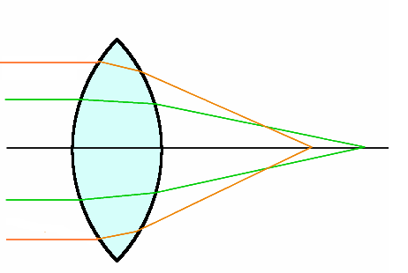
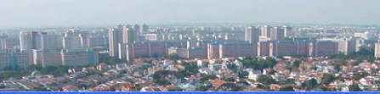


Spherical abberation
Double convex only
focal point different for parallel rays striking different portions of lens
Uncorrected for Spherical aberration
Corrected for Spherical aberration
Double convex plano correction

Slide 12

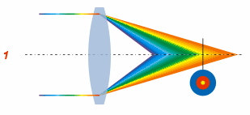
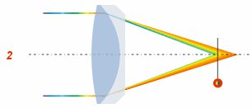

Chromatic abberation
No chromatic correction
2 wavelengths corrected to third
(red & blue corrected to Na-D) = `achro’

Slide 13
Language associated with objectives
Glass quality
E D S
Increasing quality
Spherically corrected
‘plan’
One wavelength correction¹
`achro’
Two wavelength correction
`apo’
Objectives…increasing in quality
☺
☹
E-plan
D-plan achromat
S-plan-apochromat
¹ Corrected to same focal pt as Na-D line (589.3 nm)

Slide 14
More language
R= resolution= 0.61 λ(nm) NA
NA= numeric aperture =n sin θ
(measure of light gathering power)

Slide 15
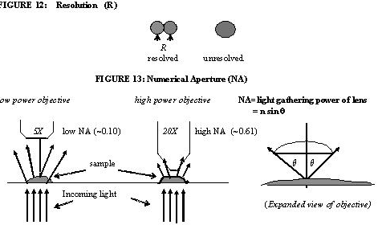
Low NA but area of lens larger=> brighter
High NA but area of lens smaller=>
darker

Slide 16
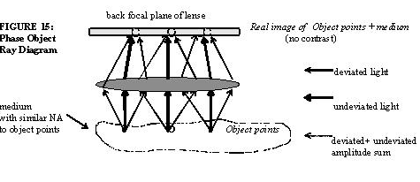
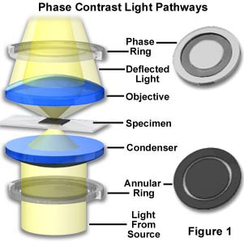
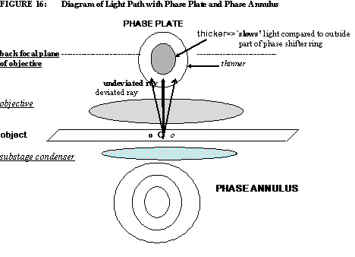
Phase contrast
Wheel marked 0,10, 20 on stage of ASC’s BH-2 scope is the phase annulus ring. There is a ring for each objective magnification

Slide 17
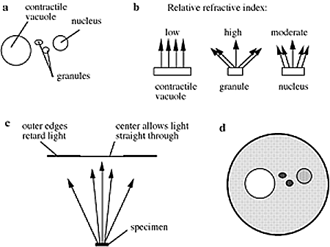
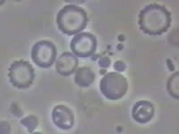
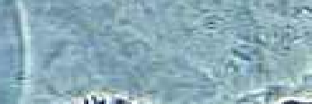
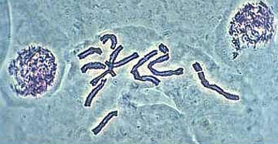
Phase resolved biological objects
No phase correction
With phase plate and annulus

