Slide 1
IR Technology Drill and Practice
What basic motion(s) are excited and observed in IR ?
Vibrations of molecules (stretches and bends) in electronic ground state
What is the correct path for a dispersive IR spectrometer ?
Source→ monochromator→ sample/background→ chopper→ detector
Source→ sample/background→ chopper→ monochromator→ detector
Source→ chopper→ monochromator→ sample/background→ detector
Source→ sample/background→ chopper→ monochromator→ detector

Slide 2
IR Technology Drill and Practice (cont.)
What is the transducer in a dispersive IR ?
bolometer
What electrical `nulling’ circuit is connected to the above transducer?
Wheatstone Bridge
What mechanical apparatus responds to the nulling circuit’s voltage change that `draws’ the spectrum in a dispersive instrument ?
Synchronous motor
Modern source in most IRs?
`Globar’
Typical cm⁻¹ range of mid-IR instruments ?
4000-400 cm⁻¹
Dispersive IR are
a) single beam and slow
b) Double beam and fast
c) Double beam and slow
d) Double beam and fast

Slide 3
IR Technology Drill and Practice (cont.)
Name 3 dispersive IR components not found in modern FTIR ?
Monochromator, chopper, bolometer
The FTIR is:
Single beam and fast
Double beam and fast
Single beam and slow
Double beam and slow
FT stands for:
Fourier Transform
Formal name for the two fundamental advantages provided by FTIR:
Jacquinot advantage and Fellgett’s advantage
Which of the above advantages is connected to light thru put?
Jacquinot advantage

Slide 4
IR Technology Drill and Practice (cont.)
What is the formula associated with Fellgett’s advantage ?
(signal/noise) = S/N = √(# scans) =√n
Pyroelectric devices
What is the transducer in FTIR instruments ?
Acronym for specific transducer in Alfred’s FTIR ?
DTGS
What critical `new’ component allows us to eliminate monochromator and chopper in an FTIR ?
Michelson-Morley Interferometer
What `spectrum’ is actually recorded by an FTIR?
a) Frequency spectrum
b) Intensity spectrum
c) Power spectrum
d) Laser spectrum

Slide 5
IR Technology Drill and Practice (cont.)
Correct FTIR beam pathway:
a) Source→ sample/reference→ monochromator→ interferometer→ detector
b) Source→ interferometer→ sample→ detector
c) Source→ sample→ interferometer→ detector
d) Source→ chopper→ interferometer→ sample→ detector
The Fourier Transform converts:
Time domain→ frequency domain
Intensity domain→ time domain
Frequency domain→ intensity domain
Voltage→ current

Slide 6
IR Technology Drill and Practice (cont.)
Direct observation of P(t), the power spectrum, is impossible because:
Detectors are not sensitive enough to IR energies
Choppers can’t turn fast enough to modulate IR light
Detectors cannot follow time changes in P(t) at the 10⁻¹³-10⁻¹⁵ s rates required
Calibration of retardation (displacement) δ is not sufficiently precise
To slow down the P(t) , the interferometer…
Combines the output of moving and fixed mirror components to produce an oscillating plot of P(t) vs δ which reduces variation of P(t) to rate of moving mirror motion T or F ?

Slide 7
IR Technology Drill and Practice (cont.)
∞
F_{k}(P(T)) = ∫P(t) cos 2πf_{k} t dt = I(f_{k})
⁰
The Fourier Transform…
a) Selects the frequency, f_{k}, for an arbitrarily assumed I_{k}
b) Computes the P(t) for a given f_{k}
c) Computes the specific intensity of energy I_{k} reaching the detector at f_{k}
d) Averages the total range of f_{k} contributions to produce %T
A single FTIR scan is produced when:
The laser calibration is completed
The moving mirror completes a full sweep of the interferometer pathway
The DTGS detector time constant for detection is attained
The chopper makes a complete 360º circuit

Slide 8
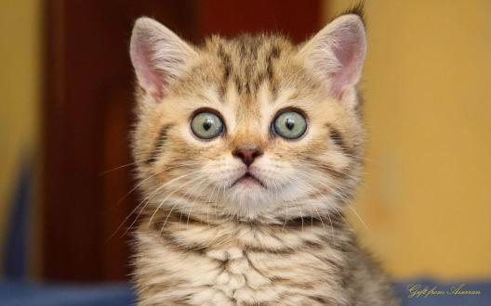
Honestly, Doc, do you really think we need to know all this ?

Slide 9
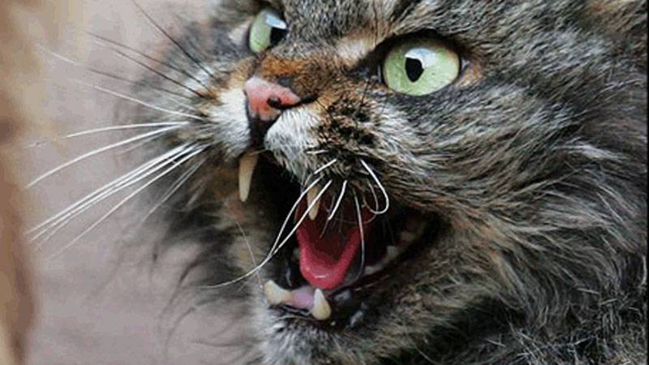
Of course, you maggoty ass maggots !

