Slide 1
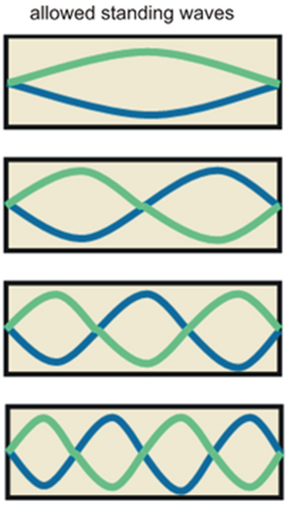
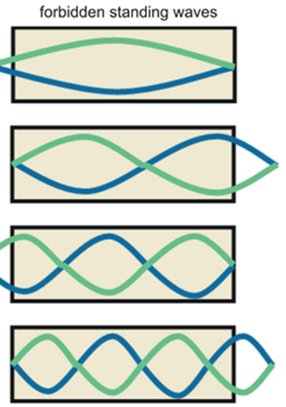
L
n=# standing peaks
λ
1
2L
2
2L/2
ω
3
2L/3
4
2L/4
In general λ = 2L/n

