Slide 1
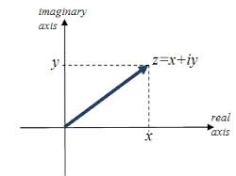
The Complex plane
From trigonometry:
x= r cos θ
y= r sin θ
= r(cos θ + i sin θ)
r
z= r e^{iθ}
Euler’s equation
θ

Slide 2
Key Equations for Complex Number Manipulations
z= r(cos θ + i sin θ)
From Trignometry
x= r cos θ
y= r sin θ
z= r e^{iθ}
Euler’s equation
(cos θ + i sin θ)^{n} = cos nθ + i sin nθ
De Moivre’s equation
(derived from Euler’s equation)

