Slide 1
A. Einstein on classical thermodynamics:
“A theory is the more impressive the greater the simplicity of its premises is, the more different kinds of things it relates , and the more extended is its area of applicability. Therefore, the deep impression which classical thermodynamics made upon me. It is the only physical theory of universal content concerning which I am convinced that, within the framework of the applicability of its basic concepts, it will never be overthrown. “ (p. 765 of your text)
Doc Fong on classical thermodynamics….
“Ditto…”

Slide 2
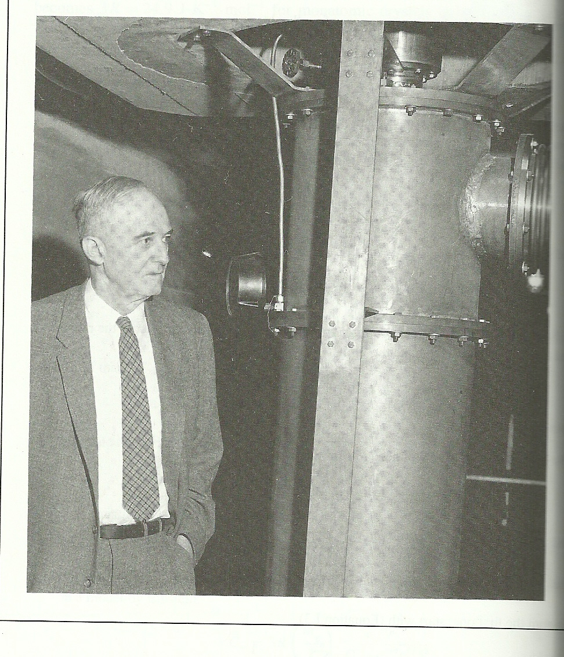
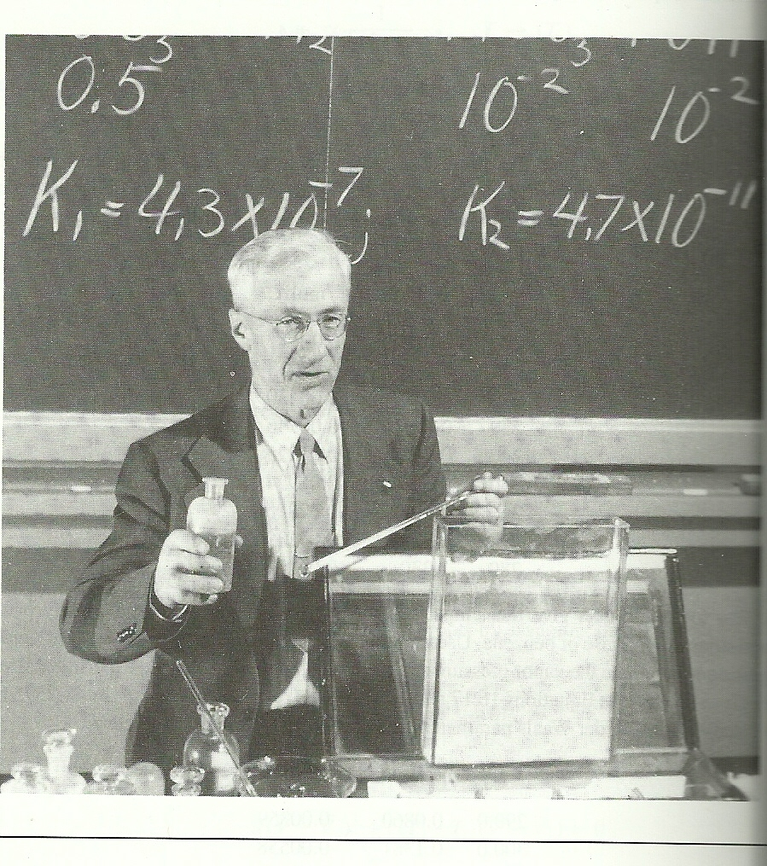
Progenitors of Doc’s own past life as lover of all things thermodynamic…..
Chem `Bowl’ lecture hall, UCB
William F. Giauque: low temperature calorimetry at Berkeley (Nobel Prize 1949)
(page 730 of text)…
Namesake of Giauque Low Temp. Lab UCB
Joel Hildebrand: `best’ chemistry teacher Berkeley ever had….(and long time expert in thermodynamics of solutions, pg. 962 of text)

Slide 3

The 3 classical `building blocks’ all `hard core’ physical scientists are supposed to know in their bones….
Classical
Thermodynamics*
Classical Mechanics*
Electricity and Magnetism
* What physical chemists normally get strong grounding in

Slide 4
The 3 laws of thermodynamics in a nutshell
1)ΔE = Q+W is a state function
(Chapter 19)
Translation: “You can’t win….”
2) ΔS_{surroundings} + ΔS_{system} > 0
(Chapter 20)
Translation: “You can’t break even….”
Even more depressing: “things always get worse…”
3)S→ 0 at T= 0 K
(Chapter 21)
Translation: “You can’t even get out of the game….”

Slide 5
state functions (see p. 769-70)
A state function is a property which is `path independent’.

Slide 6
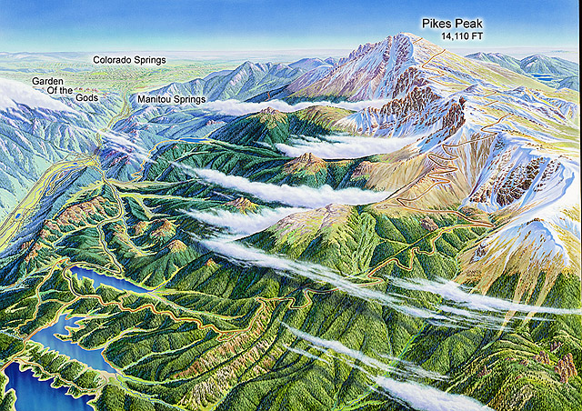
Non- chemical `Path independence’
What change is indifferent to the three trip paths taken ?
Start trip here
Go here
Δy
Your change in elevation (Δy) here is a state function independent of work and sweat of the possible paths

Slide 7
map and trips commonly used to illustrate the first law of thermodynamics
What change is indifferent to the three trip paths taken ?
Start trip here
(P₁,V₁)
Path 1
P
Path 3
(P₂,V₂)
Path 2
Go here
V

Slide 8
Assertion:
While heat (Q=Q_{in}) consumed (absorbed) by a system and the Work (W=W_{out}) done by a system (using the heat) are both forms of energy. neither is a state function.
However, the difference Q_{in} and W_{out} is a state function= energy ΔE left in the system during the exchange (~ first Law)

Slide 9
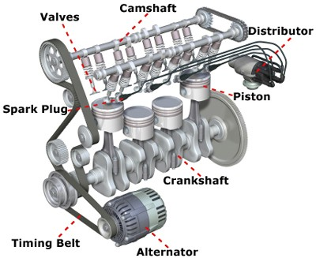
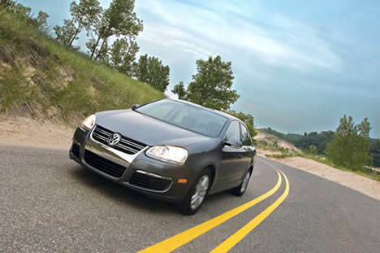
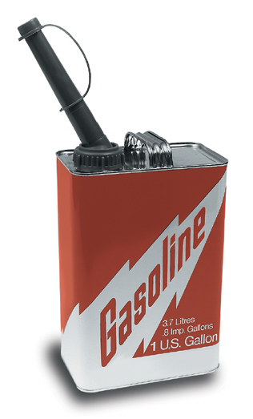
A simple example of W , Q and ΔE
Q converted to work W_{out} to move the car (vroom, vroom)
Work
~ motion of car
Burned to make heat (Q_{in} ) in pistons
Difference in Q_{in} and W_{out} is stored as energy E in the car engine block (gets hot).

Slide 10
Model for exchange of heat and work starts with an ideal gas piston…(see figure 19.1 and text page 767)
1)F=mg
P=pressure
2) W=F*d= mg*h
= mg *hA
A
ΔV
∴ W=P ΔV
m
A
Area of piston = A
h
Ideal gas

Slide 11
System vs surroundings picture
The `system’ here is the piston.
The ‘surroundings’ are what the system is exchanging heat and work with (outside its’ walls).
More generally:
System walls
EVERYTHING OUTSIDE SYSTEM ARE THE SURROUNDINGS
THE “SYSTEM”

Slide 12
Textbook sign convention for work and heat:
W=Work is positive (+) if the surroundings does work on the system
Q= Heat is positive (+) if the surroundings gives heat to the system
W >0
THE “SYSTEM”
Q >0
W <0
Q <0

Slide 13
Sign for piston work
For compression: ΔV= V_{f}-V_{i} < 0
Compression is work on the system=> work should have positive sign
∴At constant P: W_{compression} = -P ΔV

Slide 14
The first law of thermodynamics
(using your textbook’s convention)
ΔE ( a state function) =
heat absorbed by system + work done by surroundings on system
= Q + W
We will use this `Physics’ convention √
(fyi … ☹ doc hates this choice)
Alternative: System as `heat engine’ picture (Klotz, Lewis and Randall, Callen..all chemists)
)
ΔE ( a state function) =
heat absorbed by system - work done system on surroundings
= Q - W

Slide 15
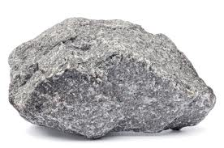

EXAMPLES OF THE PATH DEPENDENCE OF WORK
CASE 1: INSTANT PRESSURE CHANGE
0.4 mole IDEAL GAS W/ T =300 K
Piston head
INITIAL STATE 1
P
Sudden change in P
P₂= 5
5
P₁ =1 V₁=10
1
V
10
Suddenly drop a big weight on piston head, bringing P₂ instantly to 5 before volume V can start to change

Slide 16

P₂= 5
PATH DEPENDENCE OF WORK (continued)
CASE 1: INSTANT PRESSURE CHANGE (continued)
P
5
W= area under
P-V curve
1
V₂= 2
V
2
10
Rock pushes piston down at constant P₂=5 to V₂=2
W= -ΔPV = -P₂ ΔV = -5*(2-10)=40
Note: sudden P change creates heat effect too…temperature transiently changes

Slide 17

PATH DEPENDENCE OF WORK (continued)
CASE 2: INFINITESIMALLY SLOW (reversible) PRESSURE CHANG,
0.40 mole IDEAL GAS W/ T CONSTANT
A very, very, very long time later.....=> reversible compression)
Piston head
Etc….
INITIAL STATE 1
P₂=5
P₁ =1 V₁=10
V₂= 2
Instead of dropping a huge rock all at once, imagine dropping sand grains slowly onto piston
and slowly adding until P=5

Slide 18
PATH DEPENDENCE OF WORK (continued)
CASE 2: INFINITESIMALLY SLOW (reversible) PRESSURE CHANGE,
T =300 K (continued)
INITIAL STATE 1
P
FINAL STATE 2
P₂=5
5
Work here is under curve
P₁ =1 V₁=10
1
V
V₂= 2
2
10
Infinitely slowly….
At constant T
PV=RT=> P=nRT/V= 0.40*0.082*300/V
9.8/V
W= -ΔPV =
-9.8
∫1/V dV
=- 9.8 ln (2/10)=15.8

Slide 19
P₁=1 P₂=5
V₁ =10 V₂=2
(ideal gas, n=0.4 mol T=300 K)
STATE 1 STATE 2
WORK DONE TO GO FROM STATE 1→ STATE 2
Big rock
fast
W=40
Sand grains slow
W=15

