Slide 1
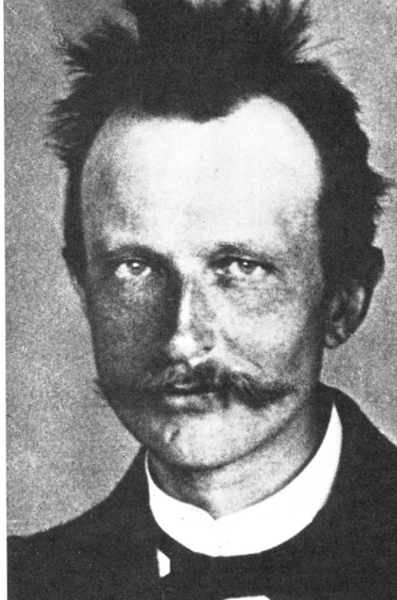
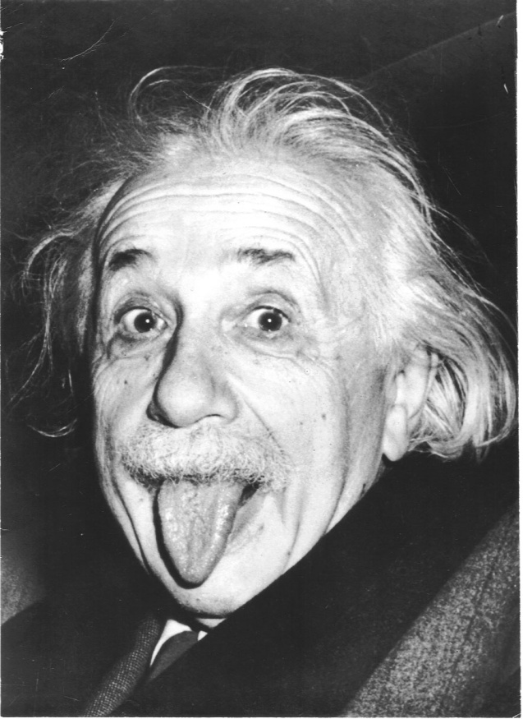
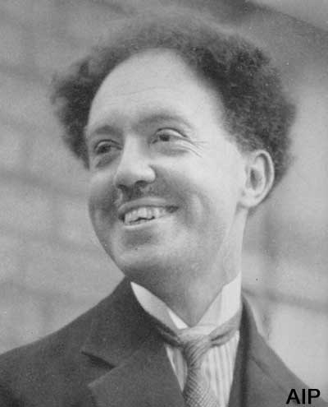
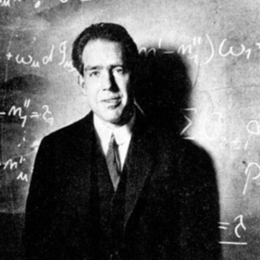
EVOLUTION OF THE `OLD’ QUANTUM THEORY OF THE ATOM
Planck
E_{light}=hf
Einstein
E_{anything}²=(m_{o}c²)² +(pc)²
DeBroglie
Bohr
nλ = 2πr_{H} _{atom}
m_{o}=0 => light =>
p_{light} = h/λ_{light}
p_{matter} = h/λ_{matter} ?
Model of H atom

Slide 2

Bohr’s mathematical model:
Predicts the emission spectrum (Rydberg equation) of the Sun (H atoms) ~ perfectly
Obs n_{i} n_{f}
656.4 nm 3 2
486.3 4 2
434.2 5 2
Bohr model
656.3 nm
486.2
434.1
`Balmer series’ assigned (see page 21 figure 1.10)
6→2
7→2
8→2
5→2
4→2
3→2

Slide 3
Bohr’s mathematical model:
2) Predicts r for ground state radius a_{o} of H perfectly
Obs a_{o}
52.9 pm
Bohr radius
52.9 pm

Slide 4
Bohr’s mathematical model:
3) Connects idea of quantized, allowable states to wave
properties and provides explanation for why negative
electron doesn’t just suck down into positive nucleus
2πr= nλ
Spookily…Bohr posits that when electron jumps from initial to final state it doesn’t exist in the intervening space while jumping…e.g. it does a quantum jump

Slide 5
Animation of a `quantum jump’
n_{f} =2
n_{i} =3

Slide 6
The three experimental observations that start all the trouble (see also: text pg 4-14)
1) Black body emission behavior (ultraviolet catastrophe) pp. 4-6
√
2) The photoelectric effect pp. 7-10
√
3) Hydrogen atom’s emission spectrum
pp. 10-14
√
Two others (not in your text): the Davisson-Germer electron diffraction effect and the Stern-Gernlach experiment prompt Einstein to refer to the effects as `SPOOKY SCIENCE’

Slide 7
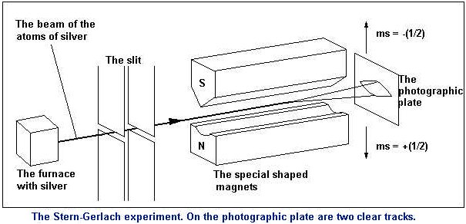

The usual rendition of the Stern-Gernlach Experiment
Proves electrons have two “spin” states (an up and a down )

Slide 8
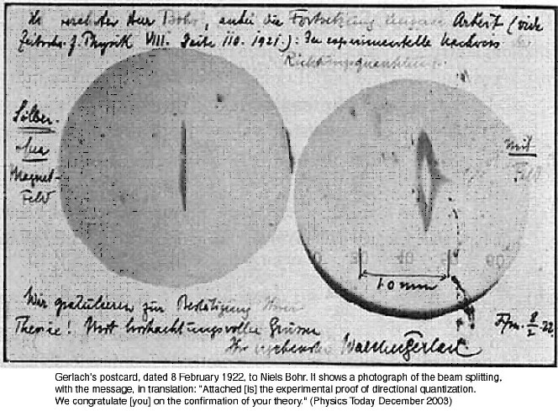
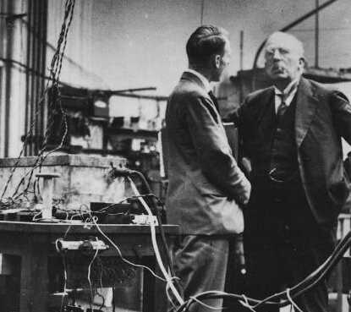
Stern-Gernlach Experiment
one amusing detail: atomic monolayer of Ag ‘developed’ (accidentally) by sulfur in Gerlach’s cheap cigar

Slide 9
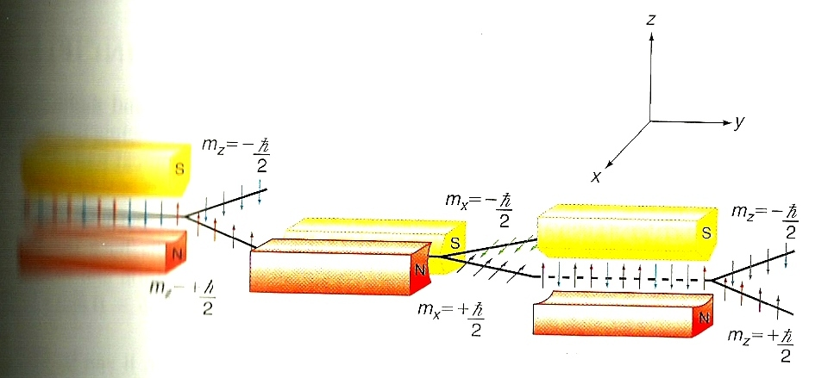
The `spooky’ rest of the Stern-Gernlach experiment:
m_{z}=-1/2
m_{z}=+1/2
Field applied along x
Field applied along z
Field re-applied along z
Take m_{z} =+1/2 case
And deflect along x; and select + ½ =m_{x}
Then, re-apply field along z axis and check if only m_{z}=+1/2 still there
Initial deflected beam of Ag
m_{z} = +1/2 case along z
The usual bit… half the beam goes up (-), half goes down (+)
The stuff usually left out
The really spooky bit…m_{z}=±1/2 both re-appear

Slide 10

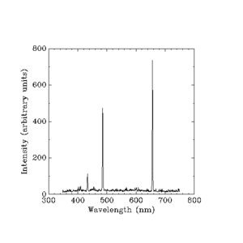
Problems with Bohr Model
(see pg 23 of text)
Can’t predict correct spectral positions for anything except H ( only 1 electron case good)
No can do…
2) Can’t explain H intensity pattern
Can’t explain why are some lines strong and some lines weak

Slide 11
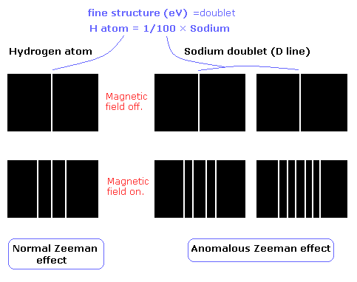
Problems with Bohr Model (continued)
3) Can’t Explain Zeeman (magnetic) splitting effect

Slide 12
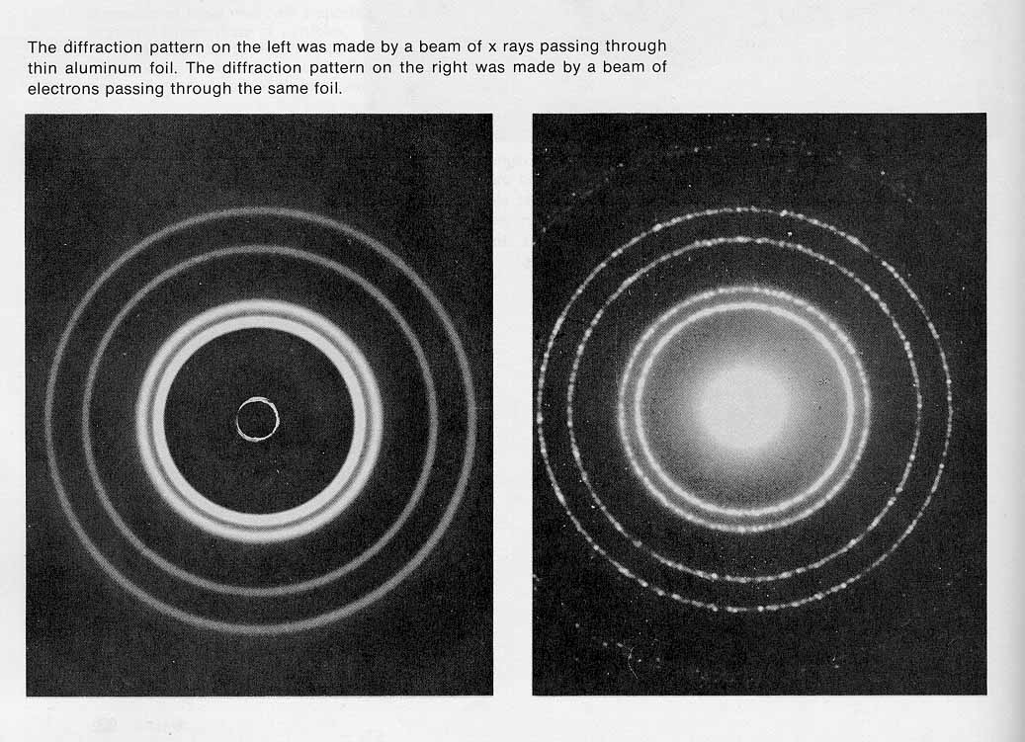
While Bohr’s model fails, DeBroglie’s `hypothesis’ that matter acts like waves finds wide evidence of being true (see Figure 1.8 p. 17)
Electron diffraction through Al
Light diffraction through Al
Braggs’ (Father and Son)
Explore X-ray waves to find structure (both get Nobel separately)
Thomsons’ (Father and Son) explore electrons and show it’s a wave (both get Nobel prize separately) see p. 18

Slide 13
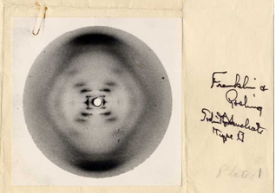
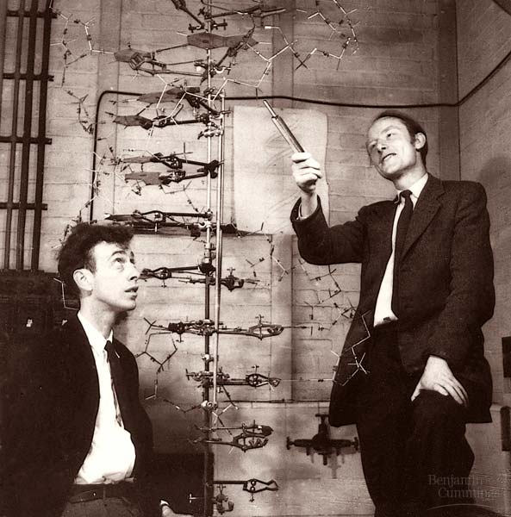
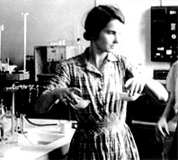
Rosalind Franklin
FRANKLIN’S X-RAY DIFFRACTION PICTURE LEADS TO STRUCTURE OF DNA

Slide 14
Observation : λ(matter) <<< λ(light)=> electrons can see more details (in principle)
Electrons EVENTUALLY do get used like x-rays to determine structure

Slide 15
The guy who figures out how to use electrons like the Braggs used x-ray light…
Abstract: Lawrence S. Bartell (b. 1923 in Ann Arbor, MI) is Philip J. Elving Professor Emeritus at the University of Michigan. He has spent his research career in structural chemistry, working on a variety of topics, in several of which he made pioneering contributions. Thus he was the first as early as in 1955 to call attention to the importance of the physical meaning of the geometrical parameters determined by different physical techniques. He studied the effects of temperature on the molecular geometry extensively. His invention that elicited the most popular attention was electron holography, in 1972. It even yielded a direct way to measure interatomic distances in molecules. In greatly modified form it is having an impact in the field of electron microscopy and also made it to the Guinness Book of World Records as the World's Most Powerful Microscope. ….most influential member in the past century by the Michigan chapter of the Alpha Chi Sigma professional chemistry fraternity. He received a “Creativity Award” from the National Science Foundation in 1982.
With L.O. Brockway*, invented electron diffraction for structural determinations
Bartell on Doc Fong’s Ph.D committee
Doc worked summer 1974 for Bartell doing laser holography
(and gets pushed into the lake by the great Bartell, for lipping off…)
*L. Pauling’s student and my grad advisor…

Slide 16
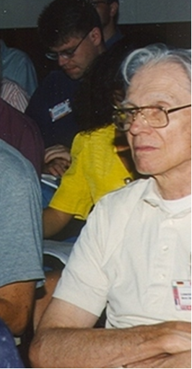
Professor Larry
Bartell…University of Michigan…genius
~ 1995 at NATO Research conference

Slide 17
The notion that particles have wave properties leads to the `spooky’ notion of “uncertainty”

Slide 18
Heisenburg’s Uncertainty Principle (p. 23 eq. 1.26 )
Δx*Δp > h (J*s)
=>Cannot know the position and momentum of a particle to better than h (utterly non-classical idea)
Alternative statement of Uncertainty Principle:
ΔE*Δt > h (J* s)
Can’t know the energy and at what time a particle is present to better than h (see problem 1.37)…
Quantum jumps occur in times shorter than uncertainty time Δt

Slide 19
`Justifying’ the Uncertainty Principle
1) Practical approach (text)
…to locate a particle you need light to `see’ it, but light now has a momentum = h/λ, so as soon as you `see’ the particle, the light you used has changed the particle’s momentum from what it was…e.g. you disturbed the system in the act of measuring it .
(see section 1-9 pg 23 of text)

Slide 20
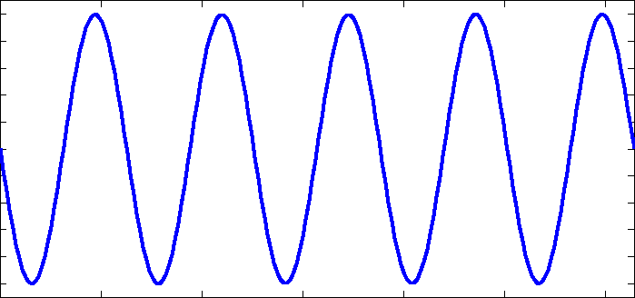
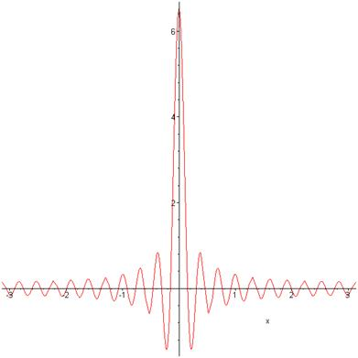
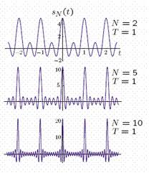
2) Matter –as-composite wave approach (why ΔE*Δt > h)
a) If a particle has a single wavelength…well defined momentum, but where is it ?
b) To localize something, several waves of differing wavelengths must be added …
c) A well localized particle in time has badly defined wavelength (~momentum or energy)
Sine Terms added=Sin(2πk t/T)
k= 1,2…N

Slide 22
A final demo of particle-as-wave weirdness

Slide 23
`gotta be’ physics: If Individual electrons appear randomly, one at a time moving towards one slit or another, each electron must pass through only one slit, eventually making a `Gaussian’ distribution.
t₁
t₂ > t₁

Slide 24

Nuh… uh…..

