Slide 1

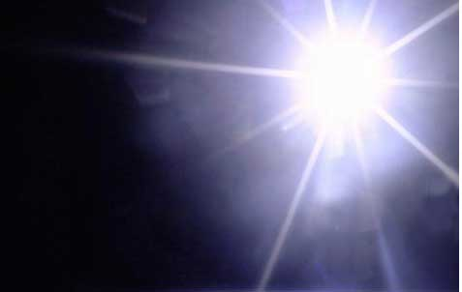
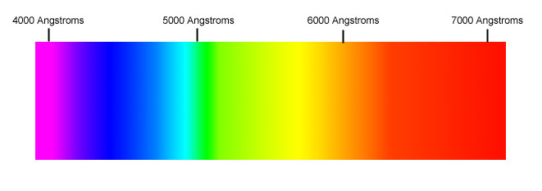
Key images of H emission spectrum
Observed wavelengths of light in sunlight (H emission)
See also: fig. 1.5 pg 11 of text
Sun is a burning ball of H which emits light
Why doesn’t the Sun emit all the colors of the spectrum ??

Slide 2
Einstein’s `Annus Mirabilis’ (miracle year)
Uber einen die Erzeigung und Verwandlung des Lichts betreffenden heuristischen Gesichtpunkt
On a Heuristic Viewpoint Concerning the Production and Transformation of Light
Annalen der Physik 17 (6): 132–148
2) Investigations on the Theory of Brownian Motion
Annalen der Physik 17 (8): 549–560
3) On the Electrodynamics of Moving Bodies
Annalen der Physik 17 (10): 891–921
4) Does the Inertia of a Body Depend on Its Energy Content ?
Annalen der Physik 18 (13): 639–641

Slide 3


Annalen der Physik 18 (13): 639–641
DOES THE INERTIA OF A BODY DEPEND
UPON ITS ENERGY-CONTENT?
By A. Einstein
September 27, 1905
The `huge’ idea
~
Can be morphed to:
E² = (m_{o}c²)² + (pc)²
Why a `huge’ idea????

Slide 4
For H spectrum: visible line set is called the `Balmer series’ (see page 21 figure 1.10)
n_{i}→n_{f}=2
7→2
5→2
6→2
4→2
3→2
From experiment:
RYDBERG EQUATION FITS FOR H ATOM
ΔE=2.173*10⁻¹⁸[1/n_{f}²-1/n_{i}²] in J/electron

Slide 5
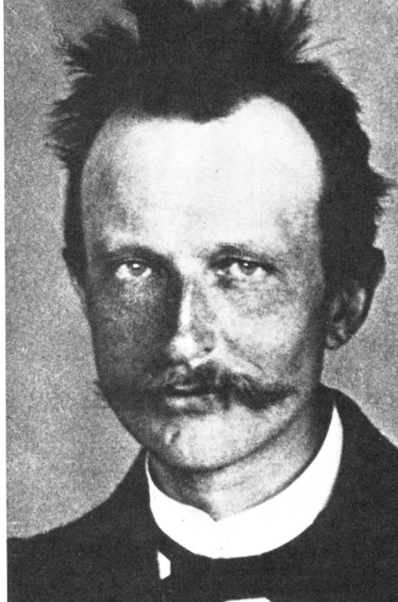
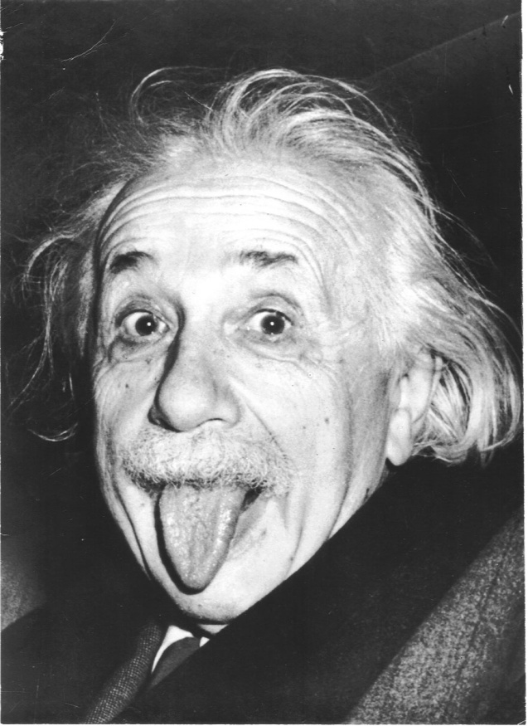
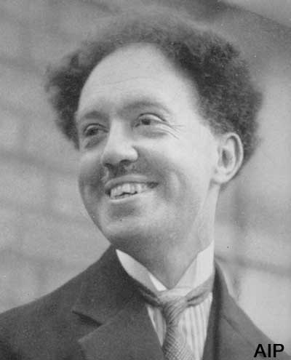
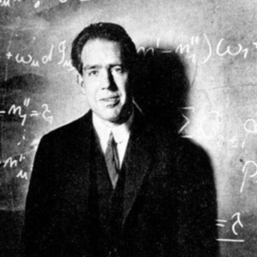
EVOLUTION OF THE `OLD’ QUANTUM THEORY OF THE ATOM
Planck
E_{light}=hf
Einstein
E_{anything}²=(m_{o}c²)² +(pc)²
DeBroglie
Bohr
nλ = 2πr_{H} _{atom}
m_{o}=0 => light =>
p_{light} = h/λ_{light}
p_{matter} = h/λ_{matter} ?
Model of H atom

Slide 6
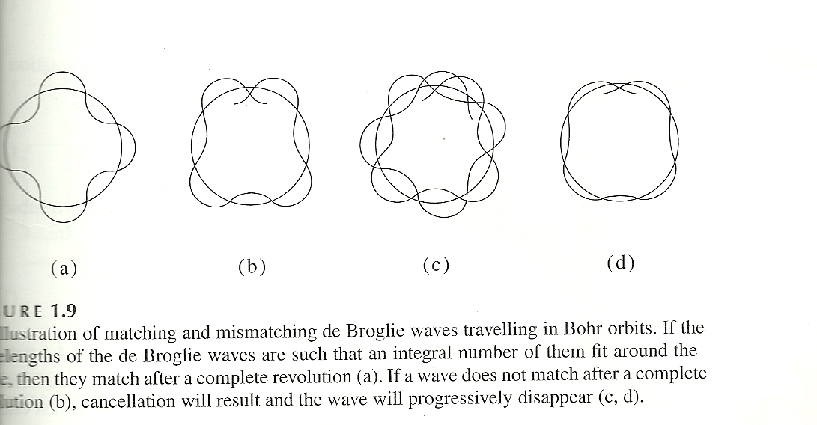
Condition for electron matter wave
nλ = 2πr_{H} _{atom}
r_{H} _{atom}
From text page 20

