Slide 1
Name the three experimental observations that start all the trouble ….
1) Black body emission behavior (ultraviolet catastrophe) pp. 4-6
2) The photoelectric effect pp. 7-10
3) Hydrogen atom’s emission spectrum
pp. 10-14
Can you explain why the first two were such a problem for classical physics ?

Slide 2


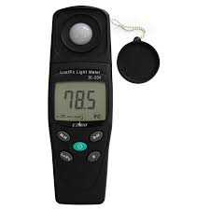
1) Black body emission behavior (ultraviolet catastrophe) pp. 4-6 re-explained in terms of a George Foreman grill
Black body radiation experiment:
Measure energy output , ρ, from the `black body’ vs. frequency of light

Slide 3
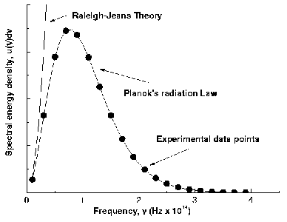
Old physics E_{light} ∝ amplitude (e.g. light is a wave)
ρ(f) = constant*T *f²
(it goes to infinity ???)
New physics E_{light} ∝ f
(=> light not a wave)
ρ= C*T*f²
1-e^{hf/kT}
Planck’s Prediction agrees with observation if…..
h= 6.626 *10⁻³⁴ J s

Slide 4
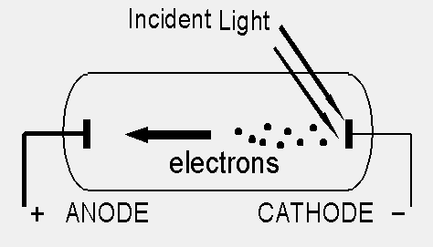
KEY `IMAGES’ OF PHOTOELECTRIC EFFECT
Kinetic energy per electron ejected from K vs frequency of impinging light
(Fong data 12-6-12)
See also: figure 1.4 of text, p 8 which is for Na
KE (J)
Energy/electron un-related
To intensity (amplitude) of incident light !!
x= f(Hz)

Slide 5

A `Mickey Mouse’ explanation of the real implications of the photoelectric effect

Slide 6
According to `common’ sense, which wave capsizes Mickey and the gang ?
High amplitude (A)
Low frequency (f)
Low amplitude (A)
high frequency (f)
Mickey and friends are the electrons in a metal

Slide 7
What actually happens in the photoelectric effect experiment
High amplitude (A)
Low frequency (f)
Low amplitude (A)
high frequency (f)

Slide 8


Slide 9
Kinetic energy per electron ejected from K vs frequency of impinging light (Fong Photoelectric experiment data 12-6-12) slope is 5.7*10⁻³⁴ J*s
KE (J)/e
Best h from fit of Planck’s law to Blackbody data
6.63*10⁻³⁴ J s
slope from a more precise photoelectric effect experiment 6.63*10⁻³⁴ J s ( a `holy shit’ result)
x= f(Hz)

Slide 10
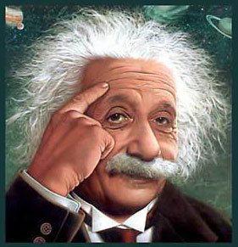
If light is not a*$%^#$!! wave, what the $^&^*&!! is it ??
“Ich denke ich
weiss, ja ! “

Slide 11
Einstein’s `Annus Mirabilis’ (miracle year: 1905)
Uber einen die Erzeigung und Verwandlung des Lichts betreffenden heuristischen Gesichtpunkt
1) On a Heuristic Viewpoint Concerning the Production and Transformation of Light
Annalen der Physik 17 (6): 132–148
2) Investigations on the Theory of Brownian Motion
Annalen der Physik 17 (8): 549–560
FYI…this explains what happens when we move at the speed of light…
3) On the Electrodynamics of Moving Bodies
Annalen der Physik 17 (10): 891–921
4) Does the Inertia of a Body Depend on Its Energy Content ?
Annalen der Physik 18 (13): 639–641

Slide 12
1) On a Heuristic Viewpoint Concerning the Production and Transformation of Light
Annalen der Physik 17 (6): 132–148
Planck’s E=hf explained in terms of light = “photons “

Slide 13
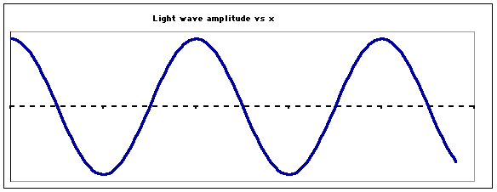
Einstein’s photon idea is a metaphor….
=A MASSLESS BULLET OF ENERGY
OLD
wave
NEW
Stream of photons
…but, which still have wave-like behavior. The massless bullets still diffract…

Slide 14
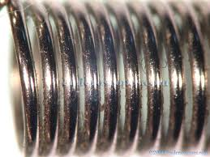
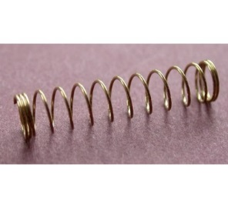
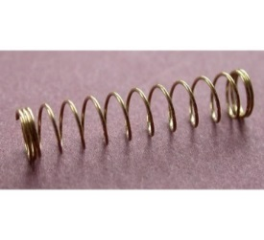


Using Planck’s equation: hf=E_{photon} leads to this picture
hf
hf
hf
hf
Stream of photons
Doc’s analogy: A photon is like a unit of compressed spring:
High frequency(high f)…high energy
tight
low frequency (low f)…low energy
loose

Slide 15


4) Annalen der Physik 18 (13): 639–641
DOES THE INERTIA OF A BODY DEPEND
UPON ITS ENERGY-CONTENT?
By A. Einstein
September 27, 1905
The `huge’ idea
~
Can be morphed to:
E² = (m_{o}c²)² + (pc)²
Why a `huge’ idea????

Slide 16
Rest mass of body
when its not moving
Speed of light
Momentum of moving body
E² = (m_{o}c²)² + (pc)²
The two huge conclusions from this:
If p=0, E =m_{o}c²
=> We can make nuclear weapons
2) If m_{o}=0 (e.g. were dealing with light)
E_{light} =p_{light} c
But Planck says E_{light} =hf=hc/λ
=> p_{light} c = hc/λ
=> p_{light} = h/λ
Light has momentum !

Slide 17
Where we are..by 1910
1) Planck explains Black Body radiation curve using idea that light energy ∝ f , not amplitude
ρ= C*T*f²
1-e^{hf/kT}
E_{light} ∝ f
Planck’s Prediction agrees with observation if…..
h= 6.626 *10⁻³⁴ J s

Slide 18
2) Einstein replaces the old model of light with photons and explains the photoelectric effect with them
E_{light} =hf = energy of the massless photon bullet/spring

Slide 19
…. experimental observations that start all the trouble ….
1) Black body emission behavior (ultraviolet catastrophe) pp. 4-6
√
2) The photoelectric effect pp. 7-10
√

Slide 20
Basic `wrong’ assumptions of `classical’ physics models `fixed’ by Planck and Einstein:
1) notion of continuity in energy exchange (equipartition of energy) doesn’t hold …particularly as size of systems decreases
2)basic concept of light as a pure wave doesn’t hold…its made of `discrete’ photons

Slide 21
…. experimental observations that start all the trouble ….
1) Black body emission behavior (ultraviolet catastrophe) pp. 4-6
√
2) The photoelectric effect pp. 7-10
√
3) Hydrogen atom’s emission spectrum
pp. 10-14
Two others (not in your text): the Davisson-Germer electron diffraction effect and the Stern-Gernlach experiment prompt Einstein to refer to the effects as `SPOOKY SCIENCE’

Slide 22

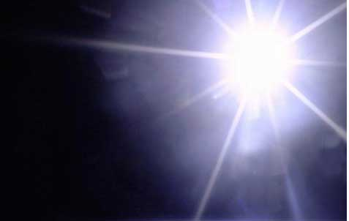
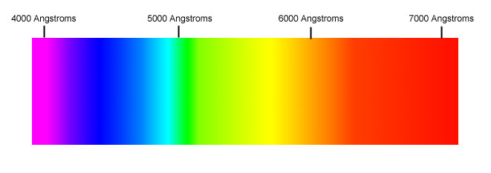
Key images of H emission spectrum
Observed wavelengths of light in sunlight (H emission)
See also: fig. 1.5 pg 11 of text
Sun is a burning ball of H which emits light
Why doesn’t the Sun emit all the colors of the spectrum ??

Slide 23
So..
1) how do we explain the discreteness of the Sun’s spectrum, and,
2) What’s with these `spooky’ electron behaviors ?

Slide 24
Explaining the sun’s spectrum starts back here:
4) Annalen der Physik 18 (13): 639–641
DOES THE INERTIA OF A BODY DEPEND
UPON ITS ENERGY-CONTENT?
By A. Einstein
September 27, 1905
E² = (m_{o}c²)² + (pc)²
(E=energy of anything)
Light has momentum !
=> p_{light} = h/λ
I’m back !

Slide 25
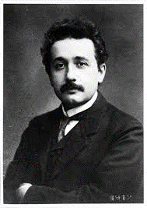
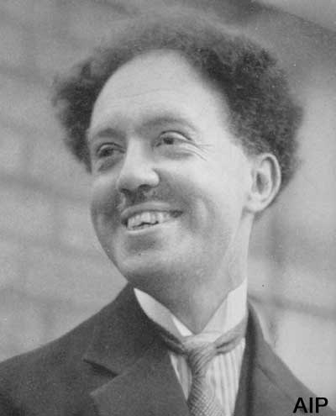
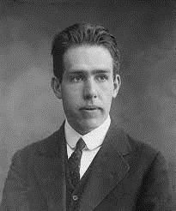
The first Successful Attempt at Explaining the spectrum of the Sun comes from these guys…
Einstein
DeBroglie
Bohr
p_{matter} = h/λ_{matter} ?
m_{o}=0 => light =>
p_{light} = h/λ_{light}
I can use that !!!
De-Broglie’s hypothesis
see pp 18-22 of text and Bohr powerpoint)

Slide 26
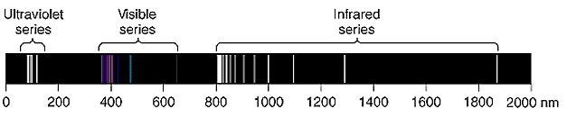
Observed Hydrogen Atom Emission Spectrum from 0-2000 nm
Paschen series limit
Lyman Balmer Paschen series name
displays several distinct `series’ of lines
Each series has a `limit’
From experiment, all lines can be fit using:
RYDBERG EQUATION: (n_{f} < n_{i} both integers 1,2,3…
ΔE=2.173*10⁻¹⁸[1/n_{f}²-1/n_{i}²] in J/electron

