Slide 1
Energy Manifold: 1 electron in ground state in box with L=2*10⁻¹⁰ m (0.2 nm)
E*
25
n=5
n=4
16
n=3
9
n=2
4
m_{e} ~1*10⁻³⁰ kg
1
n=1
E=0
*Energy in units of h² /8m_{e} L²~1.5*10⁻¹⁸J

Slide 2
Energy Manifold assuming butadiene πe⁻
are in box the length of butadiene (p. 83)
E*
25
Assume 4 π electrons resonate freely
n=5
L=5.78*10⁻¹⁰ m
n=4
16
n=3
9
ΔE=hf=5
m_{e} ~10⁻³⁰ g
n=2
4
n=1
1
E=0
*Energy in units of h² /8m_{e}L²=1.8*10⁻¹⁹ J

Slide 3
Comparison of calculated 1D particle in box magnitudes with real atomic scale systems
System considered
E(n=1)
1 electron in 2*10⁻¹⁰ m box
1.5*10⁻¹⁸ J
1 electron in 2 *10⁻¹⁰ m diameter orbit around H atom
2.2*10⁻¹⁸ J
ΔE for n=2→n=3 jump in model for butadiene (L=5.78*10⁻¹⁰ m)
5*1.8*10⁻¹⁹ =9.0*10⁻¹⁹ J
Observed HOMO-LUMO transition energy for butadiene
9.1*10⁻¹⁹ J

Slide 4
Key Particle-in-box results
1)Normalized Wave function
ψ(x) = √2/L sin (nπx/L)
2) Eigen energy , E
E=n² h² /8m_{e}L²
3) Probability density, P(x)
P(x)dx = 2/L sin² (nπx/L) dx

Slide 5
Switch slide orientation in design

Slide 6
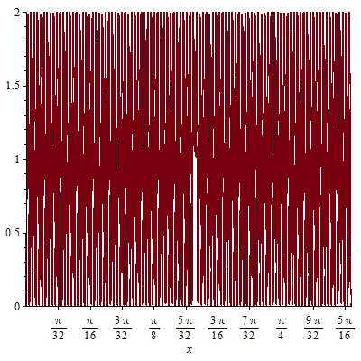
1D particle-in-a-box P(x) vs. n: at high n…the system converges to continuum
P(x) for 1D box at n=100,L=1

Slide 7
2D particle-on-a ring predictions for simple porphyrin (26 π electrons* running free
(See also: Supplement 2: The 2-D particle in-a-box applied to a real molecule)
L
L
L = 1*10⁻⁹ m
* Assumes lone pair and inner π electrons are part of delocalization

Slide 8
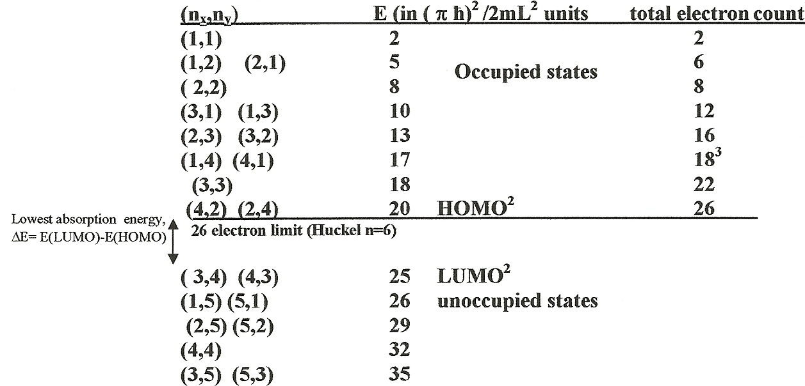
After solving 2D problem: (see supplement 2)
E =k(n_{x}² +n_{y}²)
= 3.0375*10³ (n_{x}² +n_{y} ²) cm⁻¹
HOMO=Highest Occupied Molecular Orbit
LUMO = Lowest Unoccupied Molecular Orbit
ΔE_{predicted}= k*[(3²+4²)-(4²+2²)] = k[25-20] =5k = 1.52*10⁴ cm⁻¹
ΔE_{observed} = =1.70*10⁴ cm⁻¹

