Slide 1
PHYSICS BY 1900 (p 1-2 of text)
CLASSICAL MECHANICS √
1) Newton and Lagrange
Completely describes how uncharged matter moves in any relevant field potential (gravity, spring field etc.)
2) Maxwell
ELECTROMAGNETIC THEORY √
Completely describes how charged matter moves in electric and magnetic fields
3) Huygens, Hertz, Fourier
OPTICAL THEORY √
Completely describes the behavior of light under diffraction, refraction, reflection and attenuation in matter and vacuum
4) Gibbs
THERMODYNAMICS √
Completely describes all phenomena connected to transfer of heat, energy and work in any thermally driven process

Slide 2
THE BIG ASSUMPTION IN ALL THESE CLASSICAL MODELS
ALL ENERGY IS EMITTED AND ABSORBED IN A CONTINUOUS FASHION (and does so ~ via equipartition, e.g. “evenly”)

Slide 3
The success of classical theory leads to a famously bad prediction…
“There is nothing new left in physics now. All that remains is more and more precise measurement.”
  Lord Kelvin
  speaking to the British Association for the Advancement of Science in 1900
Another Kelvin `oops’ moment…
"I can state flatly that heavier than air flying machines are impossible."

Slide 4
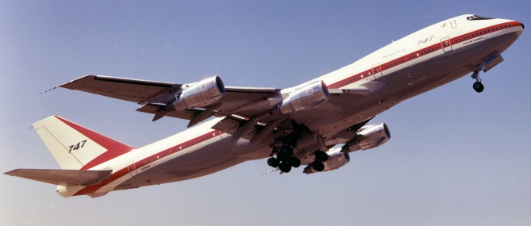
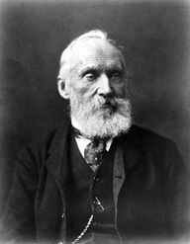
A Boing 747 weighs 3.7*10⁵ kg
(~410 tons) empty
“oops…”

Slide 5
PHYSICS BY 1910…more oops !
CLASSICAL MECHANICS √
1) Newton and Lagrange
Completely describes how uncharged matter moves in any relevant field potential (gravity, spring field etc.)
2) Maxwell
ELECTROMAGNETIC THEORY √
Completely describes how charged matter moves in electric and magnetic fields
3) Huygens, Hertz, Fourier
OPTICAL THEORY √
Completely describes the behavior of light under diffraction, refraction, reflection and attenuation in matter and vacuum
4) Gibbs
THERMODYNAMICS √
Completely describes all phenomena connected to transfer of heat, energy and work in any thermally driven process

Slide 6
The three experimental observations that cause all the trouble (see also: text pg 4-12)
1) Black body emission behavior (ultraviolet catastrophe)
2) The photoelectric effect
3) Hydrogen atom’s emission spectrum

Slide 7
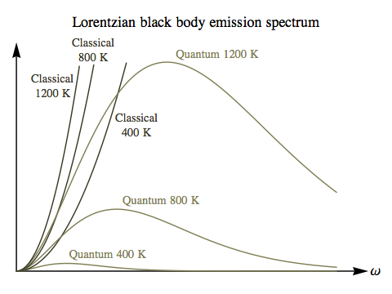
Rayleigh-Jeans equation:
the classical theory predicts…
KEY IMAGES OF BLACK BODY PROBLEM (UV catastrophe)
ρ = constant*T *f²
=energy density of light emanating from `Black body’
See also: eq 1.1, page 3 of text
OBSERVED BLACK BODY EMISSION SPECTRUM vs EMISSION FREQUENCY f
Observed 1200 K
ρ(f)
`uv catastrophe’ …because ρ→ ∞
as f→ higher (to uv) !!
Observed 800 K
Observed 400 K
f

Slide 8
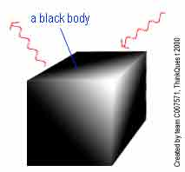
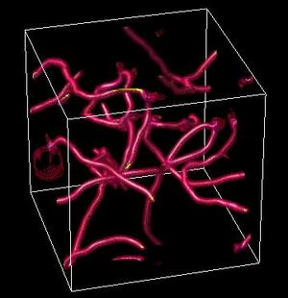
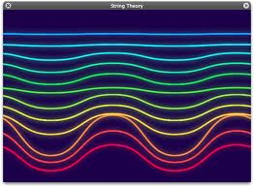
In physics…underlying instincts for how to picture things die hard
19th century 3D black body picture
21st century 11 dimensional `string’ theory purportedly describing everything
http://io9.com/5890789/the-trouble-with-string-theory

Slide 9
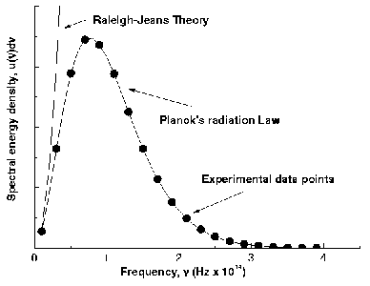
ρ=C*T*f²
E ∝ Amplitude
ρ= C*T*f²
1-e^{hf/kT}
E ∝ f
Planck’s Prediction agrees with observation if…..
h= 6.626 *10⁻³⁴ J s

Slide 10
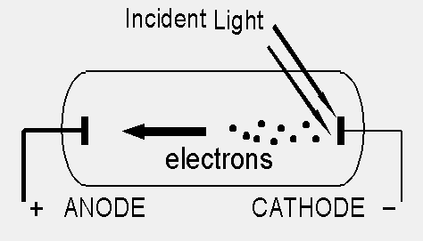
KEY `IMAGES’ OF PHOTOELECTRIC EFFECT
V
V=variable retarding voltage to reduce electron flow (I=photo current)
When I=0, V=V_{o} (called the threshold potential)
V_{o} = E _{incident light} – φ(metal work function)

Slide 11
KEY `IMAGES’ OF PHOTOELECTRIC EFFECT
Kinetic energy per electron ejected from K vs frequency of impinging light
(Fong data 12-6-12)
See also: figure 1.4 of text, p 8 which is for Na
KE (J)
Energy/electron un-related
To intensity (amplitude) of incident light !!
x= f(Hz)

