Slide 1
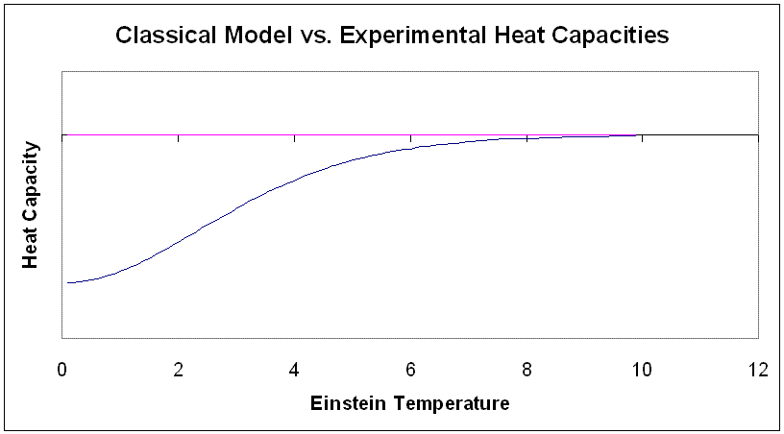
Classical Model
C_{p} ~ kR (Dulong and Petit)
experiment

Slide 2
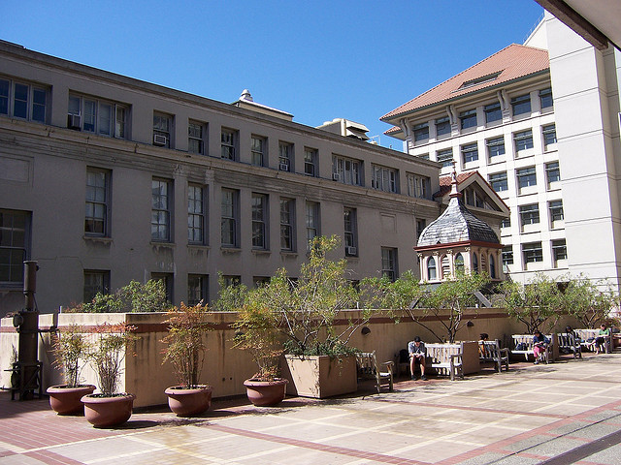
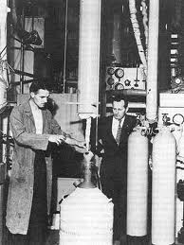
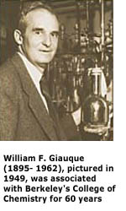
Giauque Hall (Low Temp. Lab used to be housed here…)
Adiabatic demagnetization rig
Circa 1940

Slide 3
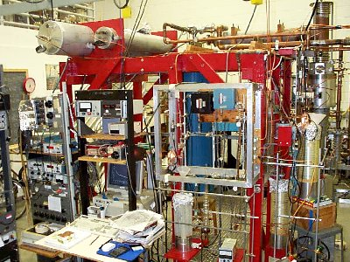
Typical `Rig’ For Modern Low Temperature Calorimetry
Northwestern University Low Temperature Lab

Slide 4
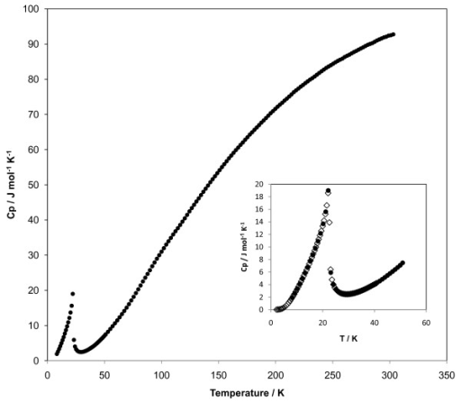
Heat Capacity spectrum of NiTiO₃
Experimentally observed phase transition

Slide 5
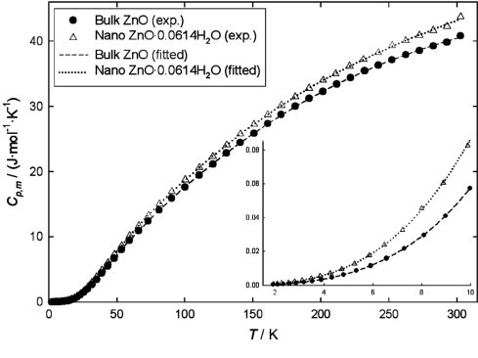


H(T)-H(0)=
No phase changes in C_{p} curve
T_{t}
phase changes in C_{p} curve
ΔH_{t}

