Slide 1
Particle-in-a-box predictions for 1,3-butadiene
4 π electrons (m=9.1*10⁻³¹ kg )assumed to roam freely (e.g. delocalize) down 4-carbon chain of length L=5.8*10⁻¹⁰ meters
=> E=h²n² /8πmL² =kn² (cm⁻¹)
k=9.055*10³ cm⁻¹
n=
3
2
1
9 k
4 k
1 k
0 k
ΔE_{predicted} = 9k-4k =5k= 4.53*10⁴ cm⁻¹
ΔE_{observed} = 4.60*10⁴ cm⁻¹

Slide 2
2D particle-on-a ring predictions for simple porphyrin (26 π electrons* running free
(See also: Supplement 2: The 2-D particle in-a-box applied to a real molecule)
L
L
L = 1*10⁻⁹ m
* Assumes lone pair and inner π electrons are part of delocalization

Slide 3
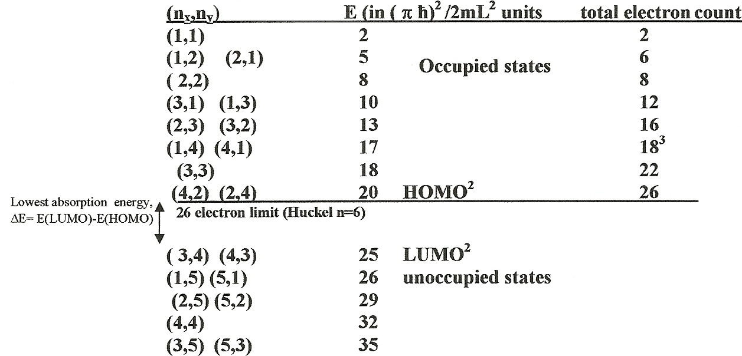
After solving 2D problem: (see supplement 2)
E =k(n_{x}² +n_{y}²)
= 3.0375*10³ (n_{x}² +n_{y} ²) cm⁻¹
HOMO=Highest Occupied Molecular Orbit
LUMO = Lowest Unoccupied Molecular Orbit
ΔE_{predicted}= k*[(3²+4²)-(4²+2²)] = k[25-20] =5k = 1.52*10⁴ cm⁻¹
ΔE_{observed} = =1.70*10⁴ cm⁻¹

Slide 4
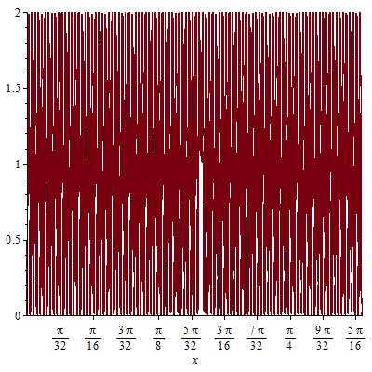
1D particle-in-a-box P(x) vs. n: at high n…the system converges to continuum
P(x) for 1D box at n=100,L=1

