Slide 1
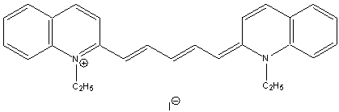
Testing Particle-in-a-box Predictions: Cyanine Dye example
Assume just π electrons move in V=0 box of length L
L
??
Etc…
Example of p=5 cyanine iodide dye
(p = # Carbons in chain connecting rings)

Slide 2
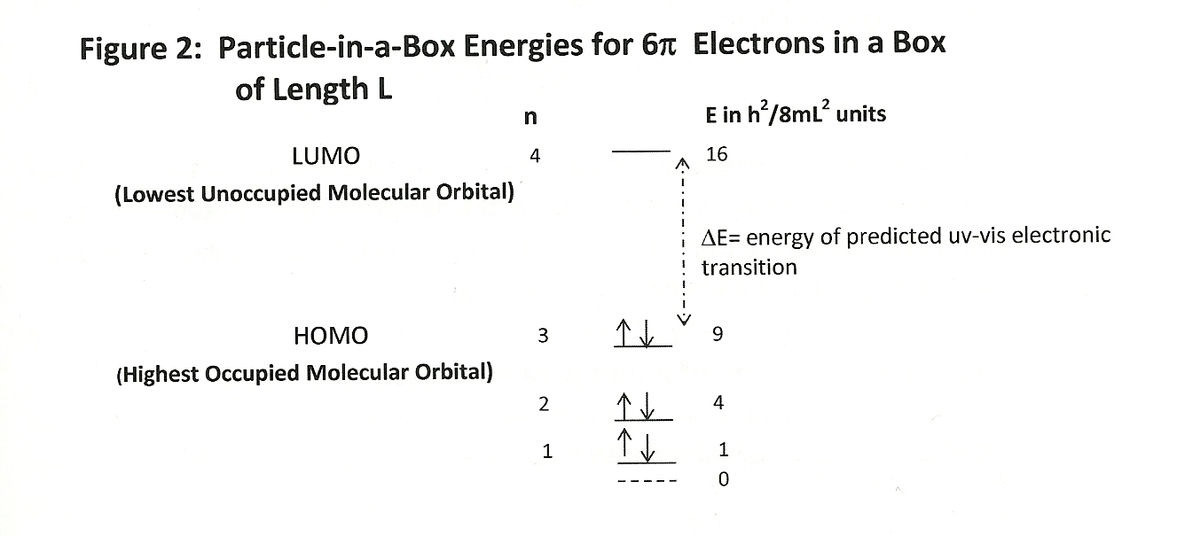
n_{f}
E(LUMO) – E(HOMO)=ΔE
(ΔE) = h² [ (n_{f}+1)² – n_{f}²]
mL²
= h² (2n_{f} +1)
8mL²

Slide 3
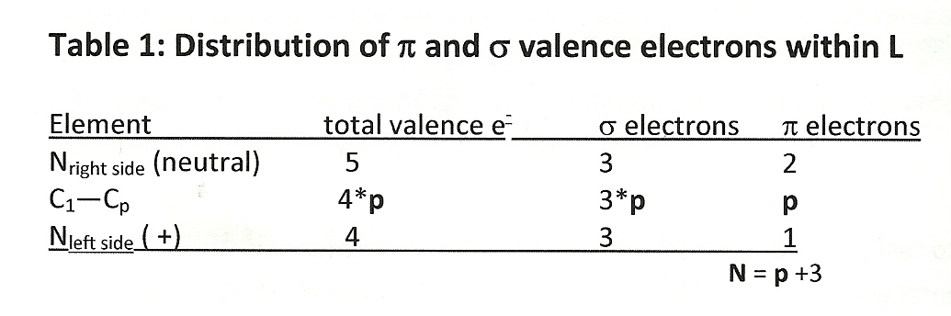
Electronic book keeping for Cyanine dyes:
Connecting p to n_{f}
N=Number of π e⁻
p= 5
2
4
How many C used to connect rings ?
1
3
5
Since 2 π e- per level, ½N = ½(p+3) = n_{f}

Slide 4
L
All bonds =1.39 10⁻¹⁰
Method 1 for estimating L
# bonds between N=p+3
Each bond is 1.39*10⁻¹⁰ m
3
Equation 3 (from Lab Manual)

Slide 5
L
All bonds =α
Method 2 for estimating L
# bonds between N=p+3
Each bond is same and with adjustable value α
4
Equation 4 (from Lab Manual)

Slide 6
½ β
L
½ β
All bonds =1.39 10⁻¹⁰
p +1 bonds
Method 3 for estimating L
# bonds between N=p+1+β
Each bond is same length =1.39*10⁻¹⁰ m
5
Equation 5 (from Lab Manual)

Slide 7



Plugging 3,4 and 5 and
½ (p+3)=n_{f} into…..
ΔE= h² (2n_{f} +1) =hc
8mL^{2 λ}_{theory}
Then substitute m=9.1*10⁻³¹ kg , h=6.626*10⁻³⁴ J s, c= 2.997*10⁸m/s
3=> 11 λ_{theory} (m) =
Experiment provides test of basic idea…in the ballpark ???
4=> 12 λ_{theory} (m) =
Experiment allows us to find best α
5=> 13 λ_{theory} (m) =
Experiment allows us to find best β

