Slide 1
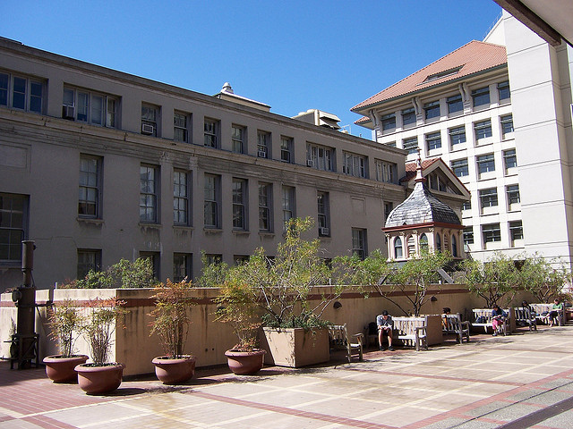
Giauque Low Temperature Lab, UC Berkeley
(Doc’s first `home-away-from home’ lab and first love…)

Slide 2
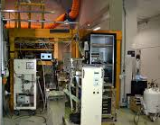
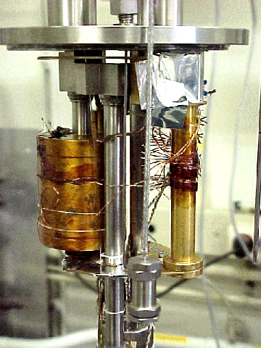
³He low temperature cryostat
The rest of the measuring system

Slide 3
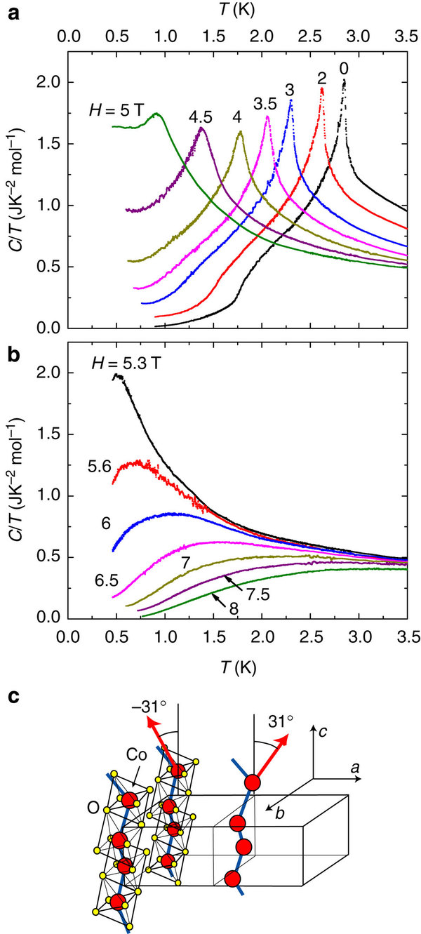
What the equipment produces:
Heat capacity “spectra”
(C/T vs T plots)

Slide 4
The Univ. of Michigan/Westrum Fiasco and how Doc rekindles a love with another kind of spectra….

Slide 5
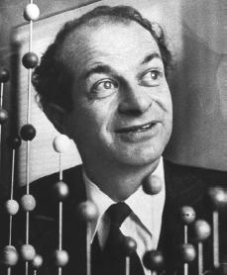
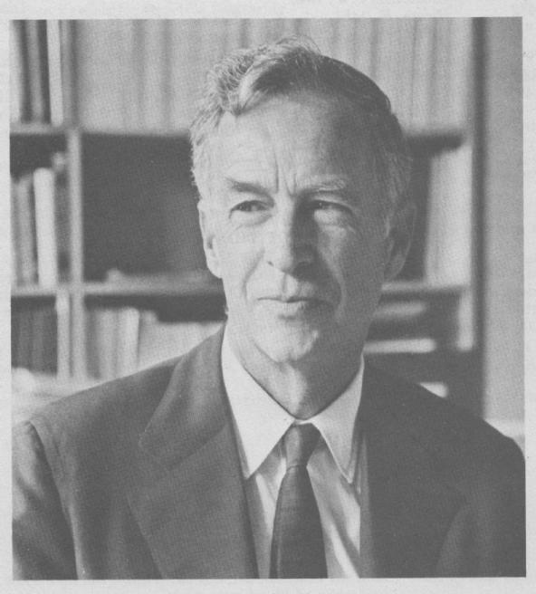
E. Bright Wilson
Harvard University, Chemistry
National Medal of Science 1975
T.W. Richards Endowed Chair
His son (Ken)wins Nobel in Physics (Cornell Univ.)
Linus Pauling
Cal Tech, Chemistry
Nobel Prize in Chemistry 1954
Nobel Peace Prize 1962

Slide 6
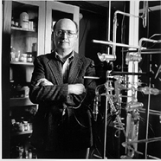

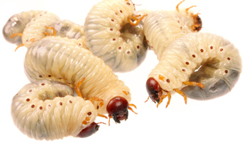
YOU !
‘Doc’ Fong
SUNY Alfred State Chemistry
Mr. `Fixit’ (and nut case)
R. L. Kuczkowski
University of Michigan, Chemistry Department Chair
Doc’s favorite, best mentor

Slide 7
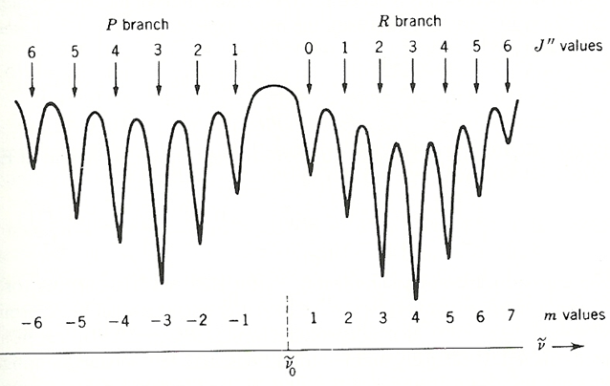
Figure 1:
Assignment of m and J for P and R Branches of a Hypothetical Diatomic IR spectrum

Slide 8
Solution to reduced mass Schrodinger equation for the Harmonic Oscillator
ϕ =(1/2^{n}n!)^{1/2} (α/π)^{1/4} H_{n}(α^{1/2}x) exp( -αx²/2), n = 0,1,2….
α = (kμ/ ħ ² ) and H_{n}(α^{1/2}x) is the `Hermite’ Polynomial…
Some Hermite polynomials (z= (α^{1/2}x ) (Table 5.2 pg. 170)
n H_{n}(z)
0 1
1 2z
2 4z² -2
3 8z³ -12z
4 16z⁴ -48z² +12
5 32z⁵ -16z³ +120z
The most important result: (n=0,1,2…..)
E_{n} = hω(n + ½ ) where ω = h(k/μ^{)1/2} = ħ(k/μ^{)1/2}
2π

Slide 9
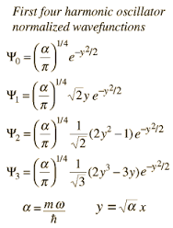

Slide 10
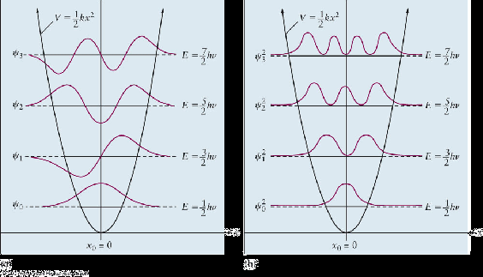
Images of Quantum Harmonic Oscillator ϕ(x)
and ϕ(x)* .ϕ(x) in ½ kx² potential well (see fig. 5.8 pg. 171 too)
ϕ(x)
ϕ(x)* .ϕ(x)
n
3
2
1
0
½ kx² potential well

Slide 11
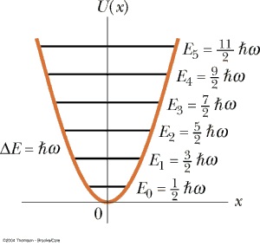
Quantum harmonic oscillator energy levels
evenly spaced and separated by ħω = ħ(k/μ)^{1/2}
n
5
4
3
2
1
0
E(n) = ħω(n + ½) n=0,1,2,3,….

Slide 12
Key Properties of Quantum Harmonic Oscillator solution
(see pp. 172-174)
n=0,2,4…ψ_{n} are even functions
n=1,3,5…ψ_{n} are odd functions
even => ψ(x) = ψ(-x); odd => ψ(x) =- ψ(-x)]
Note that: even*even = even (ex. x² * x²=x⁴)
odd* odd = even (ex. x³*x¹= x⁴)
odd* even = odd (ex. x³*x²=x⁵)
Since: integrations <ψ|A_{op}|ψ> are from -∞→ +∞=>…
average x = <ψ_{n}|x|ψ_{n}> = 0 for all n
Average p = = <ψ_{n}|-i ħ d/dx|ψ_{n}>=0 for all n
From chapter 4 also: <ψ_{n}| ψ_{m}> = δ_{nm}

Slide 13
USING ODD/EVEN PROPERTY TO RATIONALIZE THE Δn= 1 SELECTION’ RULE FOR IR TRANSITIONS
Dipole operator =(q*x) `couples’ ϕ_{n} with ϕ_{m} to produce transition via:
ϕ_{m}.(qx) ϕ_{n} dx=
q ∫ϕ_{m}.(x) ϕ_{n} dx
=> m and n must be odd/even or even odd else integral→ 0 => minimum m-n= 1

Slide 14
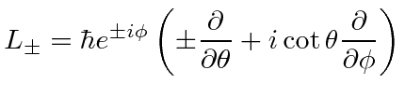
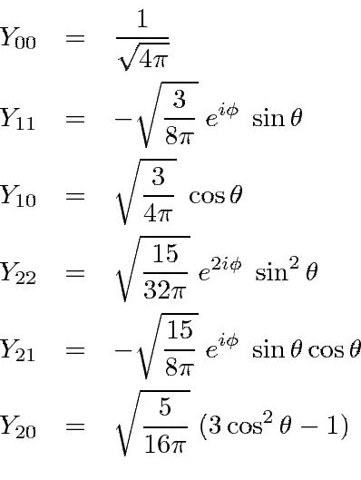

2 D spherical harmonic wave functions Y_{Jm} and associated operators (L and L²)
Y_{Jm}
Eigen values Y_{Jm} satisfy
(l = J)
l=J, m= J, J-1,J-2…
E = ħ² J(J+1)
2μr²

