Slide 1
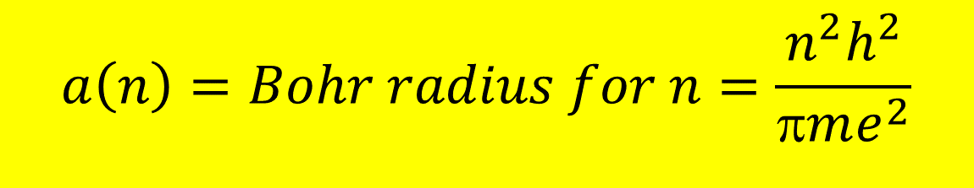
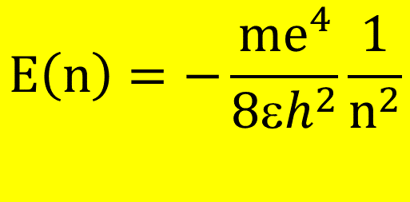
Schrodinger’s equation for Hydrogen leads correctly to the Bohr result
$$E\left(n\right)=−\frac{{me}^{4}}{8εh^{2}}\frac{1}{n^{2}}$$
$$a\left(n\right)=Bohr radius for n=\frac{n^{2}h^{2}}{πme^{2}}$$

Slide 2
Schrodinger’s equation for Hydrogen leads to families of related quantum wave function states
n= 1,2,3,4… (principal quantum #)
L = n-1, n-2….0 angular momentum quantum #)
m=m_{L} = L, L-1, L-2…0, -1,-2…-L
(magnetic quantum #)

Slide 3
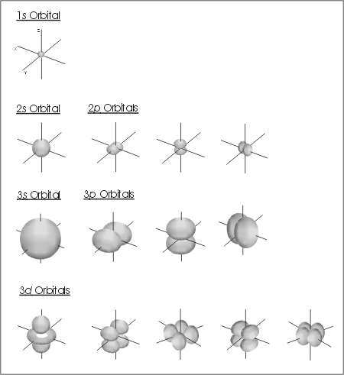
Angular Y_{lm}(θ,φ) (Spherical harmonic) part of H atom ψ(r, θ,φ)
(n L m_{L} )
Contains sines and cosines of θ and φ
(see table 6.6 pg 218)
(1 0 0)
(2 0 0)
(2 1 1)
(2 1 0)
(2 1 -1)
(3 0 0)
(3 1 1)
(3 1 0)
(3 1 -1)
(3 2 2)
(3 2 1)
(3 2 0)
(3 2 -1)
(3 2 -2)

Slide 4
Letter equivalents of L
L=0 => s
L=1 => p
L=2 => d
L=3 => f

Slide 5
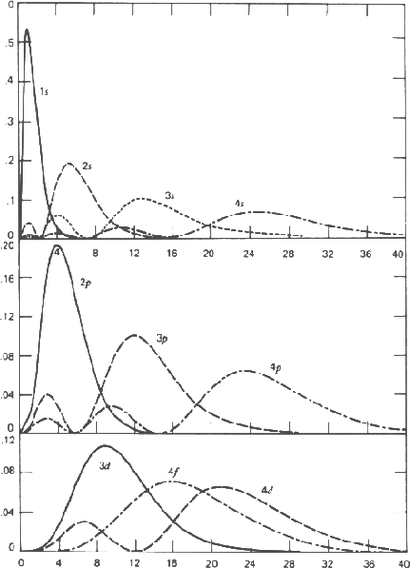
Radial R(r) (`Laguerre’) part of H atom ψ(r, θ,φ)
ns
(L=0
n=1,2…
~ R(r) ~ (a+br+cr² + …)e^{-kr}
Highest Power in polynomial = L
k=r/na_{o}
np
(L=1
n=2,3...)
nd
(L=2
n=3,4..)

Slide 6
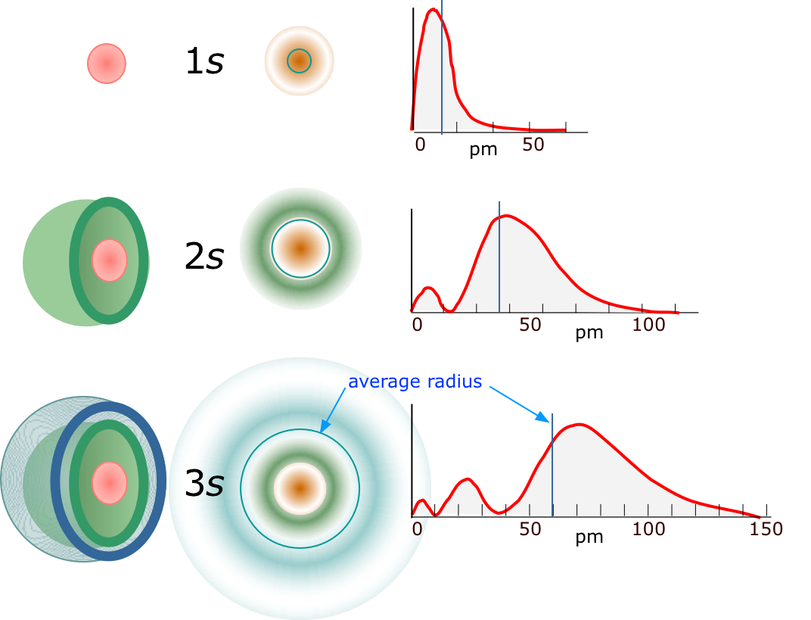
ψ_{ns} wave function seen in projection and 2D
R(r) = Radial part (with no sines or cosines) is the only contributor to ψ_{ns}

Slide 7
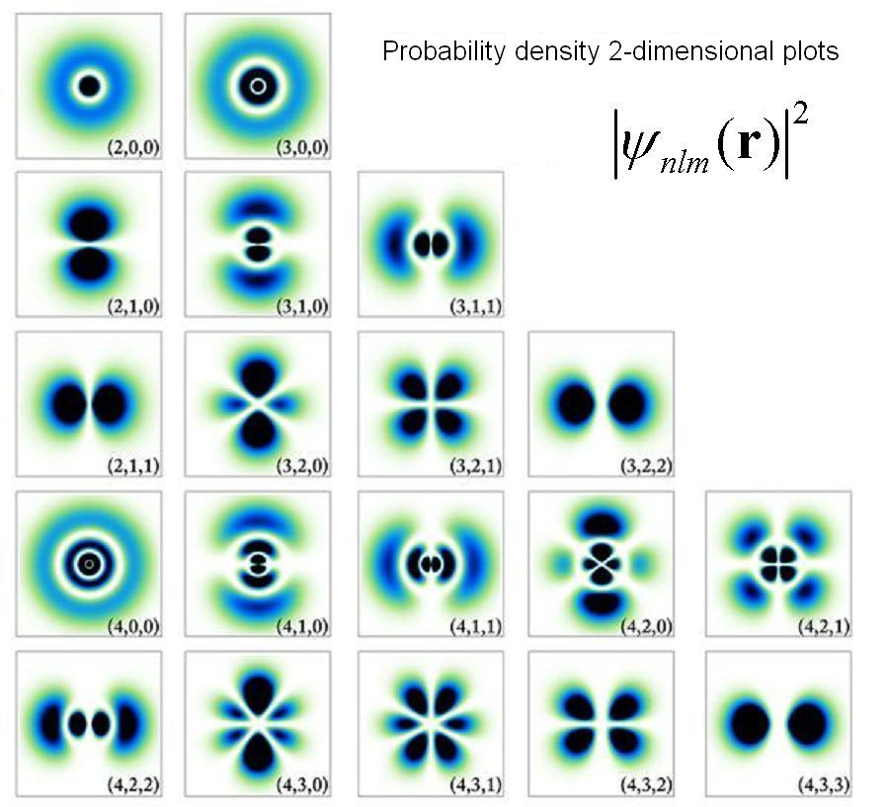
Cross section of several H atom orbital probability densities
2s
3s
2p_{z}
3d_{z}²
3d_{yz}
2p_{y}
4f_{yz}

