Slide 1
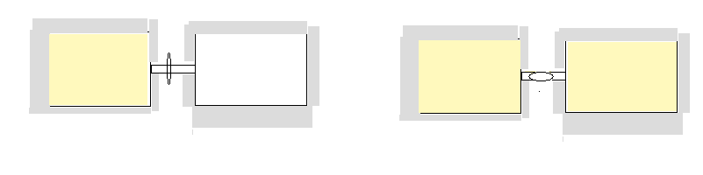
Why we need a `second law’:
Assume two boxes are connected by a stop cock and heavily insulated so that no energy goes in or out in either work or heat forms. Initially, one box is evacuated while the other has gas, with the stopcock closed.
What happens when the stopcock is turned to connect the two boxes ?
Both boxes fill and end up with equal concentrations of gas

Slide 2

Similarly, if two different gases with equal energy are in two separate boxes , with stopcock closed, what happens when the stop cock opens ???
WHY ???
WHAT `FORCE’ DRIVES THESE EFFECTS ?
They mix until evenly distributed on both sides

Slide 3
VARIOUS STATEMENTS ABOUT THE `FORCE’ DRIVING THE GAS IN THE BOXES:
THE SECOND LAW IN SEVERAL FORMS
Clausius
“It is impossible to construct a machine which is capable of conveying heat by a cyclic process from one reservoir (at a lower temperature) to another at a higher temperature unless work is done on the machine by some outside agency.” (~means can’t move heat from cold to hot without work.)
Kelvin-Planck
It is impossible to construct a machine that, operating in a
cycle, will take heat from a reservoir at constant
temperature and convert it to work without accompanying
changes in the reservoir or its surroundings.
(~ means no heat engine ever works at an efficiency of 100%)

Slide 4
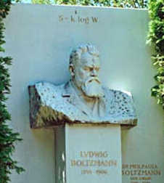
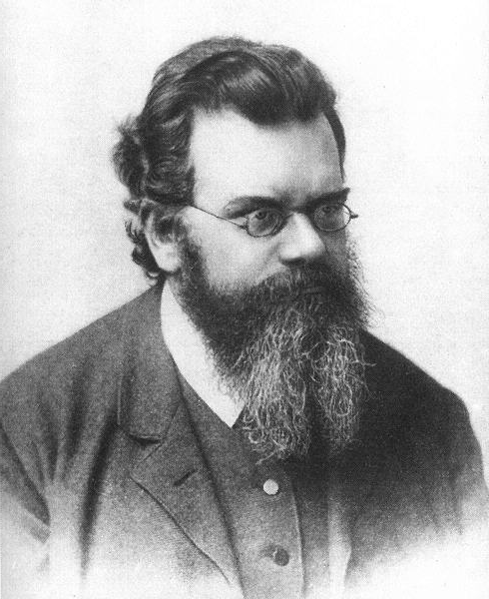
More versions of 2nd Law
Boltzmann
S=`ENTROPY’
W= # available microstates
S = k ln W
Ludwig von Boltzmann

Slide 5
Yet More versions of 2nd Law
McQuarrie p. 828-829
dS > δQ/T
…=> entropy always tends to a maximum:
ΔS _{system} +ΔS_{surroundings} > 0

Slide 6
Yet one more down-to-earth version of 2nd Law
My Dad (among others…)
“Life’s a bitch,
then you marry her,
then you die….”

Slide 7
`AD HOC’ ASSERTIONS¹
1) The quantity:
ΔS_{system} = Q_{rev, system ;} Q_{rev,system} > Q_{irrev,system}
T
Is a state function for the system that represents the `entropic force’ causing changes even if ΔE=0 (mgh analogy)
Most useful form of the Second Law
Of Thermodynamics
(in my opinion)
2) For any irreversible change,
ΔS_{total} = ΔS_{surroundings} + ΔS_{system} > 0 .
¹In more traditional developments, the `Carnot’ cycle is used to `prove’ the validity of the first assertion, and then the definition is explored –usually with ideal gas examples- to illustrate the principle captured in the second assertion.

Slide 8
`AD HOC’ ASSERTIONS (continued)
3) If f (x,y) is path independent, f(x,y) is always
an `exact’ differential =>
df = M(x,y)dx + N(x,y)dy has the property:
∂M = ∂N
∂y ∂x
…which means given M(x,y), N(x,y) the form of f(x,y) can be built from them

Slide 9
Using the `exact’ differential assertion to show why Q_{rev} is not a state function, while Q_{rev} /T is a state function (for example of Ideal Gas)
dQ_{rev} = dE – dW = dE + PdV
dQ_{rev} = C_{v}dT + PdV
For Ideal Gas
dQ_{rev}= C_{v} dT + RT/V dV
If dQ_{rev} is a state function: ∂C_{v} = ∂(RT/V)
∂V ∂T
Since C_{v}=constant, ∂C_{v} = 0
∂V
≠ ∂(RT/V )= R/V
∂T
∴ Q_{rev} is not a state function

Slide 10
dS_{sys} = dQ_{rev} = dE – dW = dE + PdV
T T T T T
dS_{sys} = C_{v}dT + PdV
T T
For Ideal Gas
dS_{sys} = C_{v} dT + RT/V dV
T T
If dS_{sys} is a state function: ∂C_{v} = ∂(R/V)
∂V ∂T
Since C_{v}=constant, ∂C_{v} = 0
∂V
= ∂(R/V )= 0
∂T
∴ S_{sys} is a state function

Slide 11
Analogy of mechanical and thermal forces
potential energy = mgh = mg =`gravitational force’
height h
reversible thermal energy absorbed by system = Q_{rev}
height of system in energy T
= `thermal force’
= `entropic force
= entropy

Slide 12
`New ideas connected with the Second Law
Time’s arrow ,chaos and microstates
  Laws of Physics work forward and back in time , but decay has only one direction
  Number of possible equivalent energy states increases rapidly when maximum # of degeneracies= maximum alternative states (chaos) occur
  ( spin or coin toss analogy/Pascal Triangle)
reversible vs irreversible processes (infinitely slow vs finite change)….Data Explorer DEMO …a change in T always accompanies a irreversible process

Slide 13
One more new idea…surroundings vs system processes…
Surroundings are huge
System is tiny compared to surroundings
Any change to it is reversible
from the surroundings’ perspective
since the `surroundings’=rest of universe, all changes appear
infinitesimally small, e.g.
differential (dx)=> reversible.
system
(pee-in-the-pool analogy)…
SURROUNDINGS
Change for the system can be either reversible or irreversible

