Slide 1
A Quicky Allyl Chemistry review
NBS substitution mechanism is:
Radical based
Carbocation based
S_{N}2
Eat dirt Doc
Name this site:
Vinyl group
Allylic site
Name this group:
+
Symmetric resonance ?
YES NO

Slide 2
A Quicky Allyl Chemistry review (continued)
Which is more likely to form , A or B ?
A
B
What factor governs the choice of B as more likely above?
Minimizing steric crowding (hindrance)
What is the most likely product of:
What factor governs the choice above?
Radical intermediate forms symmetric resonance

Slide 3
The hydrolysis reaction shown is:
Radical based
Carbocation based
S_{N}1
Eat dirt Doc
A Quicky Allyl Chemistry review (continued)
What is(are) the carbocation(s) in the above reaction ?
A
B
Which is kinetically favored and why?
A, since + charge is on 3º site
Why is B thermodynamically favored ?
More substituted around double bond (Zaitsev’s rule)

Slide 4
A Quicky Allyl Chemistry review (continued)
Both the allylic carbocation and radical mechanism share what common electronic charge transfer behavior ?
Both feature π electron shift towards radical or carbocation site to produce alternative intermediates
radical allylic shift
Carbocation allylic shift
What governs the formation of the most stable carbocation above ?
What two factors govern formation of the most stable radicals above ?
Carbocation degree (higher is better)
1) Seeks symmetric resonance
2) Minimizes steric hindrance

Slide 5

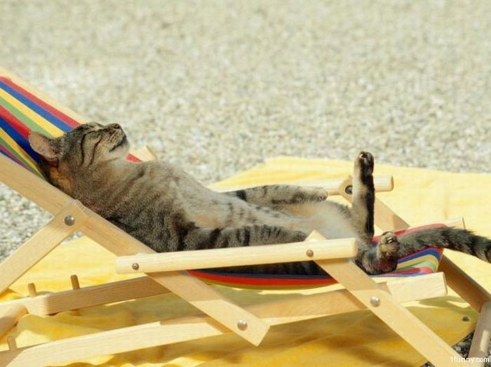
See you in 10 f***ing days

