Slide 1

Topside, anti-attack mechanism for Br₂ on trans-cinnamic acid
I’m on top of things !

Slide 2
1) Initial head-down Br₂ attack
2) Initial bridgehead formation
π Electrons make incipient bridge head bond with Br
Br-Br bond begins to break
π bond begins to break
δ-
δ+

Slide 3
3) Br-Br bond rupture and deformation/near dissolution of bridgehead (favoring carbocation on the electron rich `phenyl=phen side)
(-)
A very weak linkage exists here until Br(-) attacks, preventing rotation of phen and H
(+)
+

Slide 4
4)Final Anti attack of Br(-) at (+) side where phenyl=phen stabilizes the intermediate carbocation
+

Slide 5
5a) Rotate 3D projection to Fischer eclipsed form
Eclipsing end group
(Rotated into plane)
CW
CW
Eclipsing end group
(rotated into plane)

Slide 6
5B) draw 3D double chiral center form in vertical format
5C) convert to 2D final form
R
S

Slide 7
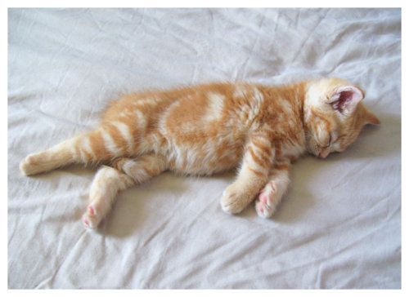
Topside, syn-attack mechanism for Br₂ on trans-cinnamic acid
I prefer lying on my side !

Slide 8
Single electron transfers from Br lone pairs and from π system to form two incipient bonds to carbons
π system and bond between two Br starts to dissolve.
COOH, H and H,phen groups flex downwards away from attacking Br as bonds form from Br to both sides of trans-cinnamic acid
1) Initial parallel Br₂ attack
d) Br-Br bond disappears and π bond disappears

Slide 9
Once the parallel attack is complete ,
the two Br eclipse each other ,
and both the Br-Br bond and the π bond
are gone
As with the anti attack, the structure is then rotated to eclipse the phen and COOH

Slide 10
The 3D eclipsed form is turned so that the projection is vertical:
R
R
Finally, the 3D vertical form is converted to the 2D Fischer projection

Slide 11


