Slide 1
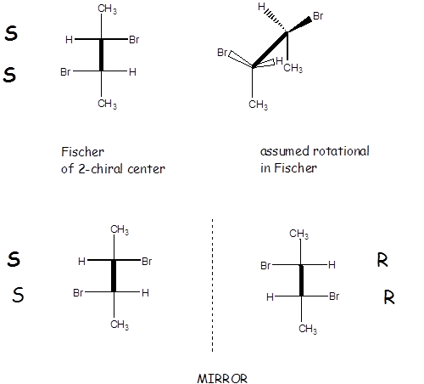
Assumed rotational orientation in Fischer (eclipsed)
ENANTIOMERIC PAIR
mirror images
NOT superimposable

Slide 2
Assumed rotational
orientation in Fischer (eclipsed)
MESO STRUCTURES
mirror images
superimposable

Slide 3
DIASTEREOMERS
NOT mirror images
NOT superimposable

Slide 4
Two chiral chemically physically
center system different ? different ?
meso structures no no
Enantiomers yes no
Diastereomers yes yes

