Slide 1
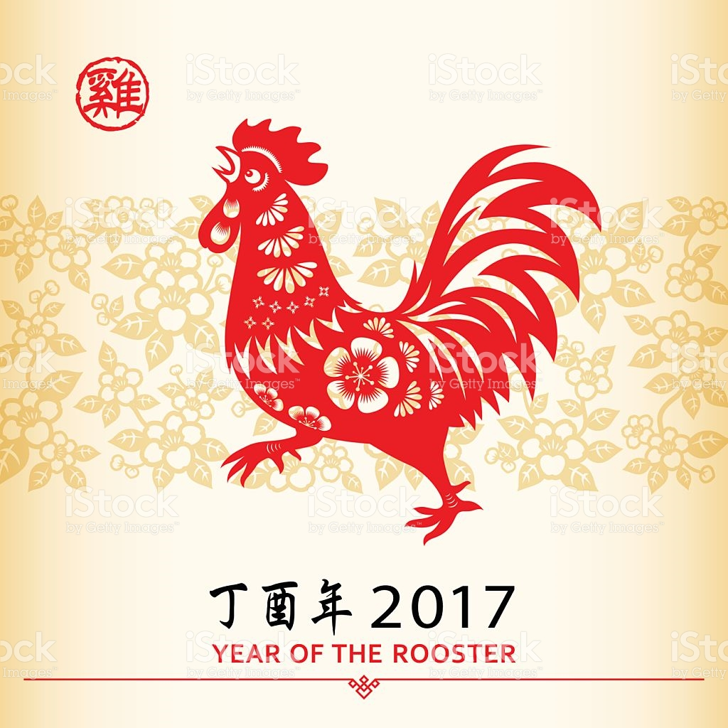
Gong xi, gong xi , xin nian hao !
2017 Year of the Rooster
__ _
(geng ji)

Slide 2
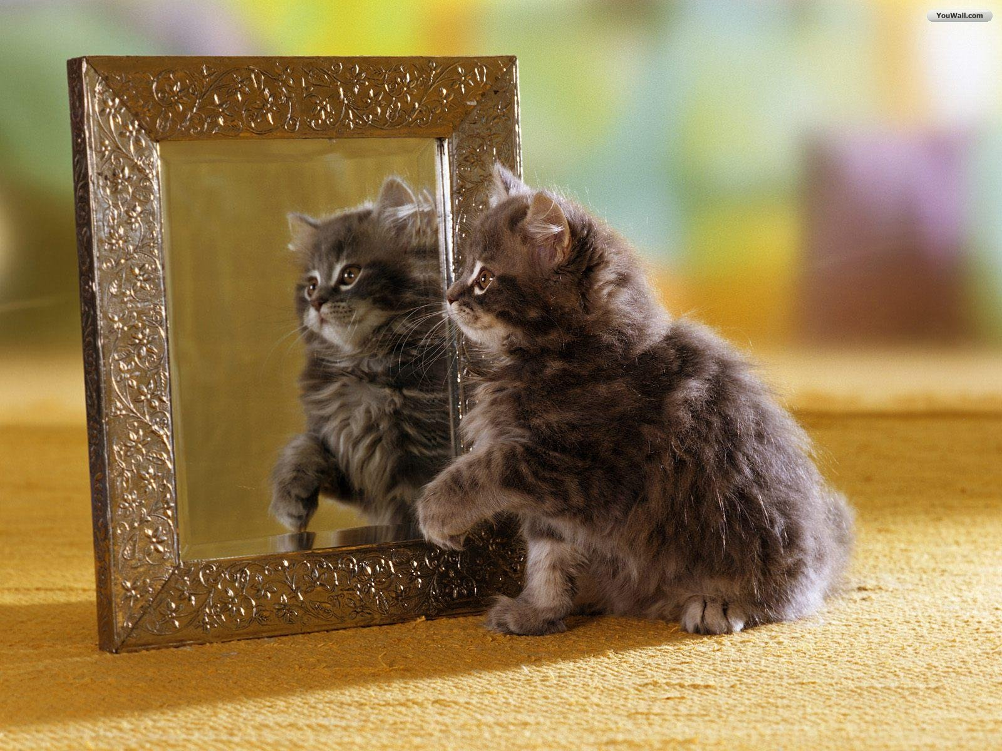
Quicky Stereochemistry review: part 2- 2 chiral center language & images

Slide 3
Stereochemistry review part 2 (cont.)
Which 3D projection below does the Fischer structure on the right correspond to ?
A B C D
Term for mirror image pair that is superimposable?
Meso structures
Not mirror images; not superimposable ….we are ….
Diastereomers

Slide 4
Stereochemistry review part 2 (cont.)
“Bob”
R or S ?
R or S ?
Bob and his mirror image Bobby form a_______________________
Enantiomeric pair
“Babs”
R or S ?
Babs and her mirror image Babette form a_______________________
Meso structure

Slide 5
Stereochemistry review part 2 (cont.)
Jim Jam
Jim and Jam will be:
Chemically different physically same
Chemically same physically same
Chemically different physically different
Chemically same physically same
Erythro
Jim is ___________________ (rhymes with Jethro)
Threo
Jam is ___________________ (the other one…)

Slide 6
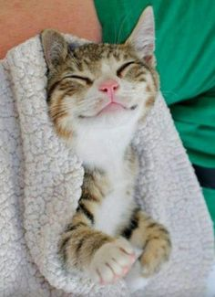
Stereochemistry review part 2 (cont.)
Any day doing Organic chemistry is a:
__________________________
Good day

