Slide 1
‘Selectflor’ = F-TEDA-2BF₄
=Commercial fluorinating agent
F⁺
+
Abbreviated version of F⁺ generating reaction
F-TEDA-2BF₄→ F⁺ + BF₄⁻ +(TEDA-BF₄)⁻
Really abbreviated way of indicating electrophilic, aromatic fluorination:

Slide 2
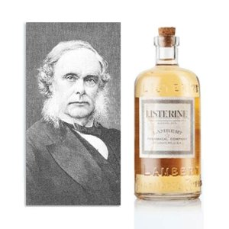
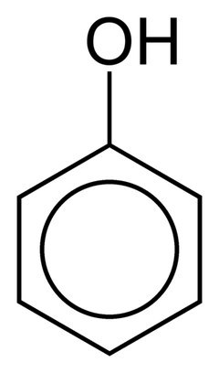
Sir Joseph Lister used `carbolic acid’=phenol to sterilize surgical instruments and wounds

Slide 3
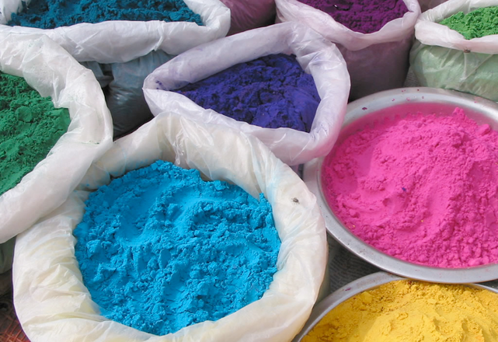
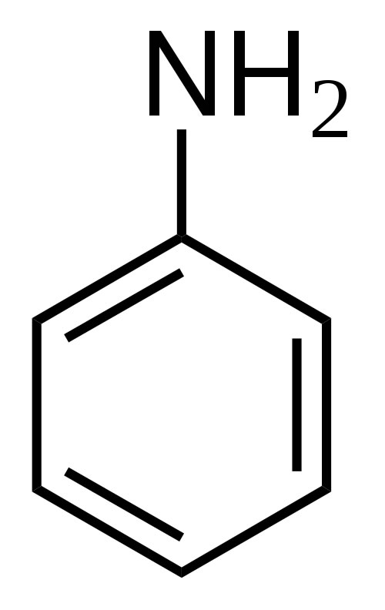
Examples of aniline-based clothing dyes

Slide 4

ENJOY YOUR BREAK, MAGGOTS !

